Slide 1
Collections

Slide 2
Collections
The .NET framework provides specialized classes for data storage and retrieval.
C# collection types are designed to store, manage and manipulate similar data more efficiently. Data manipulation includes adding, removing, finding, and inserting data in the collection.
There are three distinct collection types in C#:
standard (Non-Generic)
generic
concurrent

Slide 3
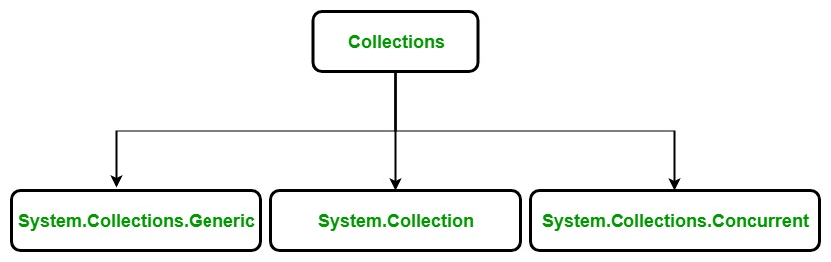

Slide 4


Slide 5
Non-Generic Collections
They do not store elements as specifically typed objects, but as objects of type Object. These collections include
ArrayList
Hashtable
SortedList
Queue
Stack

Slide 6
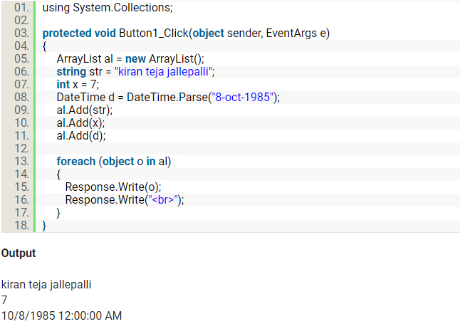
ArrayList Example

Slide 8
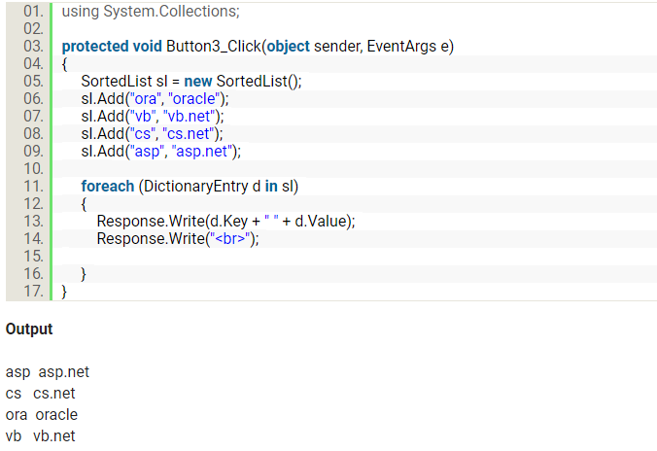
SortedList Example

Slide 10
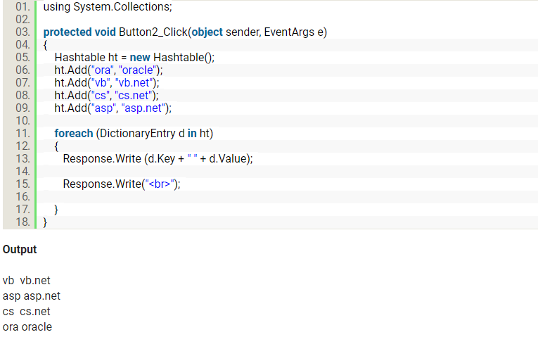
Hashtable Example

Slide 12
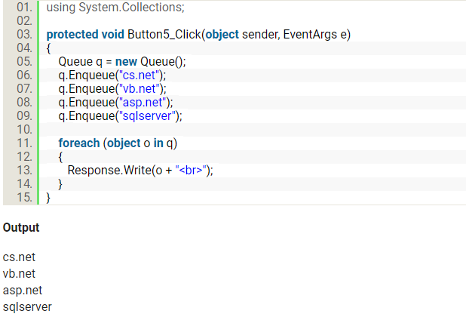
Queue Example

Slide 14
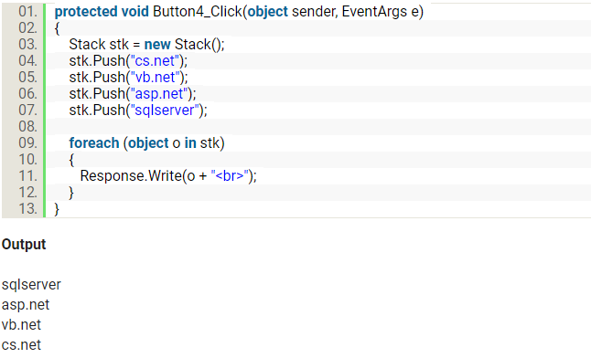
Stack Example

Slide 16
Generic Collections
Generic collections are more flexible and are the preferred way to work with data. Generics enhance code reuse, type safety, and performance. The generic collections include
Dictionary<T, T>,
List<T>,
Queue<T>,
SortedList<T>
Stack<T>.

Slide 17
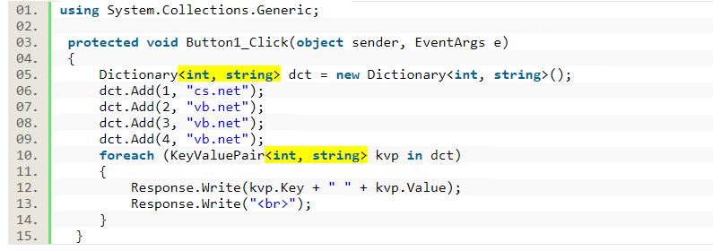
Dictionary Example

Slide 18
Concurrent Collections
Generic collections are type safety but not thread safe so The .NET Framework 4 brought the System.Collections.Concurrent namespace. This has several collection classes that are thread-safe and scalable. These collections are called concurrent collections because they can be accessed by multiple threads at a time.
Concurrent collections include
BlockingCollection<T>
ConcurrentDictionary<T, T>
ConcurrentQueue<T>
ConcurrentStack<T>

