Slide 1

A LIBRARY MANAGEMENT SYSTEM PRESENTED BY: DREAM CRUSHER
JONY martin
Cse 063 07515
Abu rishad
Cse 063 07437
Abir hossian
Cse 063 07441

Slide 2
Topic
Entity Relation Diagram

Slide 3
ERD
Entity Relation Diagram

Slide 4
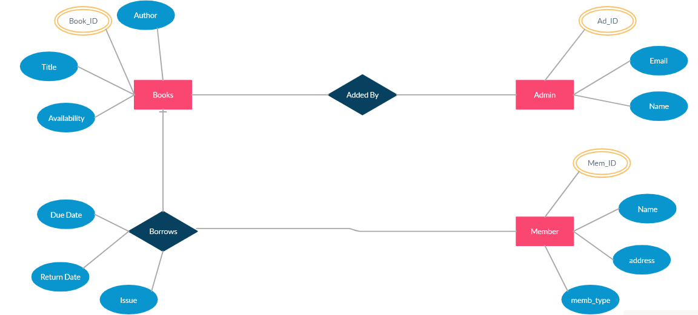
ERD of LIBRARY MANAGEMENT SYSTEM

Slide 5
ADMIN
Attribute | Type
AD ID | INT(Primary key)
Email | VarChar(1000)
Name | VarChar

Slide 6
BOOKS
Attribute | Type
Book ID | INT(Primary key)
Author | VarChar(100)
Title | VarChar(100)
Availability | VarChar

Slide 7
MEMBER
Attribute | Type
Memb ID | INT(Primary key)
Name | VarChar(100)
Address | VarChar(1000)
Memb Type | VarChar

Slide 8
Borrow
Attribute | Type
Issue | VarChar
Due Date | Date
Return Date | Date

Slide 9
Thank You

