Slide 1

A LIBRARY MANAGEMENT SYSTEM PRESENTED BY: DREAM CRUSHER
JONY martin
Cse 063 07515
Abu rishad
Cse 063 07437
Abir hossian
Cse 063 07441

Slide 2
Topic
Data Flow Diagram
Use Case Modelling

Slide 3
DFD
Data Flow Diagram

Slide 4
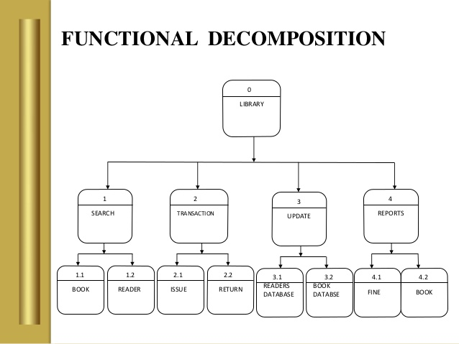

Slide 5
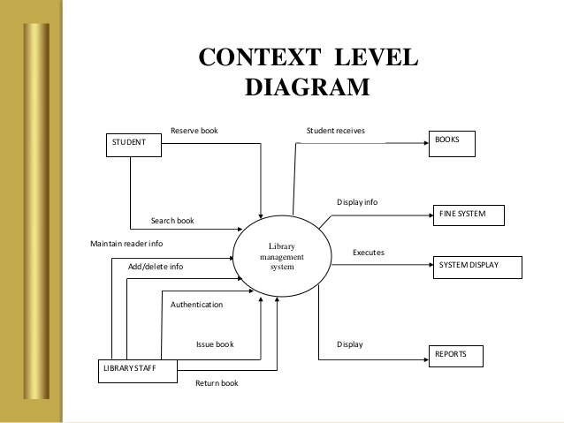

Slide 6
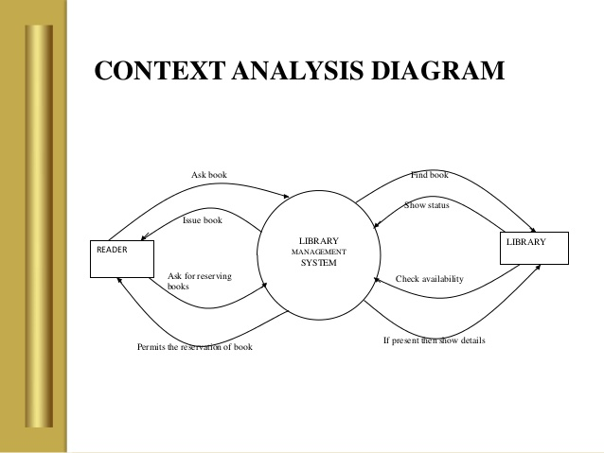

Slide 7
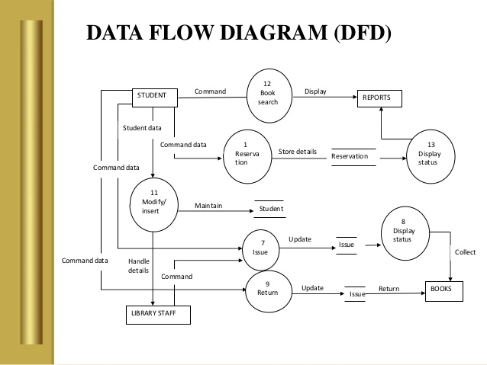
DFD Level 1

Slide 8
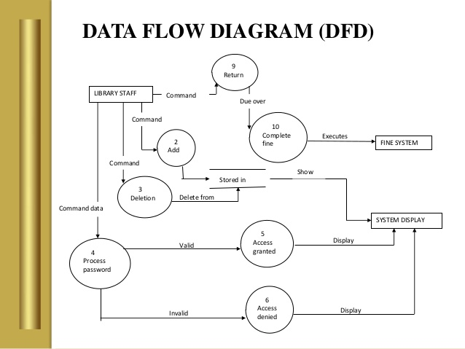
DFD Level 1

Slide 9
THANK YOU

