Slide 1

Diffusion-Based Object Detection in Aerial Images
BTP–I Project Presentation
Rishant Mallick (23EC39043)
Supervisor: Dr. Debashis Sen
Dept. of Electronics and Electrical Communication Engineering, IIT Kharagpur
Autumn Semester 2026–27 | 4 November 2026
Notes:
Introduce title, supervisor, scope: diffusion-based detectors on aerial images, HBB and OBB. ~20 s.

Slide 2
Problem Statement and Context
Problem statement
Brief context
Aerial detection: objects vary in scale, orientation, density and background.
Conventional detectors: they rely on anchors, region proposals or learned queries, so generating and assigning candidate boxes stays a hand-designed part of the pipeline.
Why we moved beyond conventional box detectors: horizontal boxes include a lot of background and cannot encode orientation, which hurts elongated or rotated aerial objects such as ships.
Why diffusion: it treats detection as denoising. Random noisy boxes are refined step by step into object locations, so no anchors, proposals or fixed queries are needed. ReDiffDet extends this to oriented boxes by modelling them as 2D Gaussians.
DiffusionDet [1]: noisy boxes refined into detections (HBB).
ReDiffDet [2]: Gaussian oriented boxes + rotation-equivariant diffusion.
OrientedDiffDet [3]: oriented proposals + feature alignment.
Datasets: DIOR, NWPU VHR-10, HRSC2016 (HBB); DIOR-R, HRSC2016, DOTA-v1.0 (OBB).
Objectives: study diffusion formulations, fine-tune DiffusionDet (HBB), evaluate ReDiffDet / GSDet outputs (OBB), and compare with published detectors under matching metrics.
Notes:
Aerial detection is hard: scale, orientation, density. Anchors/proposals/queries are the conventional way to generate candidates; diffusion denoises random boxes instead. ~50 s.

Slide 3
Diffusion Models: Core Formulation
Forward (noising)
Reverse (denoising)
Training objective
z_t = √ᾱ_t z₀ + √(1−ᾱ_t) ε, ε ~ N(0, I)
p_θ(z_{t−1} | z_t) = N(μ_θ(z_t, t), Σ_θ)
L_noise = E‖ε − ε_θ(z_t, t)‖²
ᾱ_t = ∏ α_s, α_s = 1−β_s. Any timestep sampled directly; z_T ≈ N(0, I).
Network predicts the mean via ε or z₀; target is the Gaussian posterior q(z_{t−1} | z_t, z₀).
Simplified bound on likelihood. Detectors add matching, classification and box losses.
Sampling and why it matters for detection
Inference: start from z_T ~ N(0, I) and refine z_T → … → z₀.
Noise schedule sets signal-to-noise per step and the difficulty of denoising.
DDIM / DPM-Solver use fewer steps, important since each step re-extracts features for many boxes.
Notes:
Forward adds noise in closed form; reverse is learned. Detection-specific losses are used rather than a pure noise loss. ~50 s.

Slide 4
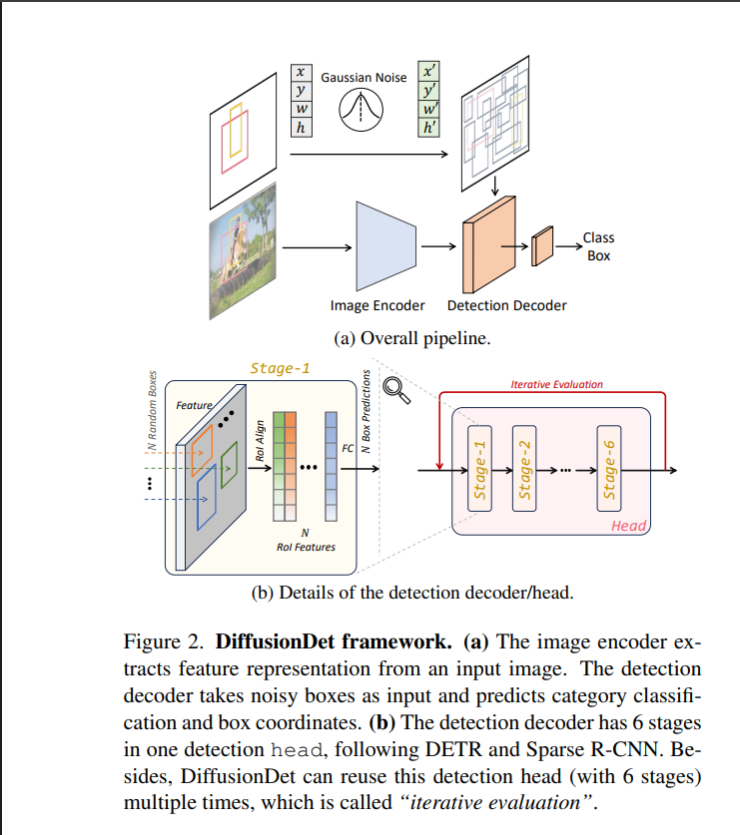
DiffusionDet: Architecture
Image encoder: backbone + FPN extract multi-scale features once.
Box state: set of N noisy boxes b_t = (x, y, w, h).
Decoder: A six-stage iterative detection head processes RoI features extracted for each noisy box proposal. Each stage performs feature transformation and instance interaction, followed by classification and bounding-box regression to progressively refine the detections.
Formal view: (p_i, b_i^pred) = D_θ(f_i, b_i^in)
Conditioning: image + timestep embedding (shared decoder across steps).
Key difference: candidates are noisy box states, not learned static queries.
Fig.: DiffusionDet framework (encoder, noisy boxes, decoder) [1]
Notes:
Left: figure from DiffusionDet. Image encoder gives multi-scale features. Noisy boxes pick RoI features. Six-stage decoder outputs classes and refined boxes, and can be re-applied: iterative evaluation. ~60 s.

Slide 5
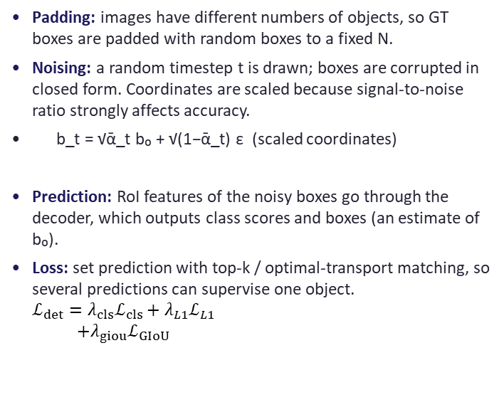
DiffusionDet: Training and Inference in Detail
Training (learn to denoise boxes)
Inference (start from pure noise)
Padding: images have different numbers of objects, so GT boxes are padded with random boxes to a fixed N.
Noising: a random timestep t is drawn; boxes are corrupted in closed form. Coordinates are scaled because signal-to-noise ratio strongly affects accuracy.
b_t = √ᾱ_t b₀ + √(1−ᾱ_t) ε (scaled coordinates)
Prediction: RoI features of the noisy boxes go through the decoder, which outputs class scores and boxes (an estimate of b₀).
Loss: set prediction with top-k / optimal-transport matching, so several predictions can supervise one object. $\begin{aligned}ℒ_{det}=λ_{cls}ℒ_{cls}+λ_{L1}ℒ_{L1} \\ +λ_{giou}ℒ_{GIoU}\end{aligned}$
Start: N boxes sampled from a Gaussian; no proposals, anchors or queries needed.
Each step: decoder predicts clean boxes and classes from the current noisy boxes; boxes are re-noised to the next, lower noise level.
Shared decoder: same parameters at every step, informed of noise level by timestep embedding.
Box renewal: low-quality candidates are replaced with fresh random boxes between steps.
Trade-off: more proposals or steps raise accuracy and cost; both can be changed at test time.
Why it suits aerial imagery
Iterative refinement: box geometry updated over several reverse steps instead of one forward prediction.
Flexible compute: number of proposals and denoising steps can be changed at evaluation time (cost vs accuracy).
Limit: boxes are horizontal, so elongated or rotated objects keep background → motivates oriented variants.
Notes:
Training: pad, noise, decode, match. Inference: encoder runs on the image, decoder is reapplied over several denoising steps with box renewal. ~60 s.

Slide 6
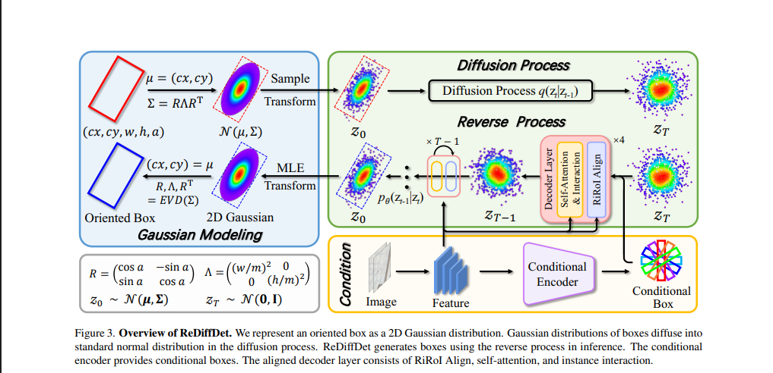
ReDiffDet: Architecture (Oriented Boxes)
Main blocks
Forward diffusion: Markov chain over Gaussian states z₀ → z_T ~ N(0, I).
Rotation equivariance: rotating the input rotates the output; isotropic end-state is rotation invariant.
Conditional encoder: image features → conditional boxes, reducing random placement.
Aligned decoder: RiRoI Align + self-attention + instance interaction.
Fig.: ReDiffDet overview [2]
Box → Gaussian: b = (cx, cy, w, h, a) ↔ N(μ, Σ), μ = (cx, cy)ᵀ
Covariance: Σ = R Λ Rᵀ, Λ = diag((w/m)², (h/m)²); angle sits in Σ, not a lone scalar. m is the scaling factor
Back to box: eigendecomposition gives axes and size
Notes:
Oriented box (cx, cy, w, h, a) becomes a 2D Gaussian. Diffusion runs on Gaussians. Conditional encoder gives image-guided starting boxes; aligned decoder refines them. ~60 s.

Slide 7
ReDiffDet Working and OrientedDiffDet Alignment
Image
Start
Reverse step
Output
Backbone features, conditional encoder
➜
z_T ~ N(0, I) plus conditional boxes
➜
p_θ(z_{t−1} | z_t, I) with aligned decoder
➜
Final Gaussians → oriented boxes
RiRoI Align
OrientedDiffDet [3] (related design)
Extracts features from a rotated region aligned to each candidate box orientation.
Self-attention + instance interaction let proposals exchange information.
Box: (x, y, w, h, Δα, Δβ): enclosing horizontal box + offsets.
Alignment: proposal turned into a directional rectangle, so pooling avoids extra background.
Speed: DPM-Solver accelerates reverse sampling.
Notes:
Reverse process conditioned on image I. RiRoI Align samples rotated regions so pooled features match the object. OrientedDiffDet: six-parameter box, alignment, DPM-Solver. ~60 s.

Slide 8
ReDiffDet: Detailed Working
1 Box → Gaussian
2 Forward diffusion
3 Why equivariance
Oriented box (cx, cy, w, h, a) becomes N(μ, Σ) with Σ = RΛRᵀ. Orientation is stored in the covariance, not as a lone angle.
Gaussian states z₀ are corrupted step by step (Markov chain) until z_T ~ N(0, I).
Rotating a box rotates its mean and covariance consistently, and the isotropic end state is rotation invariant.
4 Conditional encoder
5 Aligned decoder
6 Reverse + decode
Image features generate image-dependent conditional boxes, so denoising starts from meaningful places, not random ones.
RiRoI Align pools features from rotated regions; self-attention and instance interaction refine all candidates together.
p_θ(z_{t−1} | z_t, I) is applied repeatedly; final Gaussians are converted to oriented boxes by eigendecomposition.
Notes:
Walk through the six stages. Emphasise that orientation lives inside the covariance, so diffusion on Gaussians is rotation-consistent. ~60 s.

Slide 9
Work Carried Out
Dataset | Setting | What was done
DIOR | HBB | Fine-tuned DiffusionDet; 4 complete epochs
NWPU VHR-10 | HBB | Fine-tuned, evaluated up to 25 epochs
HRSC2016 | HBB | Fine-tuned 25 epochs; checkpoints evaluated
DIOR-R | OBB | GSDet checkpoint inference only (900 proposals, rotated NMS)
HRSC2016 | OBB | ReDiffDet inference/evaluation only (provisional)
DOTA-v1.0 | OBB | ReDiffDet inference; submitted to official DOTA server
Environment
Software: Python 3.10, PyTorch 2.4.0+cu121, MMEngine 0.10.7
Hardware: Linux/WSL, RTX 3050 Laptop GPU (4 GB VRAM)
Metrics: COCO-style AP (0.50:0.95), AP50, AP75, APs/m/l; HBB and OBB kept separate
Notes:
Fine-tuning for HBB only. ReDiffDet and GSDet OBB results are inference/evaluation only. DOTA scored on the official server. ~45 s.

Slide 10
Fine-Tuning Results: DIOR and HRSC2016 (HBB)
DIOR test (epochs 1–4)
HRSC2016 HBB (complete epochs)
Stage | AP | AP50 | AP75 | APs | APm | APl
Baseline | 0.32 | 0.56 | 0.33 | 0.2 | 0.76 | 0.8
Epoch 1 | 38.33 | 58.44 | 40.81 | 8.08 | 31.45 | 56.31
Epoch 2 | 41.96 | 63.06 | 44.97 | 9.87 | 33.18 | 60.73
Epoch 3 | 44.56 | 66.43 | 47.63 | 10.5 | 36.29 | 63.42
Epoch 4 | 45.48 | 67.51 | 48.83 | 11.85 | 36.65 | 64.23
Stage | AP | AP50 | AP75 | APm | APl
Baseline | 0.61 | 1.58 | 0.42 | 0.2 | 2.92
Epoch 5 | 82.34 | 93.97 | 88.25 | 51.63 | 84.43
Epoch 10 | 84.39 | 94.93 | 90.58 | 53.88 | 86.61
Epoch 15 | 83.84 | 94.6 | 90.27 | 55.45 | 85.87
Epoch 20 | 84.19 | 94.23 | 90.72 | 56.57 | 86.66
Epoch 25 | 84.47 | 94.42 | 90.76 | 56.48 | 86.96
DIOR: AP rises from 38.33 to 45.48 in four epochs and had not saturated; all metrics peak at epoch 4.
HRSC2016: AP 82.34 at epoch 5 already, best AP at epoch 25 (84.47), best AP50 at epoch 10 (94.93).
Baseline rows: near zero, since the pretrained detector had not been adapted to these datasets.
Notes:
Both improve rapidly after adaptation; HRSC2016 saturates around epoch 10 to 25. APs undefined on HRSC2016. ~45 s.

Slide 11
Fine-Tuning Results: NWPU VHR-10 (Key Epochs)
Epoch | AP | AP50 | AP75 | APs | APm | APl
Baseline | 0.05 | 0.09 | 0.03 | 0.01 | 0.18 | 0.01
1 | 37.81 | 60.77 | 41.83 | 42.54 | 35.33 | 34.4
2 | 46.02 | 74.33 | 51.45 | 43.28 | 43.13 | 49.4
4 | 51.33 | 79.88 | 57.73 | 46.31 | 45.41 | 63.61
8 | 59.12 | 92.44 | 67.64 | 52.99 | 52.28 | 69.33
16 | 61.76 | 94.68 | 69.21 | 53.16 | 54.01 | 71.06
19 | 61.41 | 90.91 | 69.71 | 41.94 | 54.36 | 72.91
20 | 61.14 | 92.89 | 67.75 | 39.63 | 55.37 | 69.15
25 | 59.63 | 92.18 | 64.92 | 43.93 | 53.33 | 69.3
Best: epoch 16 (AP 61.76, AP50 94.68); AP75 and APl peak at epoch 19, APm at epoch 20.
After epoch 16: AP fluctuates between 58 and 61.4 with no sustained gain; extra fine-tuning from epoch 16 did not beat it.
Note: epoch picked on test scores, not validation.
Notes:
Show only key epochs; all 25 are in the report. Peak at epoch 16, afterwards fluctuations without clear gain. ~45 s.

Slide 12
Results: DIOR (HBB) vs Published Detectors
Method | AP50 | AP75 | APs | APm | APl | AP50:95
Faster R-CNN | 73.6 | 56.5 | 7.4 | 30.9 | 63 | 51.2
Cascade R-CNN | 74.1 | 59.8 | 7.7 | 33.6 | 67.2 | 54.5
YOLOv3 | 75.7 | 60.6 | 10.1 | 36.5 | 67.6 | 55.5
YOLOv5s | 77.7 | 60.4 | 11.4 | 38.4 | 67.5 | 55.7
YOLOX-S | 76.5 | 58.2 | 10.6 | 37.6 | 65.3 | 53.9
YOLOv7-tiny | 78.9 | 62.3 | 10.1 | 39 | 69.6 | 57.6
MSA-YOLO | 79.3 | 63.3 | 12.6 | 40.1 | 70.3 | 58.6
DiffusionDet (local, ep. 4) | 67.51 | 48.83 | 11.85 | 36.65 | 64.23 | 45.48
Epoch trend (AP): 38.33 → 41.96 → 44.56 → 45.48 over epochs 1–4.
Caveat: published models trained 200 epochs at 800×800; local model 4 epochs, so indicative only. APs 11.85 beats all but MSA-YOLO.
Notes:
Local DiffusionDet after only 4 epochs trails the 200-epoch published detectors in AP, but its small-object AP is competitive. ~55 s.

Slide 13
Results: NWPU VHR-10 and HRSC2016 (HBB)
NWPU VHR-10 (epoch 16)
HRSC2016 HBB (epoch 25)
Method | AP | AP50 | AP75 | APs | APm | APl
Mask R-CNN | 60.6 | 90.8 | 69.2 | 52.2 | 60.9 | 54.8
PANet | 66.3 | 91.3 | 77.3 | 57.9 | 57.5 | 60.2
PointRend | 64.9 | 88.3 | 76.3 | 54 | 65.1 | 60.7
BlendMask | 68 | 91.1 | 79 | 56.7 | 68.1 | 57.7
Adaptive feat. learning | 69.4 | 93.1 | 81.5 | 58.4 | 69.5 | 65.6
DiffusionDet (local) | 61.76 | 94.68 | 69.21 | 53.16 | 54.01 | 71.06
Method | Metric
SRBBS (NRER) | mAP 55.7
SRBBS (NBEB) | mAP 79.7
SHD-HBB | mAP 69.5
Faster R-CNN | mAP 84.0
DiffusionDet (local) | AP 84.47, AP50 94.42
NWPU: highest AP50 (94.68) and APl (71.06) of all listed; APm is lowest. AP below four of five methods.
HRSC2016: AP 84.47 (ep. 25), AP75 90.76; protocols differ, so no strict ranking.
Notes:
NWPU: best epoch 16, selected on test, so not validation-selected. HRSC2016: published mAP and local COCO AP not strictly comparable. ~60 s.

Slide 14
Results: DIOR-R and DOTA-v1.0 (OBB)
DIOR-R
DOTA-v1.0
Method | AP50 | AP75 | mAP
Oriented RepPoints | 66.31 | 44.36 | 42.81
DCFL | 66.41 | 41.83 | 40.88
H2RBox-v2 | 57.13 | 32.13 | 32.77
COBB-sig | 65.65 | 42.78 | –
ARS-DETR | 66.12 | 45.81 | 43.89
GSDet (1 iter.) | 69.35 | 48.27 | 46.19
GSDet (3 iter.) | 70.05 | 48.91 | 46.69
Local GSDet inference | 69.7 | 48.1 | 46.23
Method | AP50 | AP75 | mAP
Oriented RepPoints | 74.38 | 46.56 | 44.57
DCFL | 73.13 | 39.62 | 41.14
H2RBox-v2 | 72.6 | 39.67 | 40.53
COBB-sig | 75.52 | 48.35 | 45.61
ARS-DETR | 74.16 | 49.41 | 46.21
GSDet (1 iter.) | 75.44 | 52.15 | 47.77
GSDet (3 iter.) | 75.74 | 52.4 | 48.16
Local DOTA output | 73.94 | 52.31 | 47.62
DIOR-R: local AP50/mAP lie between published GSDet 1- and 3-iteration values.
DOTA: mAP 47.62 vs 48.16 (GSDet, 3 iter.); AP75 52.31 close to 52.40. Server-evaluated; exact subset/config still to confirm.
Notes:
DIOR-R is GSDet inference only. DOTA scored by official evaluation server. Both sit close to published GSDet. ~55 s.

Slide 15
Results: HRSC2016 (OBB), Provisional
Method | AP | AP50 | AP75
DiffusionDet | 50.6 | 76.1 | 60.6
RoI Transformer | 61.4 | 89.2 | 75.8
Oriented R-CNN | 54.7 | 89.6 | 63.7
FCOS | 52.9 | 88.3 | 62
RepPoints | 51.8 | 83.7 | 59.1
OrientedDiffDet | 72.4 | 90.3 | 89.5
Local OBB output (ReDiffDet) | 72.32 | 90.41 | 89.51
Local run summary
Data: 444 images, 1,228 GT objects, 1,344 detections.
AP by IoU: 90.4 at 0.50, 89.5 at 0.75, 2.3 at 0.95; mean 72.32.
Status: checkpoint/state-dict mismatches and data-prefix issue recorded.
Interpretation: closeness to OrientedDiffDet (72.4 AP) reflects a shared diffusion formulation and elongated ship shapes, but is not a validated reproduction of either method.
Notes:
Be upfront: run is provisional due to checkpoint and data-prefix issues. Similarity to OrientedDiffDet does not imply equivalence. ~45 s.

Slide 16
Future Work: Conditional Brownian Bridge Diffusion
Standard diffusion
Ground-truth boxes
➜ noise ➜
Pure Gaussian noise N(0, I)
Brownian Bridge (BBDM)
Source: image-conditioned candidate boxes
➜ bridge ➜
Target: ground-truth oriented boxes
Brief theory
For oriented detection
Idea: a stochastic process conditioned on both endpoints, moving a source distribution into a target distribution.
Intermediate states: Gaussian, with means interpolating between source and target and variance controlling uncertainty.
Start: from image-conditioned candidate boxes instead of random noise.
End: at ground-truth oriented boxes.
Challenge: design the process over oriented geometry so box dimensions and rotation stay valid.
Notes:
Standard diffusion ends in pure noise; a bridge is pinned at both ends. Idea: go from image-conditioned boxes to ground-truth oriented boxes. Challenge is keeping boxes valid. ~60 s, then Q&A.

