Slide 1
NextHikes IT Solutions
Bike Sharing Demand Analysis
How time, weather and holidays affect hourly bike rentals: an Excel project
1,000 hourly records | 58,304 rentals | 1 Jan to 14 Feb 2011
Presented by: RASHMI PATIL DATE: 08 - 10 - 26

Slide 2
INTRODUCTION
Urban bike-sharing systems rely on accurate demand forecasting to ensure bikes are available when and where riders need them. This project analyzes 1,000 hourly rental records totaling 58,304 rentals from January 1 to February 14, 2011. It evaluates how key external factors—such as time of day, weather conditions, and day types—impact hourly rental volume. Using multi-stage data merging and Excel macro automation, the analysis builds interactive dashboards and short-term ETS forecasts. Ultimately, these findings deliver actionable strategies to optimize fleet positioning, maintenance schedules, and commuter service efficiency.

Slide 3
Data: three datasets, merged in two stages
Dataset 1
610 rows: date, hour, weather, temp
Dataset 2
610 rows: humidity, wind, riders
Merge_1_2
610 rows (stage 1, on "instant")
+
=
Merge_1_2
610 rows
Dataset 3
390 rows (instants 611-1000)
Clean_Data
1,000 rows (stage 2)
+
=
Stage 1 joins Dataset 1 and 2 with INDEX/MATCH. Stage 2 adds Dataset 3, which already holds every column. Datasets 2 and 3 arrived as PDFs and were converted to numbers.

Slide 4
Cleaning and checks
Duplicates
Missing values
None found in any dataset or after merging, so no rows were removed.
11 blank feels-like temperatures (atemp) were filled by regression on temp and highlighted yellow.
Data types
Checks and new columns
Dataset 3 dates were text (dd-mm-yyyy) and became real dates. PDF values became numbers.
21 automatic checks all PASS. Added day type, time of day, demand level and anomaly flag.

Slide 5
Key findings
08:00 & 17:00
-46%
95% vs 83%
26-27 Jan
Weekday commute peaks: 189 and 169 rentals per hour. Weekends peak mid-afternoon.
Rain or snow: 33 rentals per hour against 62 in clear weather.
Share of rentals by registered riders on weekdays vs weekends.
Anomalous low days (506 and 431 rentals against about 1,320 usual).
Hour of day is the strongest single driver (correlation 0.37). Temperature 0.23, humidity -0.25 and wind 0.10 are weak. The daily trend explains only 8% of variation.

Slide 6
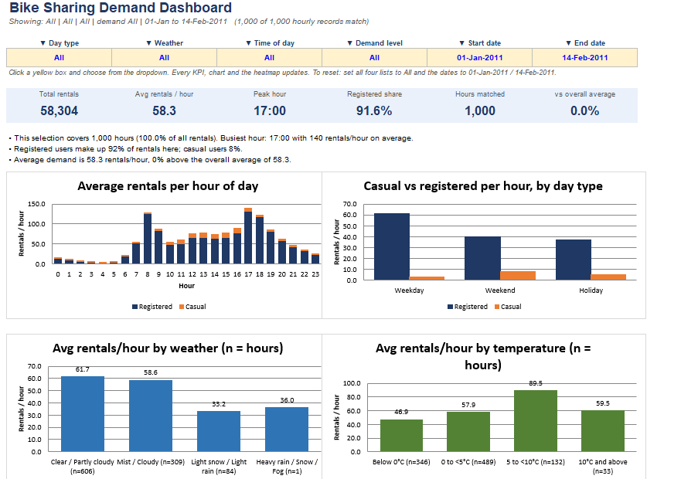
Interactive dashboard

Slide 7
    Six dropdown filters: day type, weather, time of day, demand level, start and end date.
    Every KPI card, five charts, the heatmap and the top-5 busiest hours
    update together.
    Key insight:
    Peak commute:highest usage at 17:00 rush hr.
    Core users:91.6% are registered subscribers.
    Weather:rides peak in clear weather.
    Action:shift bikers to business hubs .

Slide 8
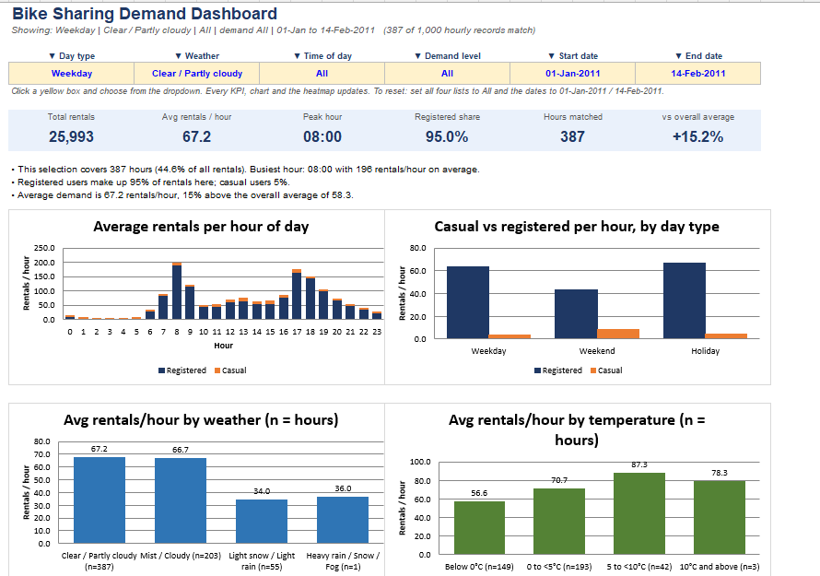

Slide 9
FOUR LINE OPTION OF DIS FLITERED VIEW
Morning peak:busiest time is 8:00am during office commute hr.
Strong loyalty:subscriber usage jumps to 95%clear weekday.
High volume: overall rentals abv average.
Action:increase bike availability at residential hub.

Slide 10
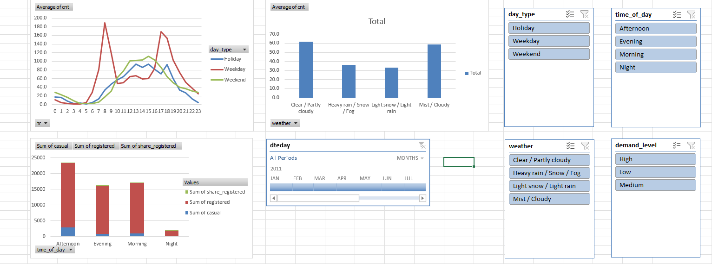
PivotTables, slicers and timeline
Paste Figure 3 here
Pivot_dashboard with slicers and timeline

Slide 11
3 PivotTables and PivotCharts: rentals by hour and day type, by weather, and casual vs registered by time of day.
Slicers: day_type, weather, time_of_day, demand_level.
Timeline on dteday.
All five controls are linked to all three pivots.

Slide 12
Forecast and anomaly detection
7-day forecast: about 1,520 rentals per day, with a wide 95% range (about 840 to 2,200). Treat it as indicative: trend R-squared is only 0.08.
Anomalies flagged by z-score: 3 hours and 2 days (26-27 Jan, snow).

Slide 13
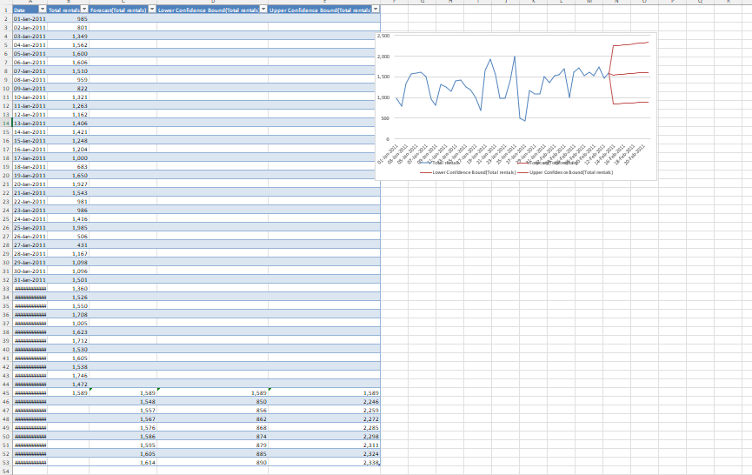

Slide 14
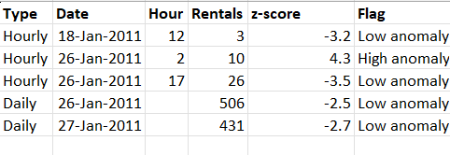

Slide 15
VBA macros and automation
BikeSharing_Automation.bas
Result in Excel
RunFullPipeline runs it all in order:
ImportAndCleanNewData: import and clean a new CSV
RefreshAnalysis: recalculate the workbook
BuildAnomalyReport: list unusual hours and days
RunAIForecast: Excel ETS forecast
ExportDashboardPDF: save the dashboard as PDF
Imported into the .xlsm workbook and run in Excel.
Created the Anomaly_Report sheet and the ETS forecast columns on Daily_Trend.
Custom functions: DayType, TimeOfDay, DemandLevel.

Slide 16
Recommendations and limitations
Recommendations
Limitations
1. Pre-position bikes before the 08:00 and 17:00 weekday peaks.
2. Do maintenance at night (only 3% of rentals).
3. Reduce bikes in service in rain or snow (about 45% fewer rentals).
4. Convert casual weekend riders to members.
5. Repeat the analysis with a full year of data.
Winter only (45 days): no seasons.
14 Feb is a partial day.
Correlation is not causation.
Forecast is indicative only.

Slide 17
CONCLUSION
Bottom line:people use this bikes mostly to gt to work,so
Our top priority z having bikes ready for 8 am & 5pm
Rush.rain & snow cut our business almost in half,so bad
Weather days r when v should scale back operations.

Slide 18
THANK YOU

