Slide 1
Hello Everyone! Welcome to all of you.

Slide 2
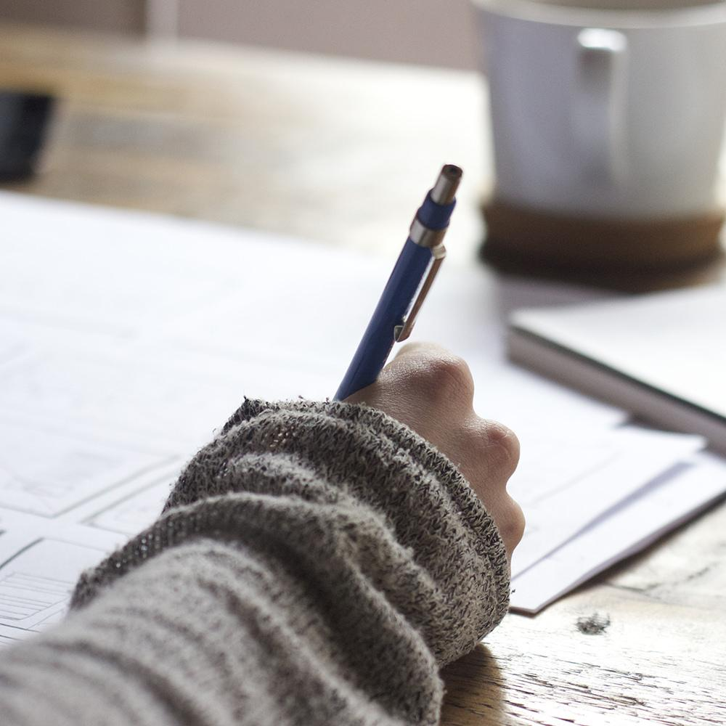
Hello!
We are CyberPunk
Let’s come together, and make this world beautiful.
You can find me at www.rishavpandey.me

Slide 3
Air pollution in World
???

Slide 4
Air pollution occurs when harmful or excessive quantities of substances including gases, particulates, and biological molecules are introduced into Earth's atmosphere. It may cause diseases, allergies and also death of humans; it may also cause harm to other living organisms such as animals and food crops, and may damage the natural or built environment. Human activity and natural processes can both generate air pollution.
Indoor air pollution and poor urban air quality are listed as two of the world's worst toxic pollution problems in the 2008 Blacksmith Institute World's Worst Polluted Places report. According to the 2014 World Health Organization report, air pollution in 2012 caused the deaths of around 7 million people worldwide, an estimate roughly echoed by one from the International Energy Agency.

Slide 6
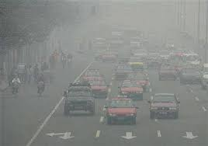
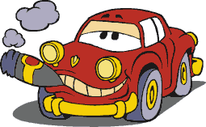

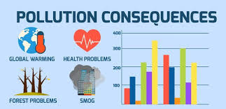
Dirty Cars, Dirty Air

Slide 7
In 2013, transportation contributed more than half of carbon monoxide and nitrogen oxides, and almost a quarter of the hydrocarbons emitted into our air.
Cars and trucks produces air pollution throughout their life, including pollution emitted during vehicles operation operations, refuelling, manufacturing and disposal. Additional emissions are associated with the refining and distribution of vehicle fuel.

Slide 8
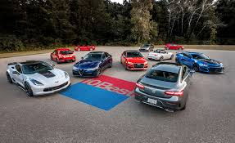
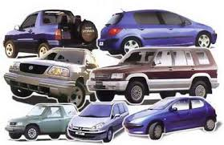
Problems associated with vehicles
Air pollution
Noise pollution
Traffic Congestion
Road accidents
Parking Issues

Slide 9
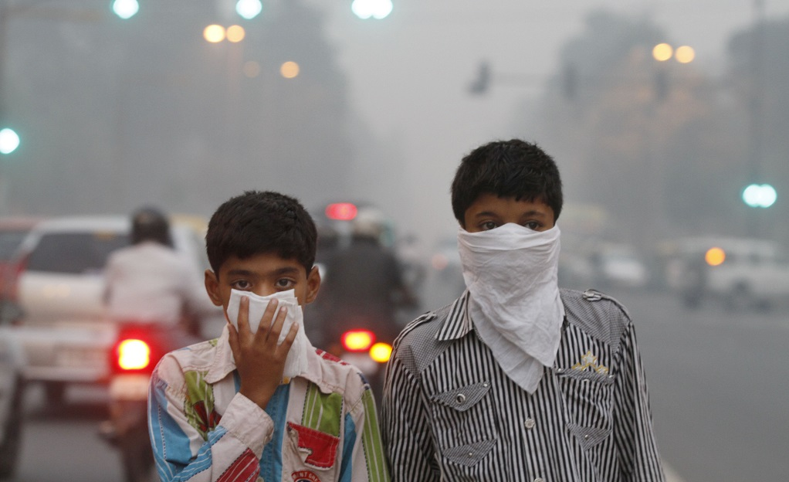
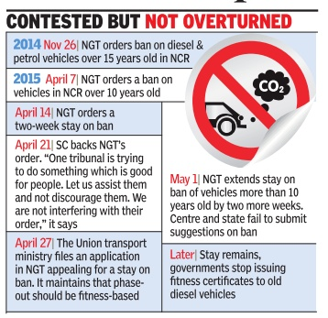
Air pollution

Slide 10
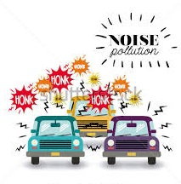
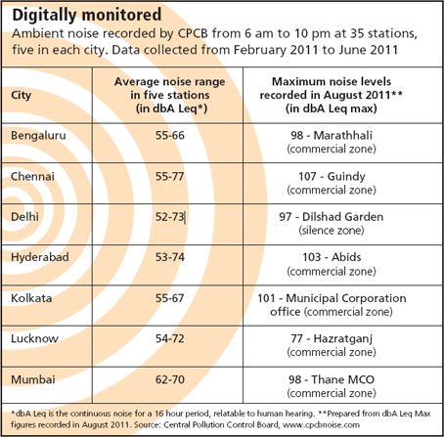
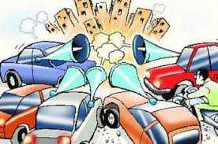
Noise Pollution

Slide 11
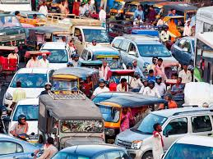
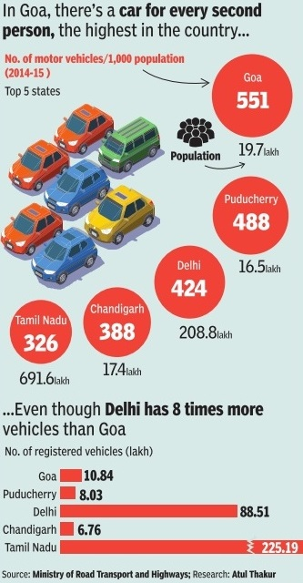
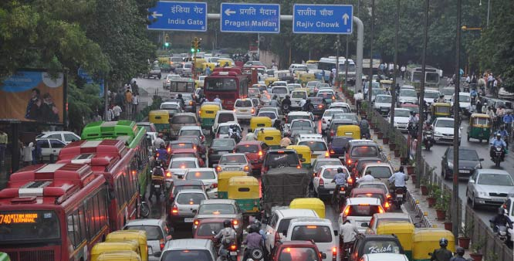
Traffic Congestion

Slide 12
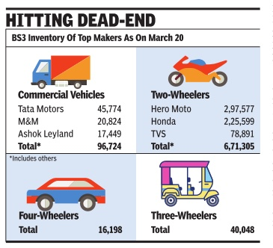
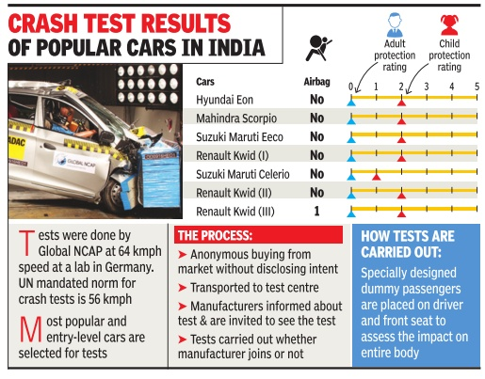
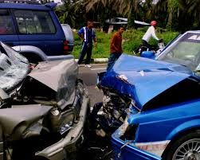
Road Accidents
Road Accidents

Slide 13
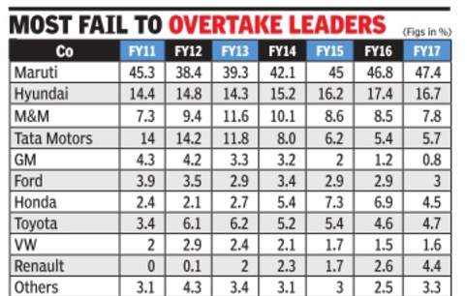
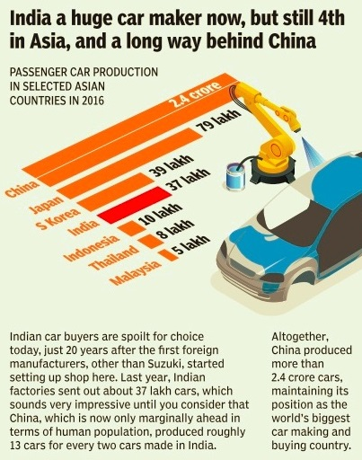
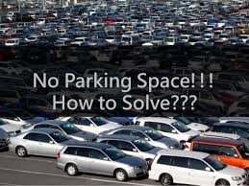
Parking Issues..

Slide 14
Is there any Solution???

Slide 15
PoolCar
Let’s have a ride together

Slide 16
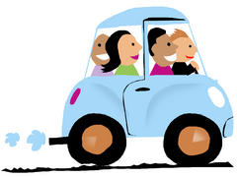
What is Car Pooling?
Carpooling (also car-sharing, ride-sharing and lift-sharing) is the sharing of car journeys so that more than one person travels in a car, and prevents the need for others to have to drive to a location themselves.

Slide 17
Benefits of Car Pooling
There are many great benefits to carpooling, many of which people do not know about or even think about. With these benefits in mind, it will be easier than ever to see why making the switch, even for just a few days a week, can be a good idea for you and your commute.
Carpooling saves money and reduces congestion on our roads and highways. It also gives you the opportunity to develop new friendships with co-workers or other commuters.
Let’s explore more…..

Slide 18
Carpooling Helps the Environment
Carpooling cuts down on the number of cars and vehicle son the road. Fewer cars means there is less carbon and other gasses and pollution getting into the air. This protects the environment by keeping the air, water, and land cleaner.

Slide 19
It is Good for You
According to numerous health reports and research, air pollution caused by auto emissions can significantly increase the likelihood of health issues such as asthma, allergies, lung cancer, COPD, and the like. Research data has also suggested that carpooling can be far less stressful than simply commuting on your own.

Slide 20
Carpooling Helps Save You Money
You can save money on gas and such by diving up the gas fees among your carpool passengers. The more people you have the more you can save. Carpooling also helps you save on the cost of vehicle repairs and maintenance if you rotate vehicle use between the members of your carpool team. Additionally, you and everyone else can save some money on road fees because with more carpooling there are fewer cars on the road and therefore less wear and damage to the roads that need to be repaired each year using taxpayer’s money.

Slide 21
Carpooling is a Very Convenient Option
Carpooling is an option that can give you great flexibility. If you need to carpool three days a week or five, you can do so. Whatever your needs are, you can look for people who need that same schedule or who can add you to their drive route on the days you need a ride. The flexibility makes it a very convenient option for any long commute.

Slide 22
It Helps You Make New Friends
Carpooling is also a wonderful way to meet interesting people, get to know the people you work with or go to school with, and to make new friends!

Slide 23
Motivation for PoolCar
In current scenario of world, we all are familiar with harmful effect of Air Pollution. There have been many reasons for increasing of this issue. In all this, Transportation is playing a good role in increasing the air pollution.
We thought about proposing a solution, which would be effective in decreasing the numbers of vehicles running on roadways.
Rajasthan IT Day 2018, gave us the opportunity to present it to world, and take some effective steps towards our greener environment.

Slide 24
Our Moto
Make our Earth Clean & Green

Slide 25
Working Mechanism of Pool Car
Driver offer a ride
OR
Passenger looks for a ride
Plan your trip
and
Pay
Travel Together

Slide 26
Our Methodology
Using data analysis, our System will give them perfect riding experience.
Recommended companions on based on their arrival, destination and their preference.
Best analysed shortest path for journey.
Helps you find nearby fellow traveller.
Hassle-free accommodation and guide.

Slide 27
S . W . O. T Analysis
Strengths
Decrease traffic
Time is not lost due to trying to find parking
Less money spent on fuel
Convenient
Weaknesses
Wear and tear on a vehicle
Depending on others
Having to be punctual
Could be an unpleasant experience.
Opportunities
Networking
Create job opportunities
Less accidents
Threats
Cycling
City Transport System
Cab Services
Those who carpool aren’t in the same area

Slide 28
Probable outcomes
Greener Environment
Less number of vehicles on road
No more parking issues
Peoples will become more friendly with each others

Slide 29
Website
This will be our first Structure
Place your screenshot here

Slide 30
Android / iOS app
Next version will be implemented using Android and iOS applications
Place your screenshot here

Slide 31
Thanks!
Any questions?
You can find me at
www.rishavpandey.me &
correspond.rishav@gmail.com

