Slide 1


Slide 2

PROBLEM STATEMENT
design a machine learning algorithm to predict the rate of property .
Given a new property your algorithm should be able to predict a rent range of the property.

Slide 3

REAL ESTATE BUSINESS
Real estate is: the property, land, buildings, and the natural resources surrounding it. The term “real estate” means real (or physical) property.

Slide 4

Basic Need:
The most expensive investment any individual makes in his/her lifetime is undoubtedly the “Roof above the head” i.e. the home.

Slide 5
Traditional Approach:
When people have to buy a new property, they first approach a real estate agent.
Then they go looking for the best houses as suggested by the broker.
Choose one.
Seller
Broker
Tenant

Slide 6

Our Approach Towards This Problem:
Using regression model we have attained an accuracy of 80-85% in predicting house rents.
We have also ensemble different machine learning model to gain better performance.
We have to care of missing data values.

Slide 7

We are also planning to use deep learning models for better accuracy.
We have tried several Ml models such as decision tree, random forest and gradient boosting algorithm.

Slide 8
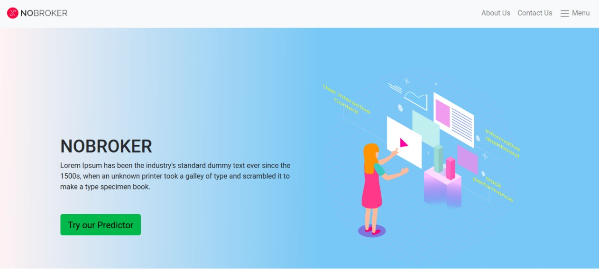
Just a lookout to our front-end.

Slide 9
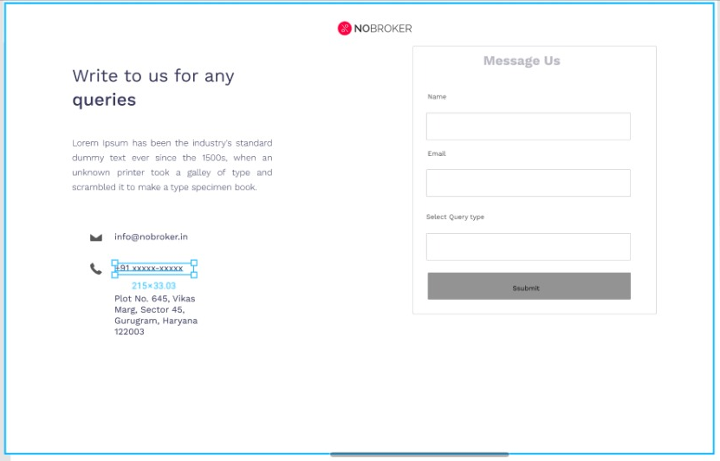
To improve the user interaction, the whole feedback and queries would be solved 24*7.

Slide 10
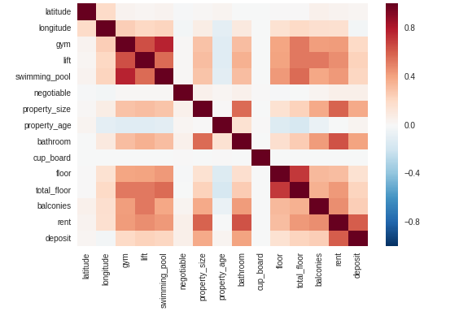
Co-relation between different attributes.

Slide 11
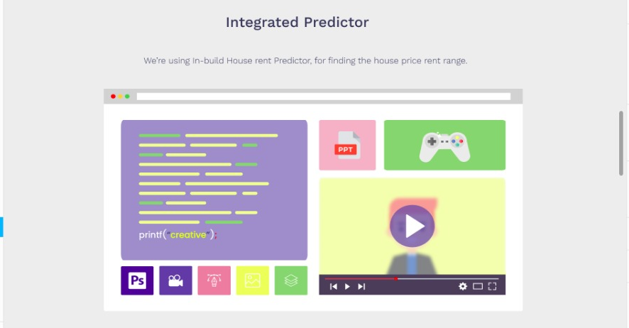
So predict your perfect price or rent with us because we value your money.

Slide 12

TECHSTACK:
Python
Flask
HTML5 & CSS3
JavaScript
Jupiter Notebook
Google Colab
Machine Learning

Slide 13
THANK YOU
EvilCoders 2.0
-Rishav Pandey
-Shashank Shekhar
-Malvika Sharma
-Surbhi Singhal
-Vishal Sinha
-Sonali Singh

