Slide 1

[Samsung PRISM] Mid Review Report
[ SMART CONTAINERS]
Team
College Professor: Mr. Kamlesh Kukreti
Students:
Rishav Raj Chaudhary
Rahul Walia
Saksham Dangwal
Kritika Pandey
Department: Computer Science
Date: 24 Dec 2019

Slide 2
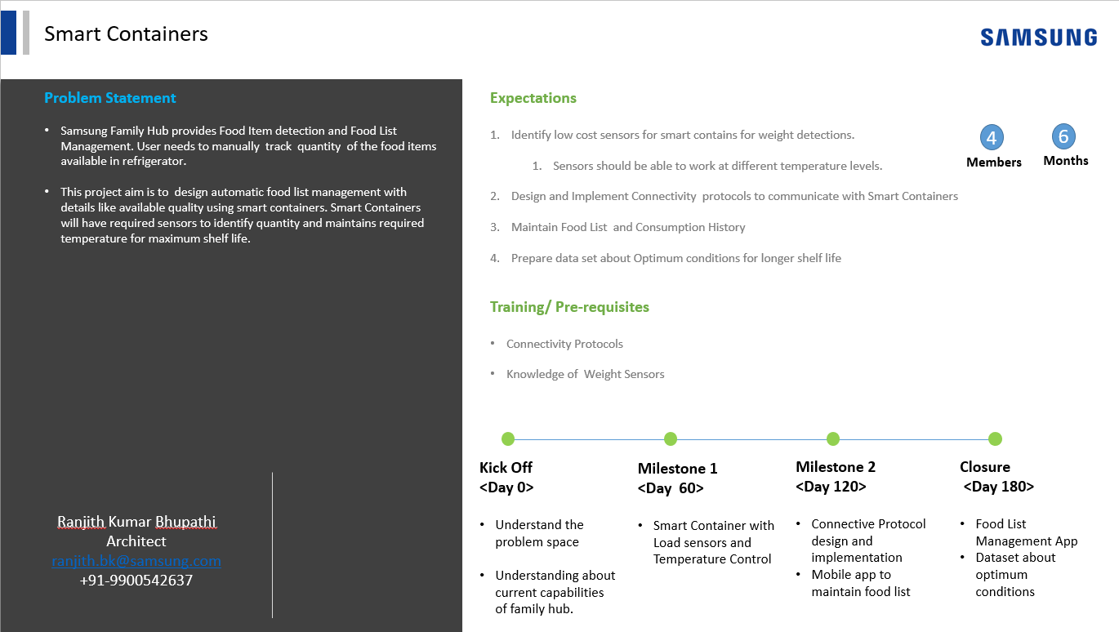

Slide 3
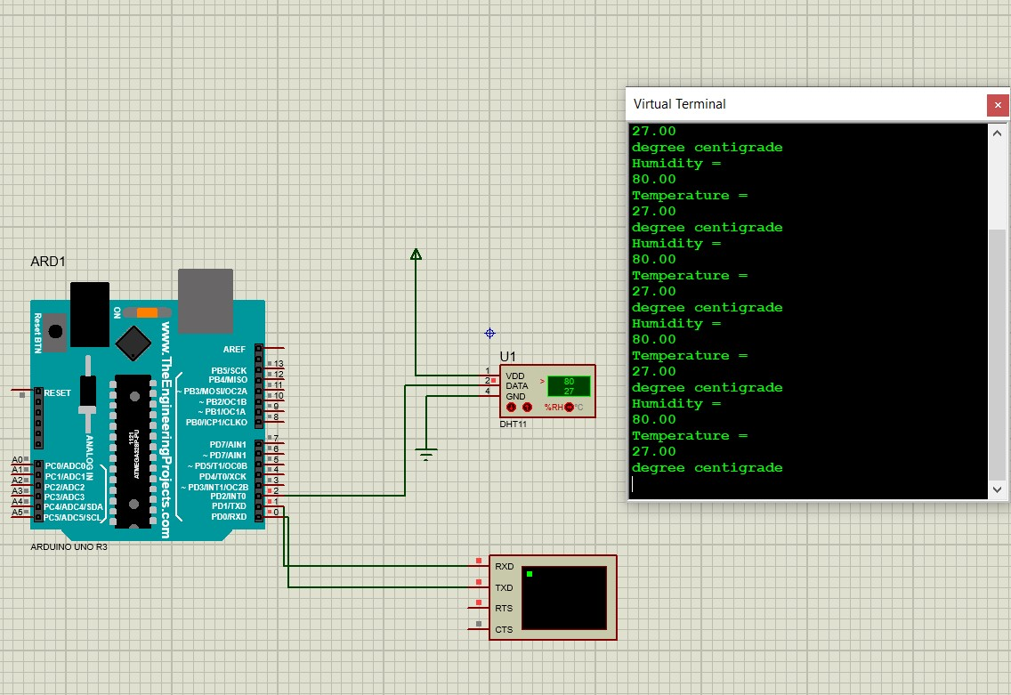
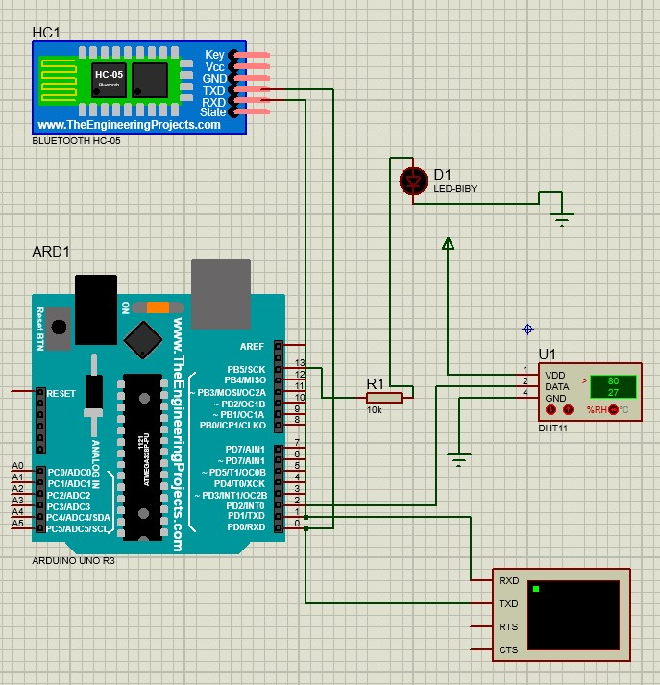
Proposed Approach / Solution
Concept Diagram :

Slide 4
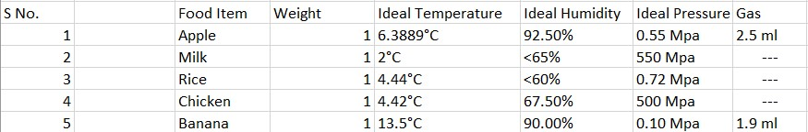
Dataset(s) Analysis / Description
Dataset Capture / Preparation / Generation :
Normal day-day edible food items.
Edible and non-edible conditions with respect to the environment.
Observation based on Kaggle datasets.
Dataset Understanding / Analysis :
Average value is taken for the observation.
Decision-based on actual value and experimented value can be made.
Dataset Pre-Processing / Related Challenges (if any) :
Redundancy based on same food item’s data.
Too much data for the same food item.
Null values for some data items.

Slide 5
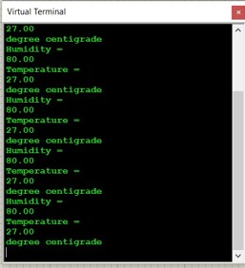
Experimental Results / Simulations / Observations
Results :
Major Observations / Conclusions & Challenges :
Detected weight, temperature, pressure, humidity, etc. for food items.
Sensors are able to work at different levels.
Maintained food list and consumption history.
Prepared dataset about optimum conditions for longer shelf life.
Challenges
Connectivity issues regarding application and container components.

Slide 6
Further Plan to Complete Project
Final Probable Deliverables :
Experimental verification with actual hardware components.
deliver actual end-end communication between container device and user’s application
Stable Connection
Robust dataset
IP Target / Plan :
(Any possibility of papers / patentable ideas / innovative aspects that can lead to patentable ideas)
Able to trace user’s work nature/day-day activities based on food consuming habits.
Probability of health issues.
Provide necessary suggestions regarding health.
Involvement of AI to provide further health-related suggestions.

Slide 7
Further Plan to Complete Project
Completion Plan:
(High level plan to complete the project in next 8 weeks after review, in format below)
Week 1 to 2
Assemble various hardware components
Connection of sensors with container and microcontroller
Week 2 to 4
Dataset Comparison
Week 5 to 6
BT-Shield configuration
Connection setup
Week 7 to 8
Application testing
Experiment with values based on the researched dataset.
Finalize the application with available data.
Challenges Anticipated:
Longer distance between phone and container.
Maintain consistent connection.
Git Upload details:

Slide 8
Thank you

