Slide 1
Lead Score Case Study Kumar Rishav Debpritam Chatterjee Akshay Bankar

Slide 2
Problem Statement
Here’s what problems company is facing :
An X Education company has a very poor lead conversion rate.
The company wishes to identify the most potential leads, also known as ‘Hot Leads’, so that it can improve the conversion rate.
The company requires us to build a model wherein you need to assign a lead score to each of the leads such that the customers with higher lead score have a higher conversion chance and the customers with lower lead score have a lower conversion chance.
The CEO, in particular, has given a ballpark of the target lead conversion rate to be around 80%

Slide 3
Business Goals & Objective
There are quite a few goals for this case studyg :
Build a logistic regression model to assign a lead score between 0 and 100 to each of the leads which can be used by the company to target potential leads.
A higher score would mean that the lead is hot, i.e. is most likely to convert into a paying customer whereas a lower score would mean that the lead is cold and will mostly not get converted.
The target lead conversion rate need to be around 80%.

Slide 4
Solution Methodology
Data cleaning and data manipulation :
Drop the duplicate records.
Drop columns, if it contains large amount of missing values and not useful for the analysis.
Handle the missing values. Imputation of the values, if necessary.
Check and handle outliers in data.

Slide 5
EDA
Univariate data analysis: value count, data distribution
Segmented Univariate data analysis.
Bivariate data analysis: correlation coefficients and pattern between the variables etc.
Multivariate Data Analysis
Dummy Variables Creations Where needed
Scaling , Feature Selection and encoding of the data.
Classification technique: logistic regression used for the model making and prediction.
Validation of the model.
Model presentation.
Conclusions and recommendations.

Slide 6
Data Manipulation :
Total Number of Rows = 9240, Total Number of Columns = 37
Single value features like “Magazine”, “Receive More Updates About Our Courses”, “Update me on Supply”
Chain Content”, “Get updates on DM Content”, “I agree to pay the amount through cheque” etc. have been dropped.
Removing the “Prospect ID” and “Lead Number” which is not necessary for the analysis
Dropping the columns having more than 30% as missing value such as ‘How did you hear about X Education’ and ‘Lead Profile’.

Slide 7
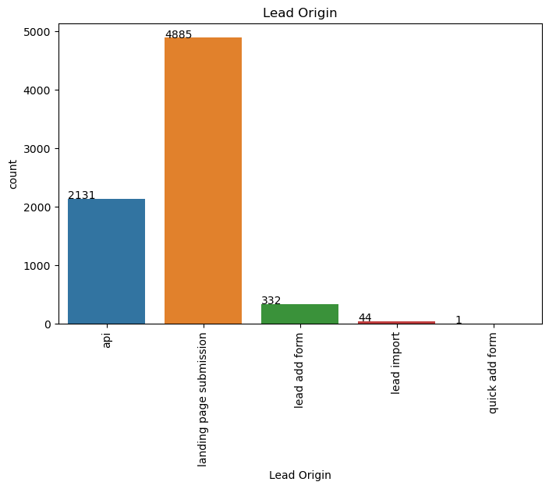
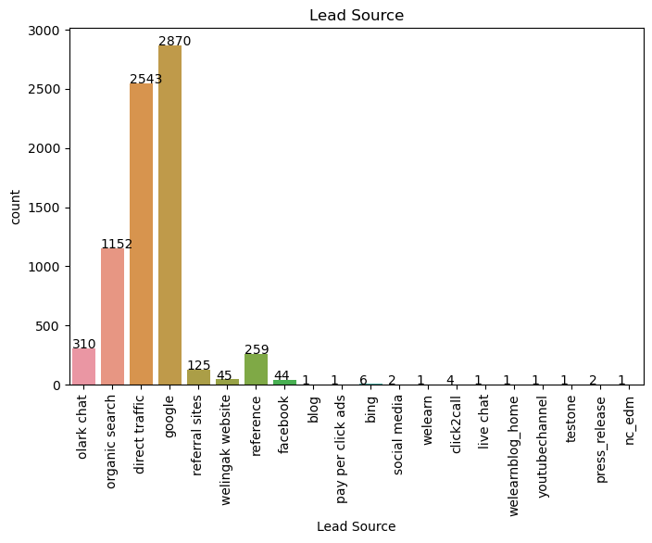
EDA:

Slide 8
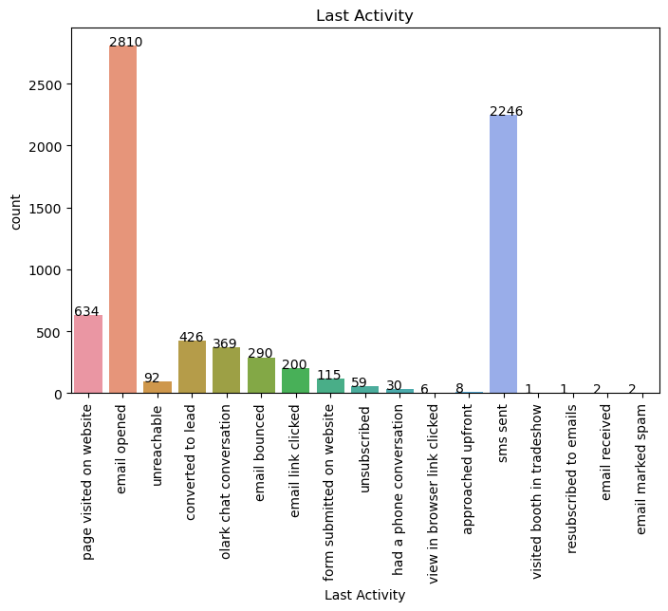
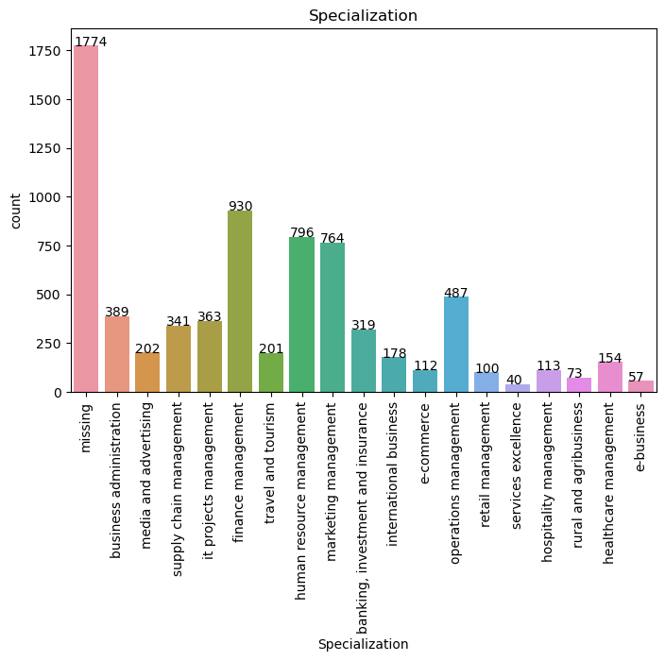

Slide 9
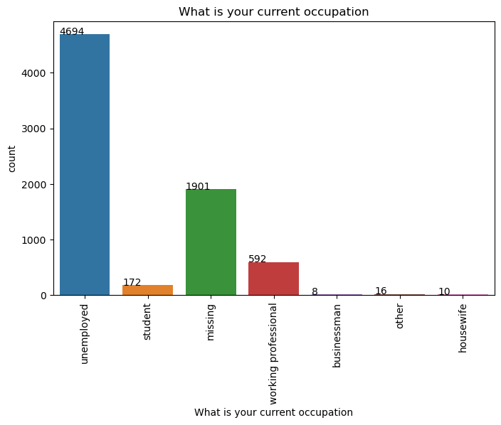
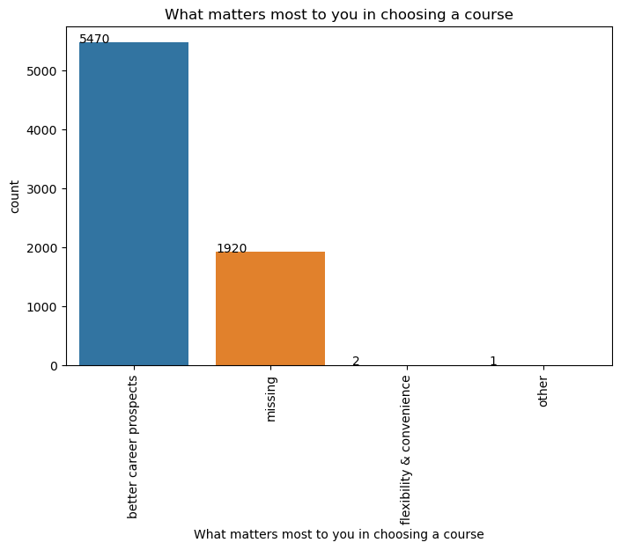

Slide 10
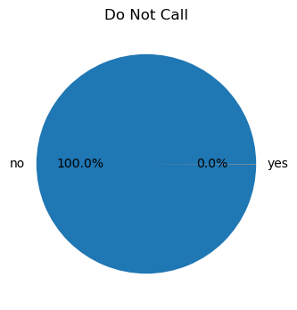
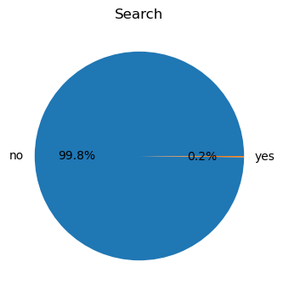
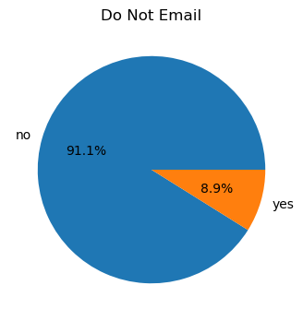
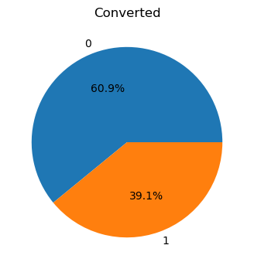
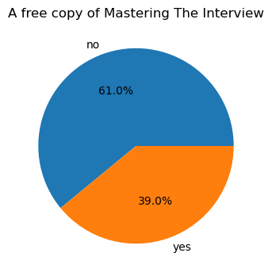
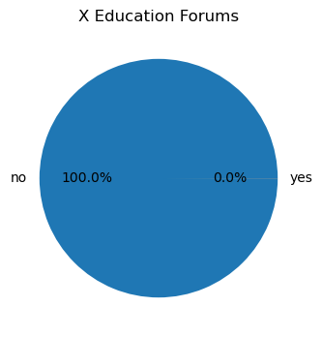

Slide 11
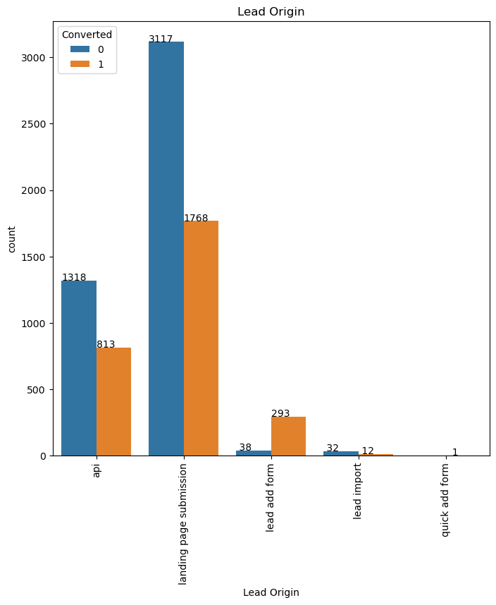
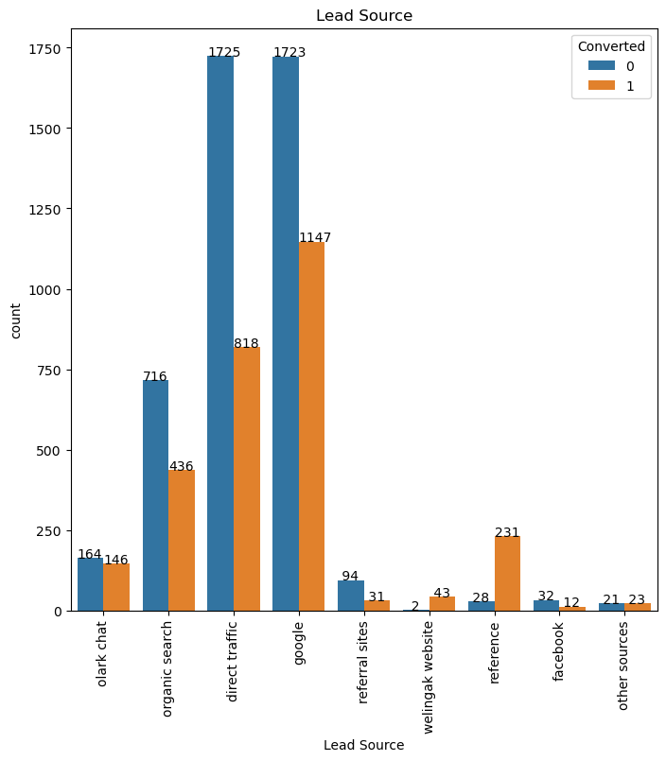
Categorical Variable Relation :

Slide 12
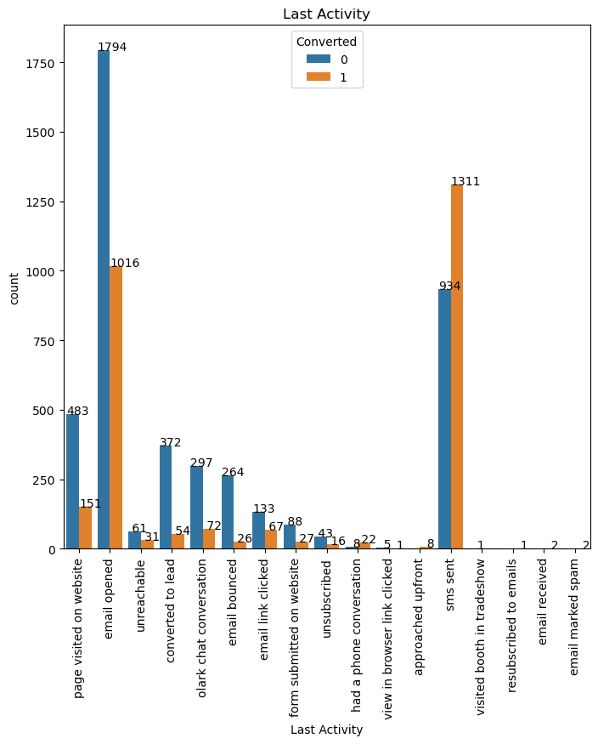
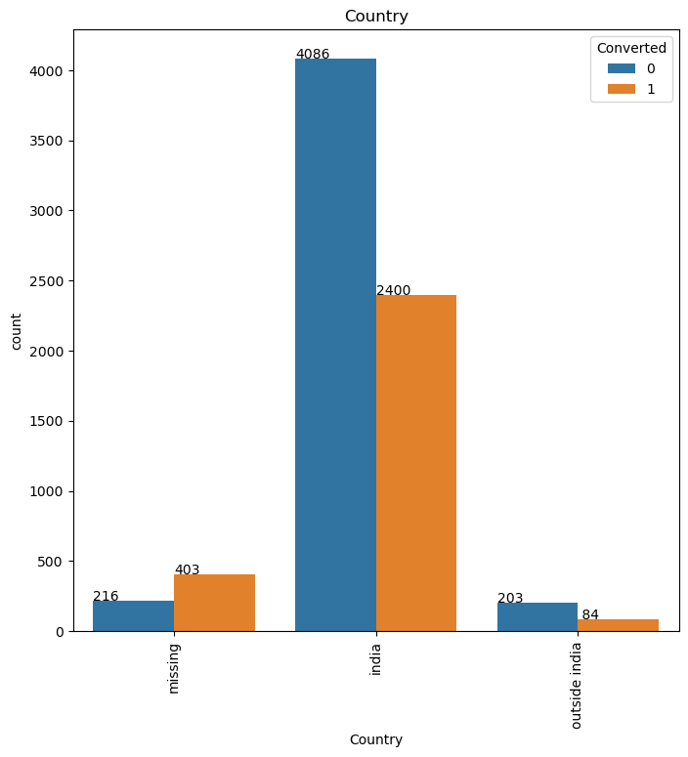

Slide 13
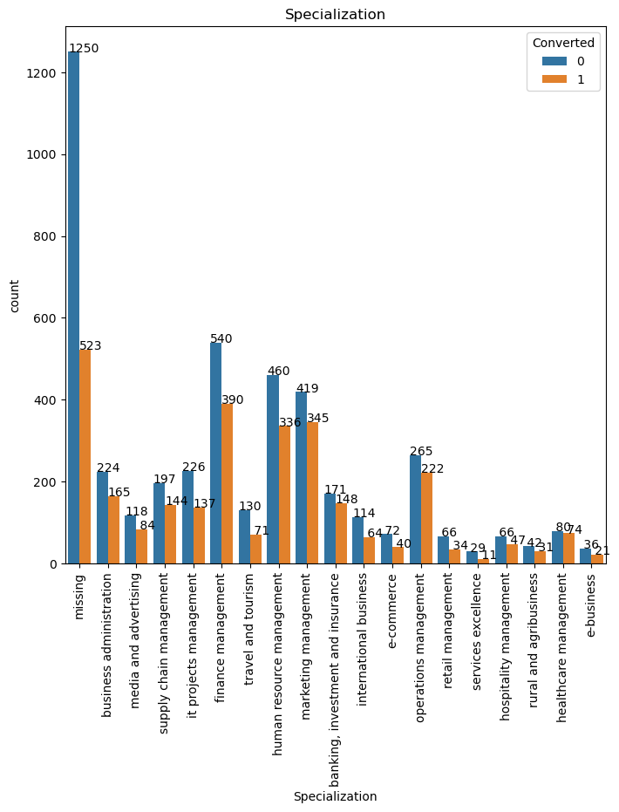

Slide 14
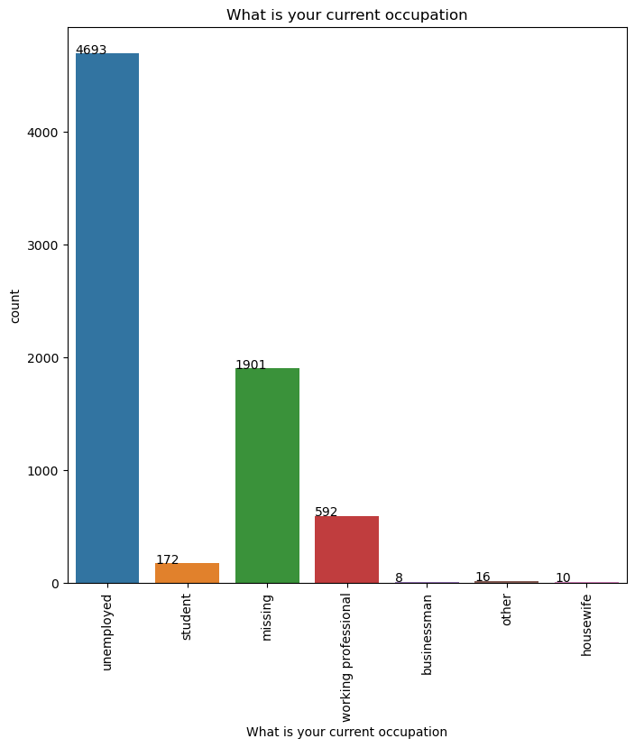
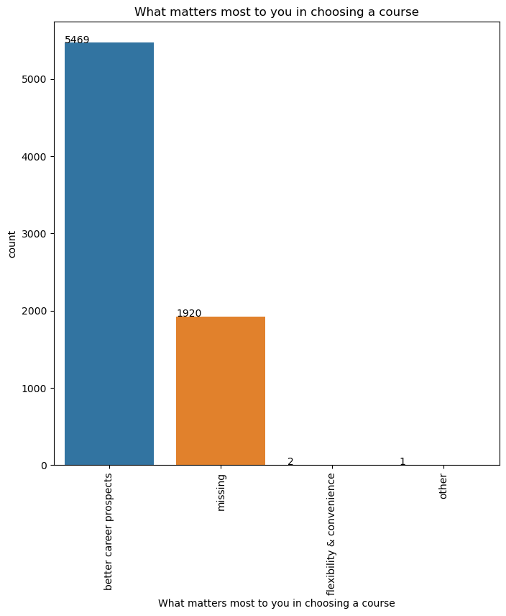

Slide 15
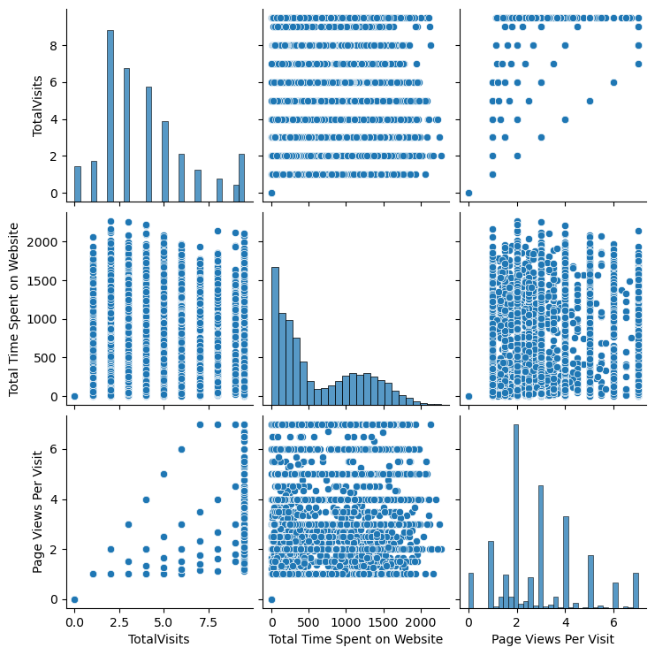
Multivariate Analysis:

Slide 16
Model Building
Splitting the Data into Training and Testing Sets
The first basic step for regression is performing a train-test split, we have chosen 70:30 ratio
Use RFE for Feature Selection
Running RFE with 15 variables as output
Predictions on test data set
Overall accuracy 80%Data cleaning and data manipulation

Slide 17
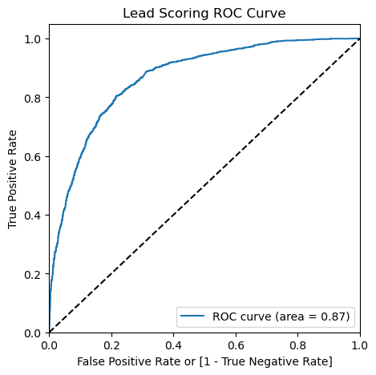
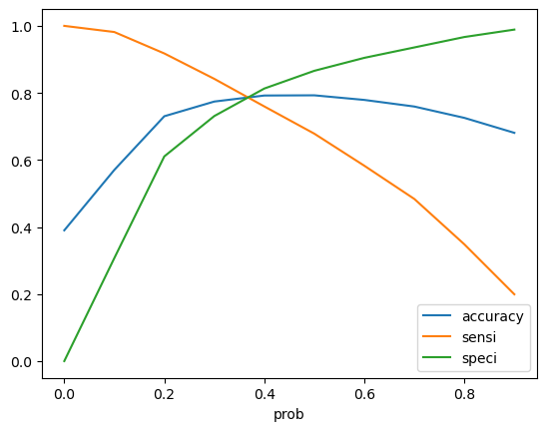
Optimize Cut Off (ROC Curve) :

Slide 18

Conclusion :
It was found that the variables that mattered the most in the potential leads are:
The total time spend on the Website.
Page Views Per Visit.
Total Visits
Then the Last Notable Activity is “Had a phone conversation”
When the last Activity is “ SMS Sent”
When the Load Origin is Load add Format
When the Leads Current Profession is “Working Professionals”

Slide 19

Thanks!

