Slide 1

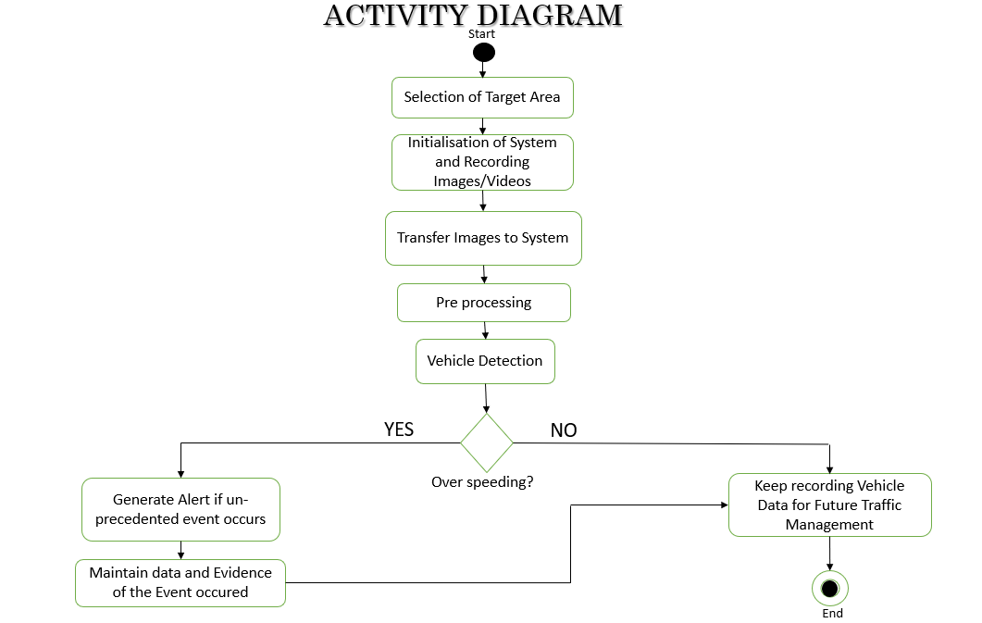
Speed Detection of Vehicle Using Machine Learning Algorithm
ABSTRACT
Images
CONCLUSION
Object Detection is related to Computer Vision. Object detection enables detecting every instance of objects in images and videos. It identifies the feature of Images that generates an intelligent understanding of images just like human vision works.. The traditional model detects a certain object in images. Vehicle detection and tracking is one of the main components of the smart traffic concept. Without having a proper knowledge of traffic flows we cannot plan and develop modern city. CCTV camera or surveillance is a source of traffic information which can be used to discover many information technology solutions, including ML algorithm.
PICTURES / DIAGRAM
Speed estimation plays vital role in Intelligent Traffic System (ITS) which can be done by using machine learning. It is more systematic or well organized and cheap or low-budget than conventional technique without using machine learning, for example: Police uses speed radar and manual inspection which is energy consuming. So, implementing this technology it can be helpful to reduce man power. As well as It can become more effective and reliable.
OBJECTIVES
To design an automated over speed detection system.
To create a system that would notify traffic police with details of an over speeding vehicle.
REFERENCE
[1] Asaad AMA, Syed IA (2009). “Object identification in video images using morphological background estimation scheme” Chapter, 22: 279-288.
[2] R. C. Gonzalez, R. E. Woods, “Digital Image Processing” Third Edition, Prentice Hall, 2007.
[3] Wen L, Fumio Y (2009). “Speed detection of moving vehicles from one scene of Quick Bird images”, Urban Remote Sensing Joint Event, pp. 1-6.
ADVANTAGES
METHODOLOGY
Haar Cascade: It is an Object Detection Algorithm used to identify faces in an image or a real time video. The algorithm uses edge or line detection. The algorithm is given a lot of positive images consisting of faces, and a lot of negative images not consisting of any face to train on them. The models stored in XML files.
OpenCV: OpenCV is the huge open-source library for the computer vision, machine learning, and image processing and now it plays a major role in real-time operation which is very important in today’s systems. By using it, one can process images and videos to identify objects, faces, or even handwriting of a human
Smart traffic management
Reduce manpower
It is more efficient and economical than conventional technique
PARTICIPANT DETAILS
Under the guidance of Assistant prof: Mathiyalagan R
Rishav Surana:18BTRIS035 Susanta Sarkar: 18BTRIS48 Siddharth Kr Harlalka: 18BTRIS066 Sujata Budha: 18BTRIS065

