Slide 1

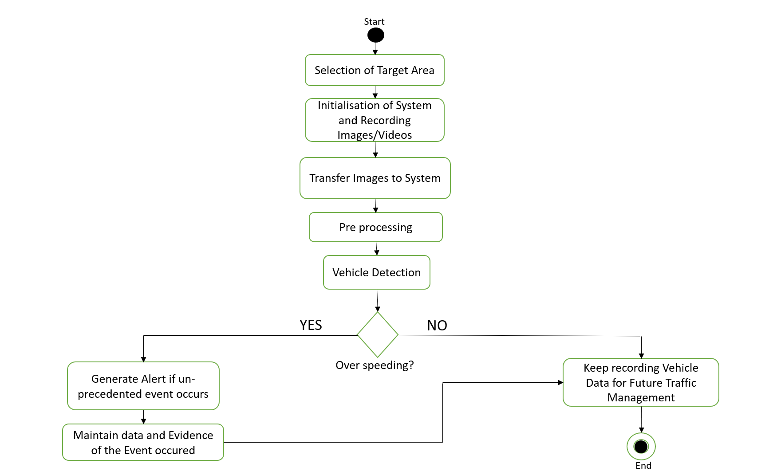
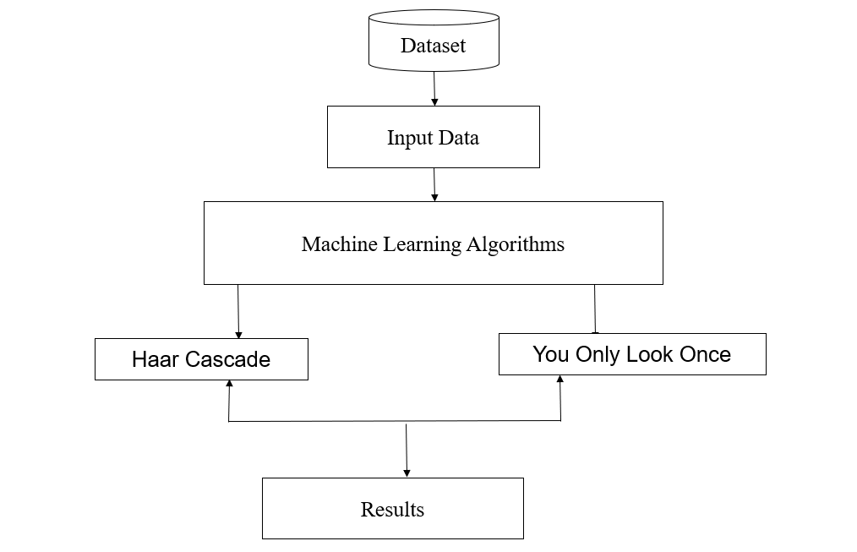
Fold or cut poster here
Fold or cut poster here
Batch Number:9
Department of Information Science and Engineering
Final Year Project Poster Presentation (UG - B.Tech)
Speed Detection of a vehicle using Machine Learning
Introduction
System Architecture
Methodology used
Abstract:
Object Detection is related to Computer Vision. Object detection enables detecting every instance of objects in images and videos. It identifies the feature of Images that generates an intelligent understanding of images just like human vision works.. The traditional model detects a certain object in images. Vehicle detection and tracking is one of the main components of the smart traffic concept. Without having a proper knowledge of traffic flows we cannot plan and develop modern city. CCTV camera or surveillance is a source of traffic information which can be used to discover many information technology solutions, including ML algorithm.
Smart traffic in the modern cities ,vehicle recognition and route tracking. It provides necessary information about traffic conditions like velocity distribution and density of vehicles. It detects possible traffic congestion. Accidents occur on the road frequently. The most common cause is rear-end collisions. Driver error such as fatigue, discomfort, over speeding or use of a phone while driving. These accidents can be reduced if these driver errors are eliminated. The aim of this project is to design an automated over speed detection system that would notify traffic police with the details of an over speeding vehicle. Once the details are sent to the regulatory authority, the driver can be charged for over speeding. The main objective of the project is to eliminate the manpower needed by the existing systems. Currently, officer has to hold the speeding gun to measure the speed of the vehicles. It should be noted that currently, only 5% of the violators get speeding tickets.
Activity Diagram
Here we have built speed detection of vehicle using machine learning algorithm and image processing techniques. We have a dataset of images containing vehicles and non-vehicles. Vehicle images are called positive images or true images which contains the images of the vehicle taken from different angle. Non-vehicle images are called negative images or false images which contains the images of road, traffic sign, bridges and trees. We use haar cascade classifier Graphical User Interface (GUI) to train the images.
Vehicle Identification or detection refers the ability of computer and software system to recognize the object in an image or scene and recognize the object. Here we have built speed detection of vehicle using machine learning algorithm and image processing techniques. We have a dataset of images containing vehicles and non-vehicles. Vehicle images are called positive images or true images which contains the images of the vehicle taken from different angle. To increase the efficiency of the algorithm we use image processing techniques such as background subtraction and shadow removal. Non-vehicle images are called negative images or false images which contains the images of road, traffic sign, bridges and trees. We use Haar cascade classifier Graphical User Interface (GUI) to train the images. The vehicle detection is done using Haar cascade trained file and the input is taken as a video file which can be taken from YouTube and any CCTV surveillance camera.
Most important part is to track the vehicle. Tracking is a process of giving and ID for the detected object to know the same object in next frame. Tracking is done using dlib library. Dlibs main function is to detect multiple objects at same time. Tracking Speed estimation is done by calculating the distance travelled by the object for two consecutive frames. Speed is calculated using Euclidean distance distance.
Design and Implementation
Design and Implementation
Here, we collect the dataset of positive and negative image. Input is taken as an video. To identify the vehicle we use Haar cascade algorithm. Further, tracking is to be done which is an important task to identify the object in the next frame. To track the multiple objects at same time we are using Dlib library. Then to calculate the speed we use Euclidean distance. Euclidean distance is to calculate the distance of two point. In this case the two points are the frame. We take the difference of the two consecutive frames and get the distance and time. When distance and time is known we can get the speed.
Conclusion
Road safety and reducing accidents is a very crucial issue and must be considered at utmost priority. One must hold to the rules of maintaining appropriate speed guidelines. Technological tools and tracking devices can be helpful in monitoring the motion and speed of vehicles can help reduce the number of accidents on roads as well as trace the origins of the mishap. In this project, we build the speed detection of vehicle using machine learning algorithm and Image processing techniques like background subtraction, shadow removal.
Results
References
Contact information
Speed estimation plays vital role in Intelligent Traffic System (ITS) which can be done by using machine learning. It is more systematic or well organized and cheap or low-budget than conventional technique without using machine learning, for example: Police uses speed radar and manual inspection which is energy consuming. So, implementing this technology it can be helpful to reduce man power. As well as It can become more effective and reliable.
[1] Asaad AMA, Syed IA (2009). “Object identification in video images using morphological background estimation scheme” Chapter, 22: 279-288.
[2] R. C. Gonzalez, R. E. Woods, “Digital Image Processing” Third Edition, Prentice Hall, 2007.
[3] Wen L, Fumio Y (2009). “Speed detection of moving vehicles from one scene of Quick Bird images”, Urban Remote Sensing Joint Event, pp. 1-6.
Under the guidance of Assistant Prof: Mathiyalagan R
Student Name Rishav Surana Susanta Sarkar Siddharth Kr Harlalka Sujata Budha | USN 1.18BTRIS035 2.18BTRIS048 3.18BTRIS066 4.18BTRIS065
Fold or cut poster here
Fold or cut poster here

