Slide 1
EDA CREDIT CASE STUDY
Presented By: Malvika Chauhan
Rishav Kumar

Slide 2
Objective
This case study aims to identify patterns which indicate if a client has difficulty paying their installments which may be used for taking actions such as denying the loan, reducing the amount of loan, lending (to risky applicants) at a higher interest rate, etc. This will ensure that the consumers capable of repaying the loan are not rejected. Identification of such applicants using EDA is the aim of this case study.

Slide 3
Data Cleaning and Preparation
Below are the steps which are performed :-
Data Inspection: It is the act of viewing data for verification and debugging purposes, before, during, or after a translation. With reference to dataset-app.info(), app.describe(), app.shape are some method in inspect the data.
Identify percentage of null values in columns: We found there are 67 columns in the dataset containing null values in application dataset and 16 in previous application dataset.
Drop columns with high null values: We followed the strategy of dropping columns having null percentage greater than 40 . Application dataset was having 49 and previous dataset was having 11 columns having null percentage greater than 40 . So we dropped them, as they might affect our analysis.

Slide 4
Impute other columns with fewer null values:
AMT_ANNUITY- There is a high range of outliers at left side of the distribution and hence imputing with mean would not be the right approach so imputing with median.
AMT_GOODS_PRICE- Since both Median and mode are same and might lead to incorrect analysis . Hence imputing it with mean.
OCCUPATION_TYPE- For OCCUPATION_TYPE filling null values with not Specified as might be customer did not wanted to specify there occupation to all or it might get miss to add in the form due to technical problem while filling the form, so we can't normally predict and add any random occupation to the customer to fill null.
NAME_TYPE_SUITE - Fill null values with mode, we might predict that customer did not accompanied with anyone and came alone.
CNT_FAM_MEMBERS- Replacing null with median as this value can not be fraction.
Outliers:
Handling outlier in AMT_ANNUITY, AMT_GOODS_PRICE by excluding values outside 99%ile.
Since AMT_INCOME_TOTAL outlier is 337500 and 99th percentile is 450000 and the number of rows with these values are 12866 and 2750 respectively. Replacing the values higher than 450000.0 with 450000.0+10000.0 to make it continuous and distinctly identifiable and not 337500.0 since 99th percentile value is higher.

Slide 5
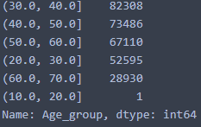
Data quality issues such as negative value in age column:
CNT_FAM_MEMBERS cannot be float. Converting to integer.
DAYS_EMPLOYED, DAY_REGISTRATION, DAYS_ID_PUBLISH should be a positive value. Converting into absolute value.
DAYS_BIRTH column is age of the person at the time of loan application. This could be converted to age in years by dividing by 365.25. Also it is with a negative sign, hence needs to be treated.
Binning continuous variables:
Min age is 20 and max age is 68- Dividing into 7 intervals and creating a new column Age_group having range as
Binning AMT_INCOME_TOTAL into income range categories for ease of analysis as 'Low','Average','High','Very High'

Slide 6
Data Analysis
Divide data into based on target 0 and 1:
We have a Imbalance Ratio: 11.32
Creating two dataframes for Target = 0 and Target = 1 as below-
app_T0 = app[app.TARGET == 0]
app_T1 = app[app.TARGET == 1]
On dividing dataset we analysis that data only consist of 8.11% cases where payment was not made on time.

Slide 7
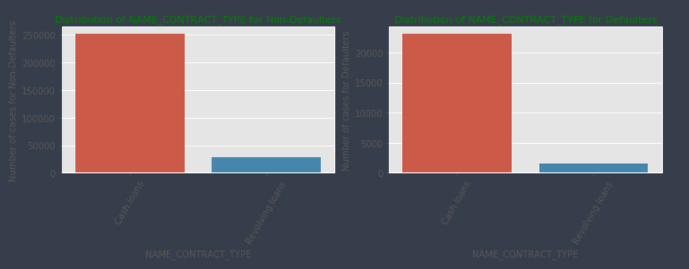
Univariate analysis
Univariate analysis explores each variable in a data set, separately. It looks at the range of values, as well as the central tendency of the values. It describes the pattern of response to the variable.
From below we can notice that revolving loans are lesser in the defaulted population. Hence we can infer that revolving loans are comparatively safer. There are around 250000 people has applied for cash loan who are not defaulters while more than 20000 people in defaulters list have applied for loan.

Slide 8
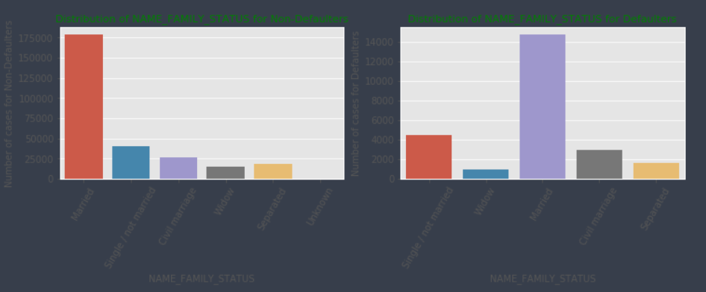
Population living in Rented apartments and those living with parents have higher default rate as they have higher proportion in the Defaulted population as compared to non defaulted population. This might be due to their less income and less cash left for loan repayment.

Slide 9
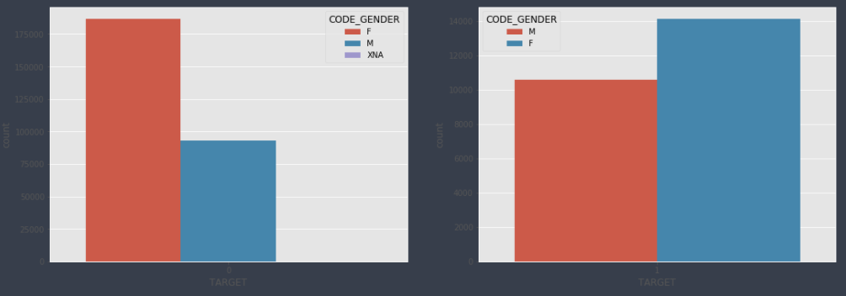
Segmental Univariate Analysis
The proportion of males applying for loans and having difficulties in payment is much more than females.

Slide 10
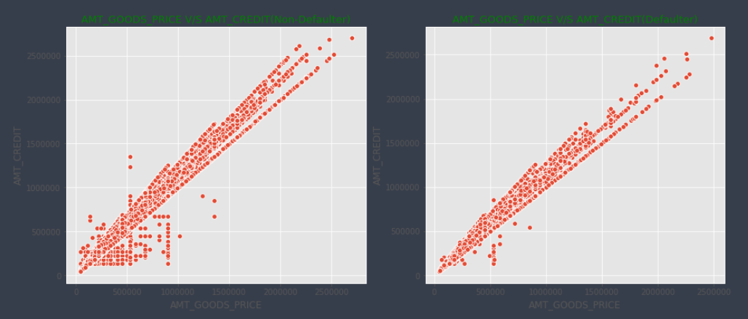
Bivariate analysis
Bivariate analysis is one of the simplest forms of quantitative (statistical) analysis. It involves the analysis of two variables (often denoted as X, Y), for the purpose of determining the empirical relationship between them.
We can conclude from below graph it becomes difficult for applicant to pay if the 'AMT_CREDIT and AMT_GOODS_PRICE' rises together.

Slide 11
Correlation matrix and top 10 correlated pairs
A correlation matrix is a table showing correlation coefficients between variables. Each cell in the table shows the correlation between two variables.

Slide 12
Merge with previous application dataset

Slide 13
Conclusion and Recommendation

