Slide 1
English and Education in India
Rishav Roy

Slide 2
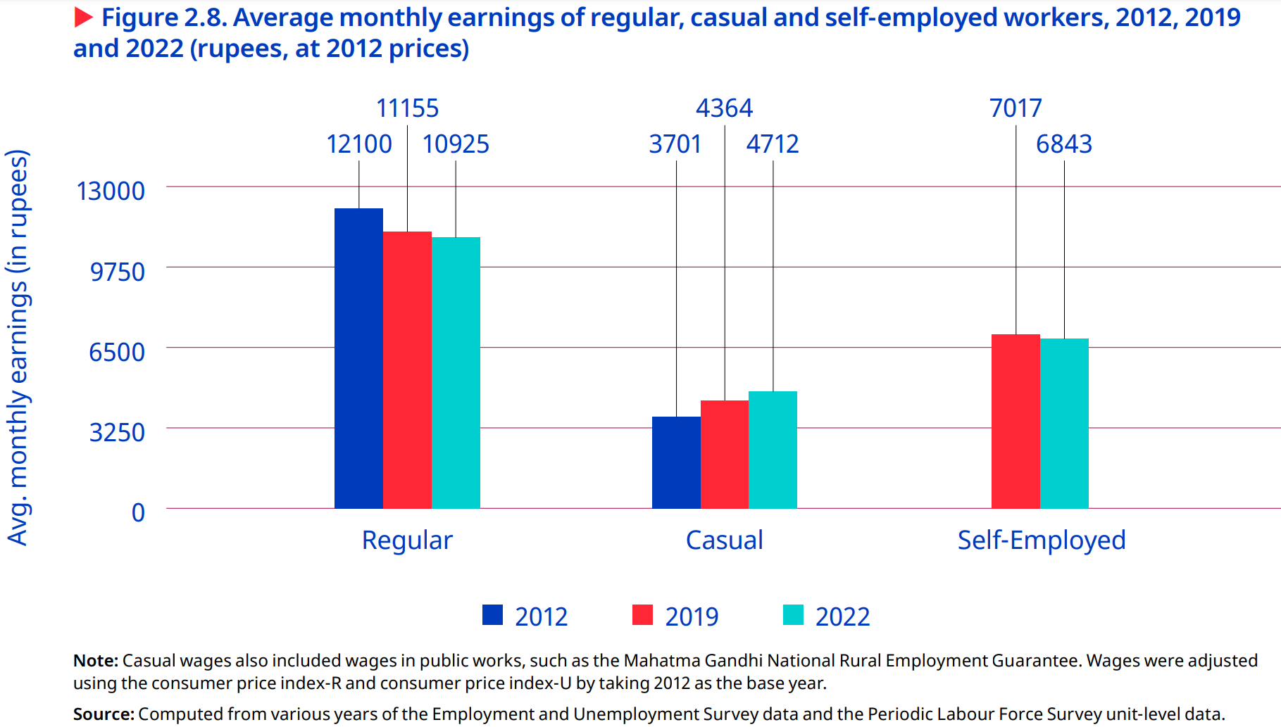
International Labour Organization (2024)

Slide 3
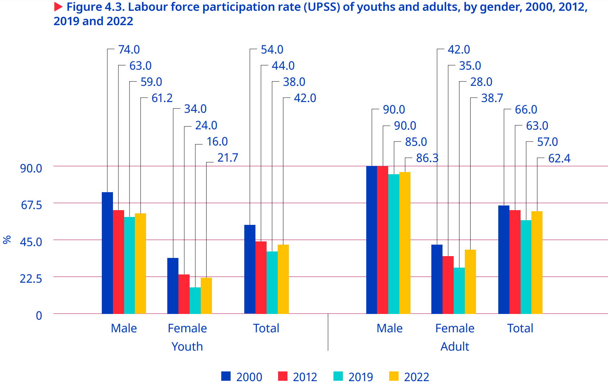
International Labour Organization (2024)

Slide 4
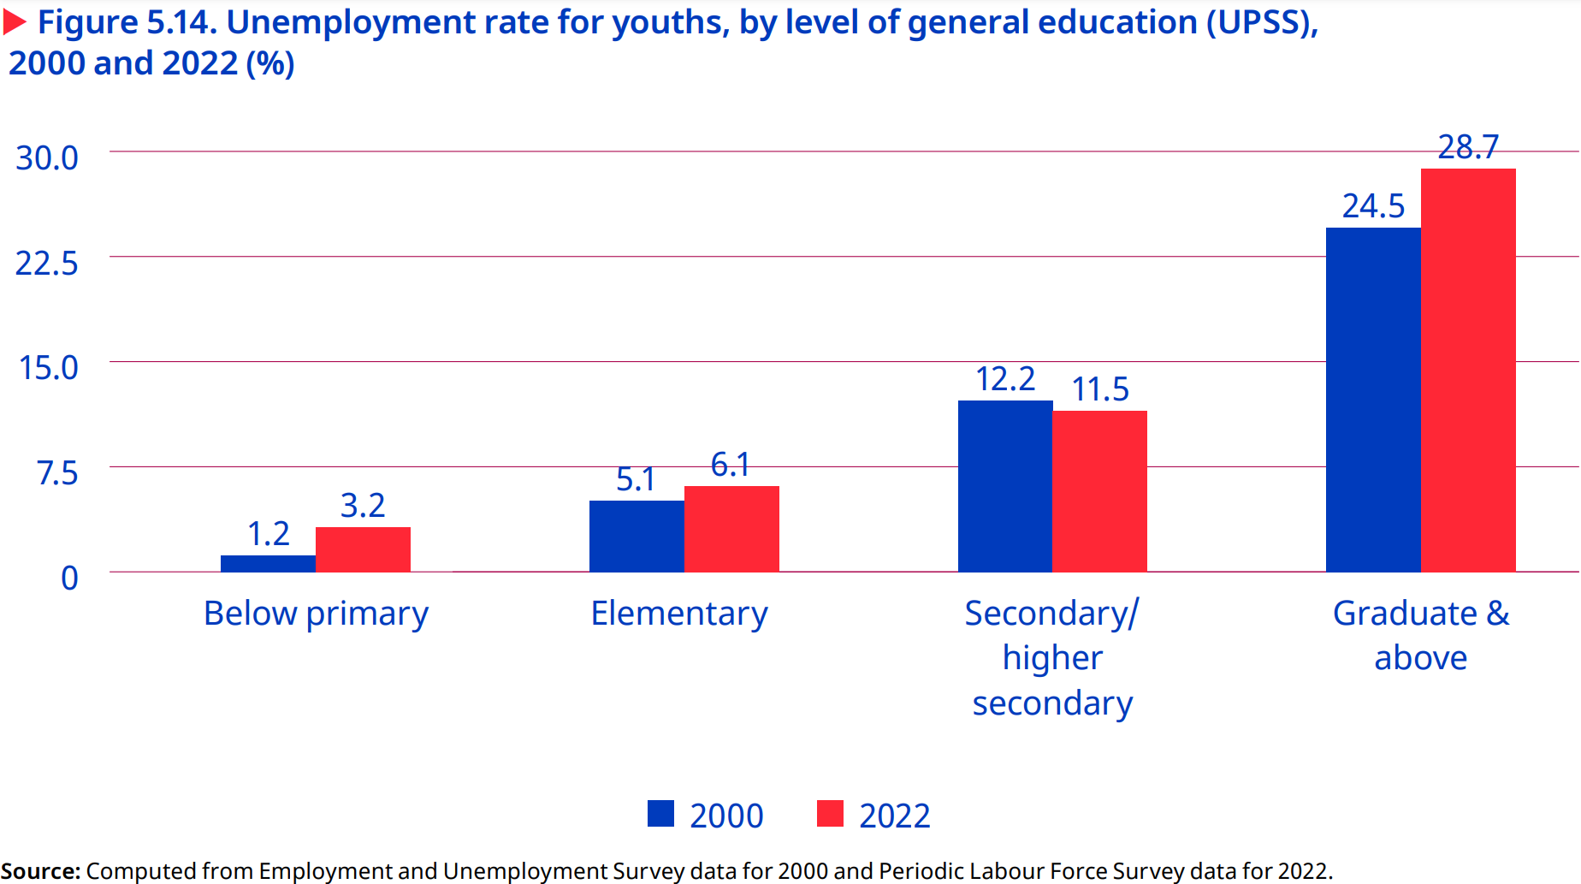
International Labour Organization (2024)

Slide 5
Our Context
In the broader economy:
Inequality
Strong but jobless growth
Under- and unemployment
In households’ labor market choices:
Bad jobs
Few jobs

Slide 6
Our Motivation
From the household’s perspective:
How can I best ensure my children’s future economic success?
From the local policy-maker’s perspective:
How can I best ensure the future welfare of my constituents?

Slide 7
A Possible Answer
Economics:
Education → human capital → higher demand, wages
India:
English skills → service jobs → higher demand, wages
Synthetized solution:
English-medium instruction (EMI)

Slide 8
Limits to the Literature
Existence of wage premia for English skills well-documented:
Azam et al., 2013; Munshi & Rosenzweig, 2006; Refeque & Azad, 2022
But there exist limitations:
Wages are limited measure of welfare
None study how to gain English skills! How can households/policy-makers actually actualize upon the lessons of the literature?

Slide 9
Limits to EMI
Failure to learn English under EMI (Lahoti & Mukhopadhyay, 2019)
Higher learning outcomes under mother tongue instruction (A. K. Mohanty, 2022)
Schools lie about EMI (Lahoti & Mukhopadhyay, 2019; Gooptu & Mukherjee, 2023)

Slide 10
Our Research Question
What is the effect of
EMI (English-medium instruction) exposure in 2007-08
on local consumption
in 2017-18?

Slide 11
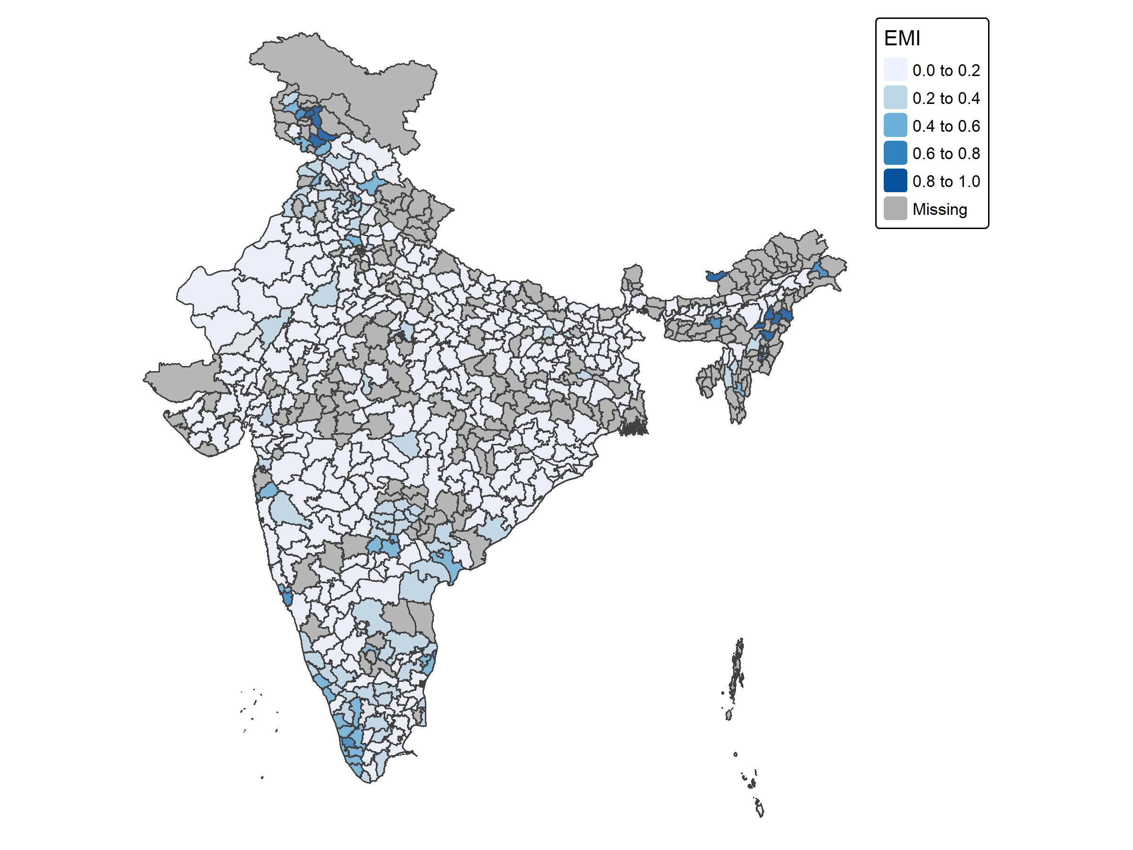
Explanatory Variable Construct for EMI what Chakraborty and Bakshi (2016) construct for public schools:
EMI Enrollment (EMIE_{d})
Data: National Sample Survey (NSS) Participation and Expenditure in Education, 2007-08
Aggregate at district level: n_{d} ∈ [25, 850], most ∈ [96, 300]
Reflects genuine parental decision-making

Slide 12
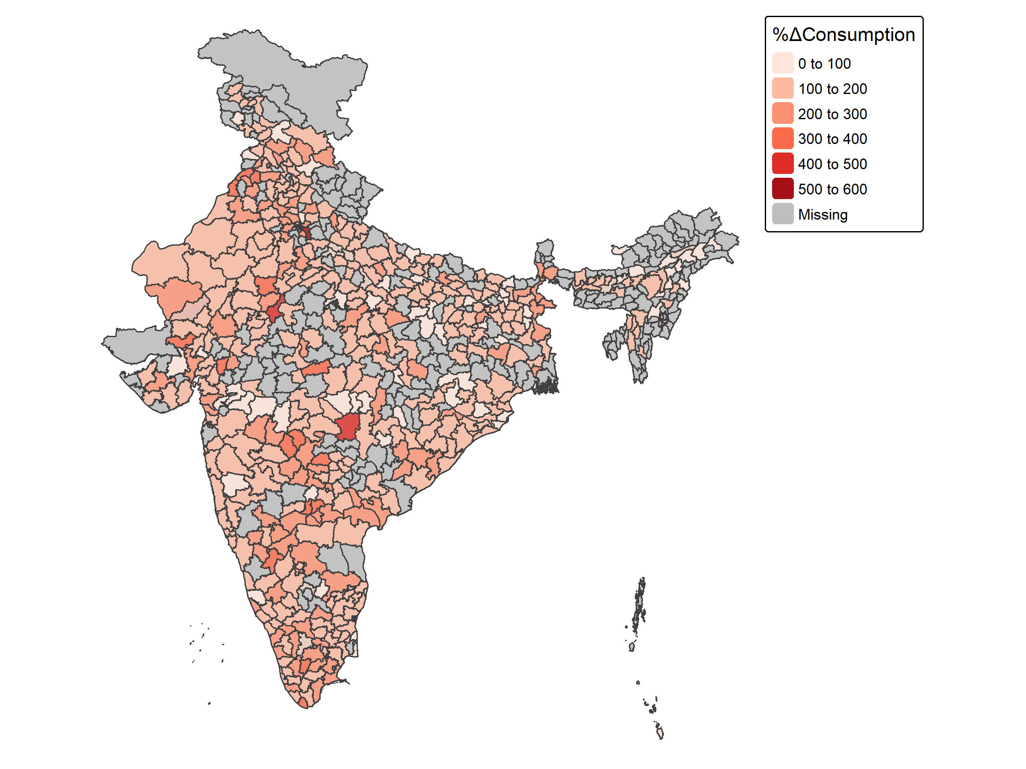
Response Variable Identify robust measures of welfare
%ΔConsumption_{d}
Data: NSS 07-08, and NSS on Household Social Consumption, 2017-18
% Δ in avg. monthly household consumption expenditure
Not robust to shocks
Not robust to regional price variation

Slide 13
Empirical Methodology How can we best isolate the effect of EMIE on %ΔConsumption?
EMIE
%ΔC

Slide 14
Econometric Challenges What prevents us from isolating the effect of EMIE on %ΔConsumption?
EMIE
%ΔC

Slide 15
Econometric Challenges What prevents us from isolating the effect of EMIE on %ΔConsumption?
EMIE
%ΔC
CONFOUNDERS

Slide 16
Empirical Methodology How can we best isolate the effect of EMIE on %ΔConsumption?
Incorporate confounders as CONTROLS in a linear regression

Slide 17
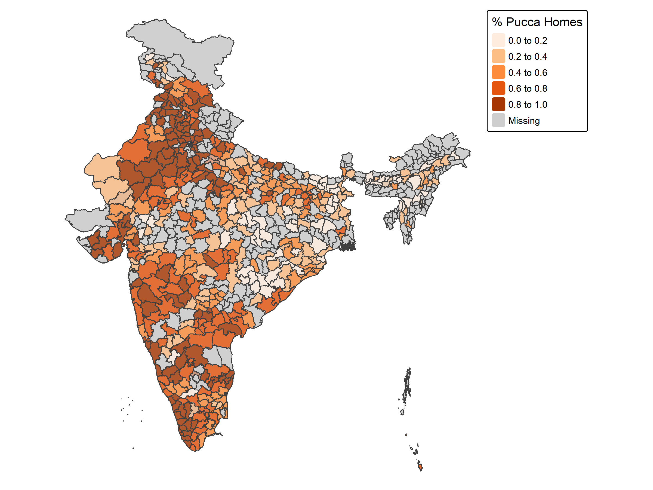
Control Variables Identify variables which could cause changes in both EMIE and %ΔConsumption

Slide 18
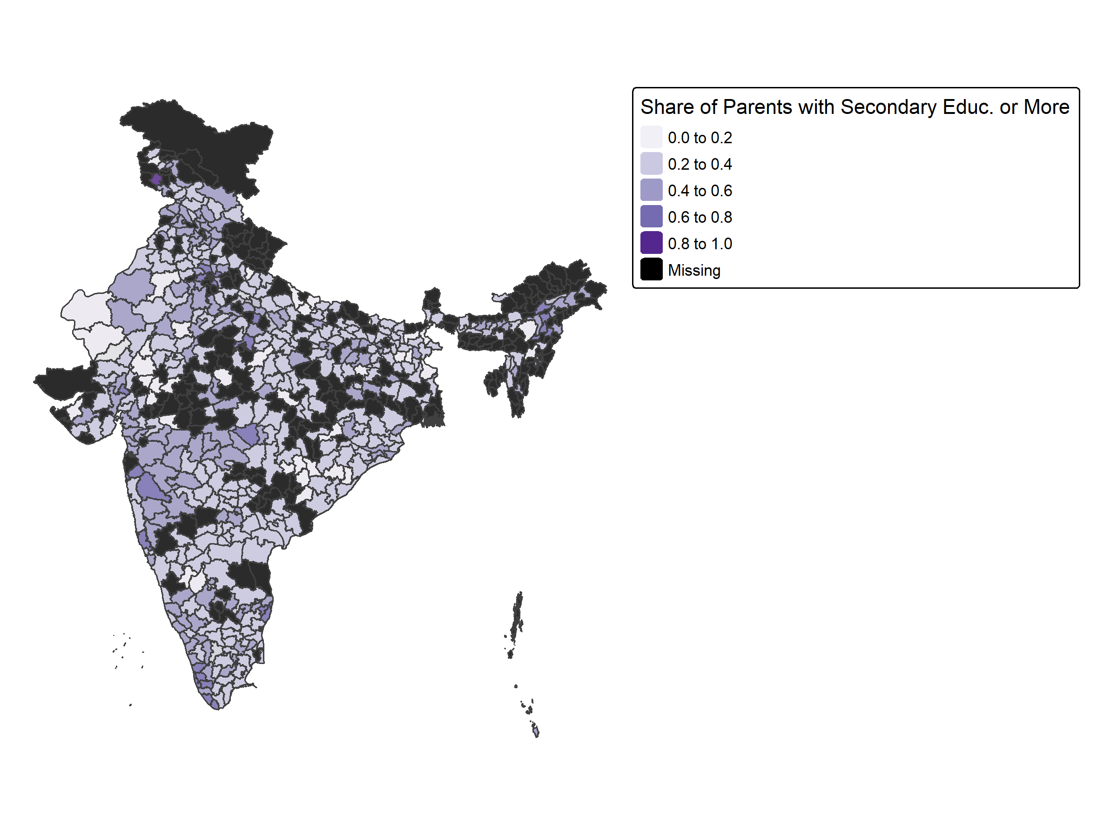
Control Variables Identify variables which could cause changes in both EMIE and %ΔConsumption

Slide 19
Econometric Tools What can we use to isolate the effect of EMIE on %ΔConsumption?
EMIE
%ΔC

Slide 20
Econometric Tools What can we use to isolate the effect of EMIE on %ΔConsumption?
EMIE
%ΔC
IV

Slide 21
Instrumental Variable
“Using several definitions of linguistic distance, I demonstrate that distance from Hindi induces people to learn English” – Shastry (2012, p. 288)
Weighted average of mother tongues’
linguistic distances from Hindi

Slide 22
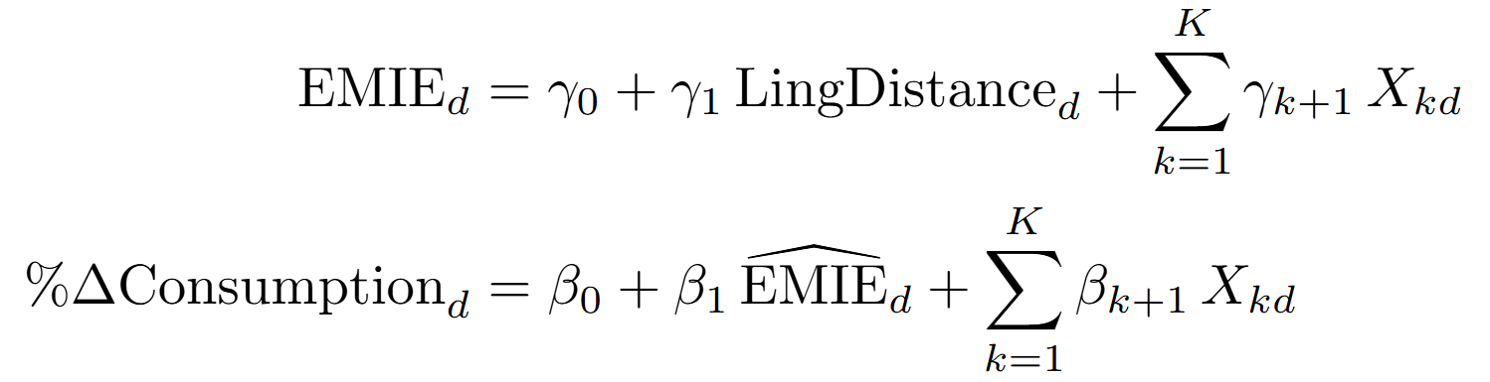
Two-Stage Least Squares Framework

Slide 23
Empirical Methodology How can we best isolate the effect of EMIE on %ΔConsumption?
Incorporate confounders as CONTROLS in a linear regression | Regress EMIE onto an INSTRUMENTAL VARIABLE

Slide 24
Explanatory Variable Construct for EMI what Chakraborty and Bakshi (2016) construct for public schools:
What about kids not enrolled in school?

Slide 25
Econometric Challenges What prevents us from isolating the effect of EMIE on %ΔConsumption?
SELECTION BIAS
EMIE
%ΔC

Slide 26
Empirical Methodology How can we best isolate the effect of EMIE on %ΔConsumption?
Incorporate confounders as CONTROLS in a linear regression | Regress EMIE onto an INSTRUMENTAL VARIABLE
Use the inverse Mills ratio (IMR) from the HECKMAN CORRECTION as another control

Slide 27
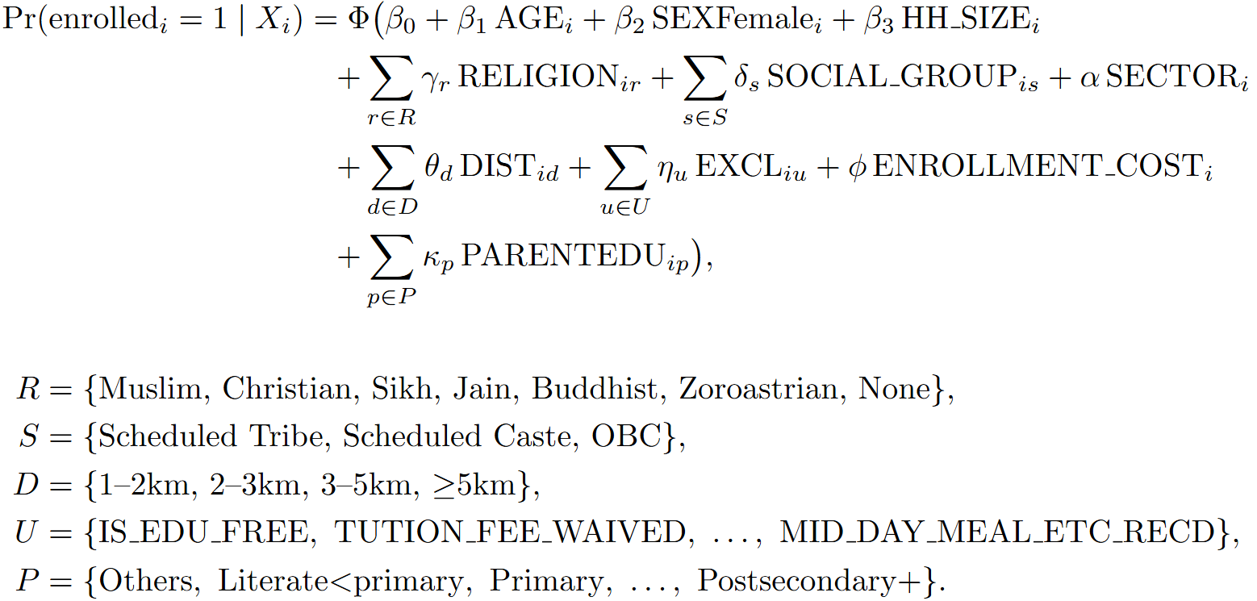
Participation Equation
Notes:
***Change variable names to be more readable

Slide 28
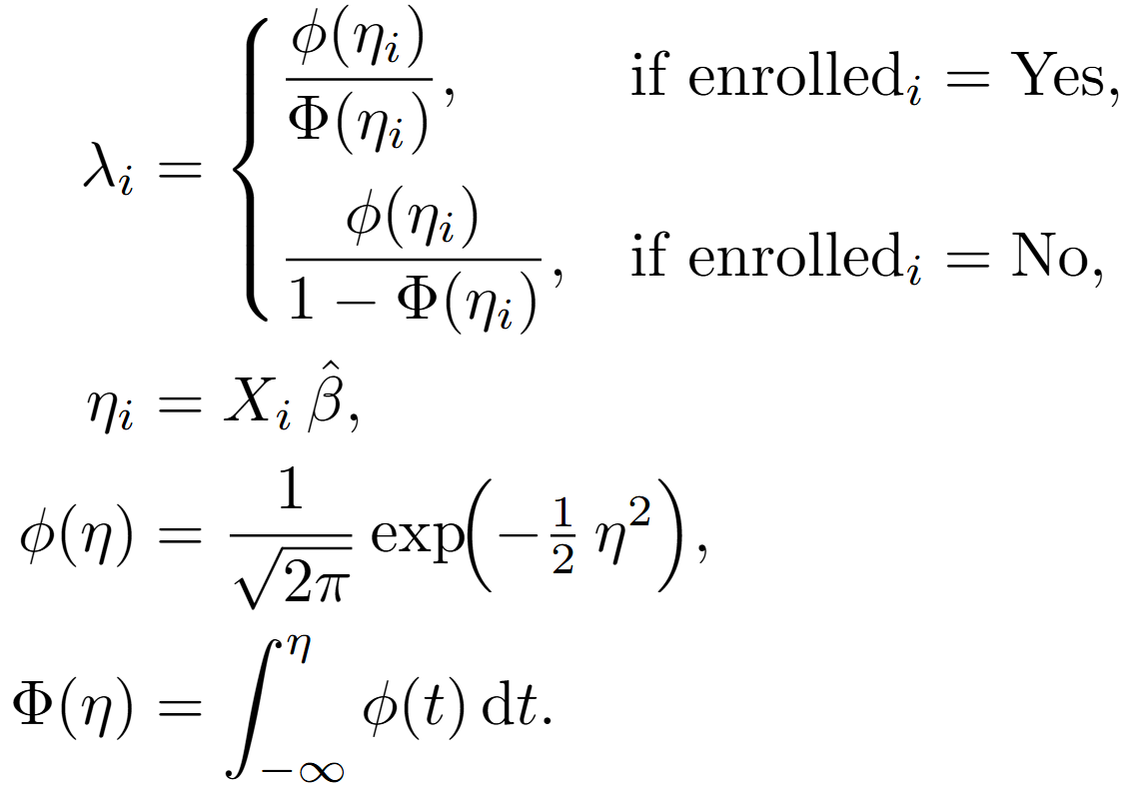
Inverse Mills Ratio

Slide 29
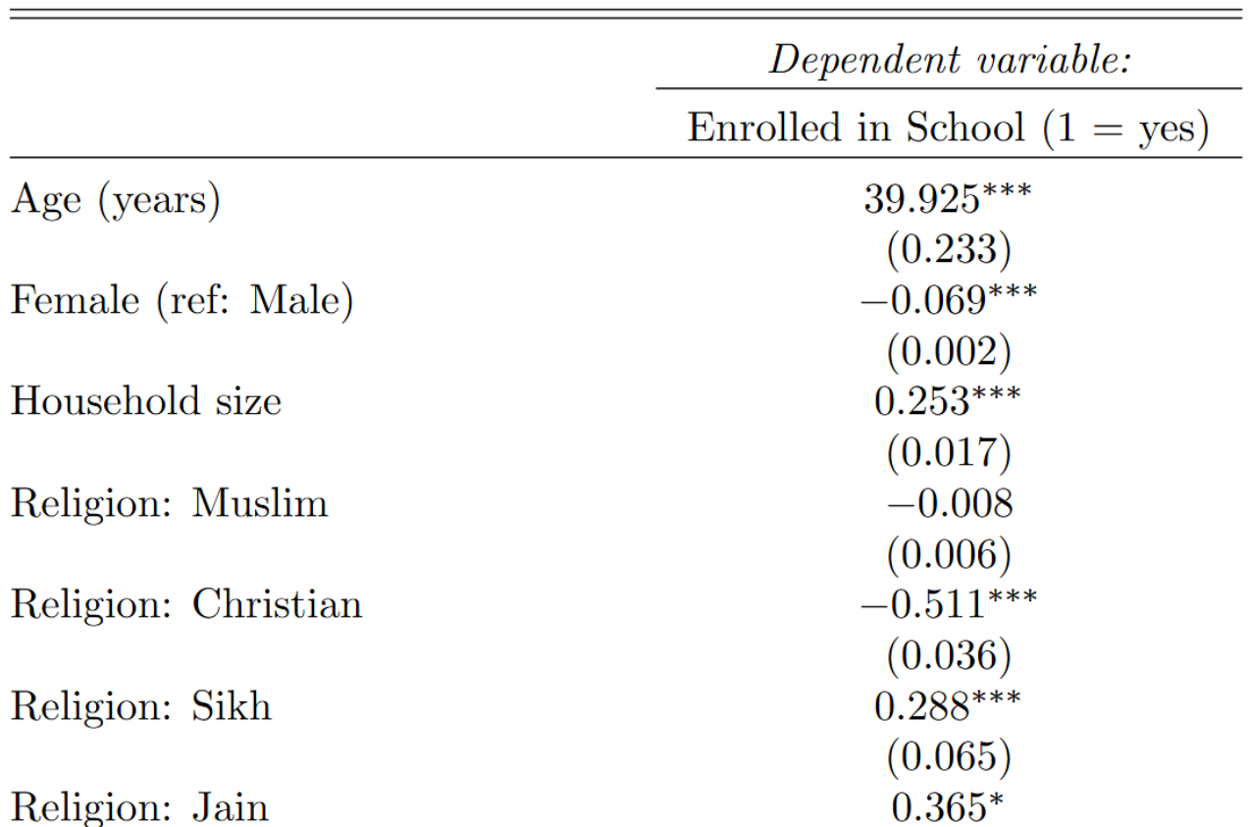
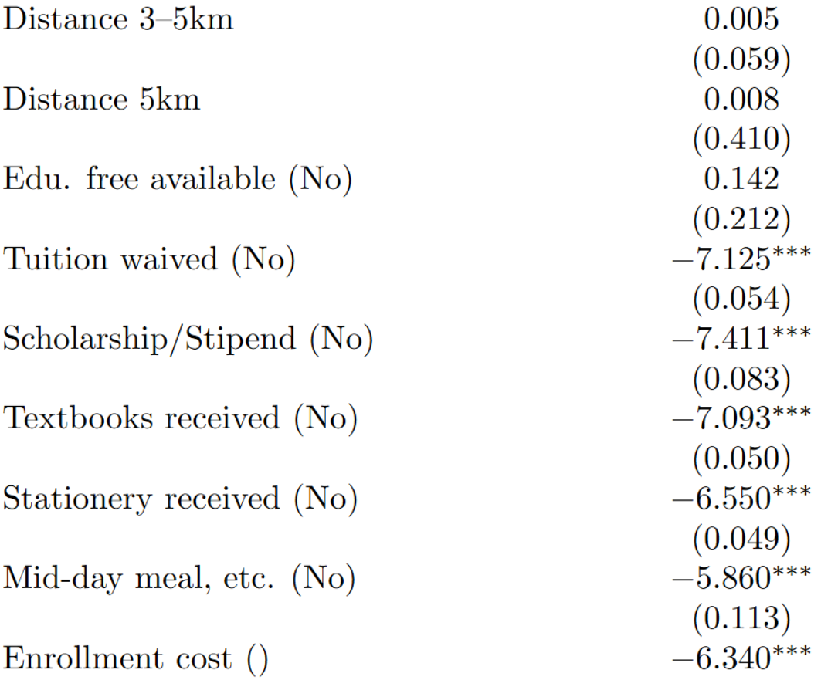
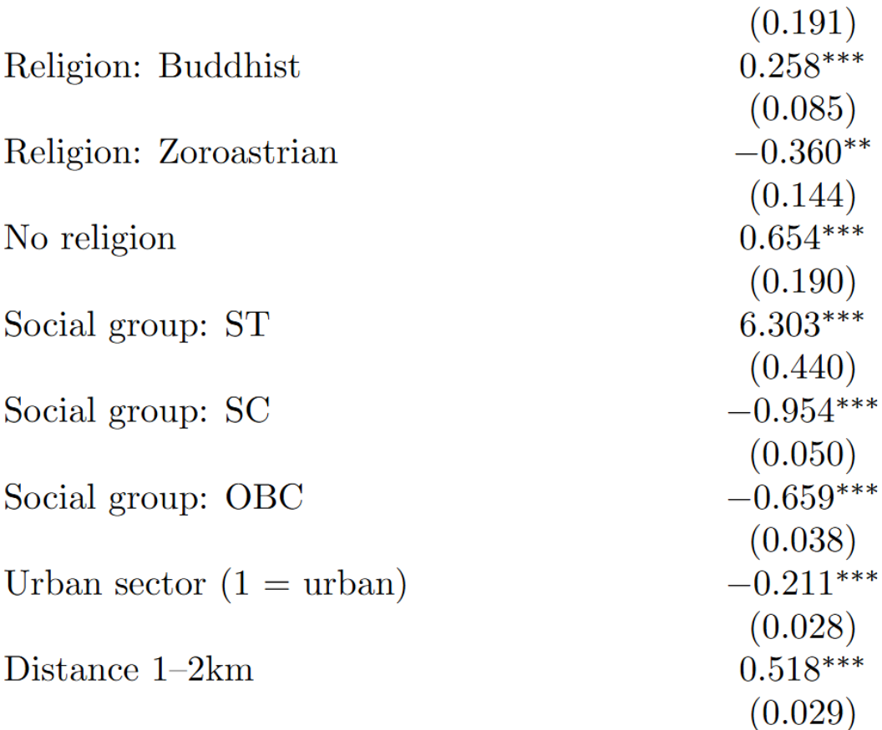
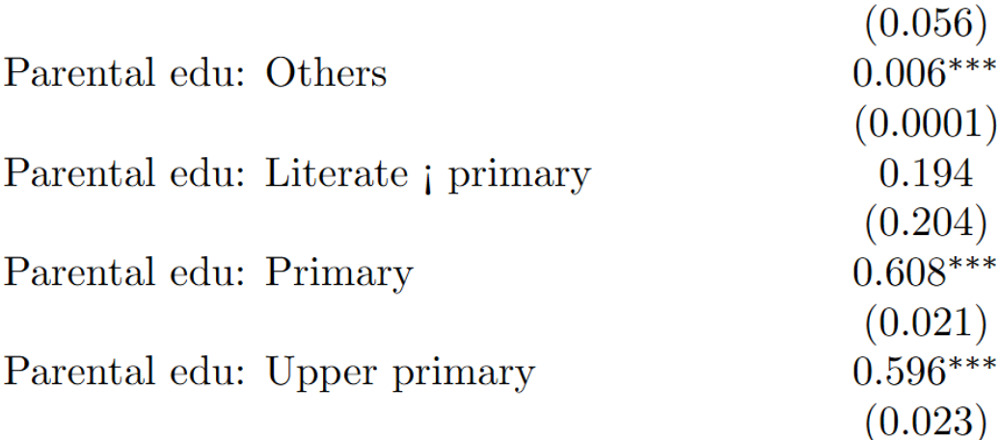
Participation Regression
Notes:
*** Fix Literate primary, Enrollment cost

Slide 30
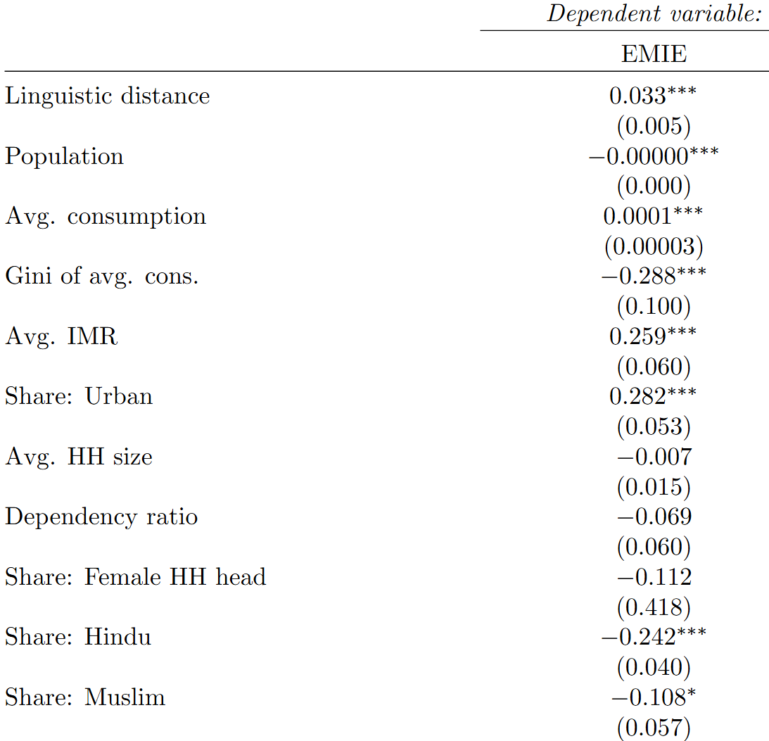
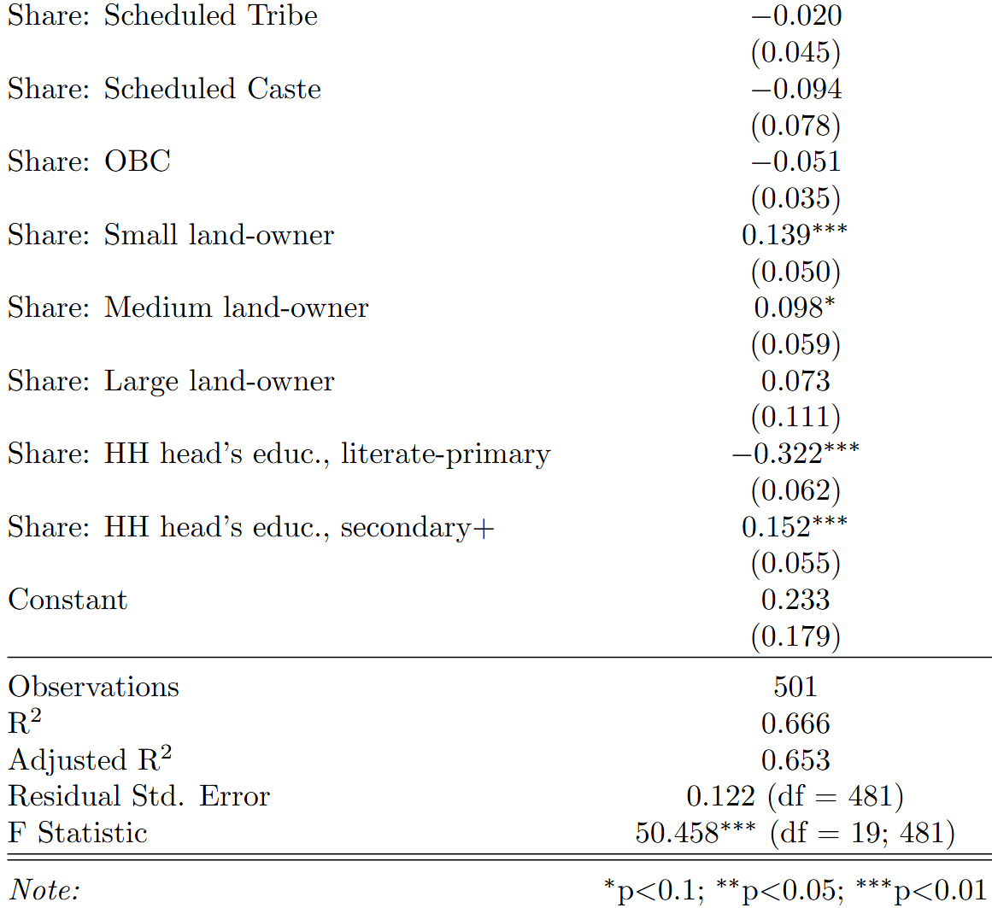
First-Stage Regression
Notes:
***Fix “Share:” labeling

Slide 33
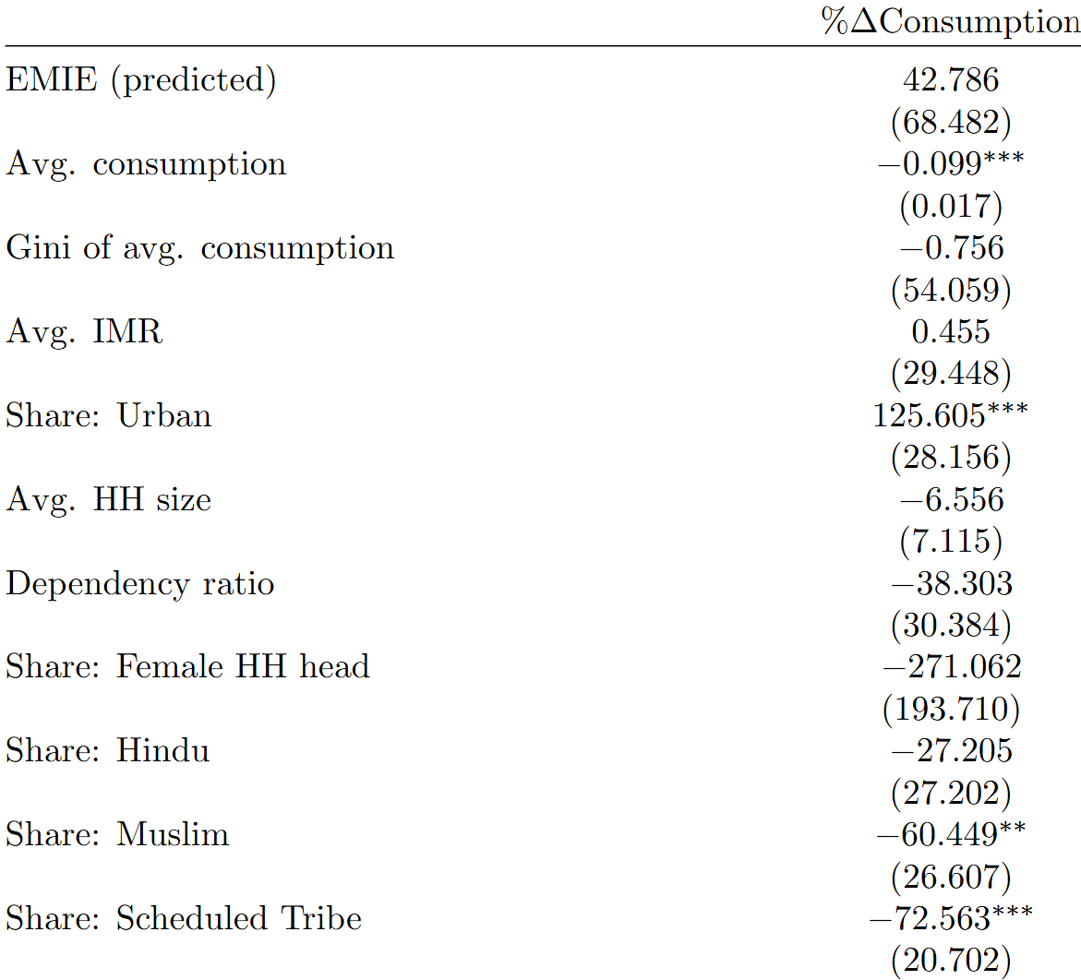
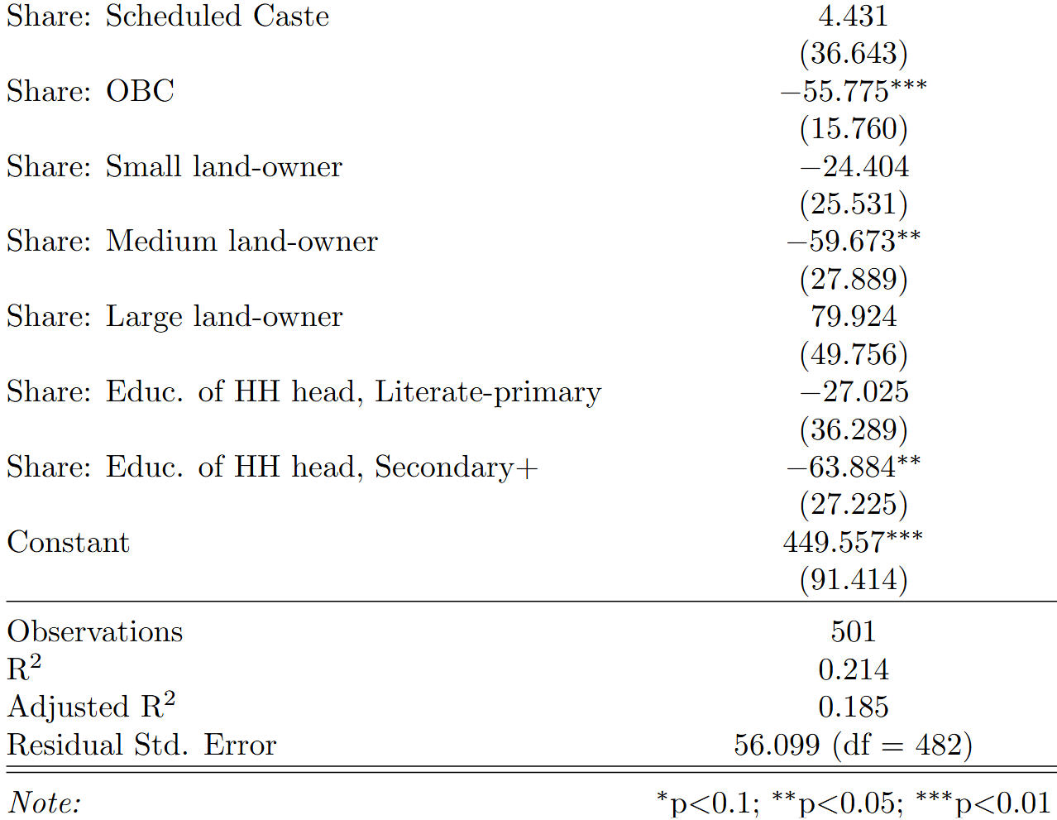
Second-Stage Regression
Notes:
***Fix to EMIE (fitted)

Slide 34
Large coefficient, but…
No significance!
Notes:
***Fix to EMIE (fitted)

Slide 36
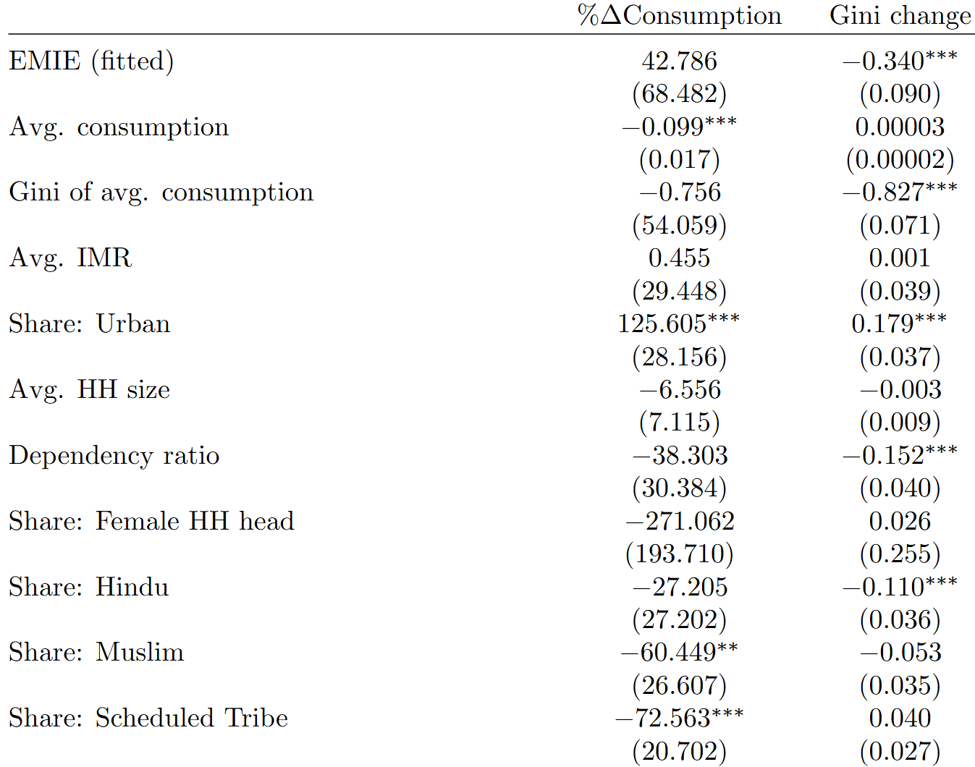
Adding another response variable reveals a…
Decrease in inequality!
Notes:
***Fix Gini change to \Delta Gini^{Cons.}

Slide 37
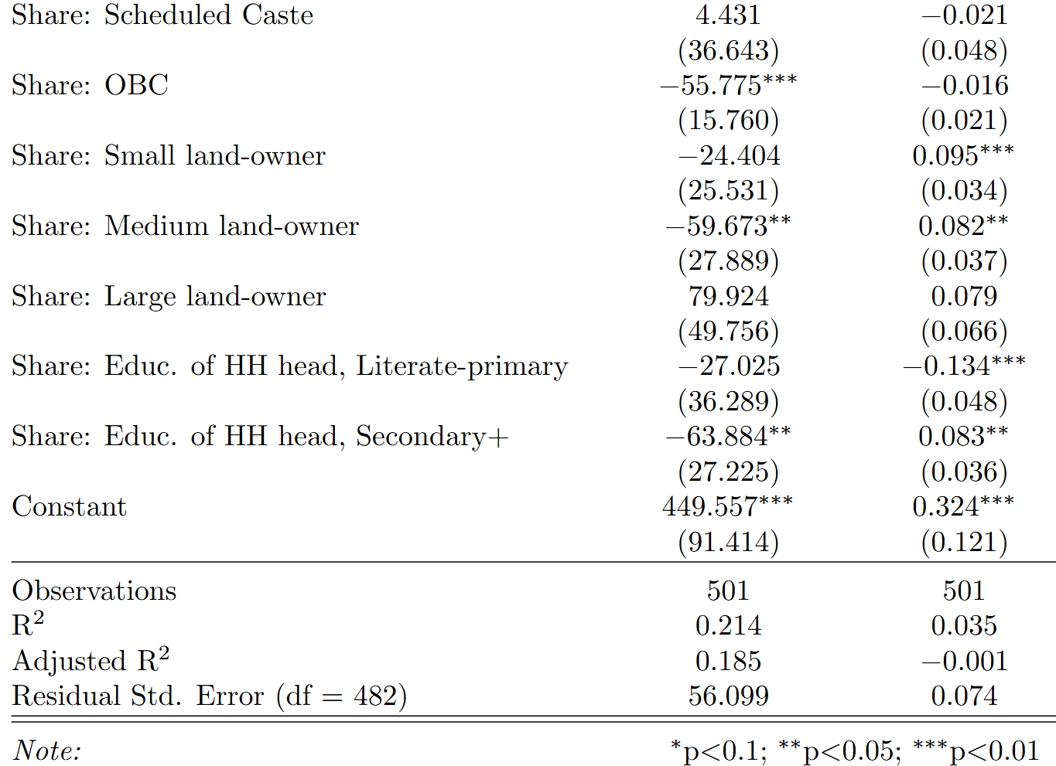
But this model does ≈ as well as the sample mean ☹

Slide 38
Econometric Challenges What prevents us from isolating the effect of EMIE on %ΔConsumption?
EMIE
%ΔC

Slide 39
Econometric Challenges What prevents us from isolating the effect of EMIE on %ΔConsumption?
EMIE
%ΔC
EMIE
%ΔC
EMIE
%ΔC
EMIE
%ΔC

Slide 40
Econometric Challenges What prevents us from isolating the effect of EMIE on %ΔConsumption?
EMIE
%ΔC
EMIE
%ΔC
EMIE
%ΔC
EMIE
%ΔC

Slide 41
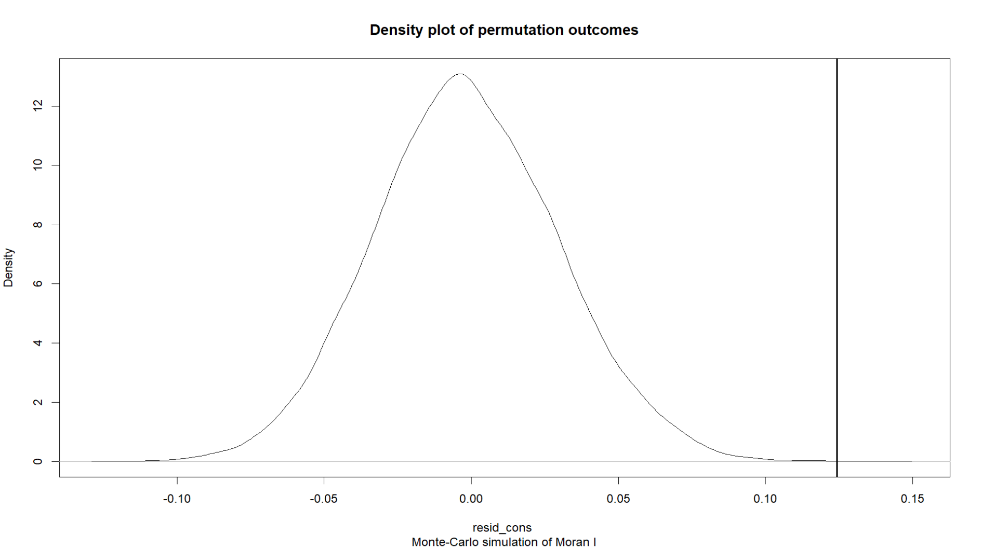
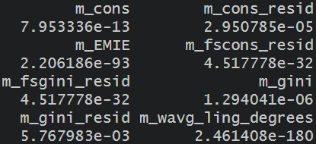
Spatial Autocorrelation p-Values
m_cons_resid via
Monte Carlo instead:
2.95×10⁻⁵ → 1.00×10⁻⁴
TLDR: Spatial autocorrelation EXTREMELY likely

Slide 42
Empirical Methodology How can we best isolate the effect of EMIE on %ΔConsumption?
Incorporate confounders as CONTROLS in a linear regression | Regress EMIE onto an INSTRUMENTAL VARIABLE
Use the inverse Mills ratio (IMR) from the HECKMAN CORRECTION as another control | Control for spatial autocorrelation using a SPATIAL DURBIN-TYPE MODEL and incorporate spatial lags as controls

Slide 43
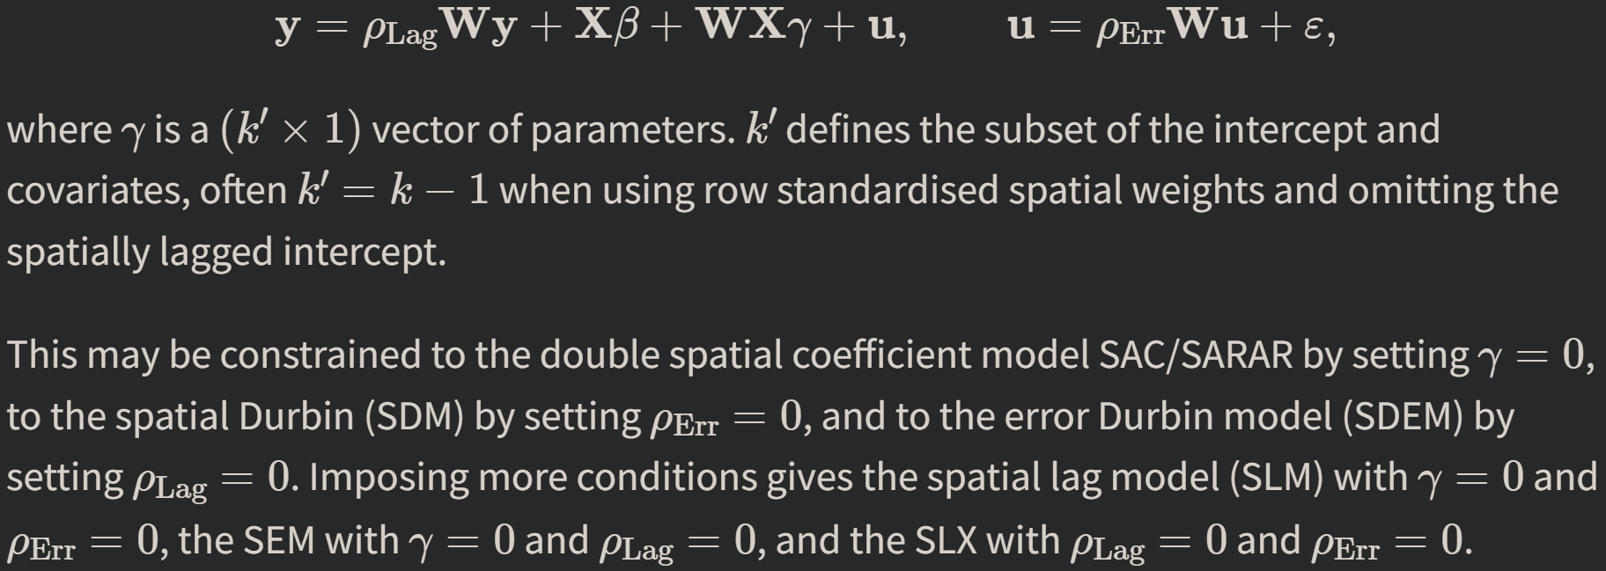
Spatial Econometrics Models and next steps…
(Pebesma & Bivand, 2025)

Slide 44
References
Abadie, A., Athey, S., Imbens, G. W., & Wooldridge, J. M. (2022). When should you adjust standard errors for clustering? The Quarterly Journal of Economics, 138(1), 1–35. https://doi.org/10.1093/qje/qjac038
Abadzi, H. (2008). Efficient learning for the poor: New insights into literacy acquisition for children. International Review of Education, 54(5–6), 581–604. https://doi.org/10.1007/s11159-008-9102-3
Abraham, V. (2019). The dynamic nature of jobless growth in india. In Globalization, labour market institutions, processes and policies in india (pp. 443–470). Palgrave Macmillan, Springer. https://doi.org/10.1007/978-981-13-7111-0_18
Agrawal, T. (2011). Returns to education in India: Some recent evidence.
Agrawal, T., & Agrawal, A. (2017). Vocational education and training in India: A labour market perspective. Journal of Vocational Education & Training, 69(2), 246–265. https://doi.org/10.1080/13636820.2017.1303785
Anselin, L. (1995). Local indicators of spatial Association—LISA. Geographical Analysis, 27(2), 93–115. https://doi.org/10.1111/j.1538-4632.1995.tb00338.x
Anselin, L. (2001). Spatial Econometrics. In B. H. Baltagi (Ed.), A Companion to Theoretical Econometrics (pp. 311–331). John Wiley & Sons, Incorporated. https://web.pdx.edu/~crkl/WISE/SEAUG/papers/anselin01_CTE14.pdf
Arora, H., Pradhan, K. C., & Sharma, R. (2024). Missing linkages and jobless growth in India: An econometric analysis. Economic Papers: A Journal of Applied Economics and Policy. https://doi.org/10.1111/1759-3441.12410
ASER Centre. (2023a). Annual Status of Education Report (Rural) 2022.
ASER Centre. (2023b). ASER 2022 national findings. In ASER. Annual status of education.
ASER Centre. (2024). Annual status of education report (rural) 2023: Beyond basics. In ASER.
Attanasio, O., Blundell, R., Conti, G., & Mason, G. (2020). Inequality in socio-emotional skills: A cross-cohort comparison. Journal of Public Economics, 191, 104171. https://doi.org/10.1016/j.jpubeco.2020.104171
Azam, M., Chin, A., & Prakash, N. (2013). The Returns to English-Language Skills in India. Economic Development and Cultural Change, 61(2), 335–367. https://doi.org/10.1086/668277
Azam, M., & Kingdon, G. G. (2015). Assessing teacher quality in India. Journal of Development Economics, 117, 74–83. https://doi.org/10.1016/j.jdeveco.2015.07.001
Baker, L. (2020, January). Britain rescues its “soft-power” branch after heavy COVID blow. https://www.reuters.com/article/us-health-coronavirus-britain-council-idUSKBN23X1NK/
Banik, S. (2018). Teaching english Literature/Language: Perspectives from a non-metro university. In Springer eBooks (pp. 167–174). https://doi.org/10.1007/978-981-13-1525-1_14
Basu, K. (2006). Teacher Truancy in India: The Role of Culture, Norms and Economic Incentives (No. 956057). https://doi.org/10.2139/ssrn.956057
Bedi, J. (2019). English language in India (1st ed.). Routledge India. https://doi.org/10.4324/9780429328329
Beer, C., & Riedl, A. (2012). Modelling spatial externalities in panel data: The Spatial Durbin model revisited. Papers in Regional Science, 91(2), 299–319. https://doi.org/10.1111/j.1435-5957.2011.00394.x
Bell, A., & Jones, K. (2015). Explaining Fixed Effects: Random Effects Modeling of Time-Series Cross-Sectional and Panel Data. Political Science Research and Methods, 3(1), 133–153. https://doi.org/10.1017/psrm.2014.7
Bennett, C., Miller, M., & Wolford, G. (2009). Neural correlates of interspecies perspective taking in the post-mortem Atlantic Salmon: An argument for multiple comparisons correction. NeuroImage, 47, S125. https://doi.org/10.1016/S1053-8119(09)71202-9
Bhandari, A., & Heshmati, A. (2006). Wage inequality and job insecurity among permanent and contract workers in india: Evidence from organized manufacturing industries. https://doi.org/10.2139/ssrn.900362
Bhandari, L., & Bordoloi, M. (2006). Income Differentials and Returns to Education. Economic and Political Weekly, 41(36), 3893–3900.
Bharti, N. K., Chancel, L., Piketty, T., & Somanchi, A. (2024). Income and Wealth Inequality in India, 1922-2023: The Rise of the Billionaire Raj. https://wid.world/www-site/uploads/2024/03/WorldInequalityLab_WP2024_09_Income-and-Wealth-Inequality-in-India-1922-2023_Final.pdf
Bhatia, A. (2020). Merging updated district-level shapefiles for India (2020) [Dataset]. india_shp_2020. https://github.com/abhatia08/india_shp_2020
Bhattacharya, S., Tiwari, K. K., Tayyab, M., Singh, D., Gautam, R. P., & Rani, S. (2018). EDUCATIONAL STATISTICS AT A GLANCE. In Government of india.
Bhattacharya, U. (2022). The teaching of english in india. Oxford Research Encyclopedia of Education. https://doi.org/10.1093/acrefore/9780190264093.013.1777
Bhattacharya, U. (2022). The teaching of english in india. Oxford Research Encyclopedia of Education. https://doi.org/10.1093/acrefore/9780190264093.013.1777
Björklund, A., & Kjellström, C. (2002). Estimating the return to investments in education: How useful is the standard Mincer equation? Economics of Education Review, 21(3), 195–210. https://doi.org/10.1016/S0272-7757(01)00003-6
Blimpo, M. P., Evans, D. K., & Lahire, N. (2015). Parental Human Capital and Effective School Management: Evidence from the Gambia [Policy Research Working Papers]. The World Bank. https://doi.org/10.1596/1813-9450-7238
Borooah, V., & Sabharwal, N. S. (2021). Chapter eleven—English as a medium of instruction in indian education: Inequality of access to educational opportunities. In Reclaiming development studies (pp. 197–226). Anthem Press Print.
British Council. (2012). The english effect.
British Council. (2020). Research summary. In The future of english: Global Perspectives.
Bühmann, D., & Trudell, B. (2008). Mother tongue matters: Local language as a key to effective learning. In UNESDOC digital library. https://unesdoc.unesco.org/ark:/48223/pf0000161121
Card, D. (1999). Chapter 30—The Causal Effect of Education on Earnings. In O. C. Ashenfelter & D. Card (Eds.), Handbook of Labor Economics (Vol. 3, pp. 1801–1863). Elsevier. https://doi.org/10.1016/S1573-4463(99)03011-4
Carliner, G. (1981). Wage differences by language group and the market for language skills in Canada. Journal of Human Resources, 16(3), 384. https://doi.org/10.2307/145627
Central Square Foundation. (2020). State of the sector report on private schools in india.
Central Statistics Office. (2008). India—Fifth Economic Census 2005 [Dataset]. Ministry of Statistics and Programme Implementation. https://microdata.gov.in/NADA/index.php/catalog/46
Central Statistics Office. (2010). India—Annual Survey of Industries 2007-08 (No. IND-CSO-ASI-2007-08-v1) [Dataset]. Ministry of Statistics and Programme Implementation. https://microdata.gov.in/NADA/index.php/catalog/20
Central Statistics Office. (2016). India—Sixth Economic Census 2013-14 [Dataset]. Ministry of Statistics and Programme Implementation. https://microdata.gov.in/NADA/index.php/catalog/47
Central Statistics Office. (2019). India—Annual Survey of Industries 2017-18 (No. IND-CSO-ASI-2017-18) [Dataset]. Ministry of Statistics and Programme Implementation. https://microdata.gov.in/NADA/index.php/catalog/149
Centre for Budget and Policy Studies. (2020). Quality and Systemic Functioning in Secondary Education in India: A study in Andhra Pradesh and Rajasthan.
Chakraborty, T., & Bakshi, S. K. (2016). English language premium: Evidence from a policy experiment in India. Economics of Education Review, 50, 1–16. https://doi.org/10.1016/j.econedurev.2015.10.004
Chamarbagwala, R., & Sharma, G. (2011). Industrial de-licensing, trade liberalization, and skill upgrading in India. Journal of Development Economics, 96(2), 314–336. https://doi.org/10.1016/j.jdeveco.2010.10.001
Chaudhury, N., Hammer, J., Kremer, M., Muralidharan, K., & Rogers, F. H. (2006). Missing in Action: Teacher and Health Worker Absence in Developing Countries. Journal of Economic Perspectives, 20(1), 91–116. https://doi.org/10.1257/089533006776526058
Chaurasia, A. R. (2023). Human development in districts of india, 2019–2021. Indian Journal of Human Development, 17(2), 219–252. https://doi.org/10.1177/09737030231178362
Chen, K., Chen, T., & Lin, H. (2020). A U-shaped curve phenomenon of international language on output growth: Empirical evidence. Applied Economics Letters, 27(8), 605–614. https://doi.org/10.1080/13504851.2020.1737313
Chetty, R., Friedman, J. N., & Rockoff, J. E. (2014). Measuring the Impacts of Teachers II: Teacher Value-Added and Student Outcomes in Adulthood. American Economic Review, 104(9), 2633–2679. https://doi.org/10.1257/aer.104.9.2633
Chiswick, B. R., & Miller, P. W. (1995). The endogeneity between language and earnings: International analyses. Journal of Labor Economics, 13(2), 246–288. https://doi.org/10.1086/298374
Chiswick, B. R., & Miller, P. W. (2005). Linguistic Distance: A Quantitative Measure of the Distance Between English and Other Languages. Journal of Multilingual and Multicultural Development. https://doi.org/10.1080/14790710508668395
Chun, Y. (2008). Modeling network autocorrelation within migration flows by eigenvector spatial filtering. Journal of Geographical Systems, 10(4), 317–344. https://doi.org/10.1007/s10109-008-0068-2

Slide 45
References
Clingingsmith, D. (2008). Bilingualism, Language Shift, and Industrialization in Mid-20th Century India.
Clingingsmith, D. (2014). Industrialization and Bilingualism in India. Journal of Human Resources, 49(1), 73–109. https://doi.org/10.3368/jhr.49.1.73
Costa, D. (2019). Indian english – a national model. Journal of English as an International Language, 14(2), 16–28.
Cunha, F., & Heckman, J. J. (2008). Formulating, Identifying and Estimating the Technology of Cognitive and Noncognitive Skill Formation. The Journal of Human Resources, 43(4), 738–782.
Davydov, D., & Weber, S. (2016). A simple characterization of the family of diversity indices. Economics Letters, 147, 121–123. https://doi.org/10.1016/j.econlet.2016.08.036
Day, J., & Lewis, B. (2013). Beyond univariate measurement of spatial autocorrelation: Disaggregated spillover effects for Indonesia. Annals of GIS, 19(3), 169–185. https://doi.org/10.1080/19475683.2013.806353
Department of School Education and Literacy. (2021). Implementation plan for national education policy 2020.
Department of School Education and Literacy. (2022a). 2 Years of National Education Policy (NEP, 2020) Implementation.
Department of School Education and Literacy. (2022b). UDISE+ micro-data 2021-22. Unified District Information System for Education Plus (UDISE+).
Desai, S., & Vanneman, R. (2018). India human development survey-II. Inter-university Consortium for Political and Social Research. https://doi.org/10.3886/ICPSR36151.v6
Dickson, M., & Harmon, C. (2011). Economic returns to education: What we know, what we don’t know, and where we are Going—Some brief pointers. Economics of Education Review, 30(6), 1118–1122. https://doi.org/10.1016/j.econedurev.2011.08.003
Doreian, P. (1981). Estimating linear models with spatially distributed data. Sociological Methodology, 12, 359. https://doi.org/10.2307/270747
Economic Divison. (2015). India on the move and churning: New evidence. In Economic Survey 2016-17 (pp. 264–284). https://www.indiabudget.gov.in/budget2017-2018/es2016-17/echap12.pdf
E.F. Education First. (2023a). EF EPI 2023 ranking of countries and regions. In EF english proficiency index.
E.F. Education First. (2023b). India | EF English Proficiency Index. EF English Proficiency Index.
Endow, T. (2019). Low cost private schools: How low cost really are these? Indian Journal of Human Development, 13(1), 102–108. https://doi.org/10.1177/0973703019838704
E.P.W. Engage. (2021). English Language education in India: How aspirations for social mobility shape pedagogy. Economic and Political Weekly.
Figueiredo, H. (2019). Over-skilling, under-Skilling, and higher education. In Encyclopedia of international higher education systems and institutions (pp. 1–8). Springer. https://doi.org/10.1007/978-94-017-9553-1_115-1
Fuchs, R. (2016). The historical and social context of Indian English. In Prosody, phonology and phonetics (pp. 9–34). Springer. https://doi.org/10.1007/978-3-662-47818-9_2
Gamallo, P., Pichel, J. R., & Alegria, I. (2017). From language identification to language distance. Physica A: Statistical Mechanics and Its Applications, 484, 152–162. https://doi.org/10.1016/j.physa.2017.05.011
Ginsburgh, V., & Weber, S. (2020). The economics of language. Journal of Economic Literature, 58(2), 348–404. https://doi.org/10.1257/jel.20191316
Gooptu, S., & Mukherjee, V. (2023). Does private tuition crowd out private schooling? Evidence from India. International Journal of Educational Development, 103, 102885. https://doi.org/10.1016/j.ijedudev.2023.102885
Graddol, D. (2010). English next india: The future of english in india [Book. British Council. https://www.britishcouncil.in/sites/default/files/english_next_india_-_david_graddol.pdf
Guo, Q., & Sun, W. (2014). Economic returns to English proficiency for college graduates in mainland China. China Economic Review, 30, 290–300. https://doi.org/10.1016/j.chieco.2014.07.014
Hampf, F., Wiederhold, S., & Woessmann, L. (2017). Skills, earnings, and employment: Exploring causality in the estimation of returns to skills. Large-Scale Assessments in Education, 5(1). https://doi.org/10.1186/s40536-017-0045-7
Hanushek, E. A. (1997). Assessing the Effects of School Resources on Student Performance: An Update. Educational Evaluation and Policy Analysis, 19(2), 141–164. https://doi.org/10.3102/01623737019002141
Heckman, J. J., Lochner, L., & Todd, P. (2006). Chapter 7 earnings functions, rates of return and treatment effects: The mincer equation and beyond. Handbook of the Economics of Education, 307–458. https://doi.org/10.1016/s1574-0692(06)01007-5
Henderson, D. J., Polachek, S. W., & Wang, L. (2011). Heterogeneity in schooling rates of return. Economics of Education Review, 30(6), 1202–1214. https://doi.org/10.1016/j.econedurev.2011.05.002
Hill, R. C., & Adkins, L. C. (2001). Chapter Twelve: Collinearity. In B. H. Baltagi (Ed.), A Companion to Theoretical Econometrics (pp. 256–278). John Wiley & Sons, Incorporated.
India State Stories. (2024). District Evolution [Dataset]. https://www.indiastatestory.in/datadownloads
International Institute for Population Sciences. (n.d.). India—National Family Health Survey 2005-2006 (No. IND_2005_DHS_v01_M) [Dataset]. The World Bank. Retrieved April 22, 2025, from https://microdata.worldbank.org/index.php/catalog/1406
International Labour Organization. (2024). India Employment Report 2024: Youth employment, education and skills. https://www.ilo.org/publications/india-employment-report-2024-youth-employment-education-and-skills
Iyer, I. N., & Ramachandran, S. (2019). English as a lingua franca in a multilingual India. Journal of Language and Education, 5(1), 103–109. https://doi.org/10.17323/2411-7390-2019-5-1-103-109
Jaacks, L., Shandilya, A., Malik, A., & Veluguri, D. V. (2020). India District Changes Tracker [Dataset]. Jaacks Research Group. https://github.com/Jaacks-Research-Group/india-district-changes-tracker.git
Jain, T. (2017). Common tongue: The impact of language on educational outcomes. The Journal of Economic History, 77(2), 473–510. https://doi.org/10.1017/s0022050717000481
Jain, T., Maitra, P., & Mani, S. (2019). Barriers to skill acquisition: Evidence from English training in India. World Development, 114, 314–325. https://doi.org/10.1016/j.worlddev.2018.10.011
Jain, V., Ahmed, I., & Vanikar, G. K. (2018). Program to Improve Private Early Education (PIPE): A case study of a systems approach for scaling quality early education solutions. Annals of the New York Academy of Sciences, 1419(1), 38–56. https://doi.org/10.1111/nyas.13695
Jha, J. (2021). Public policy dilemma of choosing the medium of instruction for school education: A case for questioning fallacies and connecting objectives. Journal of Asian Development Research, 2633190X2110346. https://doi.org/10.1177/2633190x211034697
Kara, O. (2008). Comparing two approaches to the rate of return to investment in education. Education Economics, 18(2), 153–165. https://doi.org/10.1080/09645290802416486
Kelejian, H. H., & Prucha, I. R. (2007). HAC estimation in a spatial framework. Journal of Econometrics, 140(1), 131–154. https://doi.org/10.1016/j.jeconom.2006.09.005
Kelejian, H., & Piras, G. (2017a). Appendix B - Spatial Models in R. In H. Kelejian & G. Piras (Eds.), Spatial Econometrics (pp. 363–387). Academic Press. https://doi.org/10.1016/B978-0-12-813387-3.00026-3
Kelejian, H., & Piras, G. (2017b). Chapter 2—Specification and Estimation. In H. Kelejian & G. Piras (Eds.), Spatial Econometrics (pp. 11–59). Academic Press. https://doi.org/10.1016/B978-0-12-813387-3.00002-0
Kingdon, G. (2008). Chapter 6 school-sector effects on student achievement in india. In School choice international: Exploring public-private partnerships (pp. 111–140). https://doi.org/10.7551/mitpress/7767.003.0009
Koley, M., & Bera, A. K. (2024). To use, or not to use the spatial Durbin model? – That is the question. Spatial Economic Analysis, 19(1), 30–56. https://doi.org/10.1080/17421772.2023.2256810
Kremer, M., Chaudhury, N., Rogers, F. H., Muralidharan, K., & Hammer, J. (2005). Teacher Absence in India: A Snapshot. Journal of the European Economic Association, 3(2–3), 658–667. https://doi.org/10.1162/jeea.2005.3.2-3.658
Kumar, H., & Somanathan, R. (2016). Creating Long Panels Using Census Data: 1961-2001. https://web.archive.org/web/20190429034949/http://www.cdedse.org/pdf/work248.pdf#expand
Kumar, H., & Somanathan, R. (2017). Creating Long Panels Using Census Data (1961-2001). Economic and Political Weekly, 52(29), 105–109. https://www.jstor.org/stable/26695694
Lahoti, R., & Mukhopadhyay, R. (2019). School choice in rural India. Economic and Political Weekly. https://publications.azimpremjiuniversity.edu.in/2150/1/School Choice in Rural India_Perceptions and Realities in Four States.pdf
Laitin, D. D., & Ramachandran, R. (2022). Linguistic diversity, official language choice and human capital. Journal of Development Economics, 156, 102811. https://doi.org/10.1016/j.jdeveco.2021.102811
Lall, S. V. (2007). Infrastructure and regional growth, growth dynamics and policy relevance for India. ANNALS OF REGIONAL SCIENCE, 41(3), 581–599. https://doi.org/10.1007/s00168-006-0112-4
Layard, R., & Psacharopoulos, G. (1974). The screening hypothesis and the returns to education. Journal of Political Economy, 82(5), 985–998. https://doi.org/10.1086/260251

Slide 46
References
Lesage, J. P., & Fischer, M. M. (2008). Spatial Growth Regressions: Model Specification, Estimation and Interpretation. Spatial Economic Analysis, 3(3), 275–304. https://doi.org/10.1080/17421770802353758
Li, A. (2019). Chapter 14 Spatial Autocorrelation. In R Spatial Workshop Notes. https://spatialanalysis.github.io/workshop-notes/spatial-autocorrelation.html
Li, Y., Teng, W., Tsai, L., & Lin, T. M. (2022). Does English proficiency support the economic development of non-English-speaking countries? The case of Asia. International Journal of Educational Development, 92, 102623. https://doi.org/10.1016/j.ijedudev.2022.102623
Liu, A. H., & Pizzi, E. (2016). The language of economic Growth:A new measure of linguistic heterogeneity. British Journal of Political Science, 48(4), 953–980. https://doi.org/10.1017/s0007123416000260
Liu, X., Guo, W., Feng, Q., & Wang, P. (2022). Spatial correlation, driving factors and dynamic spatial spillover of electricity consumption in China: A perspective on industry heterogeneity. Energy, 257, 124756. https://doi.org/10.1016/j.energy.2022.124756
Madheswaran, S., & Singhari, S. (2016). Social exclusion and caste discrimination in public and private sectors in India: A decomposition analysis. The Indian Journal of Labour Economics, 59(2), 175–201. https://doi.org/10.1007/s41027-017-0053-8
Mankiw, N. G., & Swagel, P. (2006). The politics and economics of offshore outsourcing. Journal of Monetary Economics, 53(5), 1027–1056. https://doi.org/10.1016/j.jmoneco.2006.05.009
Marphatia, A. A., Reid, A. M., & Yajnik, C. S. (2019). Developmental origins of secondary school dropout in rural India and its differential consequences by sex: A biosocial life-course analysis. International Journal of Educational Development, 66, 8–23. https://doi.org/10.1016/j.ijedudev.2018.12.001
Martin, L. A., Nataraj, S., & Harrison, A. E. (2017). In with the Big, Out with the Small: Removing Small-Scale Reservations in India. American Economic Review, 107(2), 354–386. https://doi.org/10.1257/aer.20141335
Masani, B. Z. (2012). English or Hinglish—Which will India choose? BBC News.
Mathew, R., & Srivastava, S. (2011). English Next India: The future of English in India. ELT Journal, 65(3), 356–359. https://doi.org/10.1093/elt/ccr034
Mathur, S. (2013). Kancha Ilaiah: Even if 10% dalit children got English education, India would change. The Times of India.
McCormick, C. (2013). Countries with better english have better economies. Harvard Business Review.
McCulloch, N. A., & Suharnoko Sjahrir, B. (2008). Endowments, Location or Luck? Evaluating the Determinants of Sub-National Growth in Decentralized Indonesia (No. 1297808).
Meghir, C., & Rivkin, S. G. (2011). Econometric methods for research in education. In Handbook of the economics of education (pp. 1–87). https://doi.org/10.1016/b978-0-444-53429-3.00001-6
Mehta, A. C. (2022). About 38 lakh children dropped out from Classes 1-8 between 2020-21 and 2021-22. News.
Melitz, J. (2016). English as a Global Language. In V. Ginsburgh & S. Weber (Eds.), The Palgrave Handbook of Economics and Language (pp. 583–615). Palgrave Macmillan UK. https://doi.org/10.1007/978-1-137-32505-1_21
Meyers, J. (2020). India Official Boundaries 2019 [Dataset]. India_Official_Boundaries_2019. https://github.com/justinelliotmeyers/India_Official_Boundaries_2019 (Original work published 2020)
Mincer, J. (1974). The Human Capital Earnings Function. In Schooling, Experience, and Earnings (pp. 83–96). National Bureau of Economic Research, Inc.
Ministry Human Resource Development. (2020). National education policy.
Mohanty, A. K. (2019). Language policy in education in India. In Routledge eBooks (pp. 329–340). https://doi.org/10.4324/9781315666235-23
Mohanty, A. K. (2022). Multilingualism as a resource: Implications for education. In Towards an integrative psychological science (pp. 163–189). Springer. https://doi.org/10.1007/978-981-16-9565-0_9
Mohanty, S. K., Dehury, B., Mishra, U. S., Dash, A., & Singh, R. R. (2019). Spatial pattern of development in districts of India. In The demographic and development divide in india (pp. 509–551). Springer. https://doi.org/10.1007/978-981-13-5820-3_10
Motiram, S., & Osberg, L. (2012). Demand or supply for schooling in rural India? Electronic International Journal of Time Use Research, 9(1).
Mukherjee, A. (2013). The service sector in india. Social science research network (No. 352; Asian Development Bank Economics Working Paper Series). https://doi.org/10.2139/ssrn.2282311
Munshi, K., & Rosenzweig, M. R. (2006). Traditional institutions meet the modern world: Caste, gender, and schooling choice in a globalizing economy. The American Economic Review, 96(4), 1225–1252. https://doi.org/10.1257/aer.96.4.1225
Muralidharan, K. (2019). The state and the market in education provision: Evidence and the way ahead.
Muralidharan, K., Das, J., Holla, A., & Mohpal, A. (2017). The fiscal cost of weak governance: Evidence from teacher absence in India. Journal of Public Economics, 145, 116–135. https://doi.org/10.1016/j.jpubeco.2016.11.005
Muralidharan, K., & Kremer, M. (2008). Chapter 5 public-private schools in rural india. In School choice international: Exploring public-private partnerships (pp. 91–110). MIT Press Books. https://doi.org/10.7551/mitpress/7767.003.0008
Muralidharan, K., & Sundararaman, V. (2013). Contract Teachers: Experimental Evidence from India (No. 19440). National Bureau of Economic Research. https://doi.org/10.3386/w19440
Muralidharan, K., & Sundararaman, V. (2015). The aggregate effect of school choice: Evidence from a two-stage experiment in india *. The Quarterly Journal of Economics, 130(3), 1011–1066. https://doi.org/10.1093/qje/qjv013
Murgante, B., & Borruso, G. (2012). Analyzing Migration Phenomena with Spatial Autocorrelation Techniques. In B. Murgante, O. Gervasi, S. Misra, N. Nedjah, A. M. A. C. Rocha, D. Taniar, & B. O. Apduhan (Eds.), Computational Science and Its Applications – ICCSA 2012 (pp. 670–685). Springer. https://doi.org/10.1007/978-3-642-31075-1_50
Muthyanolla, S. K. (2023, March). Review: What has been the Implementation Progress of National Education Policy, 2020? https://factly.in/review-what-has-been-the-implementation-progress-of-national-education-policy-2020/
Nair, P. S. K. (2015). Does medium of instruction affect learning Outcomes?—Evidence using young lives longitudinal data of andhra pradesh, india. In ESP working paper series.
Nakagawa, M., & Sugasawa, S. (2021). Linguistic distance and economic development: A cross-country analysis. Review of Development Economics, 26(2), 793–834. https://doi.org/10.1111/rode.12850
National Council of Educational Research and Training. (2023). National Achievement Survey (NAS).
National Knowledge Commission. (2009). Report to the nation. National Knowledge Commission.
National Sample Survey Office. (2010). India—Employment, Unemployment and Migration Survey, July 2007—June 2008, NSS 64th Round (No. IND-NSSO-EUMS-2007-v1) [Dataset]. https://microdata.gov.in/NADA/index.php/catalog/117/
National Sample Survey Office. (2011). India—Participation and Expenditure in Education, 2007-08, 64th Round (No. Schedule 25.2) [Dataset]. National Data Archive. https://microdata.gov.in/NADA/index.php/catalog/118/
National Sample Survey Office. (2018). India—Employment and Unemployment, July 2009—June 2010, 66th Round. Ministry of Statistics and Programme Implementation.
National Sample Survey Office. (2022). Household Social Consumption: Education, NSS 75th Round Schedule-25.2 :July 2017-June 2018 [Dataset]. Ministry of Statistics and Programme Implementation. https://microdata.gov.in/NADA/index.php/catalog/151/
National Sample Survey Office. (2023). Time Use Survey (TUS), January 2019-December 2019. Ministry of Statistics and Programme Implementation.
National Statistical Office. (2019a). INDIA - Periodic Labour Force Survey (PLFS), July 2017-June 2018 (No. DDI-IND-CSO-PLFS-2017-18) [Dataset]. National Data Archive. https://microdata.gov.in/NADA/index.php/catalog/204
National Statistical Office. (2019b). NSS report No.585: Household social consumption on education in india. Ministry of Statistics and Programme Implementation. https://mospi.gov.in/sites/default/files/publication_reports/Report_585_75th_round_Education_final_1507_0.pdf
National Statistical Office. (2019c). Summary analysis of NSS report No.585: Household social consumption on education in india. In NSS 75th round (july 2017-June 2018). Ministry of statistics and programme implementation. https://mospi.gov.in/sites/default/files/announcements/Summary Analysis_Report_585_Education.pdf
National Statistical Office. (2021a). Migration in india (JULY 2020—JUNE 2021): Periodic labour force survey (PLFS. Ministry of Statistics and Programme Implementation.
National Statistical Office. (2021b). Migration in India: Unit Level Data of Periodic Labour Force Survey (PLFS) July 2020-June 2021. Ministry of Statistics and Programme Implementation.
Office of the Registrar General and Census Commissioner of India. (2001). Census of India 2001 [Dataset]. Ministry of Home Affairs. https://censusindia.gov.in/census.website/data/census-tables
Olejnik, S., Mills, J., & Keselman, H. (2000). Using Wherry’s Adjusted R² and Mallow’s Cp for Model Selection from All Possible Regressions. The Journal of Experimental Education, 68(4), 365–380.
Ord, K. (1975). Estimation methods for models of spatial interaction. Journal of the American Statistical Association, 70(349), 120. https://doi.org/10.2307/2285387

Slide 47
References
Parida, J. K., Pattayat, S. S., & Verick, S. (2023). Why is the size of discouraged labour force increasing in India? Economic Change and Restructuring, 56(5), 3601–3630. https://doi.org/10.1007/s10644-023-09538-0
Park, S. (2011). Returning to school for higher returns. Economics of Education Review, 30(6), 1215–1228. https://doi.org/10.1016/j.econedurev.2011.07.006
Pebesma, E., & Bivand, R. (2025). Spatial Data Science With Applications in R (1st ed.). CRC Press. https://r-spatial.org/book/
Psacharopoulos, G., & Teixeira, P. (2019). Rates of return to Education: Conceptual and methodological issues. In Encyclopedia of international higher education systems and institutions (pp. 1–8). Springer. https://doi.org/10.1007/978-94-017-9553-1_109-1
Qamar, F. (2022, June). National education policy 2020: Why states are wary.
Rajan, S. I., & Bhagat, R. B. (2021). Internal migration and the COVID-19 pandemic in India. In IMISCOE research series (pp. 227–248). https://doi.org/10.1007/978-3-030-81210-2_12
Ramachandran, R. (2017). Language use in education and human capital formation: Evidence from the Ethiopian educational reform. World Development, 98, 195–213. https://doi.org/10.1016/j.worlddev.2017.04.029
Ramanathan, H. (2016). English education policy in India. In Language policy (pp. 113–126). https://doi.org/10.1007/978-3-319-22464-0_5
Refeque, E. M., & Azad, P. (2022). How do linguistic and technical skills affect earnings in India? Indian Economic Review, 57(1), 23–57. https://doi.org/10.1007/s41775-022-00132-1
Rivkin, S. G., Hanushek, E. A., & Kain, J. F. (2005). Teachers, Schools, and Academic Achievement. Econometrica : Journal of the Econometric Society, 73(2), 417–458. https://doi.org/10.1111/j.1468-0262.2005.00584.x
Runde, D. F., & Nealer, E. (2017, February). English language proficiency and development.
Sam Daniel Stalin, J. (2019). Tamil-Speaking ministers join firefight as Anti-Hindi uproar flares. NDTV.Com.
Sengupta, P., & Puri, R. (2021). Gender pay gap in india: A reality and the way Forward—An empirical approach using quantile regression technique. Studies in Microeconomics, 10(1), 50–81. https://doi.org/10.1177/2321022221995674
Shastry, G. K. (2012). Human capital response to globalization. Journal of Human Resources, 47(2), 287–330. https://doi.org/10.3368/jhr.47.2.287
Shukla, V., & Mishra, U. S. (2017). Literacy achievement in India: A demographic evaluation. PROSPECTS, 47(3), 257–274. https://doi.org/10.1007/s11125-018-9429-x
Singh, A. (2013). Size and Sources of the Private School Premium in Test Scores in India. https://ora.ox.ac.uk/objects/uuid:4edff2cf-5534-473f-b01d-f21e10f1a34d
Singh, D. P., & Biradar, R. (2022). Migration in India: Trends and characteristics. Demography India, 51(No. 1), 160–175. https://iasp.ac.in/uploads/journal/10. Migration in India trends and characteristics-1669206793.pdf
Smokotin, V. M., Alekseyenko, A. S., & Петрова, Г. (2014). The phenomenon of linguistic globalization: English as the global lingua franca (EGLF). Procedia - Social and Behavioral Sciences, 154, 509–513. https://doi.org/10.1016/j.sbspro.2014.10.177
Soni, S., & Subrahmanya, M. H. B. (2020). India’s Sectoral Growth Patterns and USD 5 Trillion Trajectory: An Empirical Investigation on Macroeconomic Impact of COVID-19. The Indian Economic Journal, 68(3), 309–322. https://doi.org/10.1177/0019466220968064
Srivastava, A., & Balodi, B. (2023). Investment in education and economic growth in india: Evidence from the last two decades. In Demographic transformation and socio-economic development (pp. 37–48). https://doi.org/10.1007/978-3-031-39382-2_3
Stares, M. (2019). Staring at R. Staring at R. https://www.staringatr.com/
Steele, L. G., Bostic, A., Lynch, S. M., & Abdelaaty, L. (2022). Measuring Ethnic Diversity. Annual Review of Sociology, 48(1), 43–63. https://doi.org/10.1146/annurev-soc-030420-015435
Sundaram, A., & Vanneman, R. (2008). Gender differentials in literacy in india: The intriguing relationship with women’s labor force participation. World Development, 36(1), 128–143. https://doi.org/10.1016/j.worlddev.2007.02.017
Swanson, S. A. (2019). A Practical Guide to Selection Bias in Instrumental Variable Analyses. Epidemiology, 30(3), 345–349. https://www.jstor.org/stable/26741264
Treffers-Daller, J., Mukhopadhyay, L., Balasubramanian, A., Tamboli, V., & Tsimpli, I. M. (2022). How ready are indian primary school children for english medium instruction? An analysis of the relationship between the reading skills of low-SES children, their oral vocabulary and English input in the classroom in government schools in India. Applied Linguistics, 43(4), 746–775. https://doi.org/10.1093/applin/amac003
United Nations Development Programme. (2024). Human Development Report 2023-24. UNDP India.
Vij, S. (2020, July). The mother tongue fanatics are keeping India a poor, backward country.
Willis, R. J. (1986). Chapter 10 Wage determinants: A survey and reinterpretation of human capital earnings functions. In Handbook of Labor Economics (Vol. 1, pp. 525–602). Elsevier. https://doi.org/10.1016/S1573-4463(86)01013-1
Withnall, A. (2020). India moves to end primary teaching in English as Modi unveils major education reforms | The Independent. The Independent.
Xie, Y., Dervieux, C., & Riederer, E. (2024). R Markdown Cookbook. https://bookdown.org/yihui/rmarkdown-cookbook/
Xu, R., & Wooldridge, J. M. (2022). A Design-Based approach to spatial correlation. https://doi.org/10.48550/arxiv.2211.14354
Zhang, C., Wang, Z., & Luo, H. (2023). Spatio-temporal variations, spatial spillover, and driving factors of carbon emission efficiency in RCEP members under the background of carbon neutrality. Environmental Science and Pollution Research, 30(13), 36485–36501. https://doi.org/10.1007/s11356-022-24778-9
Zhang, H., Dai, Y., & Liu, H. (2021). English Proficiency and happiness: The mediation of income satisfaction and leisure satisfaction and the moderation of the national economy. SAGE Open, 11(4), 215824402110544. https://doi.org/10.1177/21582440211054482
Zhang, W., Han, X., Ding, Q., & Zhang, D. (2024). Analysis of spatial spillover effects and influencing factors of transportation carbon emission efficiency from a provincial perspective in China. Environmental Science and Pollution Research, 31(8), 12174–12193. https://doi.org/10.1007/s11356-024-31840-1

Slide 48
Appendix

Slide 49
Iterated Fuzzy Joins Soundex = 0: Phonetic variants in anglicization “Baleswar” ≈ “Balasore” Jaro-Winkler ≤ 0.15: Respellings, vowel swaps with 0.85 similarity Damerau-Levenshtein ≤ 2: At most two insertions, deletions, substitutions, transpositions Optimal String Alignment ≤ 1: One single typo Iterating Iterated Fuzzy Joins Repeat for all previous years e.g., 2007-08 data matched with 2008, …, 2001 districts

Slide 50
Iterated Fuzzy Joins Soundex = 0: Phonetic variants in anglicization “Baleswar” ≈ “Balasore” Jaro-Winkler ≤ 0.15: Respellings, vowel swaps with 0.85 similarity Damerau-Levenshtein ≤ 2: At most two insertions, deletions, substitutions, transpositions Optimal String Alignment ≤ 1: One single typo Iterating Iterated Fuzzy Joins Repeat for all previous years e.g., 2007-08 data matched with 2008, …, 2001 districts
Yet the problem continues!
Must manually match the many remaining mismatches

Slide 51
All Potential Response Variables
Percent change in household consumption (absolute or %)
Data: NSS 07-08, and NSS on Household Social Consumption: Health, 2017-18
%ΔConsumption_{d}
Percent change in wages (absolute or %)
Data: Periodic Labor Force Survey (PLFS) 2017-18, NSS on Employment-Unemployment, 2007-08
%ΔWage_{d}
Change in Gini coefficient of consumption and welfare
ΔGini_{d}^{Consumption}
ΔGini_{d}^{Wage}
Percent change in employment
Data: Periodic Labor Force Survey (PLFS) 2017-18, NSS on Employment-Unemployment, 2007-08
%ΔEmployment_{d}
Change in Human Development Index
Data: National Family Health Surveys from 2005-06 (NFHS-III) and 2019-21 (NFHS-V)
%ΔHDI_{d}

Slide 52
Additional Potential Response Variables
Percent change in household consumption (absolute or %)
Data: NSS 07-08, and NSS on Household Social Consumption: Health, 2017-18
%ΔConsumption_{d}
Percent change in wages (absolute or %)
Data: Periodic Labor Force Survey (PLFS) 2017-18, NSS on Employment-Unemployment, 2007-08
%ΔWage_{d}
Change in Gini coefficient of consumption and welfare
ΔGini_{d}^{Consumption}
ΔGini_{d}^{Wage}
Percent change in employment
Data: Periodic Labor Force Survey (PLFS) 2017-18, NSS on Employment-Unemployment, 2007-08
%ΔEmployment_{d}
Change in Human Development Index
Data: National Family Health Surveys from 2005-06 (NFHS-III) and 2019-21 (NFHS-V)
%ΔHDI_{d}
Data now inaccessible
Was collected + stored by USAID

