Slide 1

N Queen Visualizer in C++
Created by
Rishav Raj Singh

Slide 2
Introduction to N Queen Problem
Problem Statement
The N Queen is the problem of placing N chess queens on an N×N chessboard so that no two queens attack each other.

Slide 3
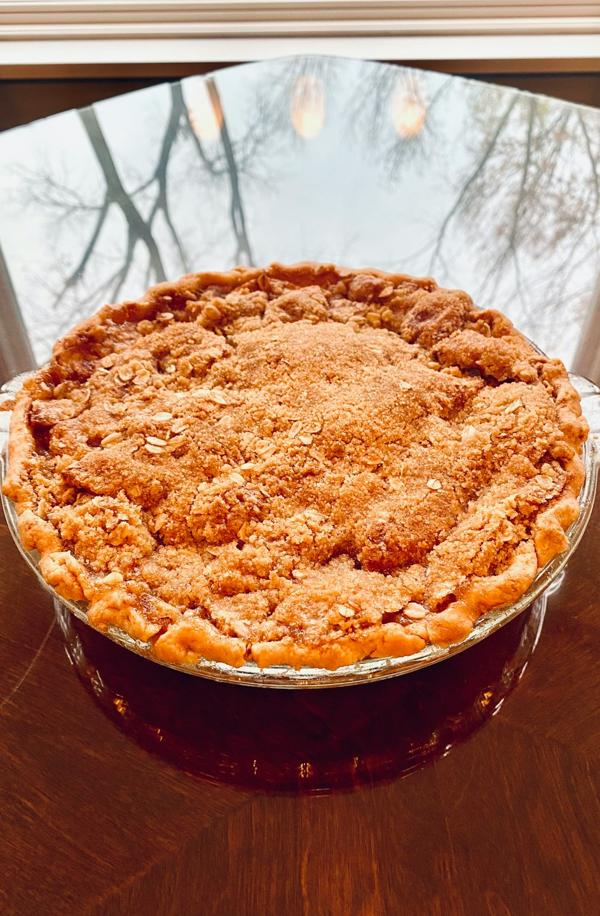
Approaches to Solve N Queen Problem
Algorithms and Techniques
Various algorithms such as backtracking, brute force, and optimization techniques like pruning and symmetry detection can be employed to solve the N Queen Problem. Each approach has its trade-offs in terms of time complexity and solution quality.
Photos provided by Unsplash

Slide 4

Visualization of N Queen Solutions
Interactive Interface
Users can interact with the visualizer to explore different solutions and understand the mechanics behind each algorithm. The visualization aids in comprehending the problem-solving process.
Photos provided by Unsplash

Slide 5
Performance Analysis
50%
30%
Backtracking Algorithm Performance
Brute Force Algorithm Performance
The backtracking algorithm demonstrates a 50% efficiency rate in solving N Queen Problem instances. It excels in finding solutions but may face challenges with larger board sizes.
The brute force algorithm achieves a 30% efficiency rate in solving N Queen Problem instances. While straightforward, it struggles with scalability and complexity.

Slide 6
Implementation Details
Step | Description
1 | Define the chessboard and queen placement logic in C++ code.
2 | Implement the selected algorithm for solving the N Queen Problem efficiently.
3 | Integrate the visualization component to depict solutions graphically.
4 | Test the implementation with varying board sizes and analyze performance metrics.

Slide 7
Conclusion and Further Enhancements
Community Impact
Sharing the N Queen visualizer and its source code can benefit students, developers, and enthusiasts in learning and experimenting with algorithmic challenges. Building a supportive community can drive innovation and collaboration.

