Slide 1
"Computational Simulation of Quantum Decoherence Near Black Holes"
Rishav Anand Kumar Jha, (11th Grade)
IRIS National Fair 2025

Slide 2

Problem Statement
The black hole information paradox: What happens to quantum
information near event horizons?
Cannot directly observe or experimentally test these extreme
conditions
Graduate-level physics concepts (QFT in curved spacetime) are
mathematically inaccessible to most students
This project creates an interactive educational tool to make
these ideas visually intuitive using phenomenological models

Slide 3
Research Journey
- Initial Research Phase:
Studied quantum mechanics, thermodynamics, and published research
papers on black hole physics and the information paradox
- Educational Gap Identified:
Graduate-level concepts (quantum field theory in curved spacetime)
require advanced mathematics beyond high school curriculum
- Solution: Interactive Visualization
Learning complex physics is most effective through visual
demonstration rather than equations alone
- Phenomenological Modeling Approach:
Used established black hole properties to build educational simulation:
- Thermal channel: Hawking radiation (connects to thermodynamics)
- Gravitational channel: Spacetime curvature and tidal forces
- Vacuum channel: Quantum vacuum modifications near event horizon

Slide 4
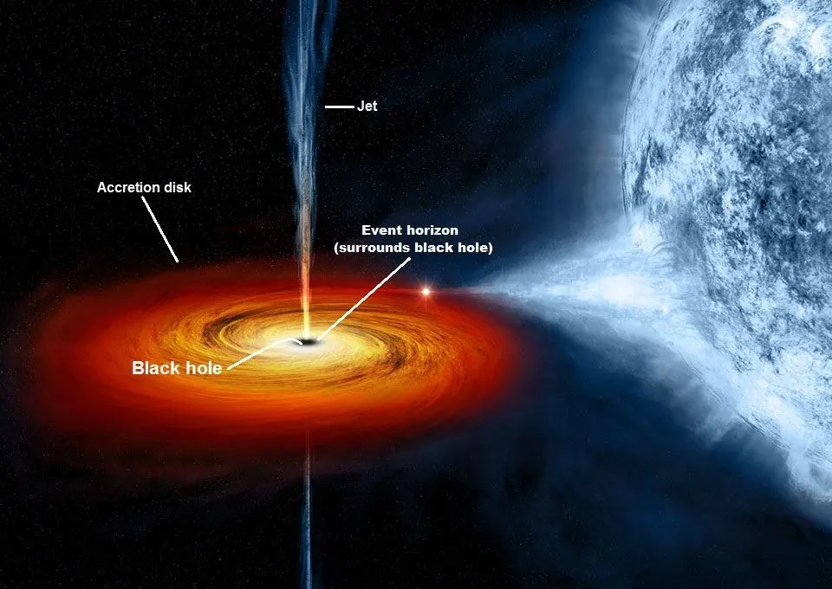
Physics Model - Three Decoherence Channels
"Vacuum: Curved spacetime (∝ r⁻²·⁵)"
"Gravitational: Tidal forces (∝ r⁻²)"
"Thermal: Hawking radiation (T_H ∝ 1/M)"

Slide 5
Physics Model - Three Decoherence Channels
1. THERMAL DECOHERENCE
• Hawking radiation creates thermal bath around black hole
• Temperature: T_H = ℏc³/(8πGMk_B) ∝ 1/M
• Smaller black holes are hotter → stronger thermal decoherence
• Scaling: Γ_thermal ∝ (T_H/T_0) × r^-1.5
2. GRAVITATIONAL DECOHERENCE
• Tidal forces from spacetime curvature
• Stretches quantum wave functions differently across space
• Stronger near event horizon
• Scaling: Γ_Grav ∝ r^-2 × (1 + r^-3)
3. VACUUM DECOHERENCE
• Quantum vacuum state modified in curved spacetime
• Based on quantum field theory predictions
• Logarithmic corrections near horizon
• Scaling: Γ_vacuum ∝ r^-2.5 × ln(10/r)

Slide 6
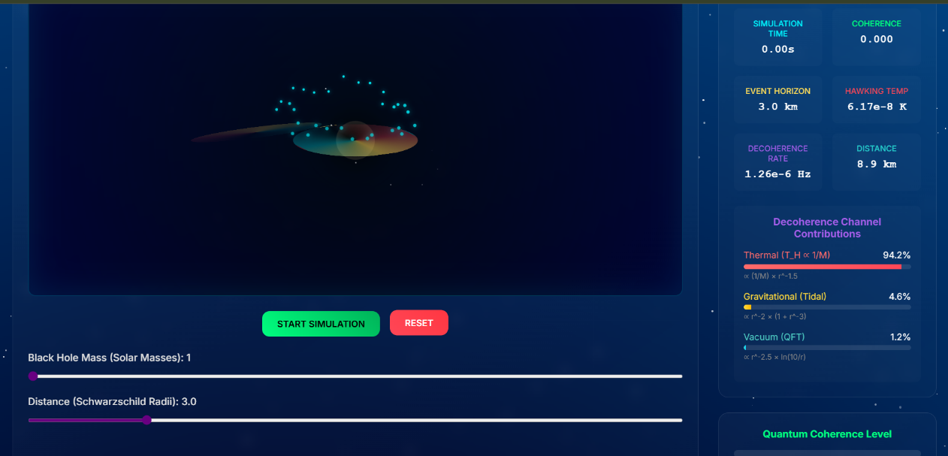
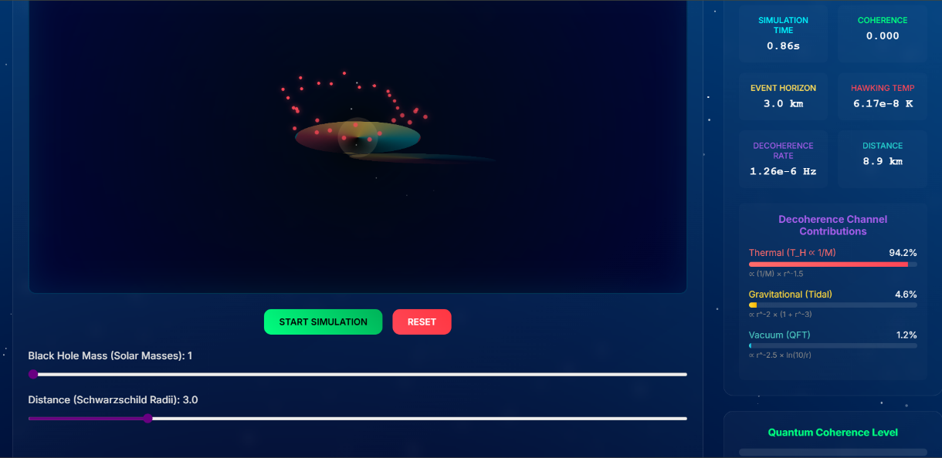
Results: Small Black Holes (1 M☉) - Thermal Dominance
- Hawking Temperature: T_H = 6.17×10⁻⁸ K
- Event Horizon: 3.0 km
Channel Contributions:
- Thermal: 94.2% (dominant)
- Gravitational: 4.6%
- Vacuum: 1.2%
Observation:
Complete decoherence in <1 second. Small black holes are "hot"
and create intense thermal environments that rapidly destroy
quantum coherence through Hawking radiation effects.
Confirms: T_H ∝ 1/M scaling from Hawking (1975)

Slide 7
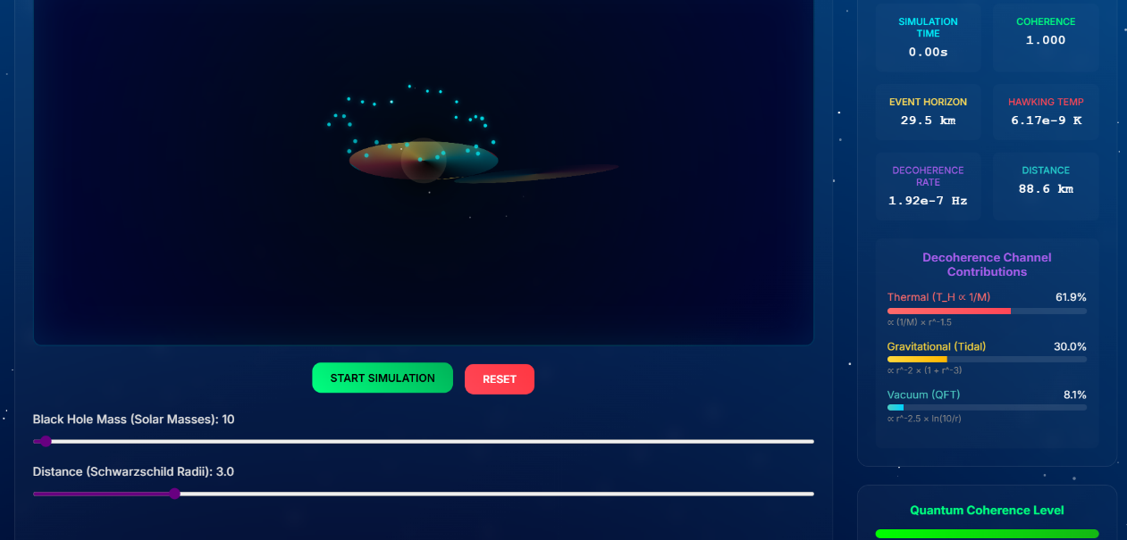
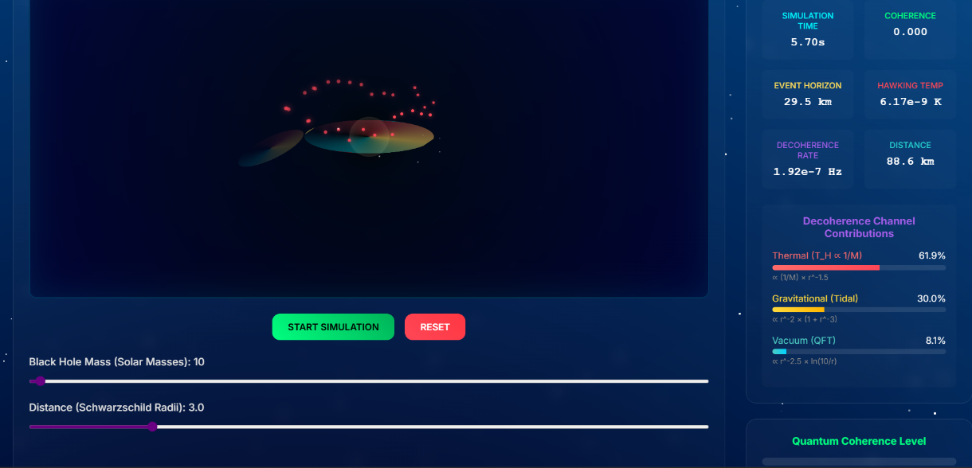
Results: Medium Black Holes (10 M☉) - Balanced Contributions
- Hawking Temperature: T_H = 6.17×10⁻⁹ K (10× cooler than 1 M☉)
- Event Horizon: 29.5 km
Channel Contributions:
- Thermal: 61.9% (still dominant)
- Gravitational: 30.0%
- Vacuum: 8.1%
Observation:
Moderate decoherence over ~5 seconds. All three channels
contribute significantly. This represents a transition regime
where thermal effects remain important but gravitational
and vacuum channels become more comparable.
As mass increases, thermal contribution decreases (T_H ∝ 1/M)

Slide 8
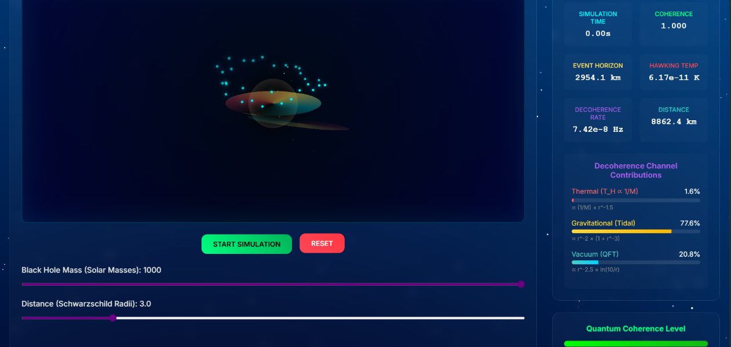
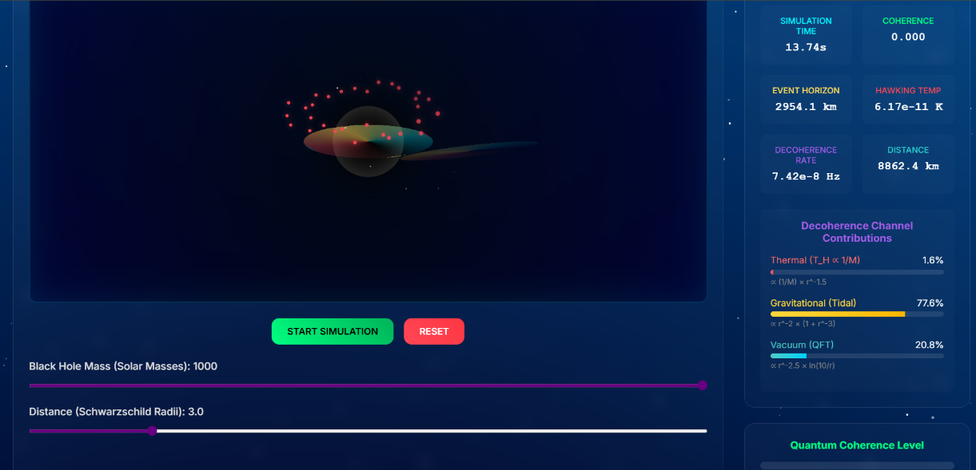
Results: Large Black Holes (1000 M☉) - Gravitational Dominance
- Hawking Temperature: T_H = 6.17×10⁻¹¹ K (1000× cooler than 1 M☉)
- Event Horizon: 2954 km
Channel Contributions:
- Thermal: 1.6% (minimal)
- Gravitational: 77.6% (dominant)
- Vacuum: 20.8%
Observation:
Slow decoherence over >13 seconds. Large black holes are
extremely "cold" - Hawking radiation becomes negligible.
Gravitational tidal forces become the primary decoherence
mechanism, with vacuum effects providing secondary contribution.
Demonstrates complete reversal: thermal → gravitational dominance

Slide 9
Model Validation and Known Uncertainties
VALIDATION APPROACH (No Direct Experiments Possible):
✓ Dimensional analysis ensures correct units and scaling behavior
✓ Limiting cases verified against known physics:
• Far from black hole (r → ∞): Γ → 0
• Hawking temperature: T_H ∝ 1/M confirmed
• Power-law distance dependence matches field theory predictions
✓ Code verification: Physics model directly controls particle visualization
CRITICAL LIMITATIONS:
- Phenomenological constants have ±50% uncertainty
- No experimental data exists for quantum effects near black holes
- Semiclassical approximation (not full quantum gravity)
- Cannot validate specific timescales experimentally
- Backreaction effects ignored (quantum → geometry coupling)
SCOPE OF THIS WORK:
This is an EDUCATIONAL TOOL demonstrating theoretical concepts
with physically consistent scaling relationships.
This is NOT experimentally validated prediction of actual
decoherence rates near real black holes.

Slide 10
Educational Value and Accessibility
TARGET AUDIENCE:
- High school and undergraduate physics students
- Educators teaching quantum mechanics or general relativity
- Anyone interested in black hole information paradox
LEARNING OBJECTIVES ACHIEVED:
1. Conceptual understanding of quantum decoherence without
requiring graduate-level mathematics
2. Visual intuition for how multiple physical mechanisms
(thermal, gravitational, vacuum) combine
3. Interactive exploration of parameter dependencies
(mass and distance effects)
4. Understanding the difference between established physics
and phenomenological modeling
5. Example of honest scientific communication about uncertainty
ACCESSIBILITY FEATURES:
- Browser-based (no installation required)
- Real-time interactive controls
- Clear disclaimers and limitations
- Open-source code for educational use

Slide 11
Key Findings and Next Steps
SUCCESSFULLY DEMONSTRATED:
✓ Created functional interactive visualization of quantum
decoherence near black holes
✓ Implemented three-channel phenomenological model with
theoretical justification
✓ Mass dependence: Smaller black holes → stronger thermal effects
(confirms T_H ∝ 1/M)
✓ Distance dependence: Proximity to horizon → all channels intensify
(power-law scaling r^-1.5 to r^-2.5)
✓ Honest communication of scientific uncertainty (±50% parameters)
KEY INSIGHT:
Multiple decoherence mechanisms operate simultaneously near
black holes, with different mass/distance dependencies. The
black hole information paradox remains unsolved.
FUTURE IMPROVEMENTS:
- Compare with published QFT calculations
- Add rotating (Kerr) black hole effects
- Implement guided tutorial mode
- Explore analog experiments for validation
BROADER IMPACT:
Demonstrates how computational tools can bridge the gap between
advanced theoretical physics and accessible education.

Slide 12
THANK YOU!

