Slide 1

Revolutionizing Communication: Unveiling the Project Web Conferencing APP with webRTC

Slide 2

Introduction
Welcome to the unveiling of Project Web Conferencing App with webRTC. This revolutionary app will transform the way we communicate and collaborate in the digital age. Join us as we explore the cutting-edge features and capabilities of this game- changing platform.

Slide 3

The Power of webRTC
webRTC is a game-changer in real-time communication, enabling seamless audio and video transmission directly in web browsers. Its low latency and high-quality transmission make it the ideal technology for modern web conferencing applications.

Slide 4
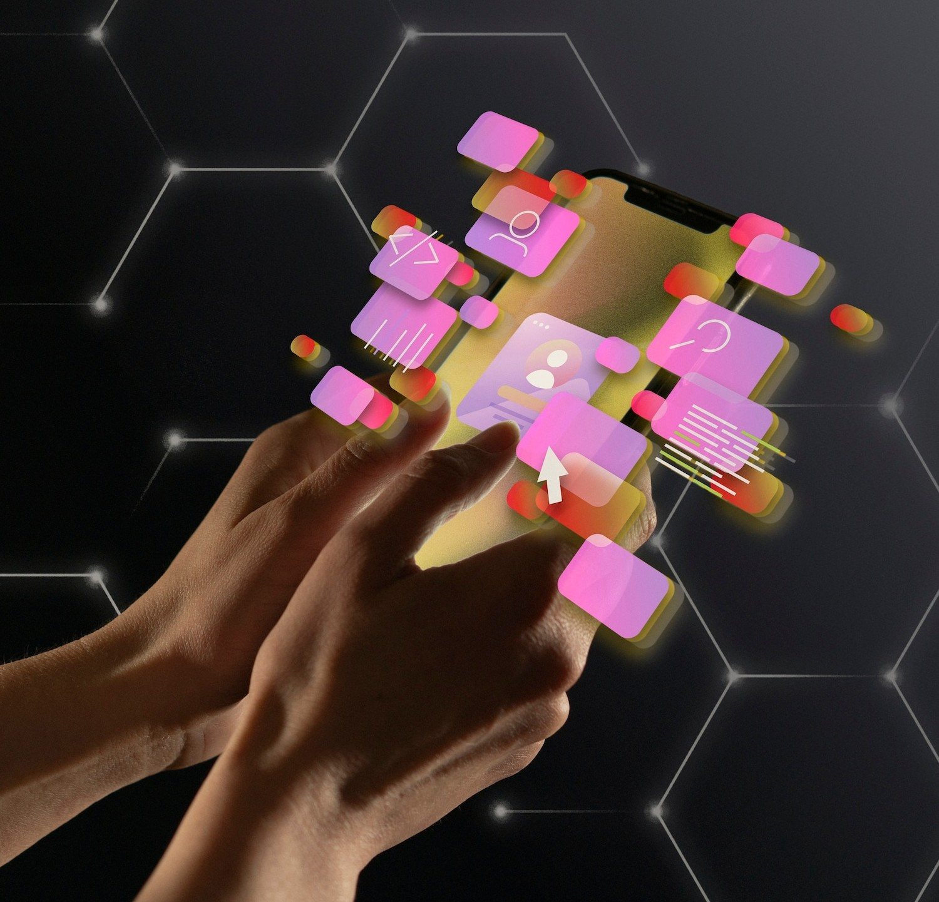
Key Features
Discover the ﬂexibility and scalability of our web conferencing app. With screen sharing, chat, and ﬁle sharing capabilities, it offers a comprehensive solution for all your virtual communication needs.

Slide 5

Enhanced User Experience
Our app prioritizes user-friendly interface and intuitive controls, ensuring a seamless experience for all participants. With customizable layouts and interactive tools, it's designed to elevate your virtual meetings.

Slide 6

Security and Privacy
Security is paramount in our web conferencing app. Through end- to-end encryption and access controls, we prioritize the privacy and conﬁdentiality of all communication, providing a secure environment for your meetings.

Slide 7

Conclusion
Thank you for joining us in unveiling the future of communication. The Project Web Conferencing App with webRTC is set to revolutionize the way we connect and collaborate.
Embrace the power of real-time
communication and elevate your virtual meetings with our cutting-edge platform.

Slide 8
Thanks!
jatinc957@email.com
+91 9882890756
Jatin Chauhan
https://meetup-jc.vercel.app/

