Slide 1
Aspect-Based Sentiment Analysis Bhubaneswar Hospitals

Slide 2
TABLE OF CONTENTS
01
Proposed Solution
Block Diagram
Results & Discussion
Problem Specification
Introduction
Literature Survey
04
02
05
03
06
References
07

Slide 3
01
Problem Specification

Slide 4
Develop an aspect-based sentiment analysis model to analyze hospital reviews.
Scrape reviews from Google Maps and other free sources.
Focus on individual aspects like service, food, staff, facilities, and hygiene.
Identify relevant aspects in hospital reviews.
Determine sentiment polarity for each aspect.
Aggregate multi-dimensional sentiment information.
Generate an overall sentiment score for the hospital.
Compare the sentiment score with the hospital’s existing rating for cross-validation.

Slide 5
02
Introduction

Slide 6
Patient feedback from online reviews is essential for improving healthcare service quality.
Star ratings on platforms like Google Maps lack detailed insights into specific aspects of hospital experiences.
Aspect-Based Sentiment Analysis (ABSA) extracts fine-grained opinions on dimensions like care, staff, and hygiene.
The project involves scraping hospital reviews, identifying key aspects, and analyzing sentiment using RoBERTa.

Slide 7
03
Literature Survey

Slide 8
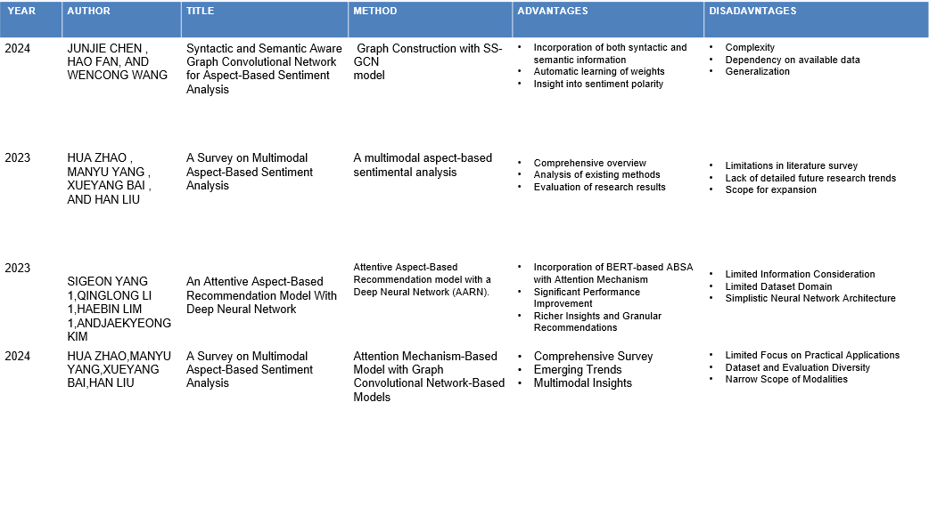
Table 1:Literature Study

Slide 9
04
Proposed Solution

Slide 10
Data Collection and Preprocessing: Scrape hospital reviews from Google Maps, clean the data, and define relevant aspects like service, food, and hygiene.
Aspect Identification: Define aspect categories and extract aspect-related phrases using rule-based or NLP methods.
RoBERTa Sentiment Analysis: Use the pre-trained RoBERTa model to determine sentiment polarity for each aspect, fine-tuning it for hospital reviews.
Score Aggregation: Combine aspect-level sentiments into an overall score, with weighting based on aspect importance and frequency.
Validation: Compare the sentiment scores with existing hospital ratings to evaluate model accuracy and identify improvement areas.
LSTM Integration: Implement LSTM models to enhance sentiment classification by capturing temporal dependencies.

Slide 11
05
Block Diagram

Slide 12
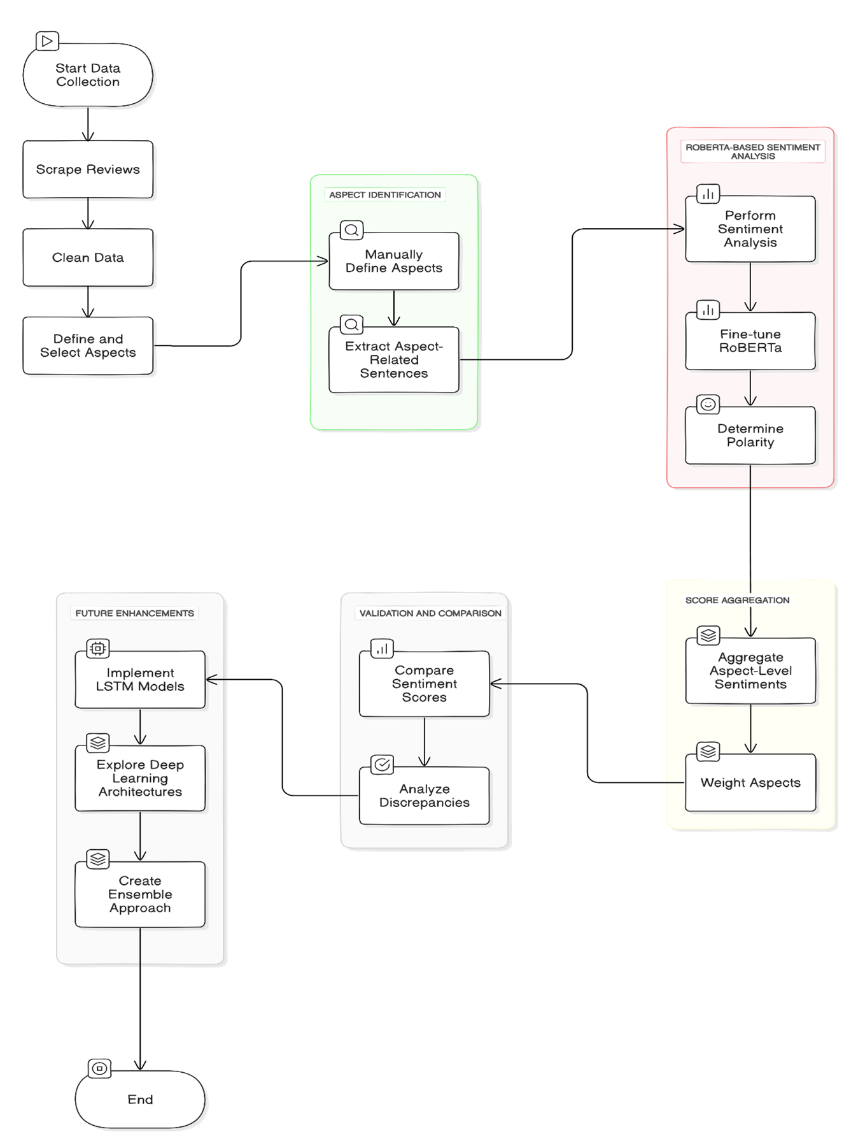
Figure 1:Block Diagram

Slide 13
06
Results & Discussion

Slide 14
Table 2:Result
Title | Hospital Rating | Review Stars | Aspect Scores
Vivekanand Hospital Bhubaneswar | 4.6 | 5 | {'service': 0.12956, 'cleanliness': 0.19434, 'food': 0.06478, 'facilities': 0.12956, 'staff': 0.12956}
Health Village Hospital | 4.6 | 3 | {'service': -0.19454000000000002, 'cleanliness': -0.29181, 'food': -0.09727000000000001, 'facilities': -0.19454000000000002, 'staff': -0.19454000000000002}
Manipal Hospitals, Bhubaneswar | 4.6 | 1 | {'service': -0.1756, 'cleanliness': -0.26339999999999997, 'food': -0.0878, 'facilities': -0.1756, 'staff': -0.1756}
Sunshine Hospital | 4.6 | 5 | {'service': 0.19424, 'cleanliness': 0.29135999999999995, 'food': 0.09712, 'facilities': 0.19424, 'staff': 0.19424}

Slide 15
Sentiment Classification Accuracy for Each Aspect:
Measures the model's ability to correctly classify sentiment (positive, negative, neutral) for each aspect.
Metrics: Accuracy, precision, recall, and F1-score will be used for evaluation.
Importance: Ensures accurate sentiment analysis for specific hospital features.
Correlation Between Generated Overall Sentiment Scores and Existing Hospital Ratings:
Evaluates the relationship between ABSA sentiment scores and existing star ratings.
Metrics: Pearson or Spearman correlation coefficients will be used to measure association.
Importance: Validates the reliability and alignment of the ABSA model with current rating systems.

Slide 16
Qualitative Analysis of Aspect-Level Insights:
Involves manual review of how well the model identifies aspects and classifies nuanced sentiments.
Importance: Provides in-depth insights into the model's performance on real-world data and highlights areas for improvement.

Slide 17
07
References

Slide 18
[1] S. Yang, Q. Li, H. Lim, and J. Kim, “An attentive aspect-based recommendation model with deep neural network,” IEEE Access, vol. 12, pp. 5781–5791, 2024.
[2] K. Jahanbin and M. A. Z. Chahooki, “Aspect-based sentiment analysis of twitter influencers to predict the trend of cryptocurrencies based on hybrid deep transfer learning models,” IEEE Access, vol. 11, pp. 121656–121670, 2023.
[3] Y. Yu, D.-T. Dinh, B.-H. Nguyen, F. Yu, and V.-N. Huynh, “Mining insights from esports game reviews with an aspect-based sentiment analysis framework,” IEEE Access, vol. 11, pp. 61161–61172, 2023.
[4] J. Chen, H. Fan, and W. Wang, “Syntactic and semantic aware graph convolutional network for aspect-based sentiment analysis,” IEEE Access, vol. 12, pp. 22500–22509, 2024.
[5] Jahanbin, K., & Chahooki, M. A. Z. (2023). Aspect-Based Sentiment Analysis of Twitter Influencers to Predict the Trend of Cryptocurrencies Based on Hybrid Deep Transfer Learning Models. IEEE Access, 11, 121656-121670.

