Slide 1
Lingua Ledger
DATANOVA 2026 GLOBAL DATA-THON · TRACK DN-AI-01
Invoice · DE
Form · JA
0.97
Contract · ES
0.71
0.94
Self-checking extraction for multilingual business documents. Every field comes back with a confidence score you can actually trust.
Rishav Naskar · rishavnaskar.r@gmail.com · Round 1 submission, November 2026
Notes:
Lingua Ledger is our entry for DN-AI-01. The main takeaway: document extraction works in demos, but fails in production because no one trusts it. We make confidence scores honest and prove it with data.

Slide 2



Every layout arrives, but trust does not
Official challenge DN-AI-01: extract, classify and structure information from multilingual invoices, contracts and forms with varying layouts and quality, and output structured, validated data with confidence scores.
Multilingual by default
Layouts keep changing
100% review or errors
Teams in India, the EU and South-East Asia handle invoices and contracts in 5 to 10 languages, often mixed on one page.
Template OCR breaks on new vendors. LLMs read anything, but they easily make up a VAT number when a scan is blurry.
Without knowing what is accurate, teams must recheck every field or risk costly ledger errors.
Notes:
This problem comes straight from DN-AI-01. The hard part is not reading text; it is knowing which of the 40 extracted fields are safe to post without human review.

Slide 3
Confidence scores you can actually trust
Approach
Layout robustness
Confidence
Human review
Template OCR
Fragile; breaks on new layouts
Basic word-level OCR confidence only
Humans must check every exception
Prompt-and-pray LLM
Reads almost anything
Self-reported, uncalibrated, and often wrong
All or nothing
Lingua Ledger
Vision LLM + OCR LLM, cross-checked
Calibrated per field: 0.9 means ~90% correct
Only low-confidence fields
Our main metric: at a target field accuracy (like 98%), what share of fields still needs a human? Lower is better, and we measure it directly.
Notes:
Current tools have big weaknesses. We do not just claim better reading; we deliver trustworthy output and prove it by measuring human review rates at a fixed accuracy target.

Slide 4





Read twice, validate, score and route
Ingest and classify
Drop in a PDF, scan or photo. We render pages and detect the language and document type (invoice, receipt, form, contract).
Extract twice independently
Path A: a vision model reads the page against a JSON schema. Path B: multilingual OCR text + layout with a text model.
Check with strict rules
Line items must sum, tax math must add up, dates must parse, and IBAN / VAT formats must match. Every rule is clear and explainable.
Score confidence per field
We combine reader agreement, OCR confidence, rule results and model estimates, then calibrate them on held-out test data.
Route only doubtful fields
Fields below the threshold go to a review queue with source crops highlighted. Everything else posts automatically with an audit trail.
Notes:
Five stages. The key innovations are extracting twice through separate paths and calibrating scores against held-out ground truth. The rest is solid engineering that most hackathons skip.

Slide 5
Two separate readers, one strict judge
Path A · Vision LLM
Ingest
Page image → schema-constrained JSON
Validators
Confidence engine
pypdfium2 render · deskew · language + doc-type classifier (small model)
Arithmetic · dates · regex (IBAN, VAT, currency) · cross-field · enums
Agreement + OCR confidence + validator + self-report → isotonic calibration (held-out)
Path B · OCR + text LLM
Tesseract (multilingual) → text + boxes → same schema
Eval harness
Review UI
Validated JSON
Review router (threshold τ)
XFUND · FUNSD · CORD · SROIE · CUAD
Next.js · highlights source region · one-click accept/fix
+ per-field confidence + audit trail (path, rules, evidence)
Low-confidence fields → queue with evidence crop; rest auto-posts
Stack: Python 3.13, pydantic schemas, Google Gemini (gemini-3.5-flash-lite for vision, text and classification, structured JSON output; switchable to Claude), Tesseract, scikit-learn (isotonic regression), FastAPI, Next.js on Vercel. Public repo, MIT licence, one command reproduces every metric.
Notes:
Look from left to right. The two readers never see each other's work. The validators use clear deterministic rules. The confidence engine is trained on held-out ground truth so the scores stay honest.

Slide 6
What makes 0.9 mean ninety percent
SIGNALS PER FIELD
CALIBRATION AND ROUTING
Both readers agree
Signals combine through a small model, then calibrate against field accuracy on held-out data per document type.
Shown on a reliability diagram with Expected Calibration Error (ECE) before and after calibration.
A single threshold τ controls routing; operators use the curve to pick their own balance between accuracy and review load.
Every field carries proof: which path found it, which rules passed, and the exact image crop.
Do the vision reader and the OCR reader return the exact same value?
Clear OCR evidence
Average Tesseract word confidence inside the field box; drops on blur, skew or stamps.
Rule check outcome
Passed, failed or not applicable for every deterministic rule checked against the field.
Raw model estimate
The LLM's own 0 to 1 estimate, used as a small signal, never as the final answer.
Arbiter decision
During disputes, a vision model views a crop around both candidates and picks or re-reads the printed value.
Notes:
This slide shows where our real innovation happens. Each signal is cheap, but the real power comes from fusing them and calibrating against ground truth so our numbers stay honest. Two slides later, the reliability diagram and review-rate curve show the result on real data.

Slide 7


Public benchmarks tested by language and field
Dataset | Document type | Languages | What we measure
XFUND v1.0 (Microsoft) | Forms | ZH, JA, ES, FR, IT, DE, PT | Key-value extraction F1 per language
FUNSD | Forms | EN | Key-value F1; English baseline
CORD v2 (Naver Clova) | Receipts | ID (Latin script) | Field F1; arithmetic validator hit-rate
SROIE (ICDAR 2019) | Receipts / invoices | EN | Exact-match F1 on company, date, address, total
CUAD (Atticus Project) | Contracts | EN | Clause extraction F1 on parties, dates, governing law, termination
Ablation
Calibration
Cost and latency
Vision-only vs OCR-only vs dual-path + validators, same prompts, same schema.
Reliability diagram, ECE, Brier score; before vs after isotonic fit, per doc type.
p50 / p95 seconds per page and dollars per 1,000 documents, by path.
All datasets are public research benchmarks under open licences; no customer data is used. Synthetic multilingual invoices cover the invoice category across the same seven languages.
Notes:
We cover nine languages across five datasets, synthetic invoices, and four document types. Every number on the next three slides is reproducible from our public repo with one command.

Slide 8
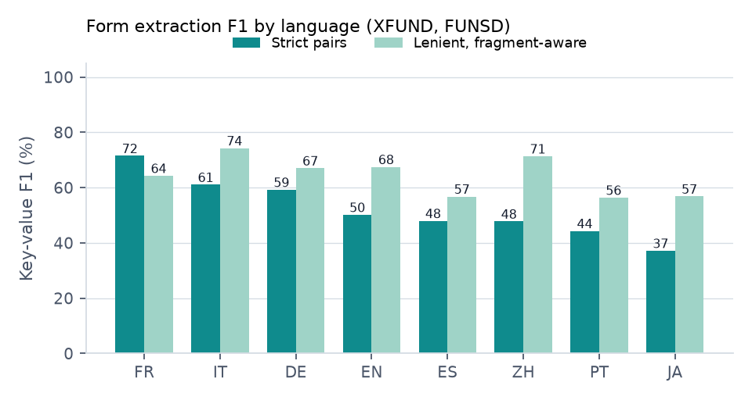
Results on 198 public benchmark documents
Benchmark | Vision only | OCR + text | Both + validators | Lenient (forms)
XFUND forms (7 langs) | 52% | 29% | 52% | 64%
FUNSD forms (EN) | 50% | 41% | 50% | 68%
CORD receipts (ID) | 95% | 52% | 95%
SROIE receipts (EN) | 95% | 89% | 95%
Synthetic invoices (7 langs) | 99% | 96% | 99%
CUAD contracts (EN) | 61% | 60% | 60%
92%
89%
document type detected correctly
language detected correctly
Field F1 scored against published ground truth. Forms: key-value pairs. Receipts and invoices: every labeled field and line item. Contracts: parties, dates, governing law. Same prompts and schema throughout.
Notes:
Every result comes from one command in the public repo. The last column is the full pipeline; the previous two show each reader running alone. We tested the arbiter honestly: letting it overwrite values did not improve accuracy on disputed fields. Because of that, we ship it as a confidence signal instead, which cuts calibration error from 0.038 to 0.037

Slide 9
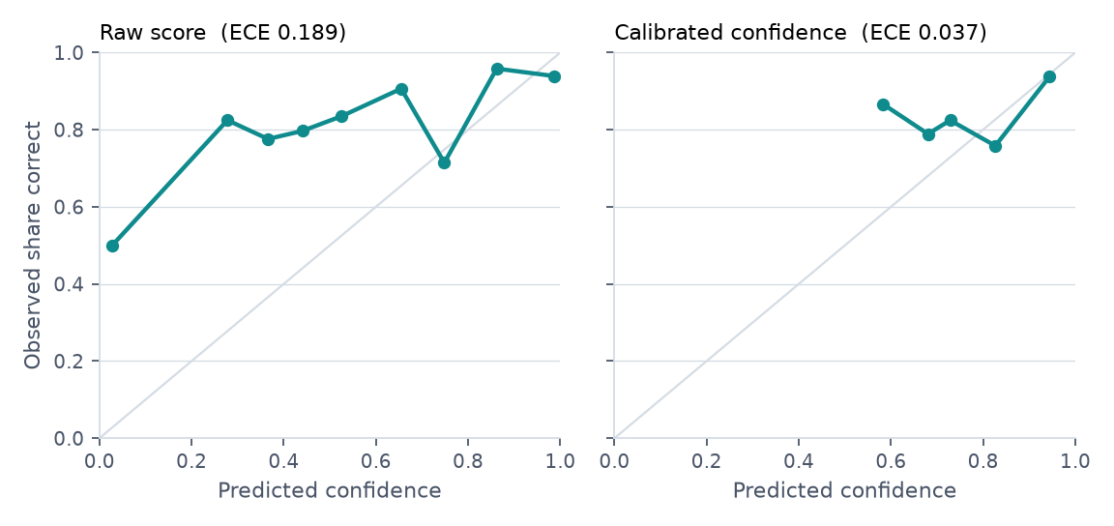
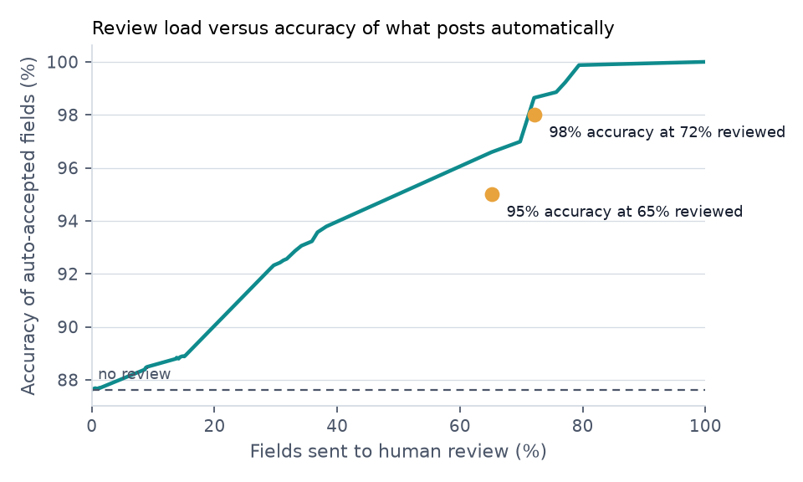
Honest confidence creates a clear review budget
0.190 → 0.037
88%
72%
65%
expected calibration error, raw score → calibrated (lower is better)
fields correct with no human review at all
of fields need a human to reach 98% accuracy on what posts automatically
of fields need a human to reach 95% accuracy
Notes:
On the left is a reliability diagram scored with two-fold cross-fitting, so every field is scored by a calibrator that never saw its document. On the right is the operating curve an operator actually uses. The amber numbers are the headline, showing how much human work buys how much accuracy.

Slide 10
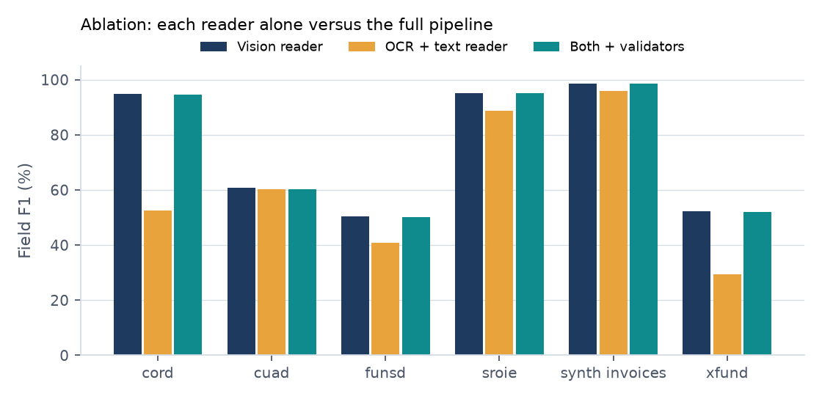
What it costs to run
10.0 s
median model reading time per document, both readers in parallel, Free Tier rate limits included
18.1 s
median end to end, with OCR, classification and throttling waits
$5.64
Tokens per document: about 3873 in, 1789 out across both readers. Review effort scales with low-confidence fields, not document volume.
model cost per 1,000 documents at list prices
Notes:
The left shows each reader alone versus the full pair with validators. The right shows standard list pricing without batching or caching, giving a realistic upper bound.

Slide 11





Demo: drop a file, watch it self-verify
Upload any PDF or photo; sample files in seven languages are ready to test.
Rechnung · DE
Vendor
Müller GmbH
0.98
Invoice no.
RE-2026-0412
0.96
Side-by-side view showing what each reader saw and where they disagreed.
Date
03.11.2026
0.95
Net
1 240,00 EUR
Validator panel: see which rules ran and which passed in plain words.
0.97
VAT 19%
235,60 EUR
0.97
Threshold slider: move τ and watch review workload and expected accuracy update live.
Total
1 475,60 EUR
0.99
IBAN
DE89 3704 ···· 3000
0.62
Export verified JSON or CSV with a complete audit trail attached.
1 field routed to review: IBAN (OCR evidence low on stamp overlap)
Notes:
The hosted demo is linked in the submission. The interface makes trust visible: two readers, clear rules, and only the fields that truly need human eyes.

Slide 12




Fewer manual reviews, zero silent errors
Who benefits
Finance, accounts-payable, procurement and legal teams, plus BPOs working across India, the EU, South-East Asia and LATAM.
Responsible by design
Humans step in only when confidence is low; nothing posts automatically below τ.
Every field carries clear evidence, making every decision easy to audit later.
Documents stay in memory and are never used for training; PII fields can be masked on export.
Calibration is reported by language and document type to highlight, not hide, weaker areas.
Built on public benchmarks, public code and verifiable numbers.
Cost savings
Review work scales with low-confidence fields, not document count. Document cost is just one or two model calls per page, as shown in our evaluation.
Easy scaling
Stateless pipeline where every step runs in parallel. Supporting new document types just takes a schema and a rule file, not a new model.
Notes:
The impact is real: teams process more documents in more languages with fewer mistakes reaching the ledger. Responsible AI is not a buzzword; it is our core routing rule.

Slide 13
Roadmap: pipeline, evidence, then production
1
Round 1 · 10 Nov
2
Round 2 · by 25 Nov
3
Beyond Round 2
Working pipeline with evidence
Better readers, same pipeline
Moving into production
Two readers, an arbiter for disputes, validators, calibration, and review routing
198 public benchmark documents, 9 languages, and one command produces all numbers
Live hosted demo with sample documents, anomaly checks, and calibrator review panel
Forms scored strict and lenient; prompt updates showed no score gain
241 unit tests released under an MIT licence
Bigger Gemini and Claude readers, one environment variable, comparing cost and accuracy
Stronger arbiter model and more languages, starting with Hindi and Arabic forms
Three-way match: reconciled purchase orders, invoices, and receipts, flagging any mismatches
Backed vendor memory with a database instead of a file
Open-weights model path for on-prem use
Connectors for email inbox, SAP, and Tally
Full table and handwriting extraction support
Notes:
Round 1 already includes the evidence we promised. Round 2 focuses on boosting quality with bigger readers and fixing our weakest languages. Everything in production covers the obvious features enterprise buyers ask for.

Slide 14
TEAM AND CONTRIBUTIONS
RN
Rishav Naskar
Software engineer · AI agents, LLM applications and full-stack web · Solo entrant
Problem framing, architecture and schema design
Dual-path extraction pipeline, validators and confidence engine
Evaluation harness, calibration and reporting
Review UI, hosted demo, documentation and video
Third-party components acknowledged in the repository: XFUND, FUNSD, CORD, SROIE and CUAD datasets; Tesseract OCR; Google Gemini API; pypdfium2; scikit-learn; FastAPI; Next.js. All code released under the MIT licence.
Lingua Ledger · rishavnaskar.r@gmail.com · repo and demo links in the submission form
Notes:
Solo project. All work is detailed per the submission rules. Links to the code repository and live demo are in the Devpost and Unstop forms.

