Slide 1
Designing an Arduino-based Non-Dispersive Infrared (NDIR) Gas – Sensor As A part of research internship at CSIR - Central Electronics Engineering Research Institute, Pilani
Submitted by:
Kotha Venkata Ramakrishna
M.Tech (Microelectronics & VLSI Design - NIT, Sikkim) Under the guidance of:
Rishav Pandey Dr. Vijay Chatterjee
B.Tech (Elect & Comm Engg - Jabalpur Engineering College) Scientist, CSIR-CEERI

Slide 2
Noise Equivalent Power:
NEP is the minimum optical power required for an output signal-to-noise ratio (SNR) of 1.
Basically, this represents the threshold above which a signal can be detected.
Detectivity:
The detectivity (D) of a detector is just the inverse of its Noise Equivalent Power. The larger the detectivity of a detector, the more it is suitable for detecting weak signals which compete with detector’s noise. Its unit is Hz^{1/2}/W
Specific Detectivity:
The specific detectivity (D*) is the detectivity normalized to a unit detector area (1 m²) and detection bandwidth (1 Hz); one can calculate it by multiplying the detectivity with the square root of the detector area (in square centimeters). Its unit is cm Hz^{1/2}/W

Slide 3
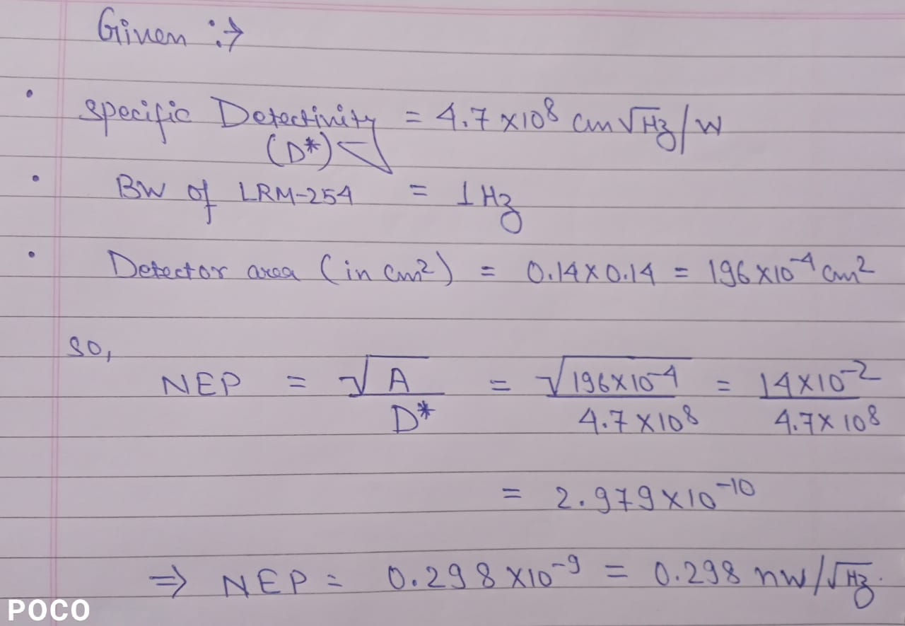
Calculation of NEP:

Slide 4
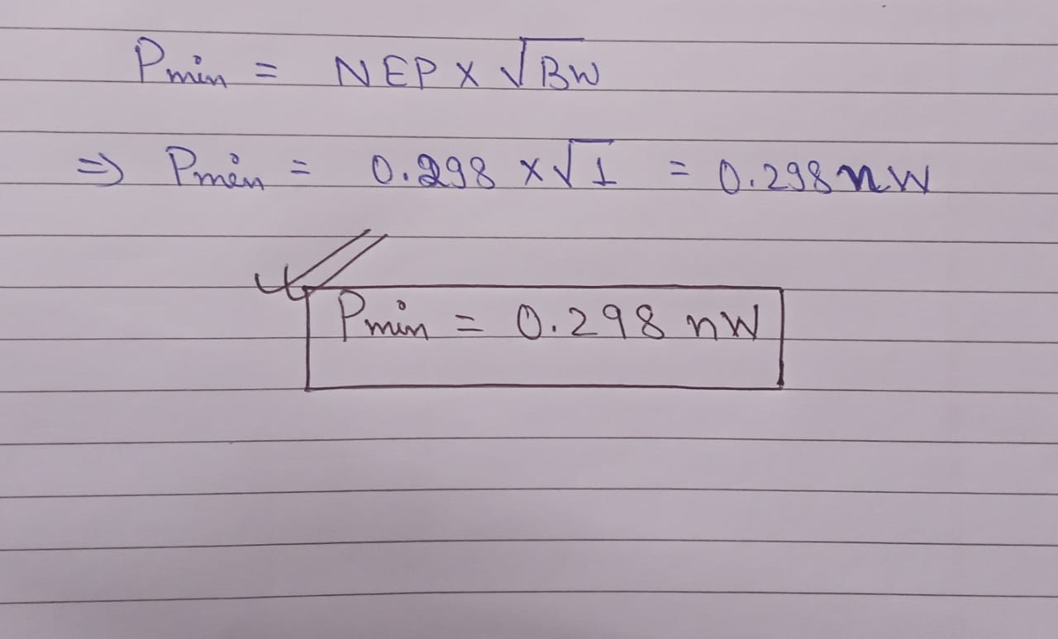
Calculation of Pmin:

Slide 5


