Slide 1
Designing an Arduino-based Non-Dispersive Infrared (NDIR) Gas – Sensor As A part of research internship at CSIR - Central Electronics Engineering Research Institute, Pilani
Submitted by:
Kotha Venkata Ramakrishna
M.Tech (Microelectronics & VLSI Design - NIT, Sikkim) Under the guidance of:
Rishav Pandey Dr. Vijay Chatterjee
B.Tech (Elect & Comm Engg - Jabalpur Engineering College) Scientist, CSIR-CEERI

Slide 2
CONTENTS
Aim and Objectives of the Project
Introduction
Block Diagram
Steps involved
References

Slide 3
Aim and Objectives of the Project
Aim of project:
To implement the Arduino based NDIR CO₂ gas detection using NDIR sensor.
Objectives of the project:
The study of absorb Frequency spectrum of CO2 gasses in IR region
To understand the working of NDIR gas-sensor.
To implement the Arduino based gas detection system using NDIR gas-sensor.

Slide 4
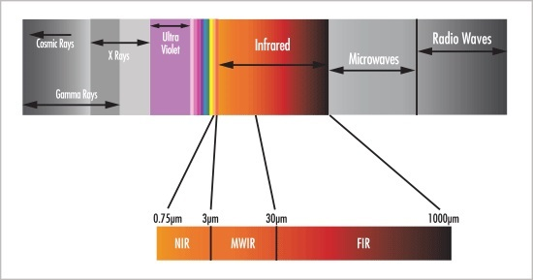
INTRODUCTION
Infrared radiation (IR), sometimes referred to simply as infrared, is a region of the electromagnetic radiation spectrum where wavelengths range from about 700 nanometres (nm) to 1 millimetre (mm).

Slide 5
INTRODUCTION
The infrared radiation is divided based om the wavelength regions in which infrared radiation is better transmitted through the atmosphere
0.74µm to 3µm near IR region, 3µm to 30µm Mid-Wave IR region, 30µm to 1000µm Far IR region.
Mid Wave IR region – MWIR(Medium Wavelength Infrared 3µm - 5µm)
– Low atmospheric transmission window(5 - 8 µm)
– LWIR(Long Wavelength Infrared 8µm - 14µm)
>30µm FAR IR region means Very Long Wavelength Infrared region.

Slide 6
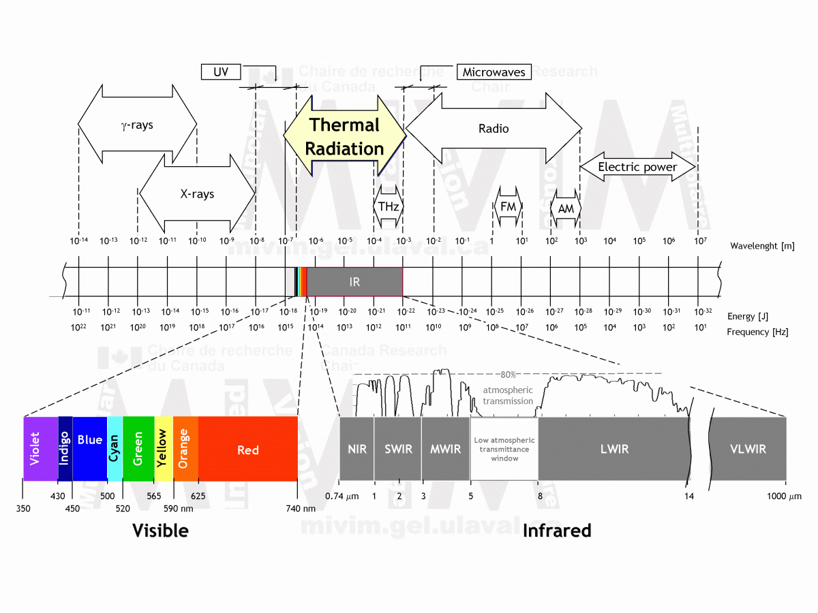

Slide 7
INTRODUCTION
Nondispersive infrared (NDIR):
A nondispersive infrared sensor (or NDIR sensor) is a simple spectroscopic sensor often used as a gas detector. It is non-dispersive in the fact that no dispersive element (e.g a prism or diffraction grating as is often present in other spectrometers) is used to separate out (like a monochromator) the broadband light into a narrow spectrum suitable for gas sensing.
Nondispersive infrared (NDIR) spectroscopy is a technique used to detect the gases like carbon di-oxide, carbon monoxide present in the air
The Gasses present in air absorb the particular wavelength of light in the IR region. Therefore the NDIR system detect these particular absorbed light Intensity and detect the gases.

Slide 8
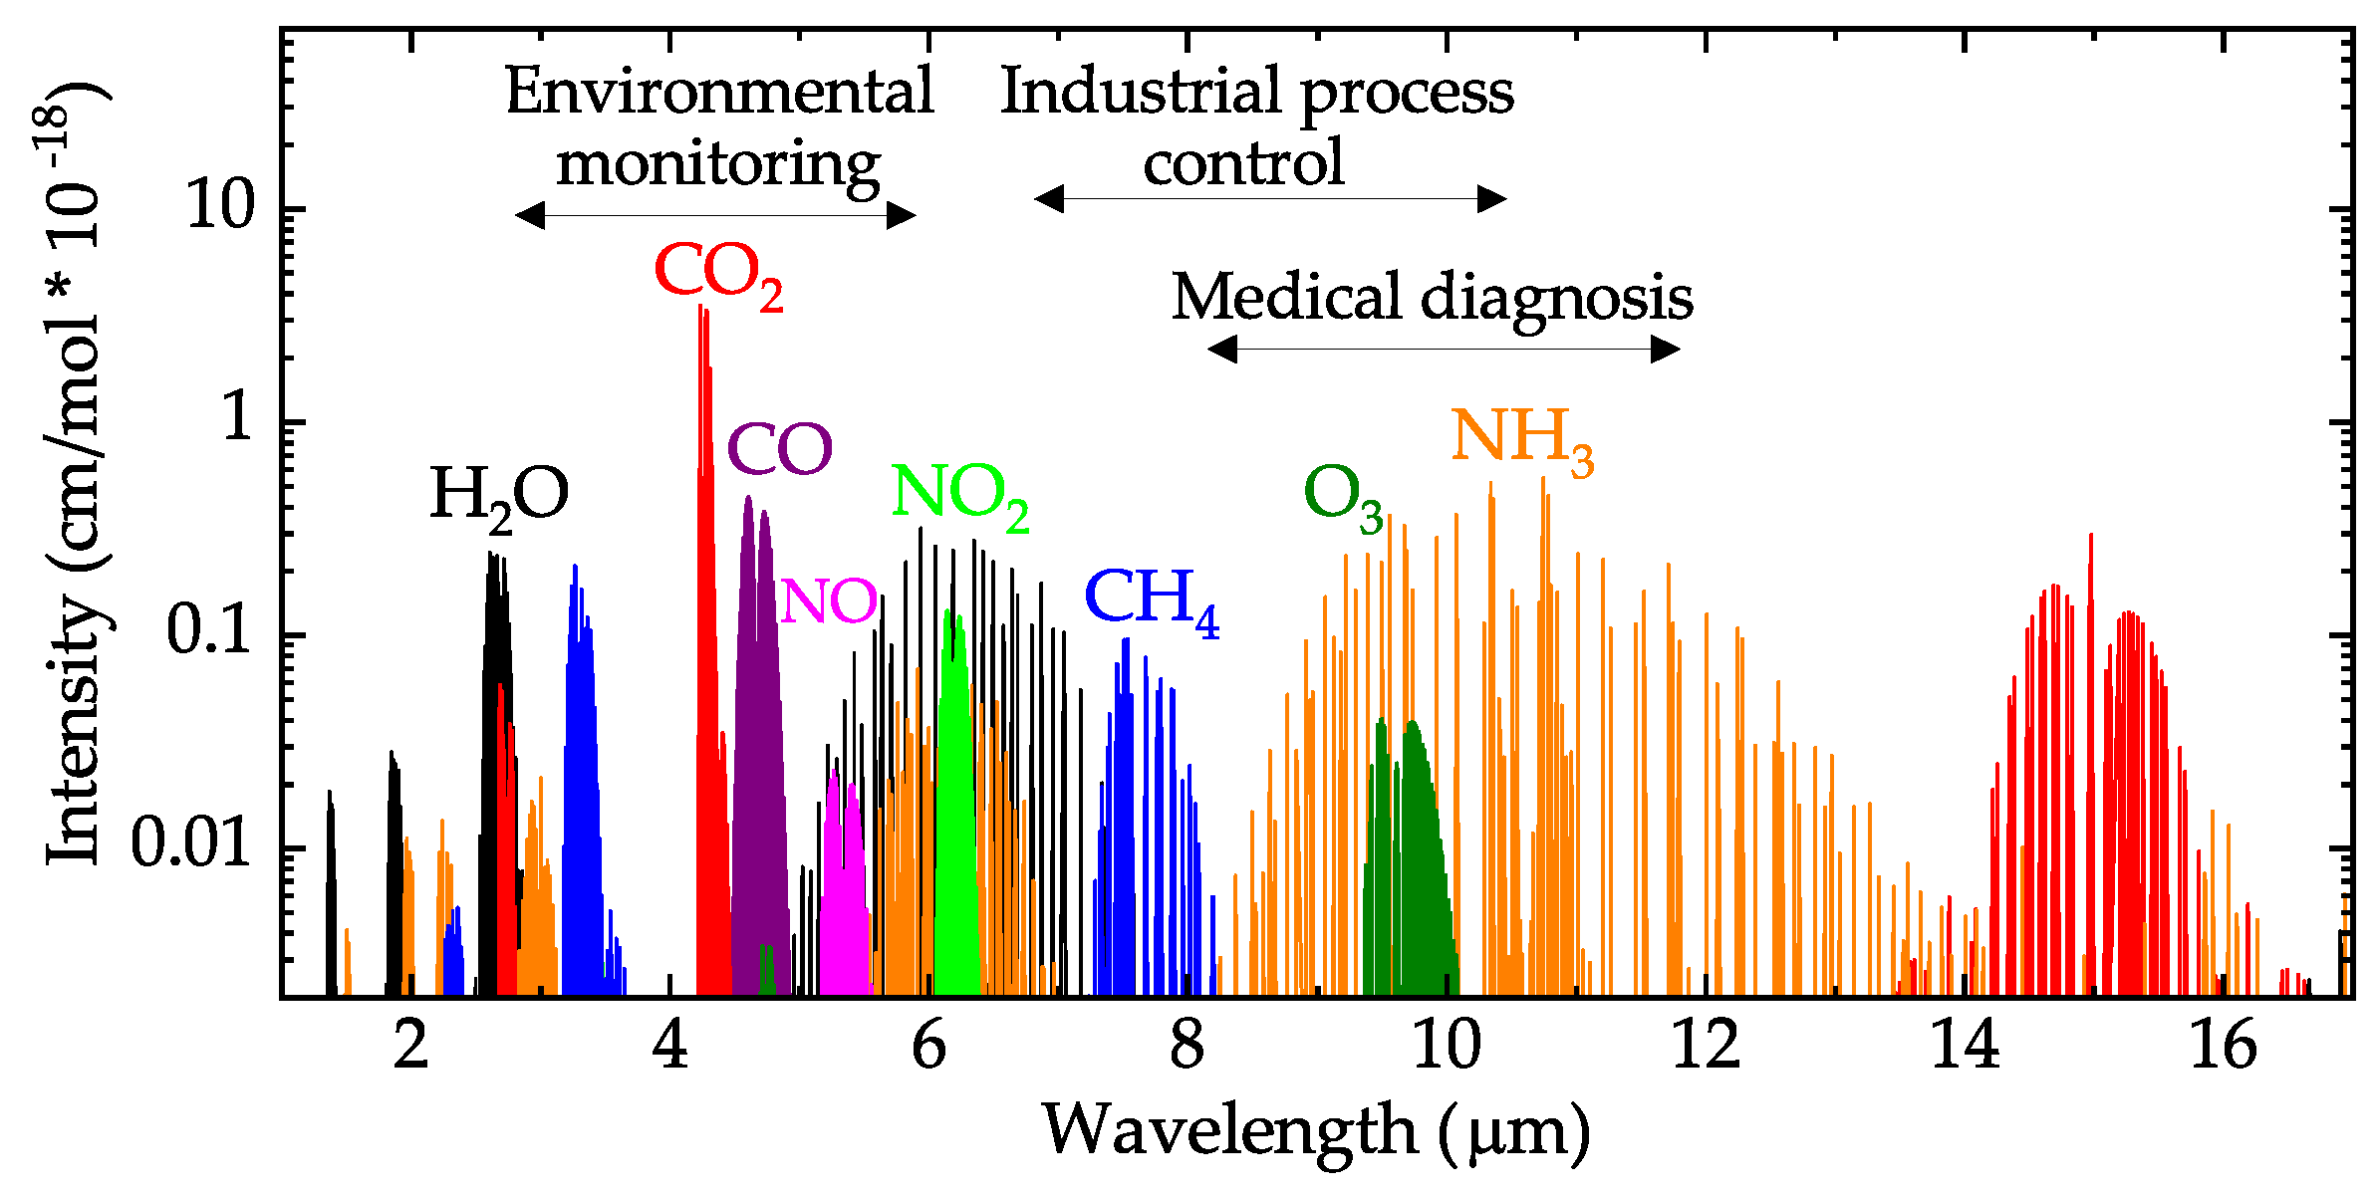
INTRODUCTION Absorption spectrum of Gases

Slide 9
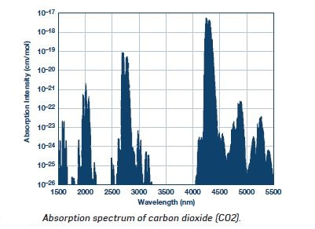
Absorption spectrum of CO₂
The gas Absorption spectrum of the Carbon di oxide gas is 4.26μm

Slide 10
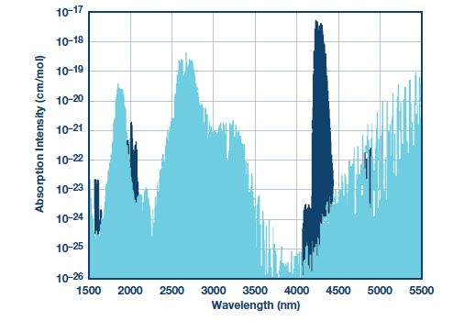
Reference Wavelength Absorption spectrum of water Vapour(Moisture in Air)
As there is no gas absorbance at 3µm to 4µm the reference wavelength is taken at 3.9µm

Slide 11
INTRODUCTION
Beer’s law:
Beer's law states that the amount of light(UV, Vis., IR) absorbance is proportional to the concentration of the absorbing medium, c:
A α c
Lambert’s law:
Lambert’s law states that the amount of light(UV, Vis., IR) absorbance is proportional to the length of the absorbing medium, i.e. path length l:
A α l
I₀
I
l

Slide 12
INTRODUCTION
Beer-Lambert Law:
The infrared intensity on the active detector decreases according to the exponential relationship called the Beer-Lambert Law:
I = I₀e^{–klx}
where:
I is the intensity in target gas.
I₀ is the intensity in zero gas.
k is the absorption coefficient for the specific gas and filter combination.
l is the equivalent optical path length between the lamp and detectors.
x is the concentration of the gas.

Slide 13

INTRODUCTION
For the active detector output, there is a corresponding output voltage change, V₀ – V:
where:
FA is the fractional absorbance.
V₀ is the output in zero gas.
V is the output in target gas.
Rearranging and combining the previous two equations gives
FA = 1 − e^{–klx}

Slide 14
Continued….
This relationship implies that for any fixed setup, the ability to resolve a change in gas level is better at low concentrations than at high concentrations.
However, k and l can be adjusted to provide the optimum absorbance for the required range of gas concentration. This means that long optical paths are more suited for low gas concentrations, and short optical paths are more suited for high gas concentrations

Slide 15
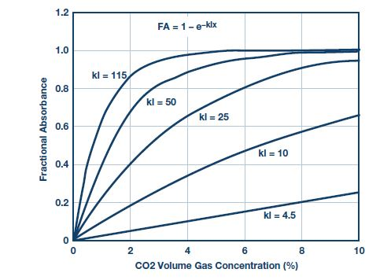

Slide 16
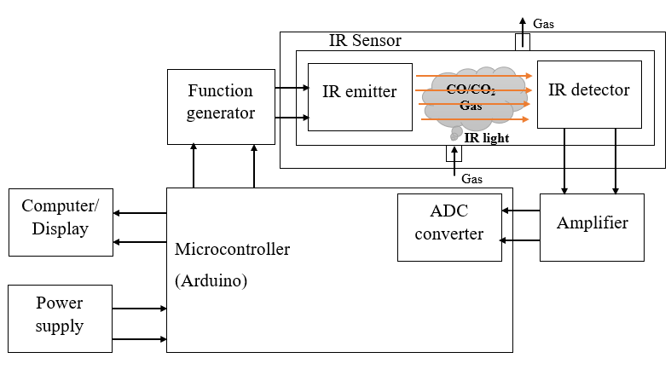
Block diagram

Slide 17
NDIR SENSOR
NDIR (Nondispersive Infrared) gas sensor consist of one Infrared light source and the Infrared receiver.
Infrared light emits the required wavelength of light and emitter detect the light.
In order to filter the light emitter has two optical filters, one is reference optical filter and other one measurement optical filter.
Reference optical filter allow the reference Infrared light with reference wavelength(usually 3.91µm) and measurement optical filter allow the measured Infrared light with observed wavelength(for CO2 4.32µm)

Slide 18
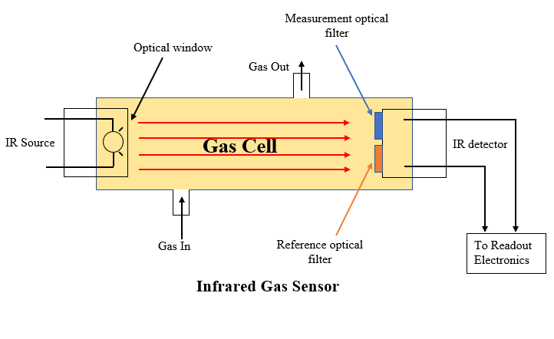
NDIR SENSOR

Slide 19
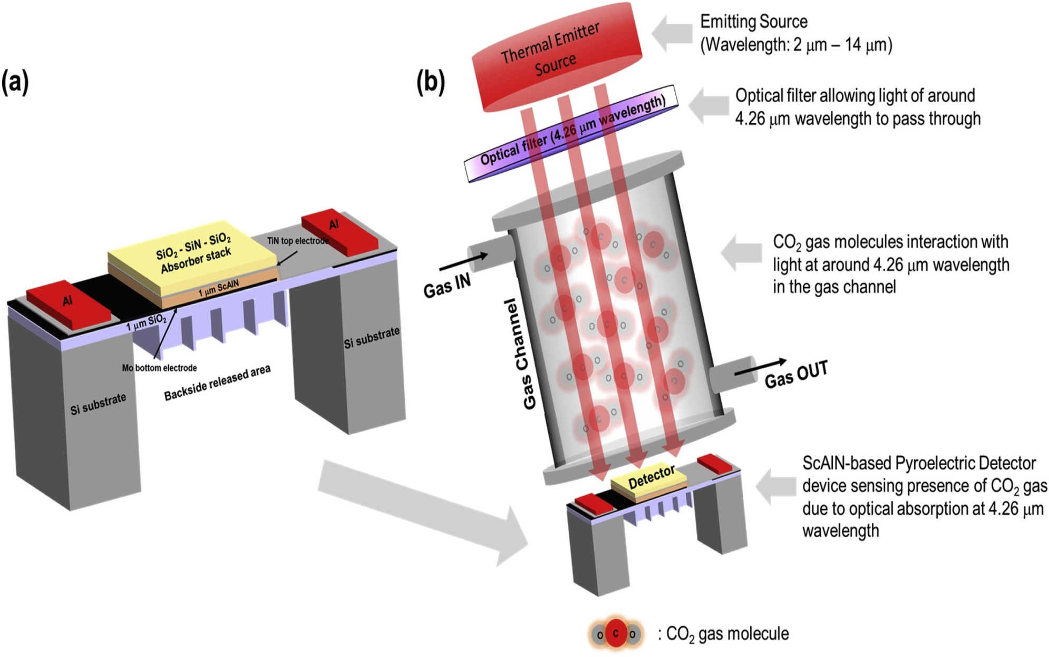
NDIR Gas Sensor Using Pyroelectric Detector

Slide 20
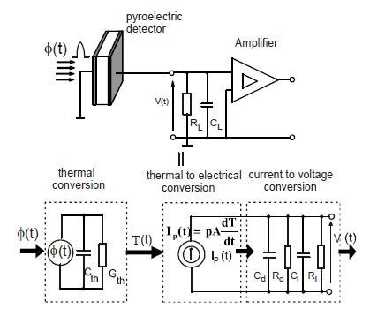
Equivalent model of pyroelectric circuit[11]

Slide 21
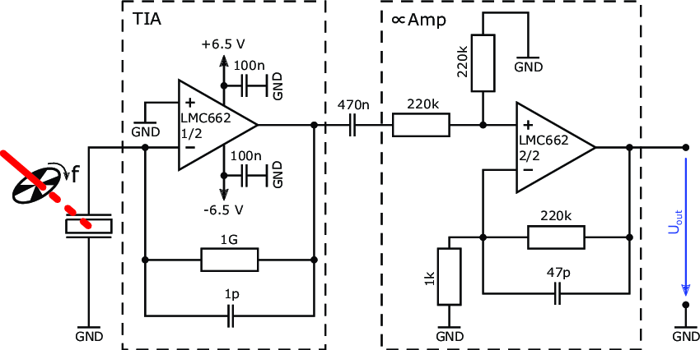
Readout circuit for the pyroelectric detector [12]
A scheme of the readout circuit for the pyroelectric detector. The modulated radiation that hits the pyroelectric detector leads to a generation of free charges.

Slide 22
Operating principle
When infrared radiation interacts with gas molecules, infrared light is absorbed by the gas molecules at a particular wavelength, causing vibration of the gas molecules. NDIR gas sensors detects the decrease in transmitted infrared light which is in proportion to gas concentration. This transmittance, the ratio of transmitted radiation energy to the incident energy, is dependent on target gas concentration.

Slide 23
Ideal Length Of NDIR Gas Cylinder
The most ideal dimension of gas chamber as per industry standard is a cylinder with 20mm Diameter x 16.5mm Length.
With this length of cylinder there is a negligible decrease in the intensity of IR radiation.
Since, as we increase the length of the gas chamber intensity of IR radiation decreases exponentially as per the below mentioned Lambert Law.
I=I₀ e^{-kl} or, A ∝ l

Slide 24
How to prevent loss of intensity due to multiple reflection?
In NDIR Gas Sensor, the intensity of IR radiation also decreases because of continuous reflection within the gas chamber.
So, in order to prevent this decrease in intensity, the gas chamber is coated with a layer of gold, so as to absorb minimum IR radiation.

Slide 25
Amplifier
The output from the sensor has very low output voltage, in order to observe the voltages we have to choose an amplifier with high gain.
Mostly differential amplifiers are used to achieve the more gain and less noise.
The output contains some noise, and these noises are eliminated by some techniques like sampling etc.

Slide 26
Microcontroller
Microcontroller is used to process the Data and to display the Output.
In this project Arduino is used as the microcontroller as it is the open source.

Slide 27
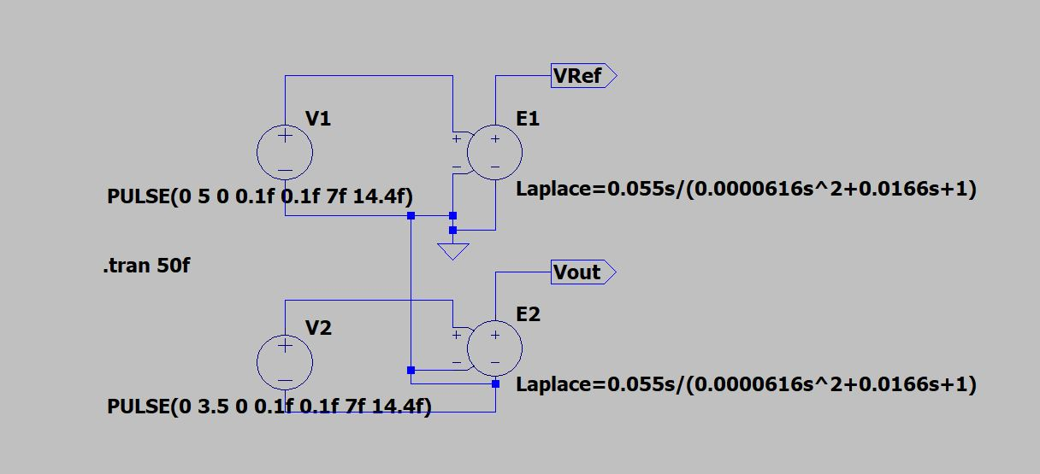
Partial results:

Slide 28
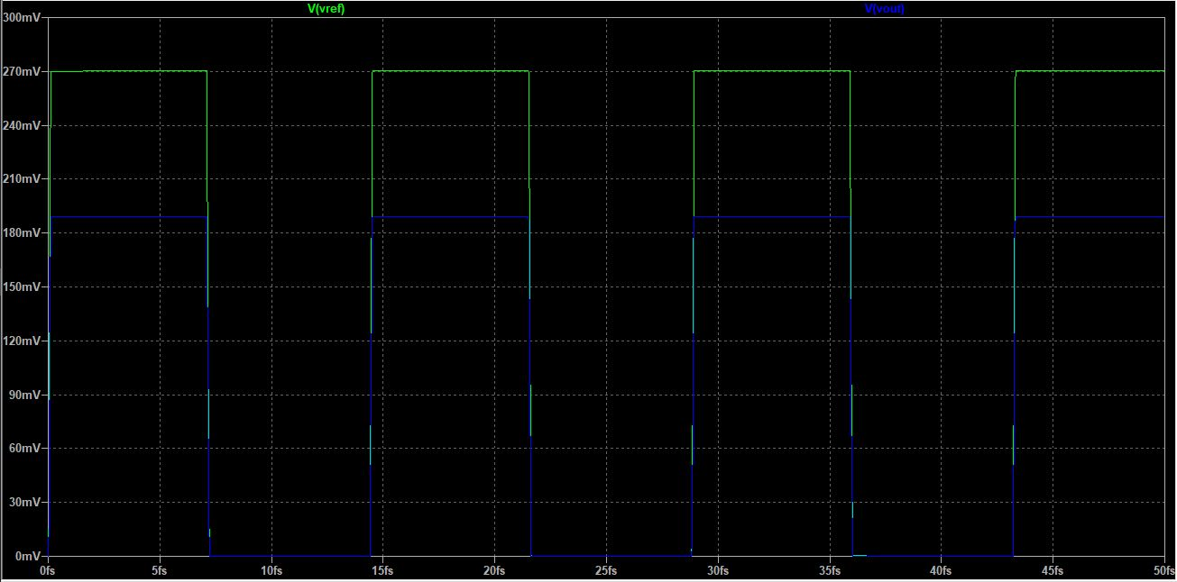
Output waveforms

Slide 29
References
[1] Complete Gas Sensor Circuit Using Nondispersive Infrared (NDIR) By Robert Lee and Walt Kester.
[2] https://spie.org/publications/fg08_p65_beers_law?SSO=1
[3] https://en.wikipedia.org/wiki/Nondispersive_infrared_sensor
[4] https://commons.wikimedia.org/wiki/File:Mid-infrared_absorption_spectra_of_Gases.png
[5] Byrnes, James (2009). Unexploded Ordnance Detection and Mitigation. Springer. pp. 21– Bibcode:2009uodm.book.....B. ISBN 978-1-4020-9252-7.
[6] "Infrared Light". RP Photonics Encyclopedia. RP Photonics. Retrieved 20 July 2021.

Slide 30
[7] "Photoacoustic technique 'hears' the sound of dangerous chemical agents". R&D Magazine. August 14, 2012. rdmag.com. Retrieved September 8, 2012.
[8] Henderson, Roy. "Wavelength considerations". Instituts für Umform- und Hochleistungs. Archived from the original on 2007-10-28. Retrieved 2007-10-18
[10] "Near, Mid and Far-Infrared". NASA IPAC. Archived from the original on 2012-05-29. Retrieved 2007-04-04.
[11] Modelling and Simulation of the Pyroelectric Detector Using MATLAB/Simulink A. Odon Institute of Electrical Engineering and Electronics, Division of Metrology and Optoelectronics, Poznan University of Technology, Piotrowo 3A, 60-965 Poznan, Poland, andrzej.odon@put.poznan.pl
[12] A CMOS Compatible Pyroelectric Mid-Infrared Detector Based on Aluminium Nitride.

Slide 31
Thank you

