Slide 1
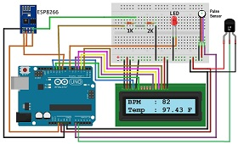
Minor Project on Patient Health Monitoring System using Arduino & ESP8266
Presented by –
Priyansh Chawla (0201EC181063)
Rishabh Tiwari (0201EC181065)
Rishav Pandey (0201EC181066)
Rohit Kumar Jaiswal (0201EC181069)
Under the guidance of Prof. Garima Tiwari

Slide 2
Project Description
Sometimes it happens when patients struggles to find hospital beds but due to high number of covid patients they are forced to stay at home and aren't monitored by any doctor. This Health Monitoring System designed with the help of Arduino UNO board and ESP8266 wifi microchip helps the doctor to monitor the patient remotely (connected via an IoT based platform ThingSpeak). ESP8266 wi-fi microchip is used to provide internet connectivity to our project (or we can connect our project to any wifi using same). The system consists of a pulse sensor and and an LM35 temperature sensor which measures the patient's heart beats per minute and body temperature respectively. The Arduino reads the sensor data, converts them into string, passes them to the IoT platform (ThingSpeak) and also displays the BPM and body temperature on LCD display.
In this way a doctor can remotely monitor the patients and take appropriate actions when required.

Slide 3

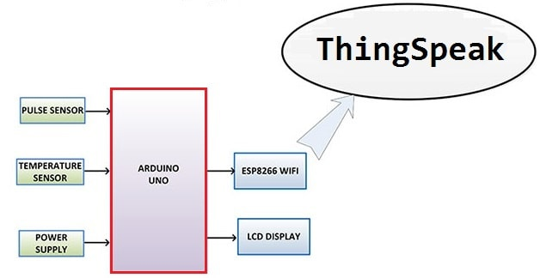
Block Diagram
This is a simple block diagram that explains the Patient Health Monitoring System using ESP8266 & Arduino. Pulse Sensor and LM35 Temperature Sensor measure BPM & Environmental Temperature respectively. The Arduino processes the code and displays it to 16*2 LCD Display. ESP8266 Wi-Fi module connects to Wi-Fi and sends the data to IoT device server. The IoT server used here is ThingSpeak. Finally, the data can be monitored from any part of the world by logging into the ThingSpeak channel.

Slide 4

Components Required
Arduino Board (UNO/NANO)
ESP8266 Wifi Module
16X2 LCD Display
Potentiometer (10k Ohm)
Resistors (2.2K & 1K Ohm)
Pulse Sensor
LM35 Temperature Sensor
LED (any colour)
Breadboard (large size)
Jumper Wires (20-30 nos.)

Slide 5
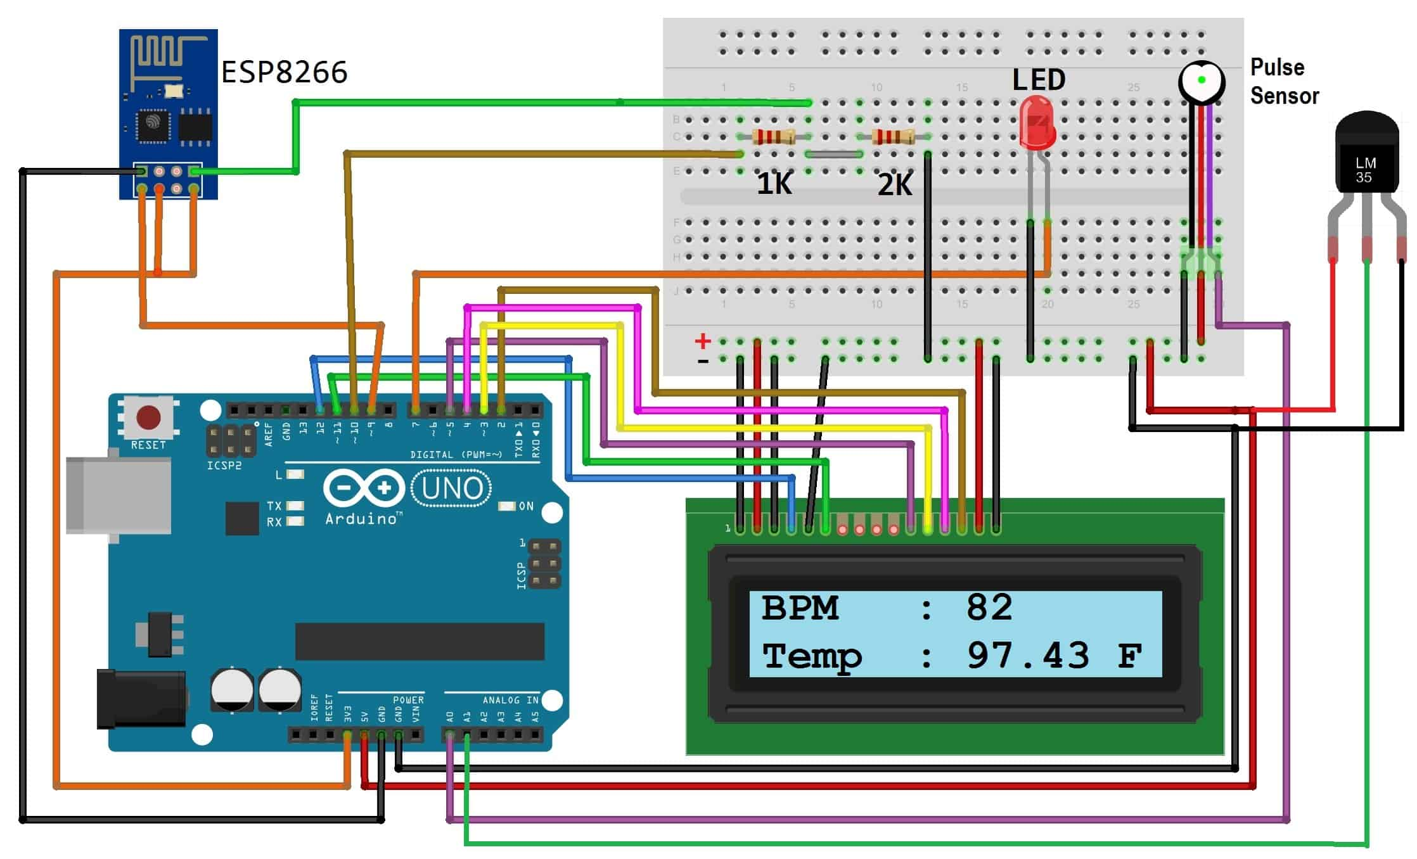
Circuit Diagram & Connections:

Slide 6
Cont…
Connect Pulse Sensor output pin to A0 of Arduino and other two pins to VCC & GND.
Connect LM35 Temperature Sensor output pin to A1 of Arduino and other two pins to VCC & GND.
Connect the LED to Digital Pin 7 of Arduino via a 220-ohm resistor.
Connect Pin 1,3,5,16 of LCD to GND.
Connect Pin 2,15 of LCD to VCC.
Connect Pin 4,6,11,12,13,14 of LCD to Digital Pin12,11,5,4,3,2 of Arduino.
The RX pin of ESP8266 works on 3.3V and it will not communicate with the Arduino when we will connect it directly to the Arduino. So, we will have to make a voltage divider for it which will convert the 5V into 3.3V. This can be done by connecting the 2.2K & 1K resistor. Thus the RX pin of the ESP8266 is connected to pin 10 of Arduino through the resistors.
Connect the TX pin of the ESP8266 to pin 9 of the Arduino.

Slide 7
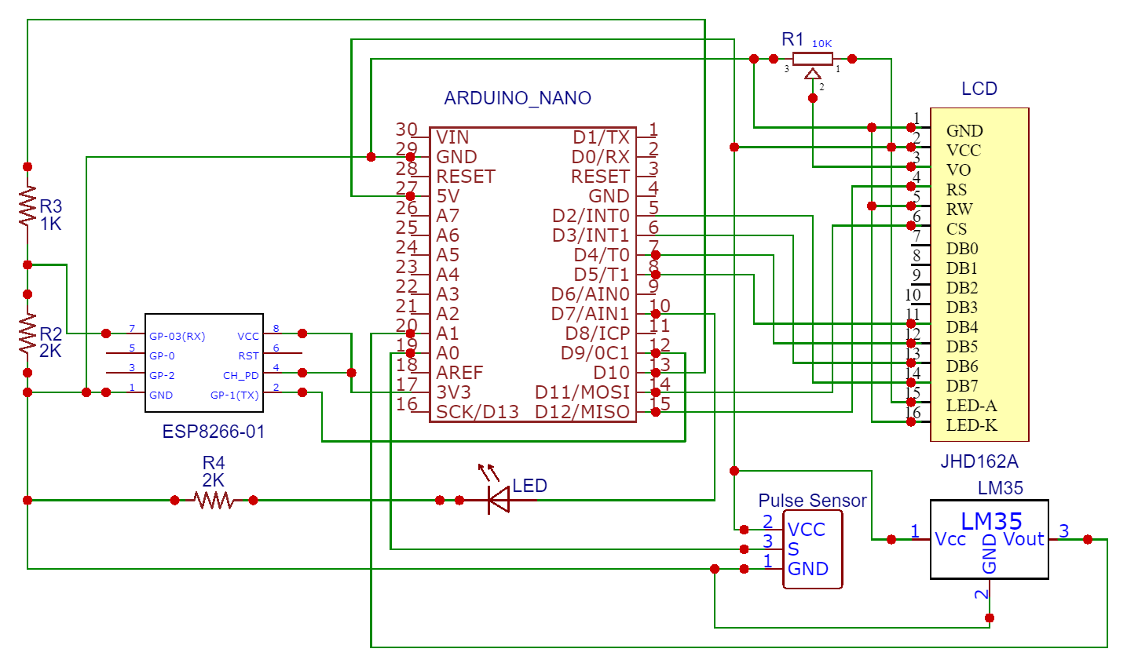
Can we use Arduino NANO instead of Arduino UNO?
Yes we can. Below, is the simple schematic diagram using Arduino NANO.

Slide 8
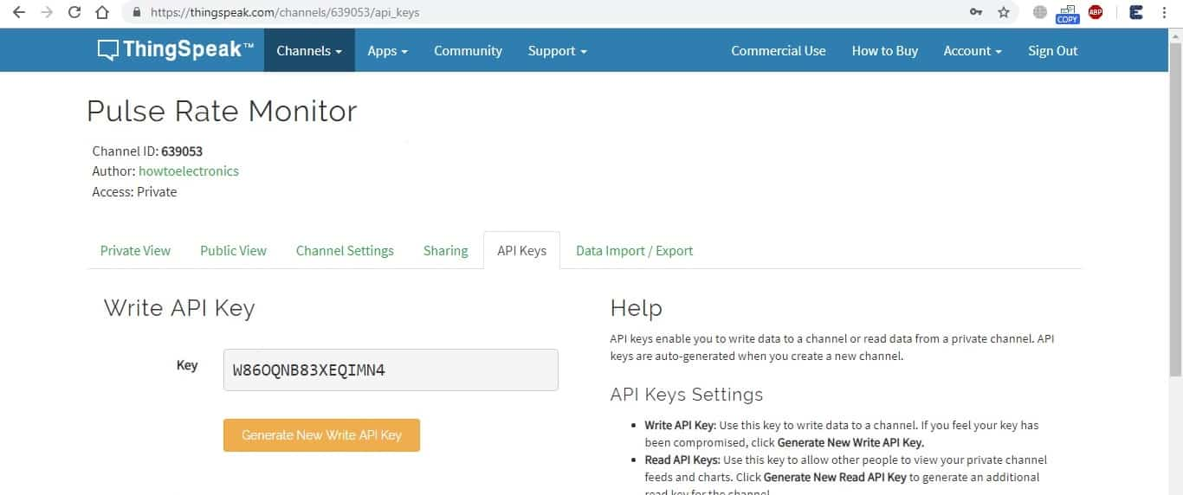
Setting up ThingSpeak
ThingSpeak is a good tool for IoT based projects. By using the ThingSpeak site, we can monitor our data and control our system over the Internet, using the Channels and web pages provided by ThingSpeak.
First we have to create a channel and then we have to provide API keys. The below key is required for programming modifications and setting our data.

Slide 9
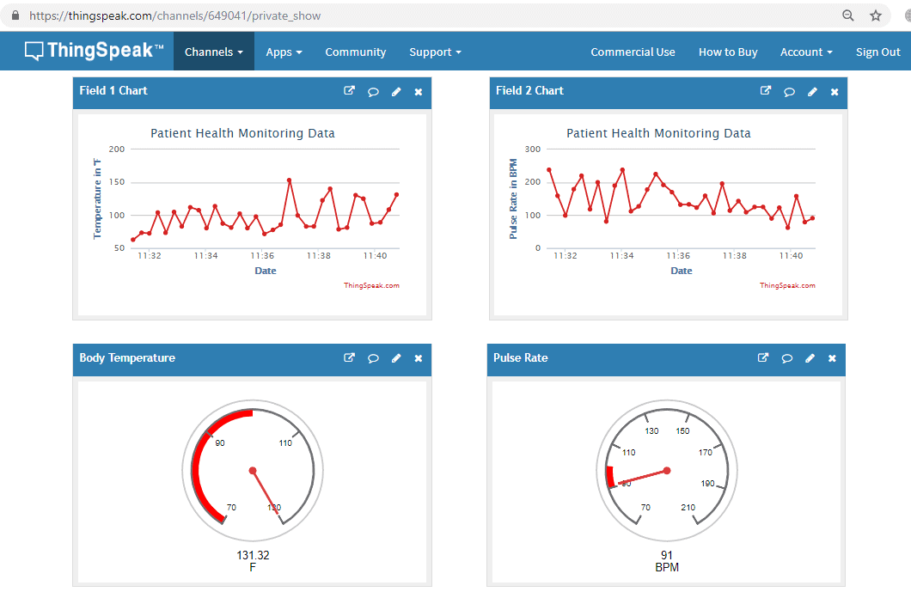
Cont….
Now, we upload the code to the Arduino UNO by assembling the circuit as shown in slide no. 5. We open the serial monitor and it will automatically connect to Wi-Fi and set up everything.
Now, we click on channels so that we can see the online data streaming, i.e Patient Health Monitoring System using ESP8266 & Arduino as shown in the figure below.

Slide 10
References….
https://en.wikipedia.org/wiki/Sensor
https://dewesoft.com/daq/what-is-a-sensor
https://www.ti.com/lit/ds/symlink/lm35.pdf
https://www.ti.com/lit/ds/symlink/lm35.pdf
https://www.rohm.com
https://en.wikipedia.org/wiki/Arduino

Slide 11


