Slide 1
Drone
Camera
Sensor 4
BLDC motor
BLDC motor
GPS
ESC1
ESC2
Sensor1
Raspberry Pi running ROS
Flight Controller
Communication
Sensor2
T
x
ESC3
ESC4
Sensor3
Rx
Power supply
BLDC motor
BLDC motor
QGroundControl
Ground Control Station
Fig. 1 : Overview of Block diagram of flood disaster management drone system(FDMDS)

Slide 2

Drone
Camera
Sensor 4
BLDC motor
BLDC motor
GPS
ESC1
ESC2
Server
Sensor1
Raspberry Pi running ROS
Flight Controller
Communication
Sensor2
T
x
ESC3
ESC4
Sensor3
Rx
Power supply
BLDC motor
BLDC motor
QGroundControl
Ground Control Station
Fig. 1 : System Block Diagram

Slide 3
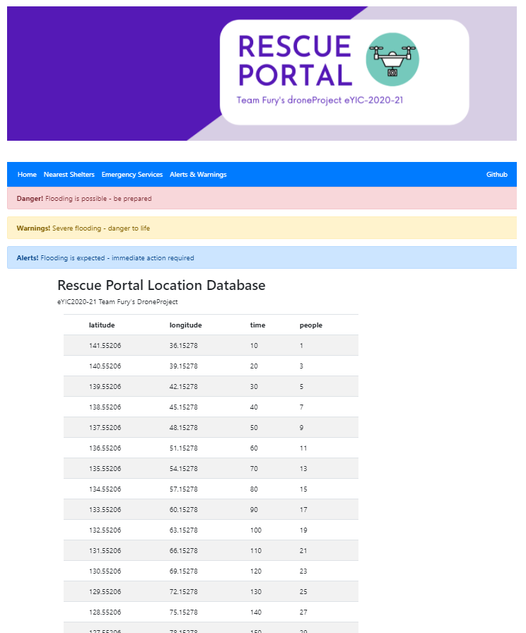
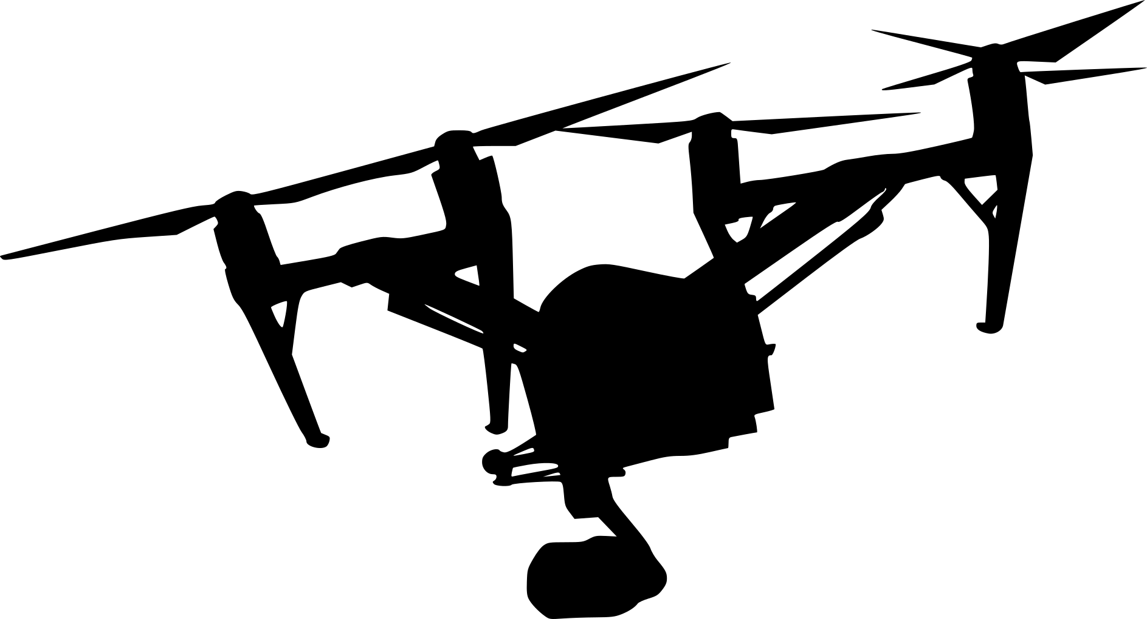


UAV
Firebase Realtime database
RescueXportal
Google sheet as Temporary Database
Fig. 2 : RescueXportal for Rescue Team

