Slide 1
AI in Software Testing

Slide 2
Artificial Intelligence
Artificial intelligence is the study of agents that perceive the world around them, form plans, and make decisions to achieve their goals
Ability to interact with the world (speech, vision, motion, manipulation)
Ability to model the world and to reason about it
Ability to learn and to adapt
Machine Learning, is a subfield of AI, looking for patterns in vast amounts of data that is just too big for humans to analyze. Its goal is to enable computers to learn on their own.

Slide 3
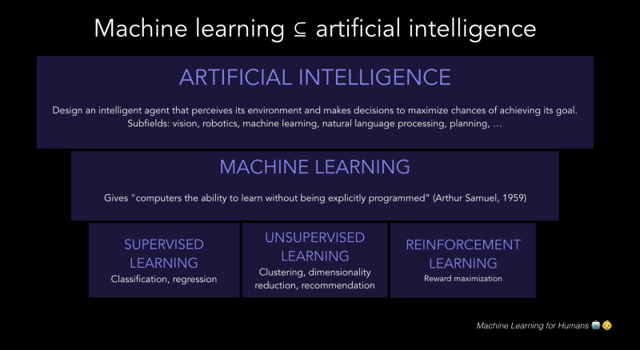

Slide 4
What is learning?
Learning is any process by which a system improves performance from experience.
Learning = Improving with experience at some task
Improve over task T
With respect to performance measure, P
Based on experience, E.
Example: Spam Filtering
T: Identify Spam Emails
P: spam emails that were filtered (labeled spam)+ non spam (labelled non spam)/total samples(including wrong prediction)
E: a database of emails that were labelled by users

Slide 5
Types of Machine Learning: Supervised Learning
We have a data set containing training examples with associated correct labels. There are two types:
Classification
Regression
Classification : assigns new observations to the class (discrete target label Y such as if input X is a cat or dog? ) to which they most likely belong
Regression: predicts a continuous target variable Y. It allows you to estimate a value, such as housing prices or human lifespan, based on input data X.

Slide 6
Supervised Learning: Classification Example
When learning to classify handwritten digits.
a supervised learning algorithm takes thousands of pictures of handwritten digits along with labels containing the correct number each image represents.
The algorithm will then learn the relationship between the images and their associated numbers
Apply that learned relationship to classify completely new images (without labels) that the machine hasn’t seen before

Slide 7
Supervised Learning: Regression Example
When predicting the stock prices of a company based on stock prices of the week:
It takes thousands of sets of weekly stock prices along with labels containing the stock price of the day after the week.
The algorithm will then learn the relationship between the stock price and previous week’s stock prices.
The relationship will be in the form of y = f(x)
Where y is stock price and x is the previous week’s stock price
If we assume the relationship to be y = mx + b then we will estimating m and b based on the training data to predict stock prices in future.
Apply this learned relationship to predict stock prices based on weekly stock data which is not in training.

Slide 8
Supervised Learning in Testing
Let us say that there are 5 different departments that can have a defect for a particular user story.
Now we have data set in the following form for user story 1:
Classification
If we have to predict whether department will have defect for a particular user story.
Regression
If we have to predict the number of defects in a particular department for a given user story.
User Story | Department | Has defect | No of defects
1 | A | Yes | 2
1 | B | Yes | 3
1 | C | No | 0
1 | D | No | 0
1 | E | Yes | 7

Slide 9
Types of Machine Learning: Unsupervised Learning:
Unsupervised learning methods are techniques trying to find hidden structure out of unlabeled data.
Clustering techniques are on of the most popular type of unsupervised learning algorithms.
In clustering, a set of inputs is to be divided into groups. The groups are not known beforehand, making this typically an unsupervised task. i.e. the we do not have labelled data.
Dimensionality Reduction refers to reducing the complexity of the data while keeping as much of the relevant structure as possible. In other words Finding the best low dimensional representation of the data.

Slide 10
Commonly used Unsupervised Learning Algorithms and their modules in python.
Clustering
K-means (Crisp clustering): sklearn.cluster.KMeans
Fuzzy C means (A point can have multiple members): skfuzzy.cluster
Spectral Clustering (Avoids spherical clusters, graph based): sklearn.cluster.SpectralClustering
Dimensionality Reduction(reduce the complexity of the data while keeping as much of the relevant structure as possible)
PCA (Principal Component Analysis): sklearn.decomposition.PCA

Slide 11
K-Means Clustering
Customer segmentation can be performed using a variety of different customer characteristics like demographics (e.g., age, gender, marital status, income), purchase behaviour purchase behavior (e.g., previous purchases)
In this example our dataset contains e annual income of customers and their annual spending on an e-commerce site.
K-means clustering algorithm can be derive understand the underlying customer segments based on the data provided.

Slide 12
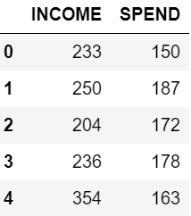
K-Means Clustering
Sample Data
K means Algorithm Steps (given k):
Partition of objects into k non-empty subsets
Identifying the cluster centroids (mean point) of the current partition.
Assigning each point to a specific cluster
Compute the distances from each point and allot points to the cluster where the distance from the centroid is minimum.
After re-allotting the points, find the centroid of the new cluster formed.
Iterate till end condition is met (max-iterations, centroids are stable)

Slide 13
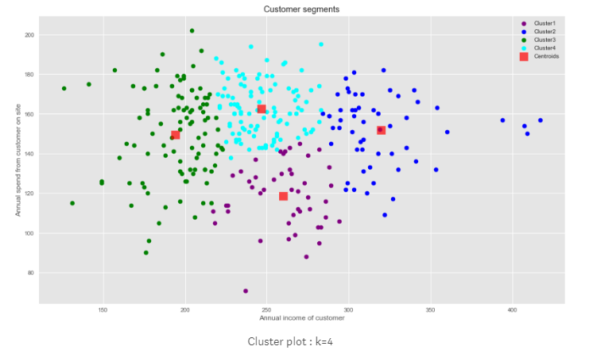
For example if we want to identify 4 segments of customers, we can run our K-means algorithm on the data with k=4.
Result

Slide 14
K-Means Clustering
The clusters formed can be interpreted as follows
Cluster 1: Customers with medium annual income and low annual spend
Cluster 2: Customers with high annual income and medium to high annual spend
Cluster 3: Customers with low annual income
Cluster 4: Customers with medium annual income but high annual spend
Based on these clusters marketing teams can formulate different strategies for each segment.

Slide 15
Deep Learning
Deep learning is a specialized form of machine learning.
It teaches computers to do what comes naturally to humans: learn by example.
Deep learning models can achieve state-of-the-art accuracy, sometimes exceeding human-level performance.
Models are trained by using a large set of labeled data and neural network architectures that contain many layers.
Some examples are:
Recurrent Neural Networks
Artificial Neural Networks
Convolutional Neural Networks

Slide 16
How is Deep Learning different from Machine Learning?
A machine learning workflow starts with relevant features being manually extracted from images. The features are then used to create a model that categorizes the objects in the image. With a deep learning workflow, relevant features are automatically extracted from images
Deep learning performs “end-to-end learning” – where a network is given raw data and a task to perform, such as classification, and it learns how to do this automatically.
Deep learning algorithms scale with data, whereas machine learning methods that plateau at a certain level of performance when you add more examples and training data to the network.
A key advantage of deep learning networks is that they often continue to improve as the size of your data increases.

Slide 17
When to use Deep Learning?
Consider whether you have a high-performance GPU and lots of labeled data. If you don’t have either of those things, it may make more sense to use machine learning instead of deep learning.
Deep learning is generally more complex, so you’ll need at least a few thousand images to get reliable results. Having a high-performance GPU means the model will take less time to analyze all those images.
When there is lack of domain understanding for feature introspection, Deep Learning techniques outshines others as you have to worry less about feature engineering.

Slide 18
Deep Learning in Testing
Consider the same example of defect detection.
We create one network that is able to predict the department with defects and number of defects in that department.
This network is computationally complex but will be more accurate and gives a better control over the learning of the model.
User Story | Department | Has defect | No of defects
1 | A | Yes | 2
1 | B | Yes | 3
1 | C | No | 0
1 | D | No | 0
1 | E | Yes | 7

Slide 19
We use Recurrent Neural Network (RNN) to get a context vector for the user story.
This context vector is then passed to two different classifiers for predicting which departments will have defects and no of defects in the department.
This is shown below:
ANN
Has Defect Prediction
…
RNN
Context Vector
…
Context Vector
Vectorised User Story to analyse
ANN
No of defects Prediction
…
Each output node of the classifier is a department

Slide 20
Getting Started with Python
To understand machine learning, you need to have basic knowledge of Python programming.
It is recommend to have a good hands on with data structures in python -
Dictionaries
Lists
Tuples
In addition, there are a number of libraries and packages generally used in performing various machine learning tasks as listed below −
numpy − is used for its N-dimensional array objects
pandas − is a data analysis library that includes dataframes
matplotlib − is 2D plotting library for creating graphs and plots
scikit-learn − the algorithms used for data analysis and data mining tasks

