Slide 1
Building a Privacy-Preserving Blockchain-Based Bidding System:
A Crypto Approach
PRESENTATION BY:
N LAKSHMI POOJITHA(19221A0574)
M S G KARTHIK GUPTHA(19221A0571)
M DAVID PAUL(19221A0573)
G GOPI RAJU(19221A0529)
GUIDED BY:
Ms.N JEEVANA JYOTHI
M.tech

Slide 2
CONTENTS
Abstract
Objective
Motivation
Problem Statement
Scope of Work
Existing System
Proposed System
Work Flow
Block Chain
Modules
Usecase Diagrams
System Requirements
Output Screens
Conclusion

Slide 3
ABSTRACT
Blockchain-based bidding systems are becoming increasingly popular nowadays. Due to the properties of blockchain, bidding records are unchangeable. With existing encryption techniques, these bidding records can only be shared by the bidder and the seller. Although this scenario sounds secure, it does not consider a coercion case. A powerful coercer may force the bidding system to open the records stored on the blockchain, and the system loses privacy.
To solve this problem, in this paper, we introduce a new encryption scheme called deniable matchmaking encryption (DME). This new encryption scheme provides deniability not only for the message, but also for the identities.
We use the chameleon hash function to make fake message and fake identities indistinguishable from the real message and the real identities. Therefore, the bidding system can use fake information to answer the coercer, and user privacy is kept by the blockchain-based bidding system.

Slide 4
OBJECTIVE
In a bidding system., the most important property is the privacy of the identities of the transaction both sides and the bidding content.

Slide 5
MOTIVATION
Encryption scheme called deniable matchmaking encryption (DME). This new encryption scheme provides deniability not only for the message, but also for the identities.

Slide 6
PROBLEM STATEMENT
Blockchain technique to create a secure and reliable data exchange platform across multiple data providers, where IoT data is encrypted and recorded in a distributed ledger.
Blockchain technique to create a secure and reliable data exchange platform across multiple data providers, where IoT data is encrypted and recorded in a distributed ledger
Block chain-based bidding systems, there are still some ‘‘out-of-rules’’ problems that can break the security and privacy of applications. try to trace an opposing party’s messages with the excuse of circumventing fake news. The government may force some service providers to hand over specified users’ secrets

Slide 7
SCOPE OF WORK
Using DME on block chain-based bidding systems, we can preserve the privacy of the buyer and seller identities during the auction.

Slide 8
EXISTING SYSTEM
Block chain has inbuilt support for data unchangeable and encryption which is making Block chain more secure and this advantages forcing application developers to migrate towards Block chain.
Online Bidding is one of the application where bidders will bid for particular tenders and some malicious internal employees will change bidding or tender details to make their favourable person to win bidding and this manipulation will cost huge loss to the bidding system.

Slide 9
DISADVANTAGES OF EXISTING SYSTEM
Privacy issues.
DME is not implemented

Slide 10
PROPOSED SYSTEM
Block chain-based bidding systems are becoming increasingly popular nowadays. Due to the properties of Block chain, bidding records are unchangeable. With existing encryption techniques, these bidding records can only be shared by the bidder and the seller. Although this scenario sounds secure, it does not consider a coercion case. A powerful coercer may force the bidding system to open the records stored on the Block chain, and the system loses privacy.
To solve this problem, in this paper, in propose paper a new encryption scheme called deniable matchmaking encryption (DME). This new encryption scheme provides deniability not only for the message, but also for the identities. We use the chameleon hash function to make fake message and fake identities indistinguishable from the real message and the real identities.
Therefore, the bidding system can use fake information to answer the coercer, and user privacy is kept by the Block chain-based bidding system.

Slide 11
ADVANTAGES OF PROPOSED SYSTEM
Higher accuracy
Chameleon hash function will implemented

Slide 12
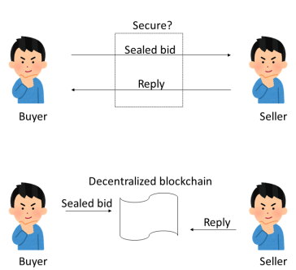
WORKFLOW

Slide 13
BLOCKCHAIN
Blockchain will store each data/transaction as block and before storing any new block, Blockchain will verify all previous blocks hashcode in all running nodes and if all block hashcodes verified then only new block will be added and if any node verification failed then data will be gathered from other working nodes and attacked system get recovered. Blockchain never allowed any attacker to modify blocks so it will consider as immutable.

Slide 14
DJANGO
Django is a high-level Python web framework that encourages rapid development and clean, pragmatic design. Built by experienced developers, it takes care of much of the hassle of web development, so you can focus on writing your app without needing to reinvent the wheel. It’s free and open source.

Slide 15
MODULES
Bidding Officer Login: bidding officer will login to application using username and password as ‘admin’ and ‘admin’ and then create tender with initial bidding amount. This user will evaluate bidding to select bidder with LOWEST amount and then will run ‘Winner Selection’ module to select winner.
Bidder Login: Bidder can signup with the application and then login and then view all tenders and bidding and can bid for desired tender. Tender status can be view by clicking on ‘View Status’ link which will display all tender, bidding and winner details.

Slide 16
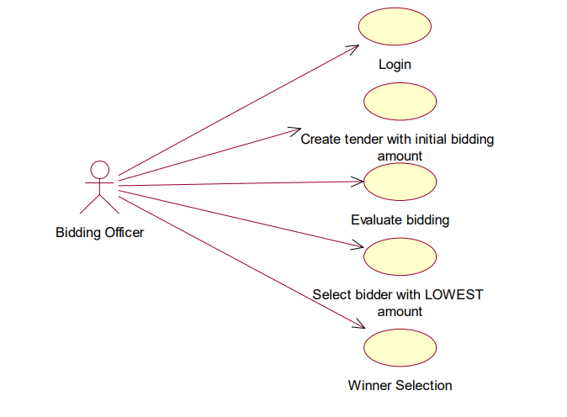
USECASE DIAGRAMS

Slide 17
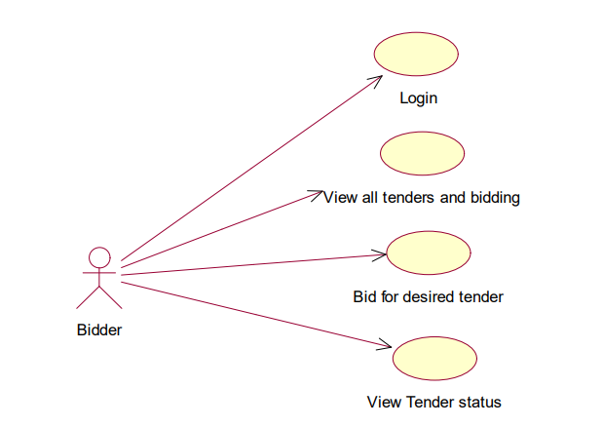

Slide 18
SYSTEM REQUIREMENTS
HARDWARE REQUIREMENTS:
System : i3
Hard Disk : 500GB.
Ram : 4 GB.

Slide 19
SYSTEM REQUIREMENTS:
SOFTWARE REQUIREMENTS:
Operating system : Windows 10/11.
Coding Language : PYTHON

Slide 20
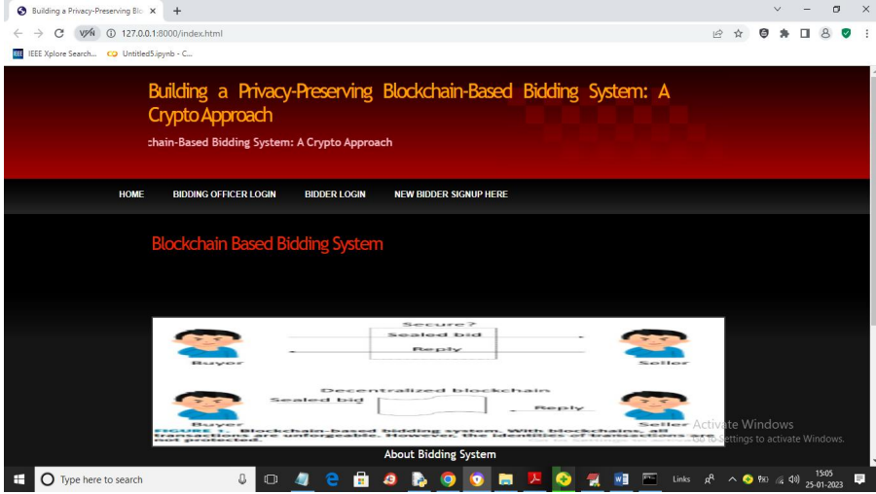
OUTPUT SCREENSHOTS
home page:

Slide 21
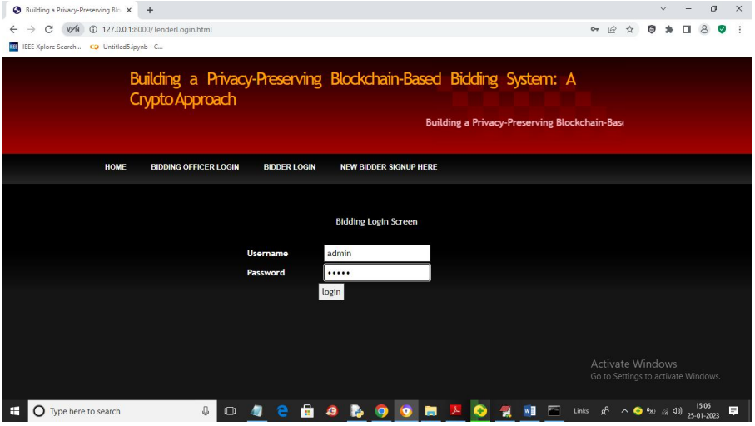
bidder-officer login:

Slide 22
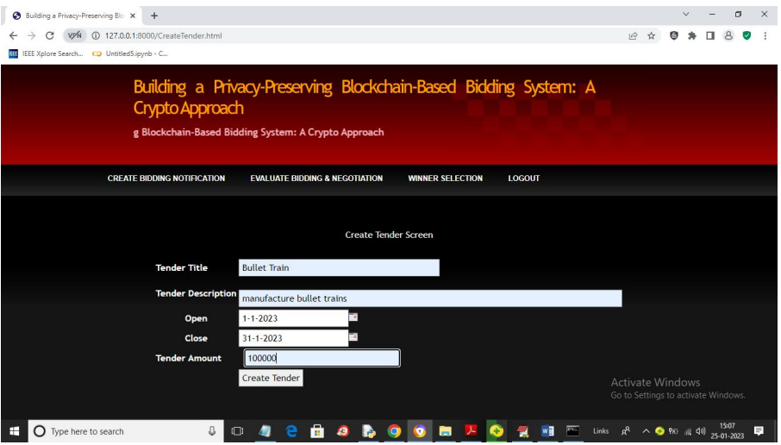
creating a tender screen:

Slide 23
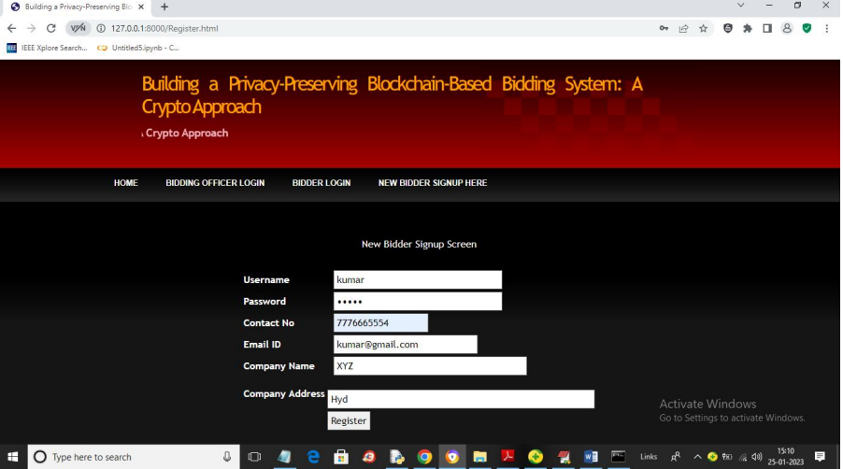
new bidder signup:

Slide 24
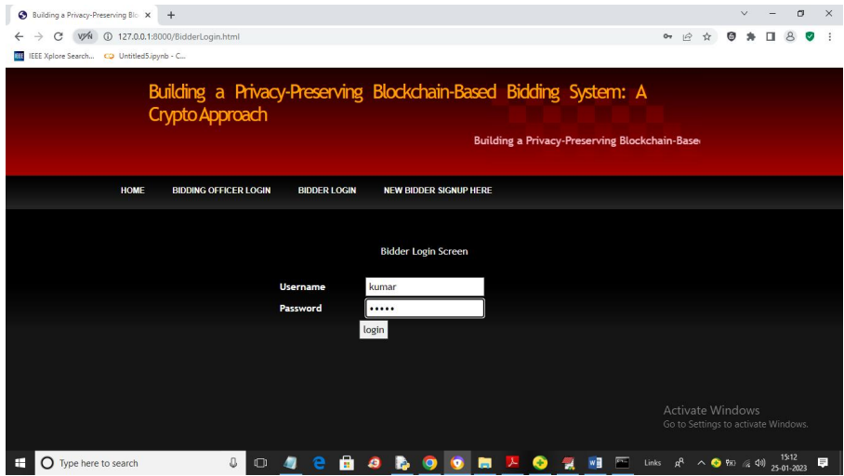
bidder login:

Slide 25
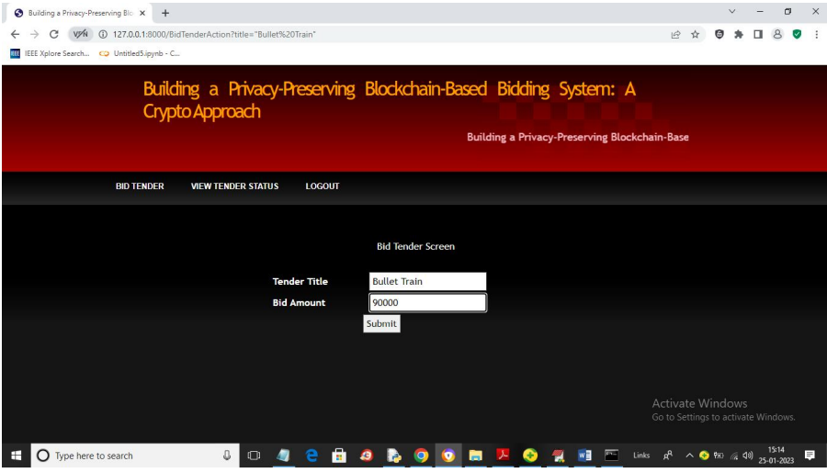
bid tender screen:

Slide 26
CONCLUSION
We proposed a new encryption called DME to solve the coercion problem on blockchain-based bidding systems. Using DME on blockchain-based bidding systems, we can preserve the privacy of the buyer and seller identities during the auction. We use a fake buyer and seller pair to cover the real transaction, including the identities and the content. We show that our scheme costs approximately twice the base scheme in both space and computational time for the deniability feature. We believe it is worth the cost to protect the privacy of transaction identities.

