Slide 1
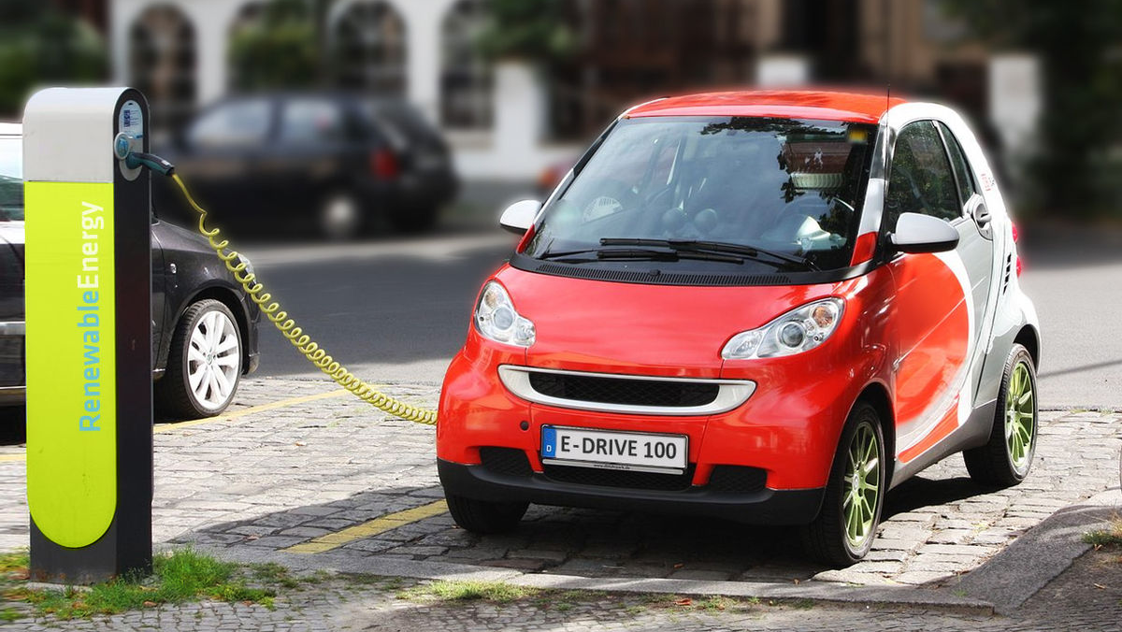
Electrifying India ⚡️
Market Insights and Strategic Recommendations for AtliQ Motors
ThePhoto by PhotoAuthor is licensed under CCYYSA.

Slide 2
Content
Introduction
01
Problem Statement
02
Process
03
Secondary Research
04
Conclusion
05

Slide 3
Introduction
AtliQ Motors is an automotive giant from the USA specializing in electric vehicles (EV). In the last 5 years, their market share rose to 25% in electric and hybrid vehicles segment in North America.

Slide 4
Problem Statement
As a part of their expansion plans, they wanted to launch their bestselling models in India where their market share is less than 2%. Bruce Haryali, the chief of AtliQ Motors India wanted to do a detailed market study of existing EV/Hybrid market in India before proceeding further. Bruce gave this task to the data analytics team of AtliQ motors and Peter Pandey is the data analyst working in this team.

Slide 5
Process
Data Understanding
Data Cleaning
Data Modeling
Data Analysis
Uncover Insights

Slide 6
Data Understanding
Given there CSV files related to electric vehicle sales data.
electric_vehicle_sales_by_state.csv
electric_vehicle_sales_by_makers.csv
dim_data.csv
These datasets includes sales by state, sales by maker, and a data dimension table useful for time-series analysis.
Key points are: Fiscal year, penetration rate, compound annual growth rate(CAGR).

Slide 7
Data Cleaning
Used Python Pandas for Cleaning
The dataset have no null values
State Dataset shape (2445, 4) and found one change in states 'Andaman & Nicobar' have 2 entries convert to 'Andaman & Nicobar Island'
Makers Dataset shape (816, 4) and converted the date format
Dim Dataset shape (36, 3) and converted the data format
All these Datasets are saved in CSV format with utf-8 encoding for further analysis in SQL.

Slide 8
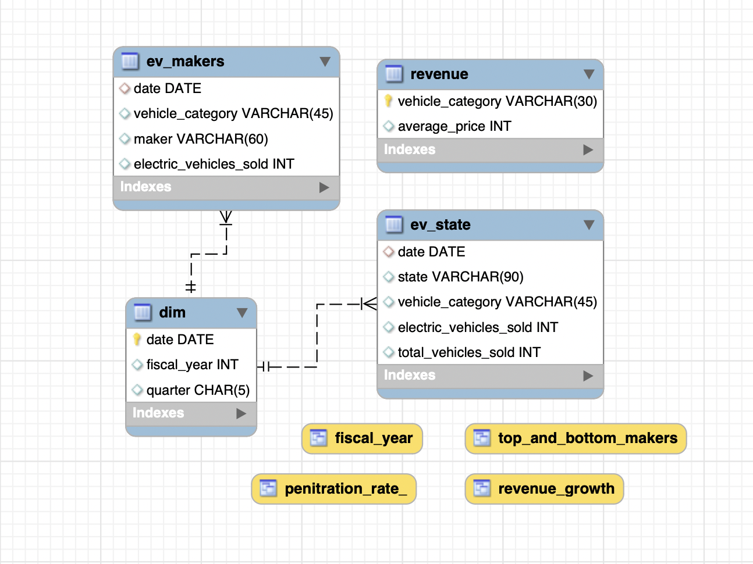
Data Modeling

Slide 9
Data Analysis
List the top 3 and bottom 3 makers for the fiscal years 2023 and 2024 in terms of the number of 2-wheelers sold.
Identify the top 5 states with the highest penetration rate in 2-wheeler and 4-wheeler EV sales in FY 2024.
List the states with negative penetration (decline) in EV sales from 2022 to 2024?
What are the quarterly trends based on sales volume for the top 5 EV makers (4-wheelers) from 2022 to 2024?
How do the EV sales and penetration rates in Delhi compare to Karnataka for 2024?
List down the compounded annual growth rate (CAGR) in 4-wheeler units for the top 5 makers from 2022 to 2024.

Slide 10
Data Analysis
List down the top 10 states that had the highest compounded annual growth rate (CAGR) from 2022 to 2024 in total vehicles sold.
What are the peak and low season months for EV sales based on the data from 2022 to 2024?
What is the projected number of EV sales (including 2-wheelers and 4-wheelers) for the top 10 states by penetration rate in 2030, based on the compounded annual growth rate (CAGR) from previous years?

Slide 11
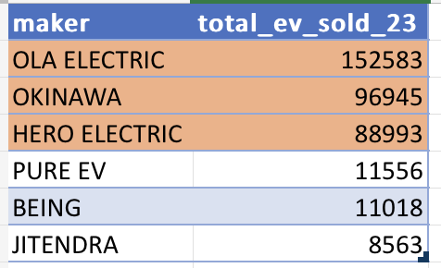
Top and Bottom 3 makers in 2023

Slide 12
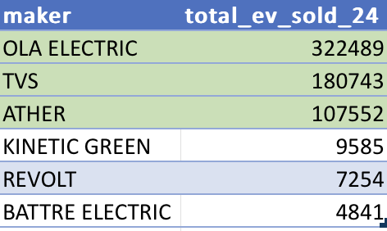
Top and Bottom 3 makers in 2024

Slide 13
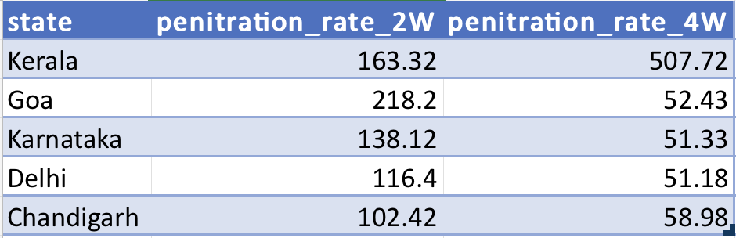
Top 5 Penetration States

Slide 14
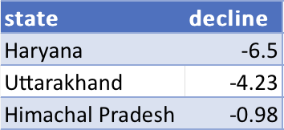
Negative Penetration Rate in EV(2022-2024)

Slide 15
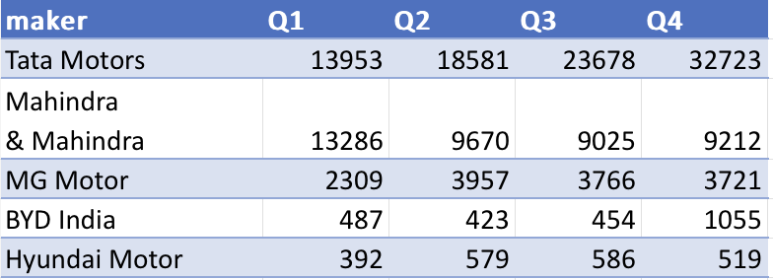
Top 5 (4-Wheel) EV makers Quarterly Trends

Slide 16
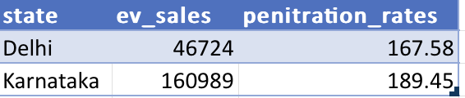
Penetration Rate in Delhi and Karnataka for 2024

Slide 17
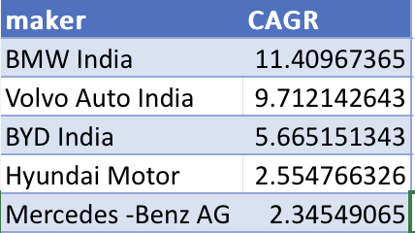
Top 5 Makers CAGR

Slide 18
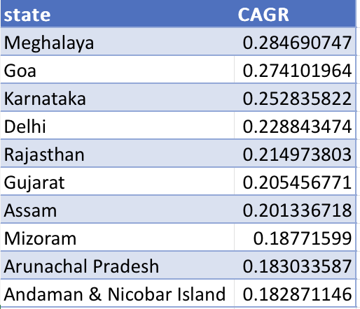
Top 10 States CAGR

Slide 19
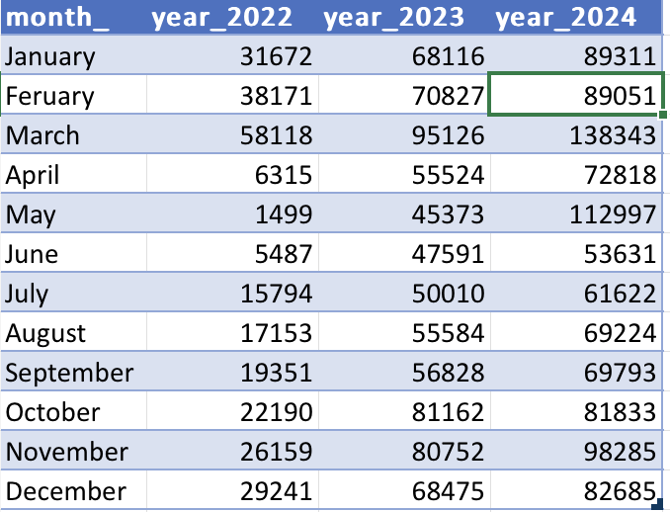
Monthly EV Sales 2022-24

Slide 20
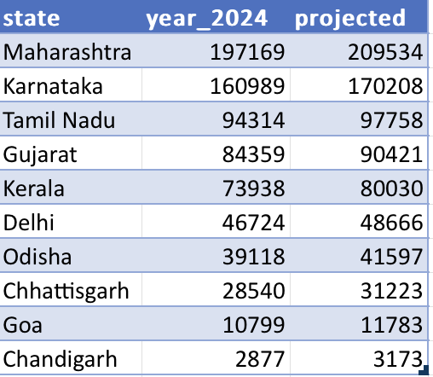
Projected EV Sales by 2030

Slide 21
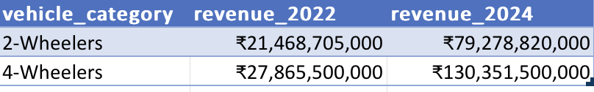
Revenue Rate of EV in 2022 VS 24

Slide 22
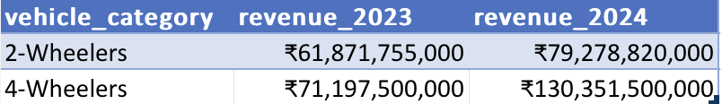
Revenue Rate of EV in 2023 VS 24

Slide 23
Uncover Insights
OLA's Market Dominance: OLA remained the top EV maker in both 2023 and 2024, suggesting strong brand loyalty or effective marketing and distribution strategies.
Emerging Competitors: The appearance of TVS and ATH in 2024 as top EV makers indicates dynamic market changes, possibly due to innovative products, better pricing, or superior technology.
States with High Penetration: Kerala, Goa, Karnataka, Delhi, and Chandigarh lead in EV penetration, suggesting these states have favorable conditions for EV adoption, such as supportive policies, better infrastructure, or higher consumer awareness.

Slide 24
Uncover Insights
States with Negative Penetration: Haryana, Uttarakhand, and Himachal Pradesh show negative growth rates, reason might me lack of charging infrastructure, consumers or lesser government support for EV adoption.
Comparison: Karnataka’s higher penetration rate could be due to more aggressive state policies, better incentives, or a stronger focus on renewable energy than Delhi.
Top 5 Makers: BMW India, Volvo auto India, BYD India, Hyundai Motor, and Benz have the highest Compound Annual Growth Rate (CAGR), indicating rapid growth in their EV sales over the period.

Slide 25
Uncover Insights
Sales Trends: Each year, March shows the highest sales, possibly due to fiscal year-end incentives, promotions, or new model launches.
Maharashtra’s Dominance: Maharashtra’s leading position indicates strong future growth, likely driven by urbanization, economic strength, and proactive government policies.
Revenue Growth: In both comparisons, the revenue rate in 2024 is higher, indicating overall market growth.

Slide 26
Secondary Research
Primary Reasons for Customers Choosing 4-Wheeler EVs in 2023 and 2024
Cost Savings: One of the primary reasons for choosing 4-wheeler EVs is the significant cost savings in the long term. With rising fuel prices, the lower operating and maintenance costs of EVs become attractive.
Environmental Concerns: Increasing awareness about climate change and pollution has led consumers to opt for environmentally friendly alternatives.

Slide 27
Secondary Research
Impact of Government Incentives and Subsidies on EV Adoption Rates
2-Wheelers: Government incentives and subsidies have greatly impacted the adoption rates of 2-wheeler EVs. Subsidies reduce the initial cost, making these vehicles affordable for middle and lower-income groups
4-Wheelers: For 4-wheelers, the impact is seen in terms of higher adoption rates among urban populations and higher-income groups.

Slide 28
Secondary Research
Correlation Between Charging Infrastructure Availability and EV Sales
Positive Correlation: There is a strong positive correlation between the availability of charging stations and the penetration rates of EVs in the top states. States like Karnataka, Goa, Kerala, and Delhi, which have higher EV sales and penetration rates, also have better charging infrastructure.
Brand Ambassador: Virat Kohli
World Wide recognized and respected person
As a sports icon known for his fitness and eco-friendly lifestyle, which are crucial for promoting EVs.

Slide 29
Secondary Research
Ideal State for AtliQ Motors to Start Manufacturing Unit
Gujarat offers substantial incentives for setting up manufacturing units, including capital subsidies, land allotment at concessional rates, and power subsidies.
Top 3 Recommendations for AtliQ Motors
Focus on Affordable EV models
Expand charging Infrastructure Partnerships
Leverage Digital Marketing

Slide 30
Conclusion
Dynamic Market: The EV market in India is highly dynamic, with rapid changes in market leaders, regional penetration, and growth rates.
Need for Tailored Strategies: Different regions and segments show varying levels of adoption and growth, highlighting the need for tailored strategies by companies and policymakers to maximize EV adoption.
Growth Potential: There is significant growth potential in the EV market, especially with supportive policies, infrastructure development, and growing consumer awareness of sustainability.

Slide 31
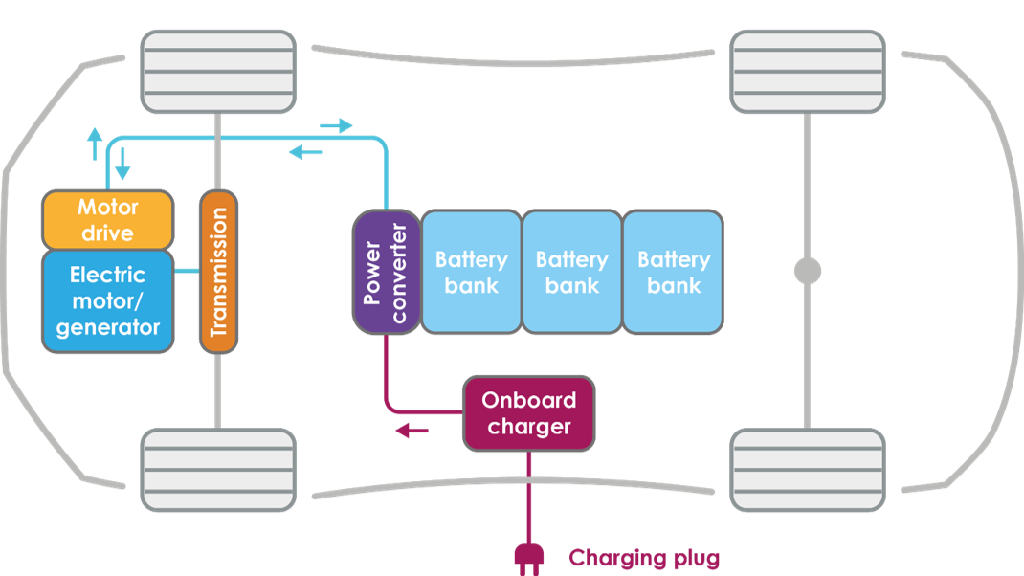
Thank you
Prepared by
Rishi Jhangili

