Slide 1



AT A GLANCE
PRIMEOR SOLUTIONS | DATA ANALYSIS INTERNSHIP
51,271
Global E-Commerce Data Analytics & Insights
audited records
$12.64M
gross revenue
End-to-end data analytics and BI system built with Excel, SQL and Power BI
$1.47M
net profit
Rishi Prajapati
11.62%
Data Analytics Intern
linkedin.com/in/rishi-prajapati-cs
github.com/rishi-prajapati-git
net profit margin
Notes:
Title slide. Introduce the project: Global E-Commerce Intelligence, built during the Primeor Solutions Data Analysis internship using Excel, SQL and Power BI.

Slide 2





Three levels, one pipeline
Raw CSV
Excel
SQL
Dashboard
Report
51,325 rows
clean + KPIs
10 queries
interactive BI
final ZIP
Level 1 | Excel
Level 2 | SQL
Level 3 | Dashboard
Raw data was duplicated, incomplete and inconsistent.
Spreadsheets could not group data across markets at scale.
Managers needed one interactive view, not tables.
Result: 51,271 clean rows, KPIs and pivots
Result: 10 queries and clear business answers
Result: 3-page dashboard with slicers

Slide 3
Level 1: from messy to trusted
1
Raw dataset
51,325 rows
THE PROBLEM
51,325 rows with duplicate transactions
Missing values in key columns
Mixed text and date formats
No clear view of profit or loss-making products
Remove duplicates
54 rows purged
2
3
Handle nulls
regional medians, 0 left
4
Standardise
text, spaces and dates
5
Validate numbers
invalid values corrected
6
Clean dataset
51,271 verified rows

Slide 4
Level 1 results: the core numbers
$12,635,222
$1,467,721.69
14.29%
Total Sales (=SUM)
Total Profit (=SUM)
Average Discount (=AVERAGE)
TOP PRODUCT BY SALES
BIGGEST LOSS-MAKER
Apple Smart Phone Full Size
Cubify 3D Printer
$86,935.78
-$8,879.97 profit
PIVOT TABLES AND CHARTS BUILT
Sales by Region
Profit by Category
Segment-wise Sales
Monthly Sales Trend

Slide 5
Level 2: asking SQL the right questions
Spreadsheets could not group data across markets, customers and categories at scale.
Cleaned file
Schema
Import
Indexes
10 queries
Insights
from Level 1
DDL design
SQLite DB
dates and keys
one per question
short answers
THE 10 QUERIES
01
02
03
04
05
Top 10 products
Top 10 customers
Region-wise sales
Category avg profit
Highest discount
06
07
08
09
10
Negative profit orders
Monthly sales trend
Market revenue
Top sub-categories
Ship mode usage

Slide 6
Where the revenue comes from
CORE PROFIT ENGINE
Technology
13.98% margin
$4.74M sales | $663k profit
MARGIN DILUTION
Furniture
6.97% margin
$4.11M sales | $286k profit
Notes:
APAC and EU together give 51.6% of revenue. APAC and EU are exact from the SQL output; US, LATAM, EMEA, Africa and Canada are read from the dashboard chart labels (rounded).

Slide 7
Why some orders lose money
SHIPPING
60.00%
of records use Standard Class
30,764 records
12,534 loss-making records (24.45%) lost $518,633.91 in total, with discounts near 45%.
Notes:
Loss-making records average a 45.08% discount versus 4.38% on profitable ones. Counts are dataset rows (order lines).

Slide 8
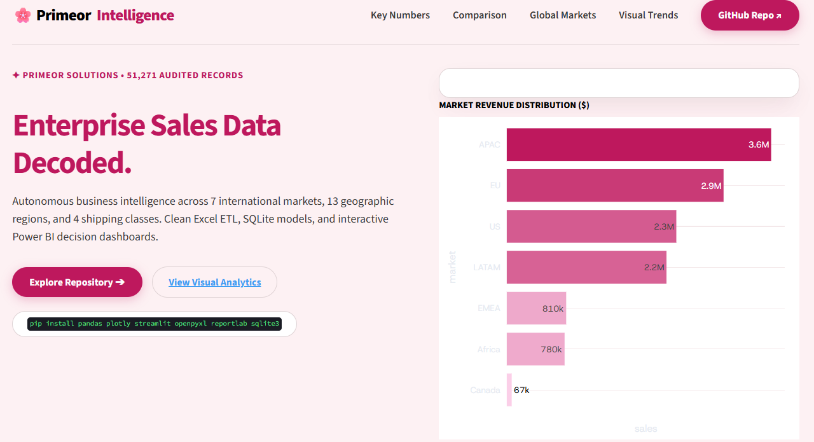
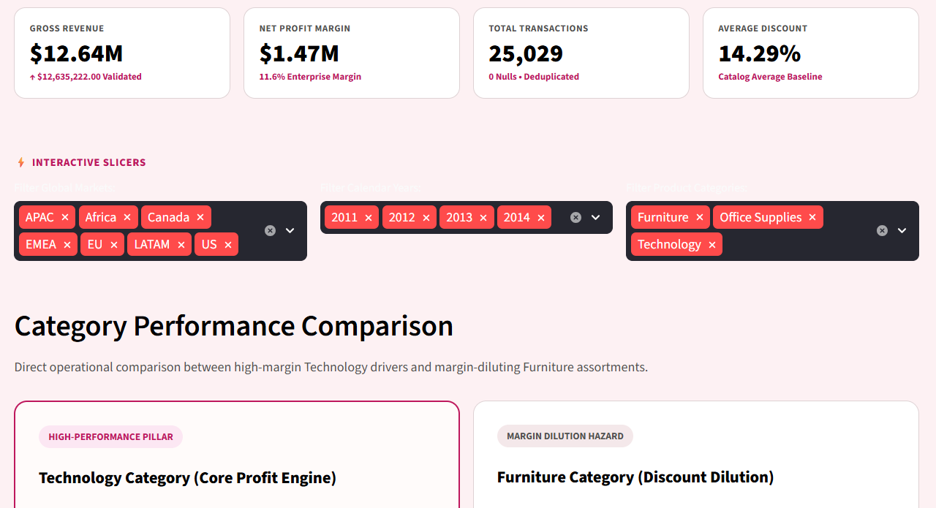
Level 3: the interactive dashboard
PAGE 1
PAGE 2
PAGE 3
Executive Overview
Sales Analysis
Product & Customer
KPI cards, market bars, yearly trend
Region, market and monthly trend
Top products, customers, sub-categories
Slicers
KPI cards
Cross-filtering
DAX measures
One colour theme

Slide 9
What the data says, and what to do
FINDINGS
RECOMMENDATIONS
APAC and EU bring 51.6% of total revenue
Put a discount ceiling on furniture
1
1
Furniture margin is only 6.97%; Tables lost $64.1k
Plan stock and delivery around APAC and EU
2
2
Loss-making records average a 45.08% discount
Negotiate better Standard Class shipping rates
3
3
Sales peak every Q4, from September to December
Book stock and carrier capacity before Q4
4
4

Slide 10


Clean data first.
Then every number agrees.
EXCEL
SQL
DASHBOARD
51,271 clean rows, $12.64M sales
10 queries, loss root cause found
3 pages, slicers, KPI cards
Thank you
linkedin.com/in/rishi-prajapati-cs
Rishi Prajapati
github.com/rishi-prajapati-git

