Slide 1
NextStop
A Travel Destination Recommendation System
IMT2020048 Varad Badhe
IMT2020066 Hasanabbas Momin
IMT2020067 Rishi Vakharia
IMT2020128 Ujjwal Agarwal

Slide 2
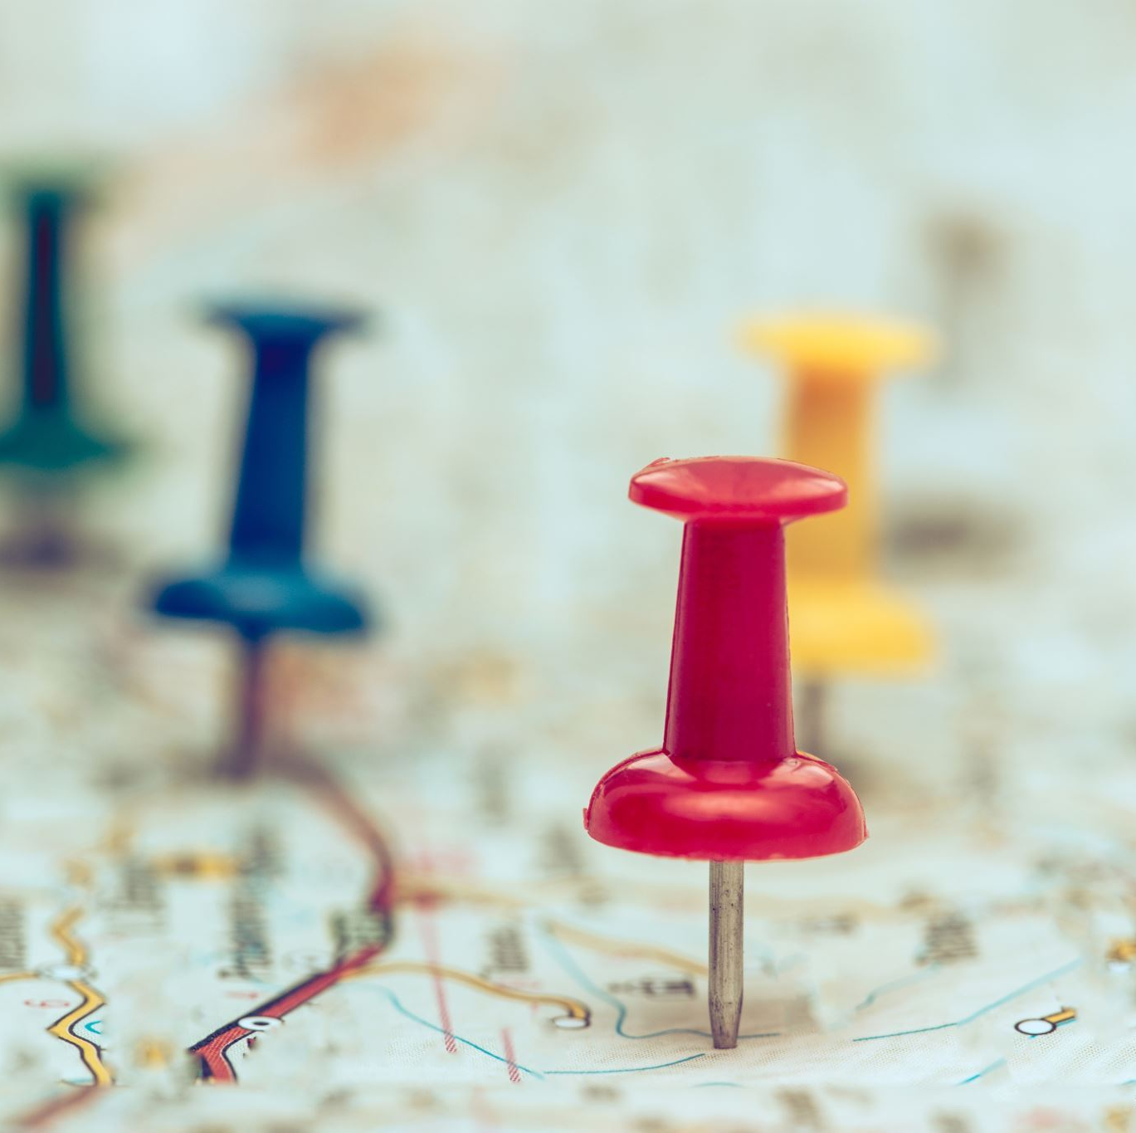
Problem Statement
To create a Travel Destination guide by suggesting cities to visit by considering the previously visited cities by the user.
This will help narrow down their possible options to go for tourism, and save them precious time on research for possible destination.

Slide 3

Some Aspects of the system
NextStop only asks for user's past travel history.
The next place can be recommended based on similarity between cities, users or the attributes of the input cities

Slide 4
Dataset
Cities.csv : this dataset stores multiple people’s travel history which we will use to train the dataset.
5k+ user
3k+ unique cities
Cities_with_attributes.csv : This dataset stores cities famous tourism attributes like beaches, architecture, history etc. Will be used for Content Based filtering.
Around 1k unique attributes
These were publicly available dataset extracted by someone else from NomadList website

Slide 5
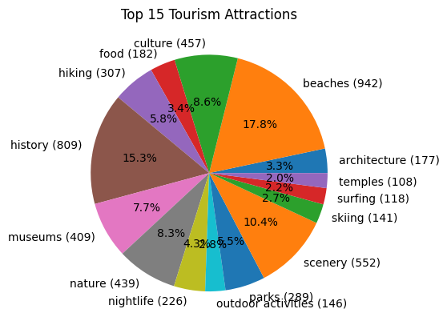
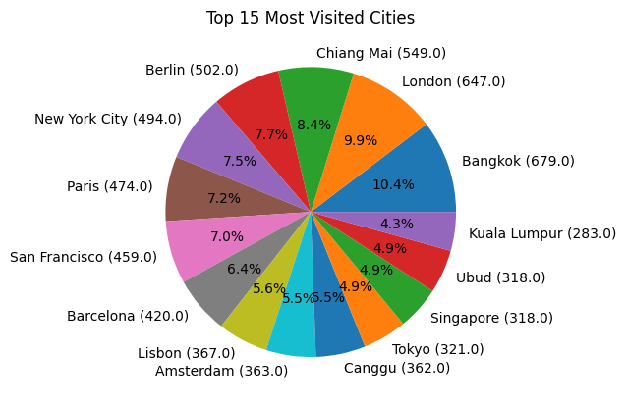
Pre-processing and Data-Analysis
The dataset contained places other than cities like airport, resort, museum etc. most of which were removed.

Slide 6
Models applied
Collaborative Filtering :
Good method for small dataset.
Items – Items similarity and User - user similarity
Content based Filtering:
Good method for large amount of content (attributes) to the cities.
Word2Vec method was used to create similarity vector for each attributes

Slide 7
Collaborative filtering is data specific which will provide better result as the dataset increases.
Content Based filtering is practical model which could provide better results given we have a proper dataset of the cities with all its attributes with some weightage.

Slide 8
Model Analysis
We used one of the entry of the cities dataset to get the accuracy of the model. We give first 4 cities and compare the predictions with the rest of the cities
Actual data point of user: [Paris, Sicili, Amsterdam, London, Instanbul, Athens, Beirut, Dubai]
Input: [Paris, Sicili, Amsterdam, London]

Slide 9
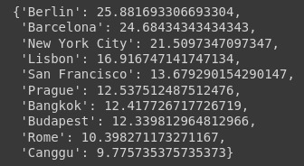
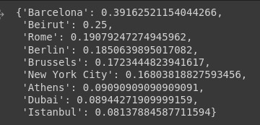
Cities actually visited by the user [Instanbul, Athens, Beirut, Dubai]
Collaborative filtering:
Item-Item based
User-user based

Slide 10
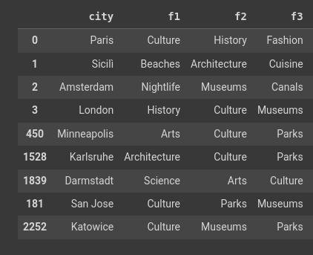
Cities actually visited by the user [Instanbul, Athens, Beirut, Dubai]
Content Based filtering:

Slide 11
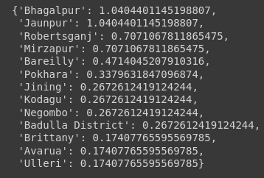
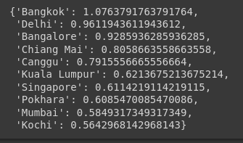
Result analysis
Input : Kota, Varanasi, Chennai, Kathmandu
Collaborative Filtering:
User-user similarity
Item-item similarity

Slide 12
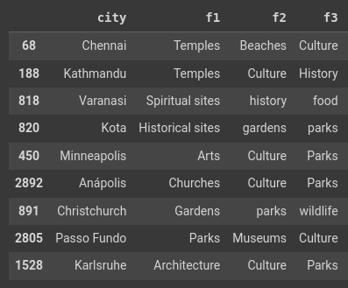
Result analysis
Content based filtering:

Slide 13
Novelty
While using word2vec for content-based recommendation, we took all possible products of vectors instead of just taking average of vectors and then multiplying. (More data is preserved)
City 1
Vec_1
Vec_2
Vec_3
City 2
Vec_1
Vec_2
Vec_3
City 1
Vec_1
Vec_2
Vec_3
City 2
Vec_1
Vec_2
Vec_3
vs
Avg
Avg

Slide 14
Future scope
These model could be combined to create a hybrid, which will show better recommendation.
Neural-Network could be applied using user and item embedding.
We can ask the user their current location and climate conditions, we can consider these metrics to give extra weightage to nearby and optimal weather destination.

