Slide 1
COTIVITI INTERN ASSESSMENT · 2026
Explainable Agentic AI
for Payment Integrity
A Multi-Stage Pipeline Combining Pattern Recognition
and Agentic Reasoning for Clinical Claims Review
Rishitha Chilukuri · Topic 2: Clinical Decision Making and Pattern Recognition
Notes:
Welcome. My name is Rishitha Chilukuri and this is my submission for the Cotiviti intern assessment. I chose Topic 2 — Clinical Decision Making and Pattern Recognition — and built a three-stage pipeline that clusters providers, detects anomalies, and uses an agentic AI layer to explain each flag with a recommended action.

Slide 2
CONTEXT
Why This Matters to Cotiviti
$100B+
TPO
Rules ≠ Enough
Lost annually to healthcare
fraud, waste & abuse (CMS)
Treatment · Payment · Operations
where Cotiviti operates
Static rules can only catch
what they were written to catch
Cotiviti's payment integrity, risk adjustment, and clinical analytics products all depend on identifying which claims are suspicious faster and more accurately than humans alone can manage.
Notes:
Cotiviti sits at the center of payment integrity and risk adjustment for health plans. The CMS reports over $100 billion lost to fraud, waste, and abuse annually — and the existing approach of hard-coded rules can only catch what someone explicitly wrote a rule for. That's the gap this project addresses.

Slide 3
TOPIC DEFINITION
Clinical Decision Making & Pattern Recognition
What It Is
Clustering
Groups providers into behavioral cohorts establishes what 'normal' looks like per specialty
The process of evaluating claims, diagnoses, and costs to decide the next action approve, flag, or escalate using AI rather than static rules.
Applies to Treatment, Payment, and Operations (TPO) across health systems and payers.
Anomaly Detection
Flags providers deviating from their baseline catches patterns rules cannot
Agentic AI
Reasons step-by-step through each flag and produces an explainable recommendation
Key differentiator: most solutions use one technique. This pipeline combines all three — making it more accurate and more explainable.
Notes:
The differentiating angle here is combination. Most applicants will likely pick one technique — a classifier or a chatbot. This project chains three techniques together: clustering defines normal, anomaly detection finds deviation, and the agentic AI layer explains why it matters.

Slide 4
TRENDS
Key Trends Shaping the Space
01
02
03
Clustering for Behavioral Baselines
Anomaly Detection for FWA
Agentic AI for Multi-Step Reasoning
K-Means and DBSCAN group providers by cost, frequency, and procedure mix per specialty — learning what 'normal' looks like rather than relying on fixed thresholds.
Isolation forests and statistical control charts flag deviations from baseline. Time-series detection catches sudden billing spikes that single-point analysis misses (Bauder & Khoshgoftaar, 2018).
LLM-based agents conduct autonomous, multi-step investigation — gathering context, validating coding, and producing an auditable recommendation. Solves the 'black box' problem (Singhal et al., 2023).
Notes:
These three trends map directly onto the three stages of the pipeline I built. Each one has academic citations in the written report. The key point to emphasize is that agentic AI is the newest and most differentiating — it's what transforms a suspicious score into an explainable, auditable decision.

Slide 5
ANALYSIS
Opportunities & Threats for Cotiviti
✦ Opportunities
⚠ Threats
Higher-precision fraud, waste, and abuse detection beyond rules-based systems
Explainable AI builds client trust — audit-defensible reasoning
Faster analyst throughput via automated pre-triage
Extensible to risk adjustment and clinical analytics
False positives create provider friction and appeals overhead
Model drift as billing patterns evolve — requires ongoing retraining
Regulatory risk: AI influencing payments must have human-in-the-loop review
Notes:
The opportunities map directly onto Cotiviti's existing product lines — payment integrity, risk adjustment, clinical analytics. The threats are real but manageable: the explainable AI layer addresses the black-box concern, and the human-in-the-loop design in the architecture handles the regulatory concern.

Slide 6
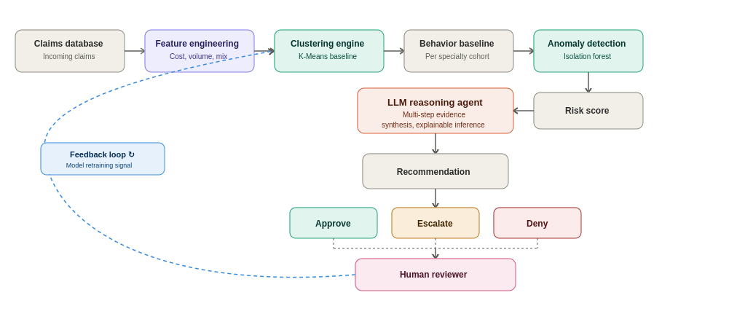
ARCHITECTURE
Proposed System Architecture
Reviewer decisions feed back into the system as a retraining signal, so baselines continuously adapt — not a static system.
Notes:
This architecture directly maps onto the three strategic recommendations in the written report. Rules engines remain the first line of defense — this pipeline sits on top and handles the cases rules miss. The key design choice is the feedback loop: every human reviewer decision becomes a training signal, so the system gets smarter over time.

Slide 7
STRATEGY
Strategic Recommendations for Cotiviti
Clustering-Based Behavioral Baseline Engine
1
Near-term
Cluster providers by specialty, procedure mix, and cost profile. Replace static thresholds with dynamic, data-driven baselines. Fastest layer to prototype directly augments existing rules engines.
Real-Time Anomaly & Time-Series Detection
2
Mid-term
Flag statistically unusual claims or sudden billing shifts over time. Prioritize by severity. Time-series monitoring catches emerging patterns before they scale not retrospectively during an audit.
Agentic AI Layer for Explainable Triage
3
Differentiator
The agent orchestrates verification: compares claim to cluster, validates CPT/ICD consistency, reviews historical patterns, evaluates medical necessity, and outputs an auditable recommendation (approve / escalate / deny).
Notes:
These three recommendations build on each other — you can't skip to recommendation 3 without 1 and 2 in place. That's intentional: it gives Cotiviti a clear phased roadmap rather than a single big-bang investment.

Slide 8
PROOF OF CONCEPT
What Was Built
The POC demonstrates the full three-stage pipeline on 84 synthetic healthcare provider profiles across 5 specialties, with 4 deliberately planted anomalies to validate detection accuracy.
pipeline.py
cotiviti_poc_
anomaly_triage.html
README.md
Standalone Python implementation of clustering + anomaly detection. Runs independently, validates 4/4 planted anomalies caught.
Interactive browser demo full three-stage pipeline with live agentic AI layer via Claude API. No install required.
Run instructions and design rationale explaining each architectural decision.
Validation: 4 / 4 planted anomalies correctly flagged · All files independently submittable
Notes:
Three files, each independently submittable as required. The Python file is the core data science logic — clustering and anomaly detection — with no external dependencies beyond the standard library. The HTML file adds the agentic AI layer on top. I'll screenshare the HTML demo live.

Slide 9
PROOF OF CONCEPT
How the Pipeline Works
Stage 1
Providers are grouped within their specialty using K-Means style centroid clustering, z-score normalized across cost, volume, and procedure mix. Each specialty gets its own baseline a cardiologist's billing is never compared to a dermatologist's.
Clustering Engine
Stage 2
Each provider's Euclidean distance from its specialty centroid is computed. Per-specialty adaptive thresholds (90th percentile) flag outliers. Severity (CRITICAL / HIGH / MEDIUM) and feature contributions (which metric drove the flag) are surfaced for each case.
Anomaly Detection
Stage 3
The agent (Claude Sonnet 4.6) receives each flagged provider's stats, peer baseline, severity, and top feature contributors. It reasons through three verification steps, then outputs: approve, escalate, or deny with a plain-language explanation for audit.
Agentic AI Layer
Notes:
Walk through each stage with the screenshare. Stage 1: click 'Run pipeline' and explain the scatter plot — each color is a specialty cluster. Stage 2: point out the flagged providers (red outline). Stage 3: click one and watch the agent reason through it in real time. Emphasize that the reasoning step-by-step output is what makes this explainable and audit-ready.

Slide 10
RESULTS
Pipeline Validation Results
PRV-9001
Family Medicine
CRITICAL
5.59σ
Upcoding
4 / 4
PRV-9003
Orthopedics
CRITICAL
4.75σ
Extreme cost outlier
Planted anomalies
correctly flagged
PRV-9004
Cardiology
CRITICAL
4.37σ
Procedure count outlier
All CRITICAL severity
All ranked in top 4
Out of 84 providers
PRV-9002
Physical Therapy
CRITICAL
3.87σ
Phantom billing volume
Notes:
This is the validation slide. I deliberately planted 4 anomalies representing real fraud and billing error patterns. The pipeline caught all 4, ranked them all in the top 4 out of 84 providers, and classified all as CRITICAL severity. That's the proof the detection logic works before the agent even gets involved.

Slide 11
Key Takeaways
Combination
Three techniques together (clustering → anomaly detection → agentic AI) are more accurate and explainable than any single approach alone.
Cotiviti-aligned
Every design decision maps to Cotiviti's core business: payment integrity, risk adjustment, and audit defensibility.
Production-ready thinking
Adaptive thresholds, feature attribution, severity stratification, confidence scoring, and a feedback loop for continuous improvement.
Explainability
The agentic AI layer produces step-by-step reasoning for every flag turning a statistical anomaly score into an audit-ready case summary.
Rishitha Chilukuri · Cotiviti Intern Assessment 2026 · rishitha0126@gmail.com
Notes:
Close by reinforcing the three differentiators: combination of techniques, direct Cotiviti business alignment, and production-ready design thinking. Then transition immediately to the live demo screenshare.

