Slide 1
Gang of Four (GoF)
Lecture 10
CSCI 6628
(Covers Larman chap 26)

Slide 2
Lecture 11 - Objectives
Description
Learn to apply GoF principles or patterns for OOD.

Slide 3
Assignment

Slide 4
The “Gang of Four” (GoF)
Design Patterns book catalogs 23 different patterns
Solutions to different classes of problems, in C++ & Smalltalk
Problems and solutions are broadly applicable, used by many people over many years
Patterns suggest opportunities for reuse in analysis, design and programming
GoF presents each pattern in a structured format
See 11_1_GoF_pattern_tutorial.pdf !
Notes:
What do you think of this format? Pros and cons?

Slide 5
Elements of Design Patterns
Design patterns have 4 essential elements:
Pattern name: increases vocabulary of designers
Problem: intent, context, when to apply
Solution: UML-like structure, abstract code
Consequences: results and tradeoffs
Do I need Design Patterns?
See here.

Slide 6
Design Patterns are NOT
Data structures that can be encoded in classes and reused as is (i.e., linked lists, hash tables)
Complex domain-specific designs (for an entire application or subsystem)
If they are not familiar data structures or complex domain-specific subsystems, what are they?
They are:
“Descriptions of communicating objects and classes that are customized to solve a general design problem in a particular context.”

Slide 7
Three Types of GoF Patterns
Creational patterns:
Deal with initializing and configuring objects
Structural patterns:
Composition of classes or objects
Decouple interface and implementation of classes
Behavioral patterns:
Deal with dynamic interactions among societies of objects
How they distribute responsibility

Slide 8
Creational Patterns
Singleton
Guarantee access to a singular (sole) instance
Simple Factory
Create specialized, complex objects
Abstract Factory
Create a family of specialized factories
Factory Method
Define an interface for creating an object, but let subclasses decide which class to instantiate
Builder
Construct a complex object step by step
Prototype
Clone new instances from a prototype
Lazy initialization
Delay costly creation until it is needed

Slide 9
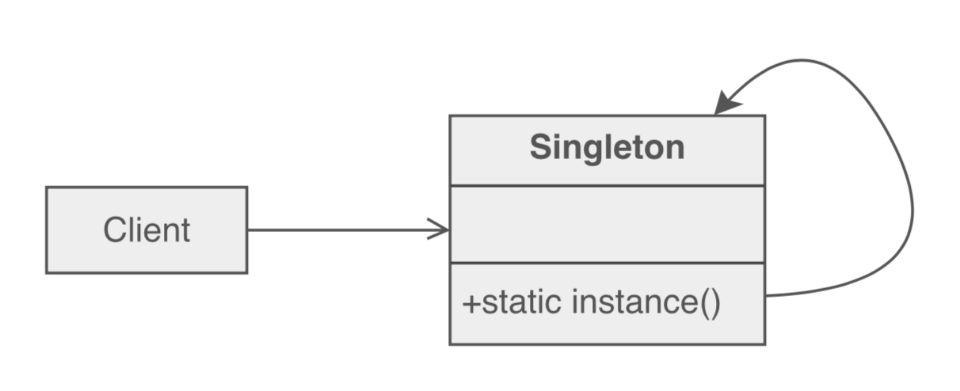
Singleton pattern
Problem: Application needs one, and only one, instance of an object. Additionally, lazy initialization and global access are necessary.
Solution: Make the class of the single instance responsible for access and "initialization on first use". The single instance is a private static attribute. The accessor function is a public static method.

Slide 10

Singleton pattern (creational)
A class with just instance and provide a global point of access
Global Variables can be dangerous! (side effects, break information hiding)
class Singleton
{ public:
static Singleton* getInstance();
protected: //Why are the following protected?
Singleton();
Singleton(const Singleton&);
Singleton& operator= (const Singleton&);
private: static Singleton* instance;
};
Singleton *p2 = p1->getInstance();

Slide 11
Structural patterns
Adapter:
Converts interface of a class into one that clients expect
Bridge:
Links abstraction with many possible implementations
Composite:
Represents part-whole hierarchies as tree structures
Decorator:
Attach additional responsibilities to object dynamically
Facade:
Simplifies the interface for a subsystem
Flyweight:
Shares many fine-grained objects efficiently
Proxy:
Provides a surrogate or placeholder for another object to control access to it

Slide 12
Adapter pattern
Problem: How to resolve incompatible interfaces or provide a stable interface to similar components with different interfaces?
Solution: Convert original (interface) component into another one through an intermediate adapter.
Use interfaces and polymorphism to add indirection to varying APIs
Example (11_2_Adapter_Pattern.pdf).

Slide 13
POS example: Instantiate adapters for external services

Slide 14
Using an Adapter: adapt postSale request to SOAP XML interface

Slide 15
Benefits of Adapter pattern
Reduces coupling to implementation specific details
Polymorphism and Indirection reveals essential behavior provided
Including name of design pattern in new class in class diagrams and code communicates to other developers in terms of known design patterns

Slide 16
Behavioral Patterns
Chain of Responsibility
Request delegated to the responsible service provider
Command
Request or Action is first-class object, hence storable
Iterator
Aggregate and access elements sequentially
Interpreter
Language interpreter for a small grammar
Mediator
Coordinates interactions between its associates
Memento
Snapshot captures and restores object states privately

Slide 17
Observer
Observers update automatically when observed object changes
State
Object whose behavior depends on its state
Strategy
Abstraction for selecting one of many algorithms
Template Method
Algorithm with some steps supplied by derived class
Visitor
Operations applied to elements of a heterogeneous object structure

Slide 18
Observer pattern
Problem: A large monolithic design does not scale well as new graphing or monitoring requirements are levied.
Solution: Delegate all "view" functionality to decoupled and distinct Observer objects. Whenever the Subject changes, it broadcasts to all registered Observers that it has changed, and each Observer queries the Subject for that subset of the Subject's state that it is responsible for monitoring.

Slide 19
Observer pattern
Intent:
Define a one-to-many dependency between objects so that when one object changes state, all its dependents are notified and updated automatically
Used in Model-View-Controller framework
Model is problem domain
View is windowing system
Controller is mouse/keyboard control
JDK’s Abstract Window Toolkit (listeners)
Java’s Thread monitors, notify(), etc.
Notes:
The Observer defines a one-to-many relationship so that when one object changes state, the others are notified and updated automatically.

Slide 20
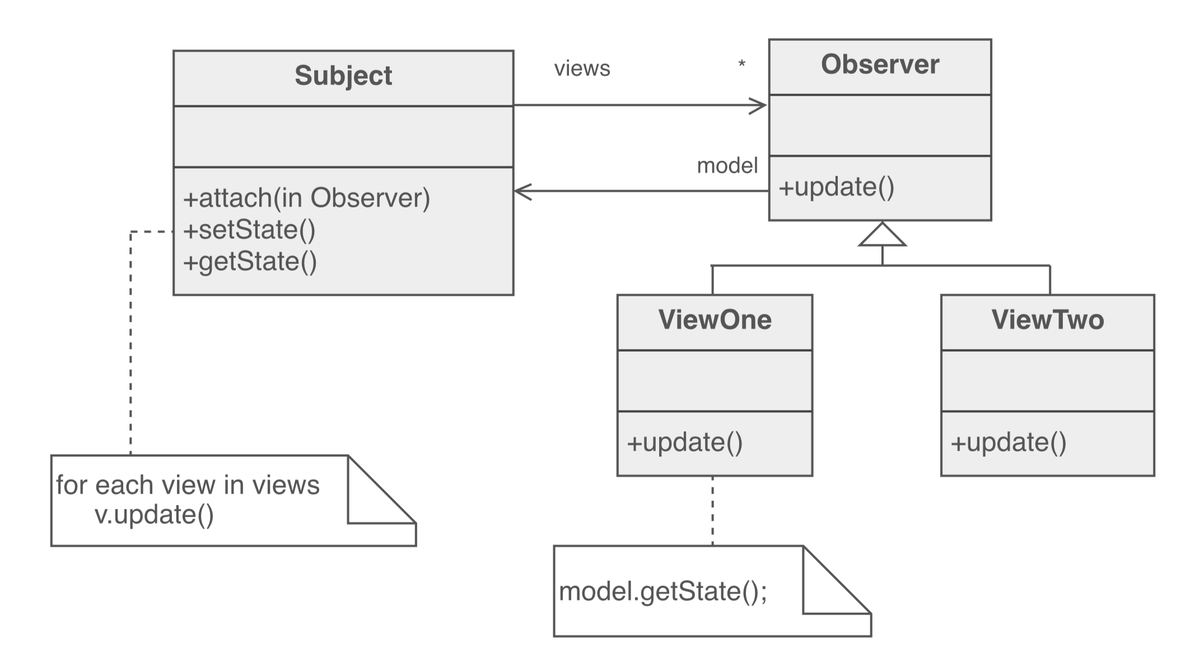
Observer Pattern overview

Slide 21
Structure of Observer Pattern

Slide 22
Benefits of Design Patterns
Design patterns enable large-scale reuse of software architectures and also help document systems
Patterns explicitly capture expert knowledge and design tradeoffs and make it more widely available
Patterns help improve developer communication
Pattern names form a common vocabulary

Slide 23
Group work
Remaining lecture (as well as next) will be done as a Jigsaw again.
Expert Group 1: Proxy pattern
Expert Group 2: Factory pattern
Expert Group 3: Strategy pattern
Expert Group 4: Facade pattern
Outcome: a handout (about 1-2 pages) per pattern
More details later.

Slide 24
Jigsaw - 1
Each team assigns one person to one of the following expert groups:
Expert Group 1: Proxy pattern
Expert Group 2: Factory pattern
Expert Group 3: Strategy pattern
Expert Group 4: Facade pattern

Slide 25
Jigsaw - 2
Inform yourself about your pattern
e.g., based on the book chapters, videos or other qualified sources
Guidance questions:
What is the problem / why use it?
How can the pattern solve the problem?
Benefits and contradictions?
Note: if you don’t do your homework, you let your team.

Slide 26
Jigsaw - 3
All “expert groups” get together
E.g., All students that are in “Expert Group 3” will sit together.
Discuss your findings within the expert group until everyone is on the same page
Duration 30min (hard time limit; make sure you are done)
You may want to make some notes

Slide 27
Jigsaw - 4
Develop a handout for the other groups that contain your main findings.
Suggestion: use the guidance questions from slide “Jigsaw – 2”.
Try not to have more than 1 page per pattern; preferred in digitally written.
Duration 45min (hard time limit; make sure you are done).

Slide 28
Jigsaw - 5
Go back to your original group (your team)
Everyone presents their findings to the team
Based on the developed hand outs
Duration 40min (hard time limit; make sure you are done).
That means about 10 minutes per pattern.

Slide 29
Simple Factory pattern
Context/Problem
Who should be responsible for creating objects when there are special considerations, such as complex logic,a desire to separate the creation responsibilities for better cohesion, and so forth
Solution
Create a Pure Fabrication to handle the creation

Slide 30
Factory can create different objects from a file

Slide 31
Advantages of Factory Objects?
Separates responsibility of complex creation into cohesive helper classes
Hides complex creation logic, such as initialization from a file
Handles memory management strategies, such or recycling or caching

Slide 32
Use Singleton to create a Factory

Slide 33
Adapter, Factory and Singleton working together

Slide 34
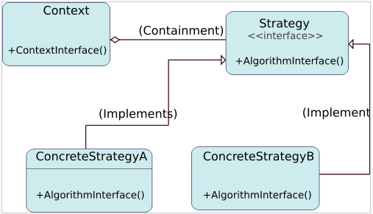
Strategy design pattern
Problem: How to design a family of algorithms or policies that are essentially the same but vary in details?
Solution: "Define a family of algorithms, encapsulate each one, and make them interchangeable." [Gamma, p315]
Use abstraction and polymorphism to show high level algorithm and hide varying implementation details
.

Slide 35
Multiple SalePricingStrategy classes with polymorphic getTotal method

Slide 36
Patterns in software libraries
AWT and Swing use Observer pattern
Iterator pattern in C++ template library & JDK
Façade pattern used in many student-oriented libraries to simplify more complicated libraries!
Bridge and other patterns recurs in middleware for distributed computing frameworks
…

