Slide 1
Iterative, Evolutionary, and Agile
Lecture 2
CSCI 4497 & CSCI 6628
(Covers Larman chap 2-4)

Slide 2
Lecture 2 - Objectives
Description
Define an iterative and agile process.
Define fundamental concepts in the Unified Process.

Slide 3
Assignment
Project Backlog
Create the ordered Project Backlog which is the first phase!
Due: before next class!
Late submissions will lose points.

Slide 4
Software and entropy
A virtue of software: relatively easy to change
Otherwise it might as well be hardware
Nevertheless, the more complex a software system gets, the harder it is to change—why?
Larger software systems are harder to understand
The more changes get introduced into a system, the more it tends toward entropy
I.e., its internal order breaks down

Slide 5
Planning for change
How can good comments facilitate and reduce the cost of software maintenance?
Hint: think about invariants, things that don’t change.
Comments describe meaning of code
Assuming programmers maintain comments when they change the code!
How can modularity help manage change?
Modules help to isolate and localize change

Slide 6
A software life cycle is a process
A process involves activities, constraints and resources that produce an intended output.
Each process activity, e.g., design, must have entry and exit criteria—why?
A process uses resources, subject to constraints (e.g., a schedule or a budget)
A process is organized in some order or sequence, structuring activities as a whole
A process has a set of guiding principles or criteria that explain the goals of each activity

Slide 7
Agile/Iterative vs. traditional
Although this class focuses on agile and iterative approaches like RUP and Scrum, it is important to know traditional approaches as well.
Note: traditional approaches like Waterfall are still used!

Slide 8
Waterfall model of software process
Multimedia: stages in the process
Cascades from one stage down to the next, in stately, lockstep, glorious order.
Gravity only allows the waterfall to go downstream;
it’s very hard to swim upstream
Department of Defense contracts prescribed this model for software deliverables for many years, in DOD Standard 2167-A.

Slide 9
Why would corporate manager types like the waterfall life cycle model?
Minimizes change, maximizes predictability
Costs and risks are more predictable
Each stage has milestones and deliverables: project managers can use to gauge how close project is to completion
Sets up division of labor: many software shops associate different people with different stages:
Systems analyst does analysis,
Architect does design,
Programmers code,
Testers validate, etc.

Slide 10
Testing in the waterfall model
Let’s look at more Pfleeger’s version of waterfall model
Many waterfall models show 5 stages—why more here?
What kind of arrows are missing?
Is this diagram a more realistic picture?
Is this view of the process a good idea?
The reality is that not only does software change, but change happens during the process
Realistic models are not strictly linear, but allow for cycles
Bear in mind, however, that more cycles mean more costs

Slide 11
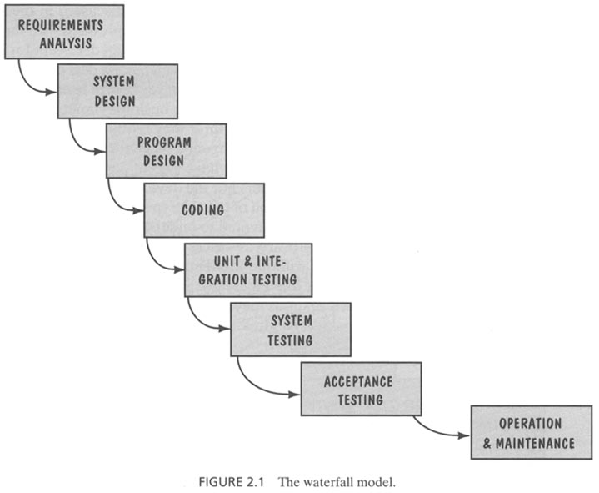

Slide 12
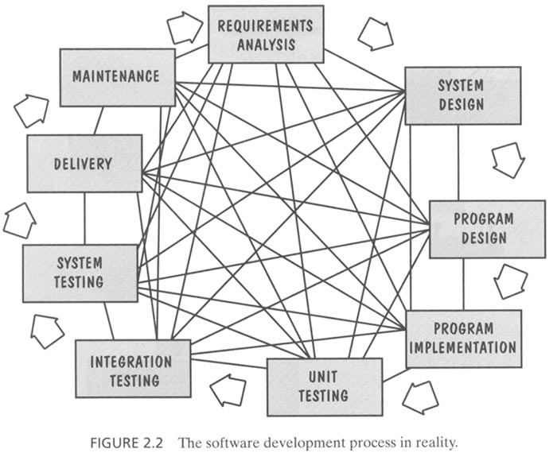

Slide 13
More drawbacks of the waterfall model
Offers no insight into how each activity transforms the artifacts (documents) of one stage into another
For example, requirements specification → design documents?
Fails to treat software as a problem-solving process
Unlike hardware, software development is not a manufacturing but a creative process
Manufacturing processes really can be linear sequences, but creative processes usually involve back-and-forth activities such as revisions
Software development involves a lot of communication between various human stakeholders
Nevertheless, more complex models often embellish the waterfall,
incorporating feedback loops and additional activities

Slide 14
Other Models
There are many other models which will be only briefly introduced over the next few slides.

Slide 15
Prototyping
This model adds prototyping as sub-process
A prototype is a partially developed product that enables customers and developers to examine some aspect of a proposed system and decide if it is suitable for a finished product
Why add prototypes to the life cycle?
Used to explore the risky aspects of the system:
Risk of developing the “wrong” system (what customer doesn’t want), can be a user interface without functionality
Other technical risks – e.g. performance, using a new technology, alternative algorithms, etc.
Prototype may be thrown away or evolve into product

Slide 16
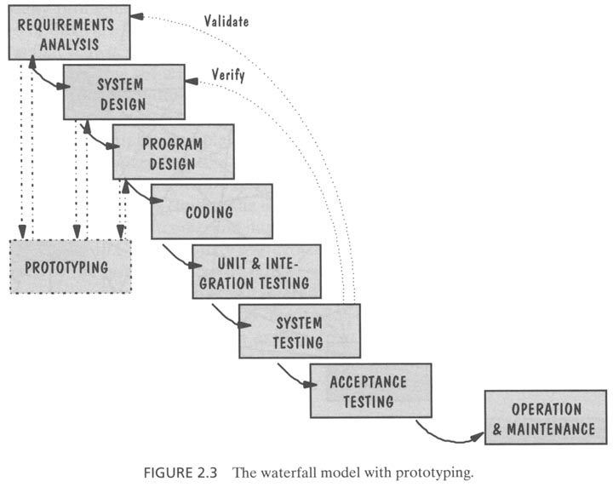

Slide 17
V-Model
Developed by the German Ministry of Defense
What does this model highlight?
Unit and system testing verify the program design, ensuring that parts and whole work correctly
Acceptance testing, conducted by the customer rather than developers, validates the requirements, tying each system function meets a particular requirement in the specification
How does this model account for cycles?
If problems are found during verification or validation, then re-execute left side of V to make fixes and improvements
While the waterfall emphasizes documents and artifacts, the V model emphasizes activities and correctness

Slide 18
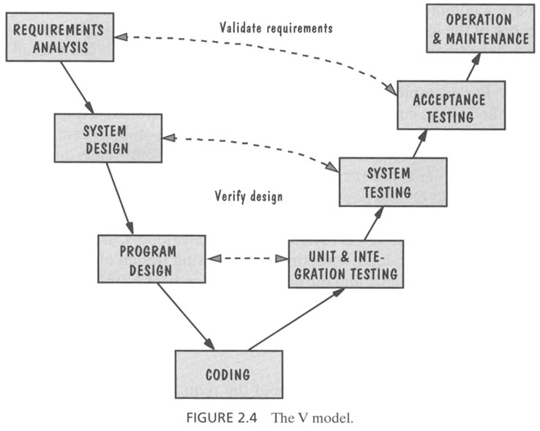

Slide 19
Balzer’s transformational model
Tries to reduce error in most software processes by:
eliminating development steps,
emphasizing formal specifications,
and using automated support to facilitate transformations from specification to deliverable system
Hitch: the need for a formal specification precise enough for automated transformations
We’ll see that even semi-formal specifications can help with other software life cycles

Slide 20
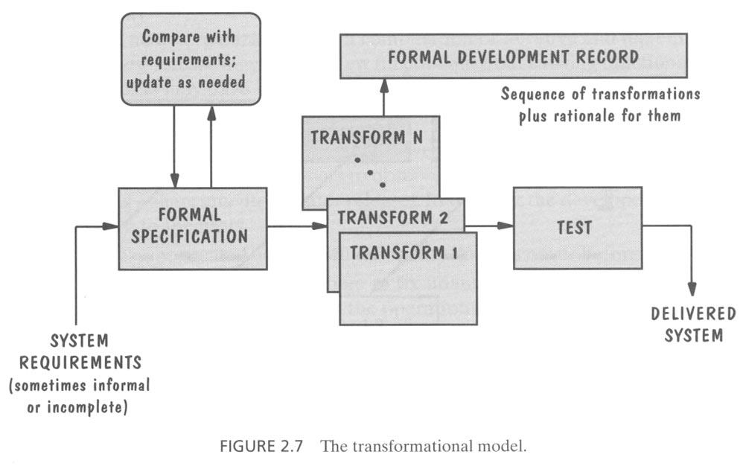

Slide 21
Phased development
Nowadays, customers are less willing to wait years for a software system to be ready
So it’s necessary to reduce the cycle time of software products
In 1996, 80% of HP’s revenues derived from products developed in previous two years
How is this accelerated cycle time made possible?
Phased development reduces cycle time
Design a system so it can be delivered in pieces, letting users have some functionality while the rest is under development
So there are usually two or more systems in parallel:
The operational or production system in use by customers
The development system which will replace the current release
As users use Release n, developers are building Release n + 1

Slide 22
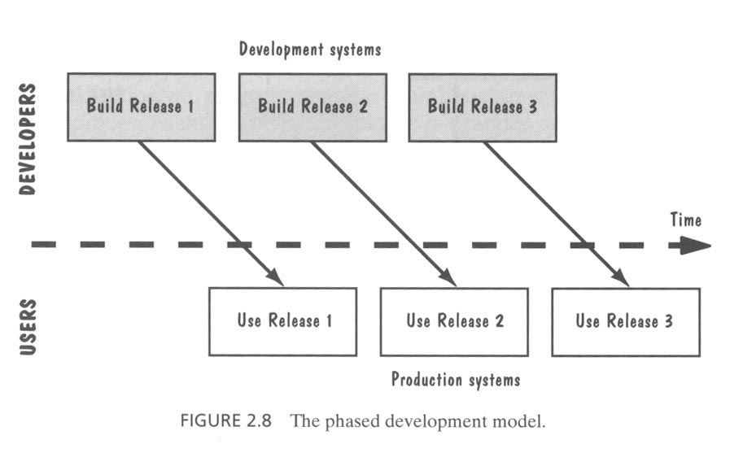

Slide 23
Iterative and incremental process
Incremental development partitions a system by functionality
Early release starts with small, functional subsystem, later releases add functionality
Top part of this figure shows how incremental development builds up to full functionality
Iterative development improves overall system in each release
Delivers a full system in the first release, then changes the functionality of each subsystem with each new release
Suppose a customer wants to develop a word processing package
Incremental approach: provide just Creation functions in Release 1, then both Creation and Organization in Release 2, finally add Formatting in Release 3, …
Iterative approach: provide primitive forms of all three functions in Release 1, then enhance (making them faster, improving the interface, etc.) in subsequent releases
Pros and cons of these two approaches?
Many organizations combine iterative and incremental approaches

Slide 24
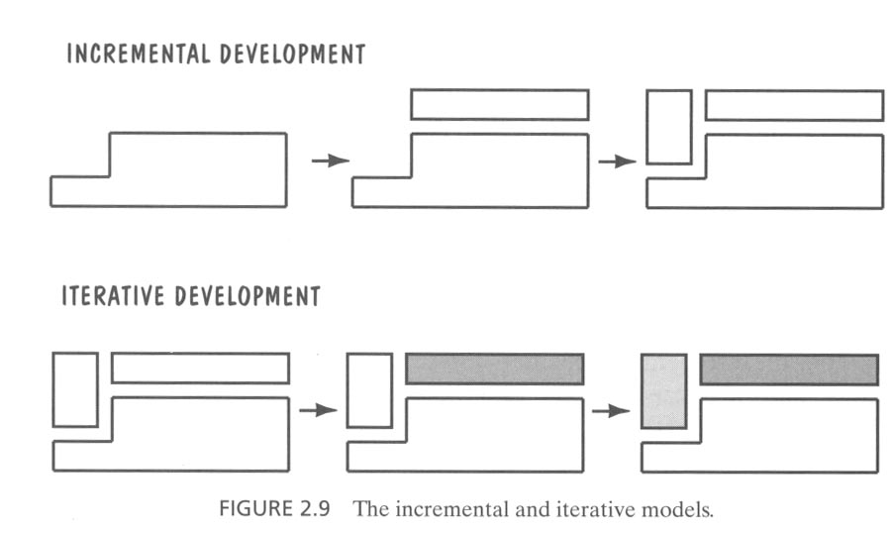

Slide 25
Agile Methods
Typically lightweight
WRT commitment to phases and documentation
Versus waterfall models which require “heavy” documentation of each phase before proceeding
Flexible, Adaptable, Iterative
Examples: RUP (Rational Unified Process - Krutchen, 2000) or UP (Unified Process – JBR 1999), Extreme Programming (XP), Scrum

Slide 26
Exercise (~10min):
Read “2_1_Iterative_Design.pdf"

Slide 27
Rational Unified Process (RUP)

Slide 28
RUP
Developed by “three amigos” at Rational Software (IBM)
Grady Booch, Ivar Jacobson, and Jim Rumbaugh
Unified Modeling Language (UML) is a set of graphical and linguistic notations for modeling systems, not a process or method
The three amigos also developed Rational Unified Process (RUP)
You don’t have to use RUP to use UML
Interestingly different from the traditional waterfall model
Highly iterative and incremental process
Software product is not released in one big bang at end of project
Instead, developed and released in pieces (prototypes, partial releases, beta, etc.)

Slide 29
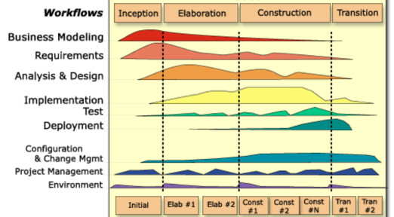
How do traditional stages iterate?
Workflows look traditional, but they iterate in four phases

Slide 30
Lifecycle Phases
Inception – “Daydream”
Elaboration – “Design/Details”
Construction – “Do it”
Transition – “Deploy it”
Phases are not the classical requirements/ design/coding/implementation processes
Phases iterate over many cycles

Slide 31
Inception → …
During inception, establish business rationale and scope for project
Approximate vision, business case, scope, vague estimates.
Business case: how much it will cost and how much it will bring in?
Scope: try to get sense of size of the project and whether it’s doable
Creates a vision and scope document at a high level of abstraction
Only needs 1 week!

Slide 32
Elaboration → …
In elaboration, collect more detailed requirements and do high-level analysis and design
Inception gives you the go-ahead to start a project, elaboration determines the risks
Requirement risks: big danger is that you may build the wrong system
Technological risks: can the technology actually do the job? will the pieces fit together?
Skills risks: can you get the staff and expertise you need?
Political risks: can political forces get in the way?
Develop use cases, non-functional requirements & domain model

Slide 33
Construction → ...
Construction builds production-quality software in many increments, tested and integrated, each satisfying a subset of the requirements of the project
Delivery may be to external, early users, or purely internal
Each iteration contains usual life-cycle phases of analysis, design, implementation and testing
Planning is crucial: use cases and other UML documents

Slide 34
Transition → ...
Transition activities include beta testing, performance tuning (optimization) and user training
No new functionality unless it’s small and essential
Bug fixes are OK

Slide 35
UP phases are iterative & incremental
Inception
Feasibility phase and approximate vision
Elaboration
Core architecture implementation, high risk resolution
Construction
Implementation of remaining elements
Transition
Beta tests, deployment

Slide 36
UP Artifacts
The UP describes work activities, which result in work products called artifacts
Examples of artifacts:
Vision, scope and business case descriptions
Use cases (describe scenarios for user-system interactions)
UML diagrams for domain modeling, system modeling
Source code (and source code documentation)
Web graphics
Database schema
Artifacts will be discussed over the next lectures.

Slide 37
Milestone for first Elaboration
At start of elaboration, identify part of the project to design & implement
A typical and crucial scenario (from a use case)
After first elaboration, project is, say, 1/5th done
Can then provide estimates for rest of project
Significant risks are identified and understood
How is such a milestone different from a stage in the waterfall model?

Slide 38
Process disciplines or workflows
Requirements analysis
Design: architectural and class levels
Implementation
Testing
Management
Configuration and change
Project
Most of the process workflows occur during each iteration

Slide 39
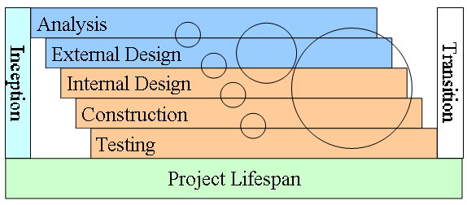
What does diagram imply about UP?
How can iterations reduce risk or reveal problems?

Slide 40
Exercise (~10min):
Read “2_2_you_didnt_understand_iterative_dev_when.pdf”.
Think about it by yourself (5min)
Do you think you understand iterative development?

Slide 41
Helpful links
https://www.smartsheet.com/agile-vs-scrum-vs-waterfall-vs-kanban

