Slide 1
Requirements, Use cases and Domain models
Lecture 3
CSCI 4497 & CSCI 6628
(Covers Larman chap 5-9)

Slide 2
Lecture 3 - Objectives
Description
Motivate doing evolutionary requirements.
Define the FURPS+ model.
Identify and write use cases.
Understanding domain models.

Slide 3
Assignment
Sprint 1
“Proof of Concept Implementation” of a few primary use cases / top of your product backlog.
Usually represent the highest risks or core business.
Steps: detail requirements, design & analysis, implement and test.
Outcome: Working prototype including document
Due: before class in week 6 (three weeks from today)!
Late submissions will lose points.
Note: Sprint length is 3 weeks.
You will do a 5 min demonstration beginning of week 6.

Slide 4
Evolutionary Requirements

Slide 5
Definition Requirements
Requirements are capabilities and conditions to which the system and more broadly, the project must conform
A prime challenge of requirements analysis is to find, communicate, and remember what is really needed, in the form that clearly speaks to the client and development team members.

Slide 6
Requirements analysis and system specification
Why is it one of first activities in software life cycle?
Need to understand what customer wants first!
Goal is to understand the customer’s problem
Though customer may not fully understand it!
Requirements analysis says: “Make a list of the guidelines we will use to know when the job is done and the customer is satisfied.”
AKA requirements gathering or requirements engineering
System specification says: “Here’s a description of what the program will do (not how) to satisfy the requirements.”
Distinguish requirements gathering & system analysis?
A top-level exploration into the problem and discovery of whether it can be done and how long it will take

Slide 7
Types and Categories of Requirements
Functional requirements describe system behaviors
Priority: rank order the features wanted in importance
Criticality: how essential is each requirement to the overall system?
Risks: when might a requirement not be satisfied? What can be done to reduce this risk?

Slide 8
Non-functional requirements describe other desired attributes of overall system—
Product cost (how do measure cost?)
Performance (efficiency, response time? startup time?)
Portability (target platforms?), binary or byte-code compatibility?
Availability (how much down time is acceptable?)
Security (can it prevent intrusion?)
Safety (can it avoid damage to people or environment?)
Maintainability (in OO context: extensibility, reusability)

Slide 9
FURPS+ model
FURPS is a checklist for requirements developed by Grady in 1992:
Functional (features, capabilities, security)
Usability (human factors, help, documentation)
Reliability (frequency of failure, recoverability, predictability)
Performance (response time, throughput, accuracy, availability, resource usage)
Supportability (adaptability, maintainability, internationalization, configurability)

Slide 10
What’s with the + in FURPS+?
And don’t forget….
Implementation (resource limitation, language and tools, hardware)
Interface (constraints posed by interfacing with external systems)
Operations (system management in its operational setting)
Packaging (for example, a physical box)
Legal (licensing)

Slide 11
How are Requirements Organized?
Use-Case Model: A set of typical scenarios of using a system.
Supplementary Specification: Basically, everything not in the use cases.
Glossary: In its simplest form, it defines noteworthy terms.
Vision: Summarizes high-level requirements that are elaborated in the Use-Case Model and Supplementary Specification, and summarizes the business case for the project.
Business Rules: They typically describe requirements or policies that transcend one software project they are required in the domain or business, and many applications may need to conform to them.
Note: Use-Cases will be discussed in the following. Examples for the other items are in BB
“3_other_requirements.zip”. They are relevant for the exams!

Slide 12
Desiderata for a requirements specification
Should say what, not how. Why?
Correct: does what the client wants, according to specification
Like motherhood and apple pie—how to accomplish it?
Ask the client: keep a list of questions for the client
Prototyping: explore risky aspects of the system with client
Verifiable: can determine whether requirements have been met
But how do verify a requirement like “user-friendly” or “it should never crash”?
Notes:
Desiderata = Erwünschtes
Like motherhood and apple pie = klar wie Klosbrühe

Slide 13
Unambiguous: every requirement has only one interpretation
Consistent: no internal conflicts
If you call an input "Start and Stop" in one place, don't call it "Start/Stop" in another
Complete: has everything designers need to create the software
Understandable: stakeholders understand enough to buy into it
Tension between understandability and other desiderata?
Modifiable: requirements change!
Changes should be noted and agreed upon, in the spec

Slide 14
Use Cases

Slide 15
Use cases
First developed by Ivar Jacobson
Now part of the UML (though not necessarily object-oriented)
Emphasizes user’s point of view and explains everything in the user’s language
A "use case" is a set of cases or scenarios for using a system, tied together by a common user goal
Essentially descriptive answers to questions that start with “What does the system do if …”
E.g., “What does the auto-teller do if a customer has just deposited a check within 24 hours and there’s not enough in the account without the check to provide the desired withdrawal?”
Use case describes what the auto-teller does in that situation
Use case model = the set of all use cases

Slide 16
Use cases are text stories, widely used to discover and record requirements.
Notice that use cases are not diagrams, they are text. Focusing on secondary-value UML use case diagrams rather than the important use case text is a common mistake for use case novices.
They influence many aspects of a project including OOA/D and will be input to many subsequent artifacts in the case studies.

Slide 17
Brief Use Case format
There are 3 formats: brief (one paragraph), casual (multiple paragraphs) and fully-dressed (all detail).
Brief format narrates a story or scenario of use in prose form, e.g.:
Rent Videos. A Customer arrives with videos to rent. The Clerk enters their ID, and each video ID. The System outputs information on each. The Clerk requests the rental report. The System outputs it, which is given to the Customer with their videos.

Slide 18
Definition: What are Actors, Scenarios, and Use Cases?
An actor is something with behavior, such as a person (identified by role), computer system, or organization; for example, a cashier.
A scenario is a specific sequence of actions and interactions between actors and the system; it is also called a use case instance. It is one particular story of using a system, or one path through the use case.
A use case is a collection of related success and failure scenarios that describe an actor using a system to support a goal.

Slide 19
Fully dressed use case
Use Case: Buy a Product (Describe user’s goal in user’s language)
Actors: Customer, System (Why is it a good idea to define actors?)
Customer browsers through catalog and selects items to buy
Customer goes to check out
Customer fills in shipping information (address; next-day or 3-day delivery)
System presents full pricing information, including shipping
Customer fills in credit card information
System authorizes purchase
System confirms sale immediately
System sends confirming email to customer

Slide 20
Alternative: Authorization Failure (At what step might this happen?)
6a. At step 6, system fails to authorize credit purchase
Allow customer to re-enter credit card information and re- try
Alternative: Regular customer (At what step might this happen?)
3a. System displays current shipping information, pricing information, and last four digits of credit card information
3b. Customer may accept or override these defaults
Return to primary scenario at step 6

Slide 21
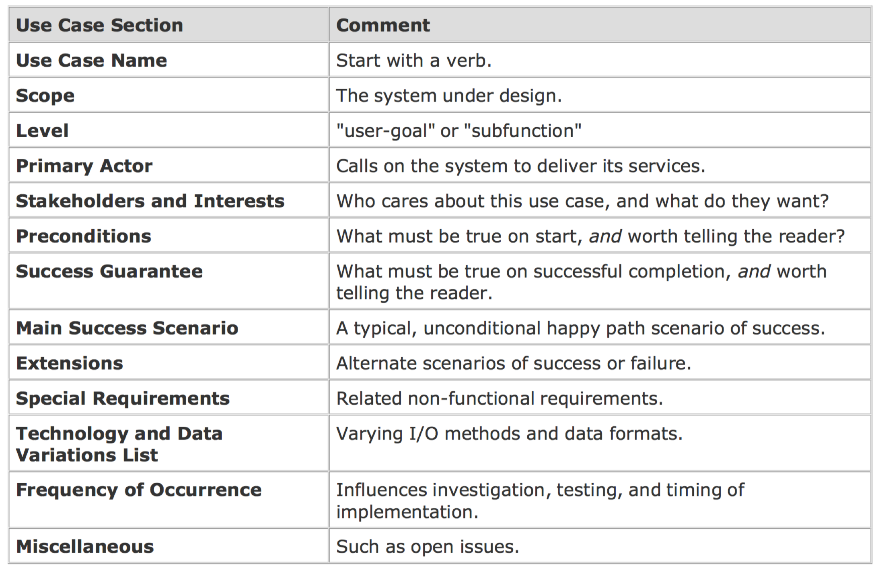
Format Fully dressed use case
Note: not all are always required, however every Use Case should have a Name,
Actors and the Main Flow

Slide 22
Individual exercise (~15min):
Download and read / skim:
“3_2_UC_section_explanations.pdf” provides some more details about the sections in a fully dressed Use Case.
“3_3_UC_Example.pdf” provides an example of a fully dressed Use Case.

Slide 23
Scenario, use case and goal
A scenario is a specific sequence of actions and interactions in a use case.
One path through the use case
E.g., The scenario of buying a product
A use case is a collection of success and failure scenarios describing an actor using a system to support a goal.

Slide 24
What behavior should we model with a use case?
Cockburn: Elementary Business Process (EBP) guideline:
“A task performed by one person in one place at one time, in response to a business event, which adds measurable business value and leaves the data in a consistent state.”
Naively, can you apply the “boss test” for an EBP?
Boss: “What do you do all day?”
Me: “I logged in!”
Is Boss happy?
Size: An EBP-level use case usually is composed of several steps, not just one or two.

Slide 25
Use Case Levels: Applying the Guidelines
Which of following meets EBP & size guidelines?
Negotiate a Supplier Contract
Rent DVD
Log In
Start Up
The others can also be modeled as use cases
But focus first on essential cases (EBP level)
Notes:
Rent DVD

Slide 26
Guidelines for Use Case Modeling
Keep use case names simple: Verb object
Deposit money.
Not: Deposit money into checking. Why not?
Accomplish a user’s goal
Invalid PIN is not a use case. Why not?
Include Secondary Actors (e.g., Bank)
Avoid ambiguity
E.g., in the ATM problem, System could be the machine or the Bank’s back-end server
Start Up and Shut Down are use cases
Why do we usually not include them at first?

Slide 27
A use case diagram is not a flow chart
Steps in the use case (such as enter PIN) are not necessarily use cases. Why not?
Keep each step and alternative simple; e.g., don’t validate PIN and balance in same step (and same alternative scenario)
Transactions (such as deposit money and withdraw cash) are candidate use cases. Why?

Slide 28
Heuristics for writing use case text
Avoid implementation specific language in use cases, such as IF-THEN-ELSE or GUI elements or specific people or depts
Which is better: “The clerk pushes the OK button.” or: “The clerk signifies the transaction is done.”?
The latter defers a UI consideration until design.
Write use cases with the user’s vocabulary, the way a users would describe performing the task
Use cases never initiate actions; actors do.
Actors can be people, computer systems or any external entity that initiate an action.
Use case interaction produces something of value to an actor
Create use cases & requirements incrementally and iteratively
Start with an outline or high-level description
Work from a vision and scope statement
Then broaden and deepen, then narrow and prune

Slide 29
More use case pointers
Add pre-conditions and post-conditions in each use case:
What is the state of affairs before and after use case occurs?
Why?
Some analysts distinguish between business and system use cases:
System use cases focus on interaction between actors within a software system
Business use cases focuses on how a business interacts with actual customers or events
Fowler prefers to focus on business use cases first, then come up with system use cases to satisfy them
Note iterative approach in developing use cases, too

Slide 30
Text and Diagrams
Use case text provides the detailed description of a particular use case
Use case diagram provides an overview of interactions between actors and use cases
But a short time drawing a use case diagram provides a context for:
identifying use cases by name
creating a “context diagram”

Slide 31
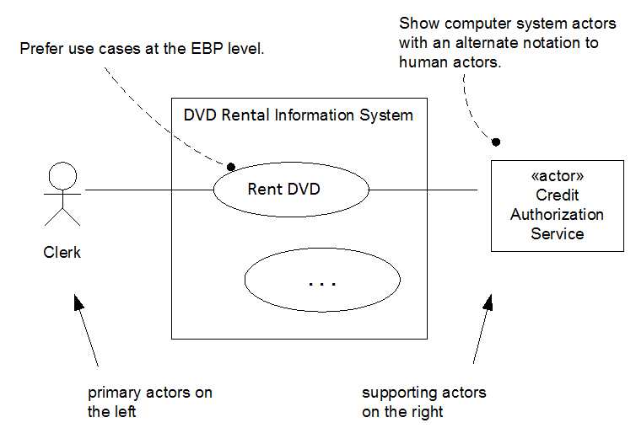
Use Case Diagrams

Slide 32
Supplementary Specification
Use cases describe functional requirements
Supplementary Specification (SS) captures non-functional reqs (URPS+):
Vision and Scope
Features list
Glossary (Data Dictionary)
Business Rules
Risk plan
Iteration Plan

Slide 33
Exercise (~20min):
Select the top entry of your Product Backlog and create the corresponding fully dressed Use Case and its use case diagram.
Outcome – Use case + use case diagram that will go in your report (assignment).

Slide 34
Domain model

Slide 35
Domain Model
A domain model is the most important and classic model in OO analysis.
It illustrates noteworthy concepts in a domain. It can act as a source of inspiration for designing some software objects and will be an input to several artifacts explored in the case studies.

Slide 36
What is a Domain Model?
Illustrates meaningful conceptual classes in problem domain
No software classes / objects!
Represents real-world concepts, not software components
Software-oriented class diagrams will be developed later, during design

Slide 37
Please watch the YouTube Video “Object Oriented Design 4”
Start time: 2:34 min to the End.
The ID part (towards the end) is not super important
Total duration: ~22min
Notes:
https://www.bing.com/videos/search?q=object+oriented%ee%80%81+design+4+%ee%80%80youtube&docid=608035334970082568&mid=4CC41B7B043A45A7F5434CC41B7B043A45A7F543&view=detail&mmscn=vidans&FORM=VIREHT

Slide 38
Questions
What are conceptual classes and how does one usually identify them?
How to decide if it is a class or an attribute?
What are associations and which one exist?
What is multiplicity?

Slide 39
Conclusion: Is the Domain Model Correct?
There is no such thing as a single correct domain model.
All models are approximations of the domain we are attempting to understand; the domain model is primarily a tool of understanding and communication among a particular group.
A useful domain model captures the essential abstractions and information required to understand the domain in the context of the current requirements, and aids people in understanding the domain its concepts, terminology, and relationships.

Slide 40
Exercise (remainder of the class):
Create a domain model for the Use Case you just developed.
Outcome – Domain model that will go in your report (assignment).

