Slide 1
Class Diagrams, Visibility and Mapping design to Code
Lecture 4
CSCI 4497 & CSCI 6628
(Covers Larman chap 9, 14, 16, 19)

Slide 2
Lecture 4 - Objectives
Description
Introduce UML class diagram notation, with examples, and various modeling applications.
Identify four kinds of visibility.
Design to establish visibility.
Map design artifacts to code in an object-oriented language.

Slide 3
(Design) Class Diagrams

Slide 4
Design Class Diagrams
UML includes class diagrams to illustrate classes, interfaces, and their associations. They are used for static object modeling.
They fall into the category of static object modeling
Different to the behavioral / dynamic ones from last week.

Slide 5
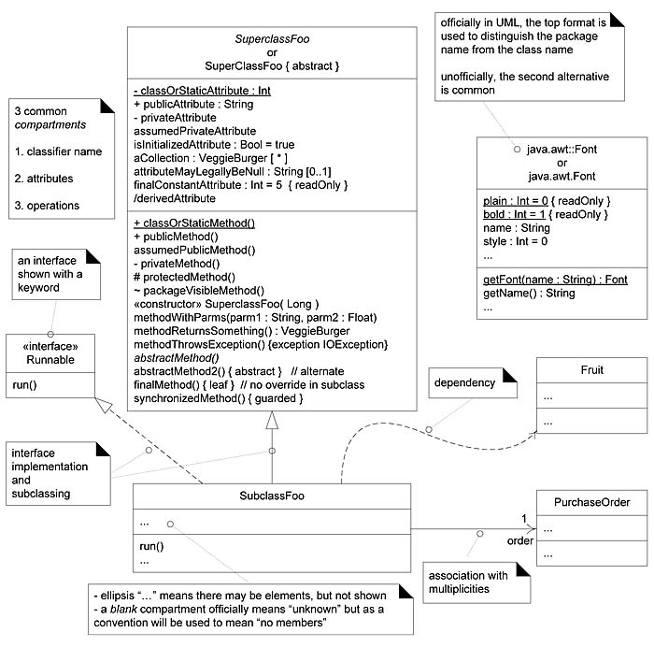
Example
Notes:
Do you think you need all of this for every diagram?

Slide 6
Definition: Design Class Diagram
In a conceptual perspective the class diagram can be used to visualize a domain model.
We also need a unique term to clarify when the class diagram is used in a software or design perspective.
Design Class Diagram (DCD)!
Note, the “components” are identical to Domain Model!
Notes:
http://stackoverflow.com/questions/21265491/what-is-the-difference-between-a-domain-class-diagram-and-a-design-class-diagram
http://stackoverflow.com/questions/17778945/difference-between-a-class-diagram-and-a-design-class-diagram
Most of the time, people model their code. That's good! In that case, class diagram modeling is used to graphically represent the structure of (object-oriented) classes: class, method, attribute, annotations with stereotypes. Imagine all the JPA, Spring, whatever annotations in the class diagram of a JPA-J2EE based architecture...
As it's said above, the "design class diagram" should only design your domain model, from an architecture level. What are the basic entities your structural system rely on? No details about the programming language, no "dto", "dao" or technical stuff like that. Here's a good example I use: online shopping cart domain model. It only contains the architecturally significant classes.

Slide 7
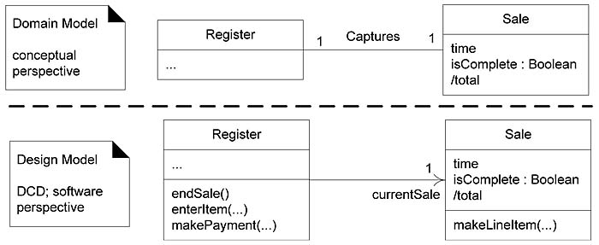
Domain Model vs. DCD

Slide 8
Developing a DCD
1. Identify software classes:
Register Sale ProductCatalog ProductSpecification Store SalesLineItem Payment
Begin drawing a class diagram
Think how the belong / work together

Slide 9
Include the attributes from the domain model
The full format of the attribute text notation is:
visibility name : type multiplicity = default {property-string}
Guideline: Attributes are usually assumed private if no visibility is given.
Visibility marks include + (public), - (private), and so forth in front of an attribute

Slide 10
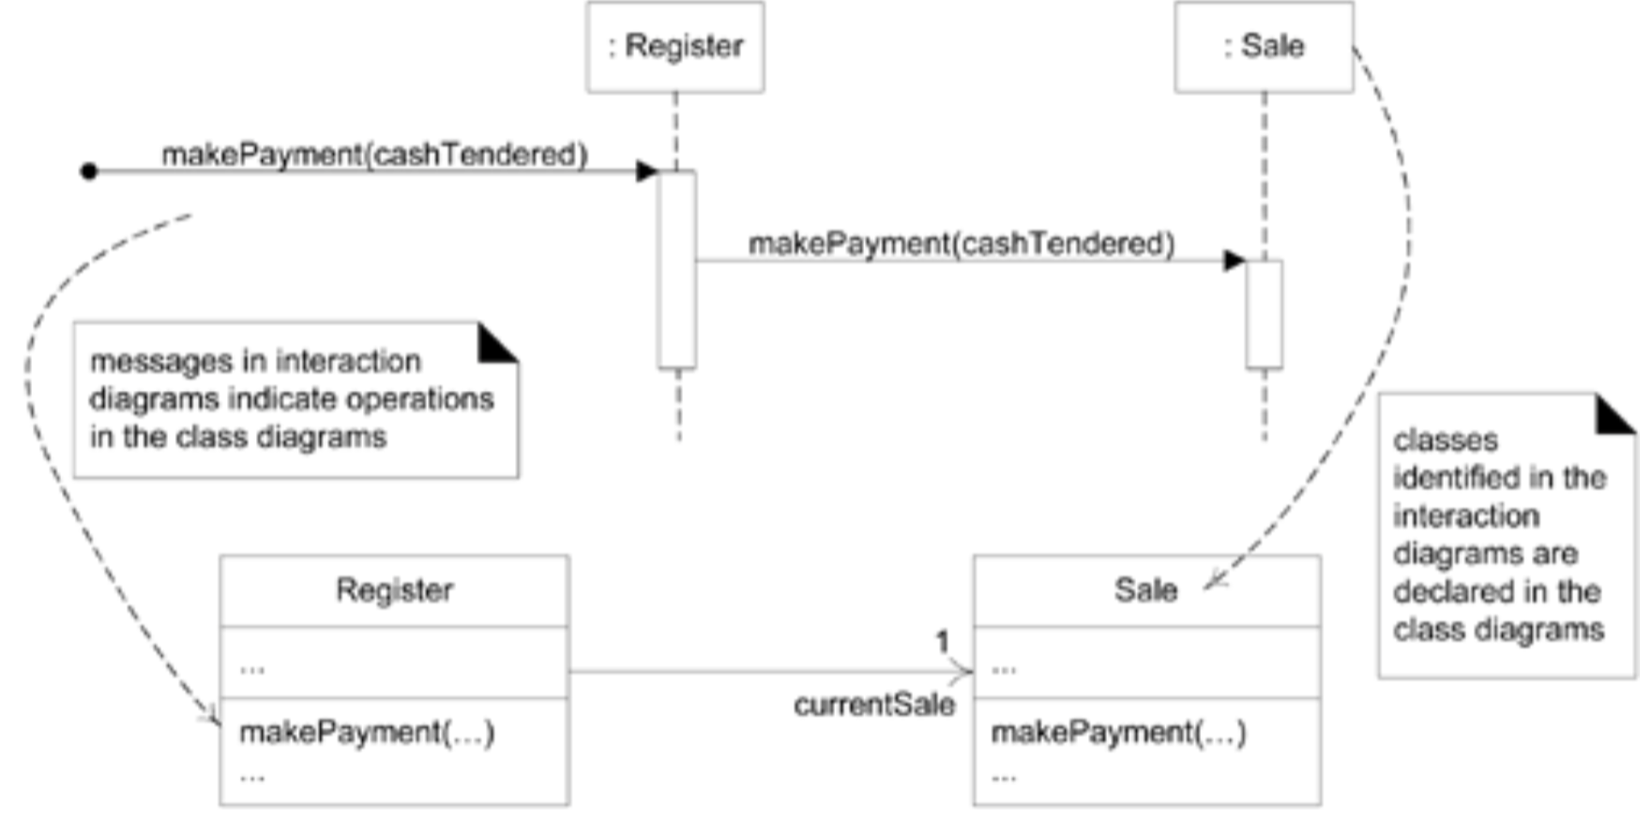
4. Add method names - from interaction diagrams - model class & interaction diagrams in parallel

Slide 11
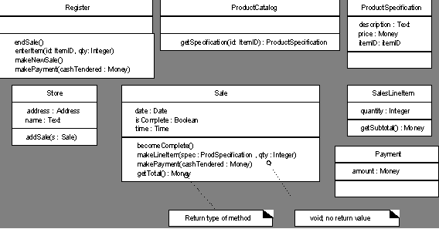
5. Parameters, return types optional? - readability vs. code generation

Slide 12
One of the compartments of the UML class box shows the signatures of operations/methods:
UML-1
visibility name (parameter-list) : return-type {property-string}
UML-2
visibility name (parameter-list) {property-string}
Guidelines:
Assume the version that includes a return type.
Operations are usually assumed public if no visibility is shown.
Notes:
property-string = read only, guarded, ...

Slide 13
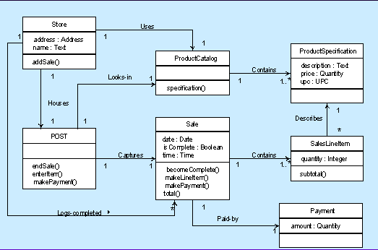
6. Add associations and navigability - Navigability implies visibility of attributes - a navigability arrow pointing from the source (Store) to target (ProductCatalog) object, indicating a Store object has an knowledge one ProductCatalog
Notes:
If “Store” is the source class and “ProductCatalog” is the target class, the arrowhead would be placed on the “ProductCatalog” side of the association. A navigable association of this type means that at runtime object “Store” knows about object “ProductCatalog”, but object “ProductCatalog” has no knowledge of or visibility into object “Store”.

Slide 14
7. Adding dependency relationships
Indicates that one element has knowledge of another element
I.e., a change in specification of one thing may affect another thing that uses it, but not necessarily the reverse
A dashed directed line
Typically non-attribute visibility between classes

Slide 15
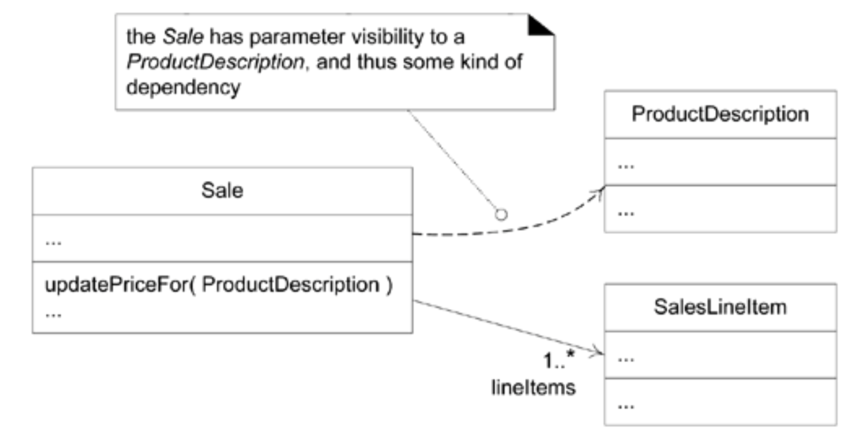

Slide 16
Association vs. dependency
Association is reference based relationship between two classes. E.g., class A holds a class level reference to class B. Association can be represented by a line between these classes with an arrow indicating the navigation direction. In case arrow is on the both sides, association has bidirectional navigation.
Dependency is often confused as Association. Dependency is normally created when you receive a reference to a class as part of a particular operation / method. Dependency indicates that you may invoke one of the APIs of the received class reference and any modification to that class may break your class as well.
https://nirajrules.wordpress.com/2011/07/15/association-vs-dependency-vs-aggregation-vs-composition/
Notes:
https://nirajrules.wordpress.com/2011/07/15/association-vs-dependency-vs-aggregation-vs-composition/

Slide 17
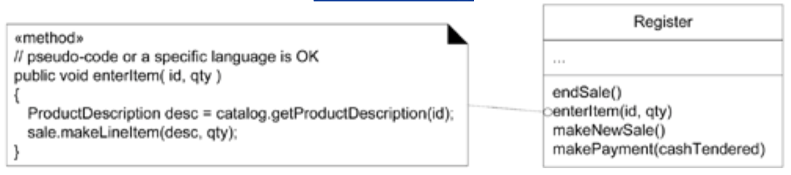
Note Symbols: Notes, Comments, Constraints, and Method Bodies
Note symbols can be used on any UML diagram, but are especially common on class diagrams. A UML note symbol is displayed as a dog-eared rectangle with a dashed line to the annotated element;

Slide 18
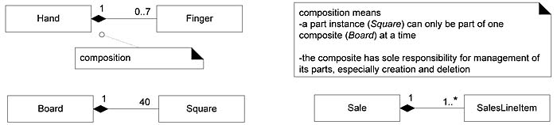
Composition (whole-part) relations

Slide 19
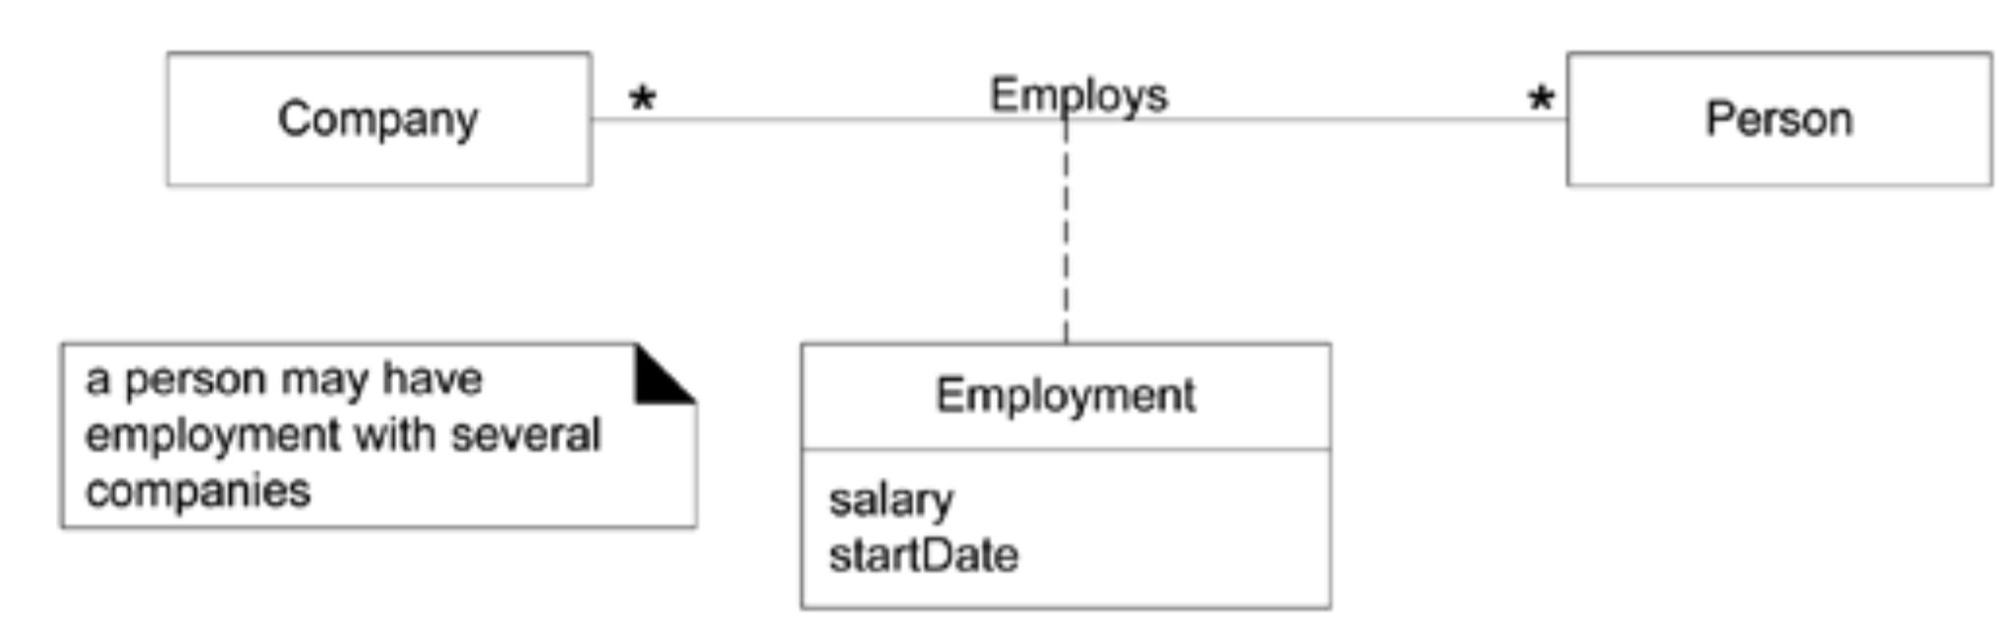
Association classes
Model association with attribute & operations

Slide 20
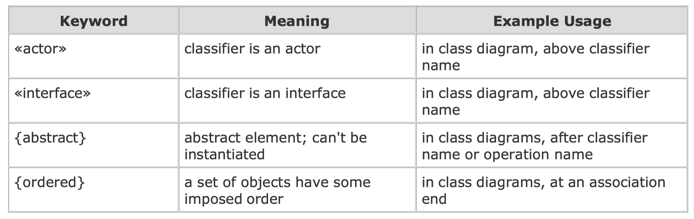
Keywords

Slide 21
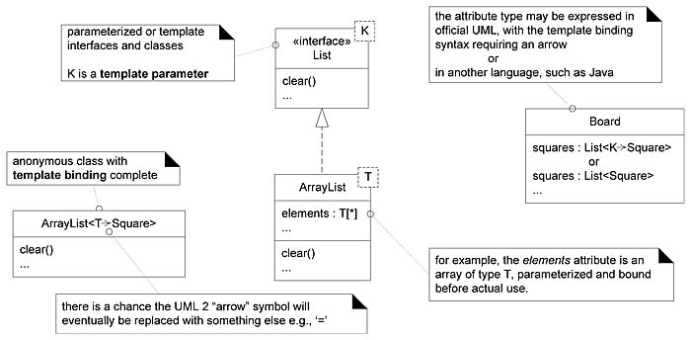
Interfaces and Template Classes
- Interface is a predefined «stereotype» - Templates take parameters in corner

Slide 22
Generalization, Abstract Classes, Abstract Operations
Generalization in the UML is shown with a solid line and fat triangular arrow from the subclass to superclass.
In a DCD software-perspective class diagram, it implies OOPL inheritance from the superclass to subclass.
Abstract classes and operations can be shown either with an {abstract} tag (useful when sketching UML) or by italicizing the name (easy to support in a UML tool).

Slide 23
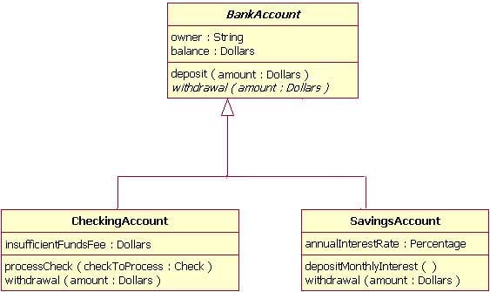

Slide 24
Exercise (~20min):
Create a design class diagram for the previous use case (that you worked on).
Note, “4_1_CD_relationships_UML.pdf” provides a good summary of all relationships that are possible including some examples.
Outcome – DCD that will go in your report.

Slide 25
Requirements to Design Iteratively
So far, emphasized analysis of the requirements and objects; in the following emphasis toward designing a solution for this sprint in terms of collaborating software objects.
A transition from primarily a requirements or analysis focus to primarily a design and implementation focus will occur in each iteration.
Early iterations/sprints will spend relatively more time on analysis activities.

Slide 26
Does modeling take too much time?
It must surely seem like the prior modeling would take weeks of effort. Not so!
However, when one is comfortable with these skills, the duration to do the modeling is realistically just a few hours or days.

Slide 27
Designing for Visibility

Slide 28
Visibility
Visibility is the ability of one object to see or have reference to another.
All created diagrams for the system operations illustrate messages between objects.
For a sender object to send a message to a receiver object, the sender must be visible to the receiver the sender must have some kind of reference or pointer to the receiver object.

Slide 29
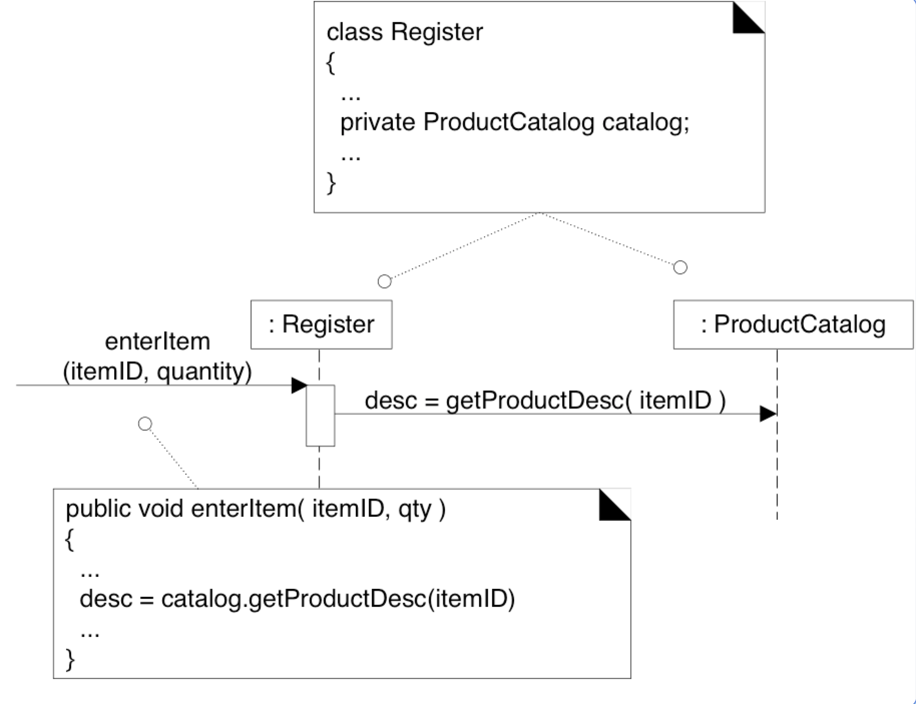
Notes:
For example, the getProductDescription message sent from a Register to a ProductCatalog implies that the ProductCatalog instance is visible to the Register instance.
When creating a design of interacting objects, it is necessary to ensure that the necessary visibility is present to support message interaction.

Slide 30
What is visibility?
In common usage, visibility is the ability of an object to "see" or have a reference to another object.
There are four common ways that visibility can be achieved from object A to object B:
Attribute visibility B is an attribute of A.
Parameter visibility B is a parameter of a method of A.
Local visibility B is a (non-parameter) local object in a method of A.
Global visibility B is in some way globally visible.

Slide 31
Exercise (~20min):
Find a partner (your neighbor).
The younger one does ‘attribute + parameter’ visibility from “4_2_Visility_types_examples. pdf” and the older one the other two.
Explain each other the visibility ways you just read.

Slide 32
Questions & Answers
Q. Which would you use if you wanted a relatively permanent connection between sender & receiver objects?
A. attribute, or global
Q. Which would you use if you didn't want a permanent connection?
A. parameter, or local
Q. How would you achieve global visibility?
A. use a global variable in C++, static (or class) variable (in C++ or Java) or the Singleton pattern (a static method that returns the object)

Slide 33
Questions & Answers
Q. Which would you use if you wanted a relatively permanent connection between sender & receiver objects?
A. _________________
Q. Which would you use if you didn't want a permanent connection?
A. ____________________
Q. How would you achieve global visibility?
A. _____________________
Notes:
1. attribute, or global
2. parameter, or local
3. use a global variable in C++, static (or class) variable (in C++ or Java) or the Singleton pattern (a static method that returns the object)

Slide 34
Mapping Designs to Code

Slide 35
OO development is iterative
The UML artifacts created during the design work the interaction diagrams and DCDs will be used as input to the code generation process.
Some tools generate partial code from UML
Programmers make changes as the work out the details
Therefore, Expect and plan for change and deviation from design during programming

Slide 36
Creativity and Change During Implementation
Programming work is not a trivial code generation step; quite the opposite!
Results generated during design modeling are an incomplete first step; during programming and testing, myriad changes will be made and detailed problems will be uncovered and resolved.
The ideas and understanding (not the diagrams or documents!) generated during modeling will provide a great base for programming.
But, expect and plan for lots of change and deviation from the design during programming.

Slide 37
Mapping Designs to Code
Write source code for:
Class and interface definitions
Method definitions
Work from OOA/D artifacts
Create class definitions for Domain Class Diagrams (DCDs)
Create methods from Interaction diagrams

Slide 38
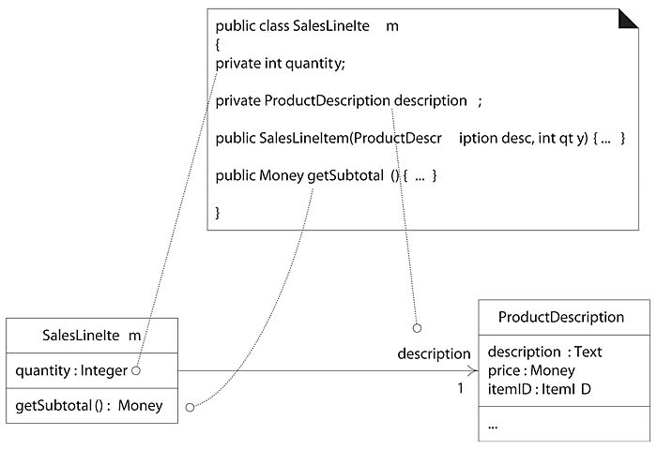
From DCD to Java class
Notes:
Note the addition in the source code of the Java constructor SalesLineItem(...). It is derived from the create(desc, qty) message sent to a SalesLineItem in the enterItem interaction diagram. This indicates, in Java, that a constructor supporting these parameters is required. The create method is often excluded from the class diagram because of its commonality and multiple interpretations, depending on the target language.

Slide 39
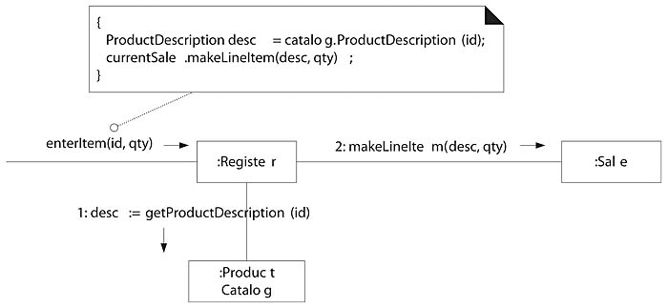
From Interaction diagram to method

Slide 40
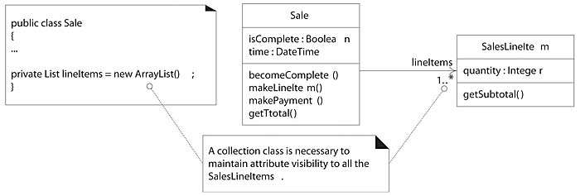
Collection classes
Notes:
One-to-many relationships are common. For example, a Sale must maintain visibility to a group of many SalesLineItem instances, as shown in Figure 20.5. In OO programming languages, these relationships are usually implemented with the introduction of a collection object, such as a List or Map, or even a simple array.

Slide 41
Exception handling
Why is it wise to consider large-scale exception handling strategies during design modeling?
In UML, exceptions can be inserted as property strings of messages

Slide 42
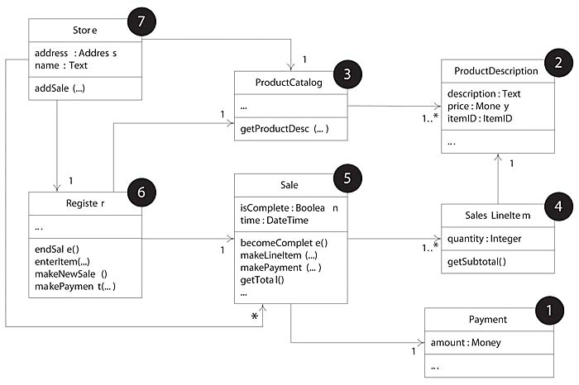
Why implement from least-coupled to most-coupled?

