Slide 1
State Diagrams 2. Mid-Term Review 3. Sprint 1 Presentations
Lecture 6
CSCI 6628
(Covers Larman chap 28,29 & Designing Object Systems by Cook and Daniels. http://www.syntropy.uk/syntropy chap 4,5,7)

Slide 2
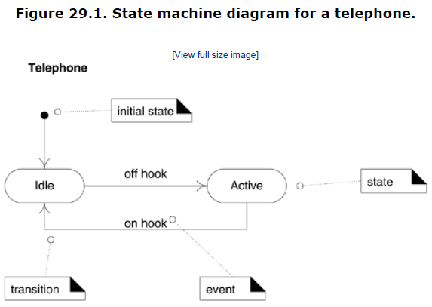
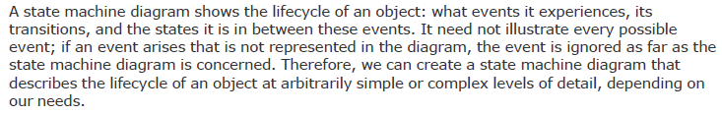

Slide 3
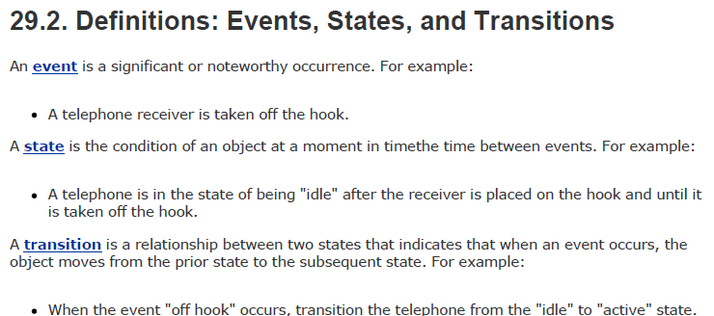

Slide 4
State-independent (modeless):
If an object always responds the same way to an event. –state machine(diagram) probably not needed
State-Dependent:
Objects that react differently to events depending on their state or mode.
Example: A telephone is very State-Dependent. Pushing a button (generating an event) depends on the current state of phone offhook or onhook

Slide 5
Modeling State-Dependent Objects
Model the behavior of a complex reactive object in response to events.
Model legal sequences of operations protocol.
Complex Reactive Objects
Physical Devices (phone, car, microwave, vending machine)
Transactions (a sale, order, payment, shipping)
Role Mutators (object that change their role). Example: a person changing roles from civilian to a veteran. Each role represented by a state.

Slide 6
Protocols and Legal Sequences
Communication Protocols: TCP, new protocols, are easily understood with a state machine diagram
UI Page/Window Flow or Navigation: the sequence between pages
UI Flow Controllers or Sessions: server-side object controlling page flow, state of session.
Use Case System Operations: like ProcessSale, makeNewSale, enterItem, etc.
Individual UI Window Event Handling: like Edit-Paste action is only valid if there is something in the “clipboard” to paste.

Slide 7
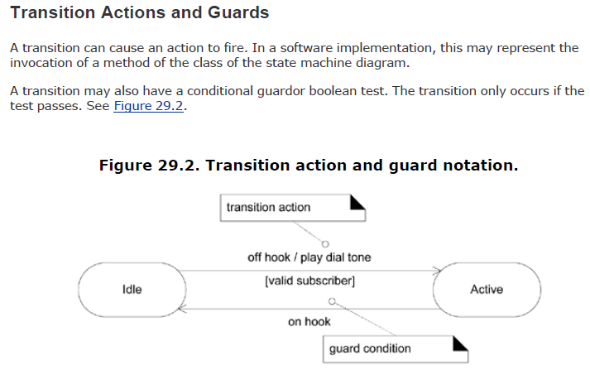

Slide 8

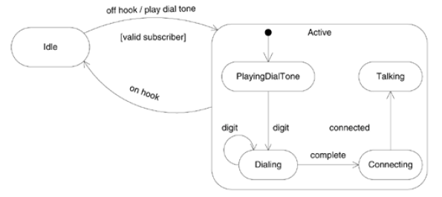

Slide 9
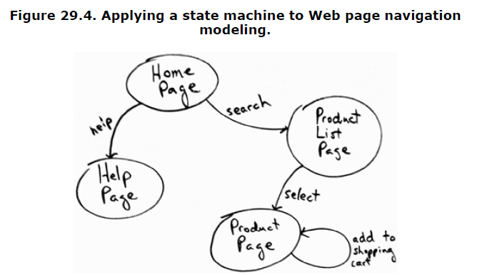

Slide 10
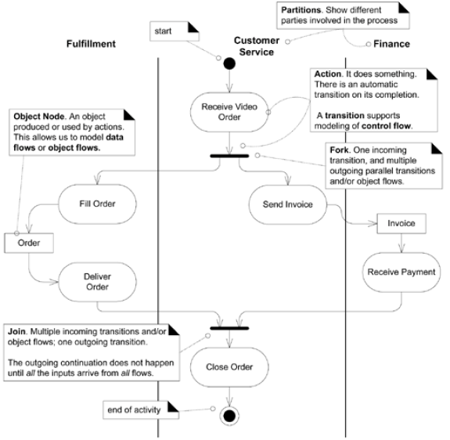

Slide 11
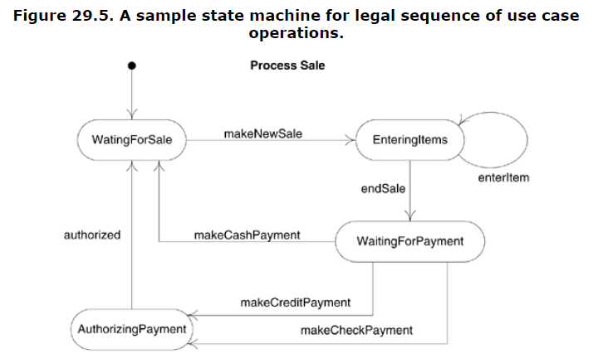

Slide 12
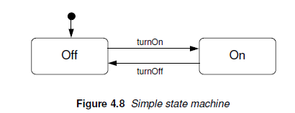
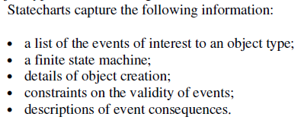
Chapter 4: Designing Object Systems, Cook and Daniels

Slide 13
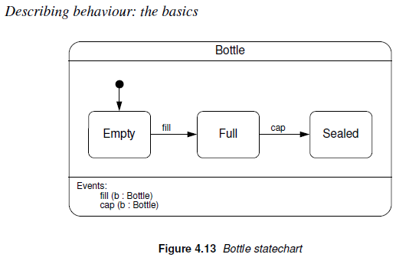

Slide 14
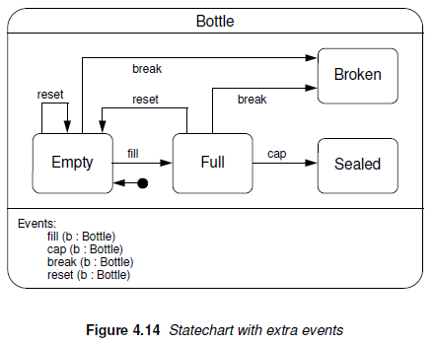
Notes:
We enhanced by adding 2 extra events: break and reset events. Break event occurs when a bottle breaks while being filled or waiting to be filled. Reset event occurs when a bottle is emptied and returned to the beginning of the production line. A reset event can occur when a bottle is empty.

Slide 15
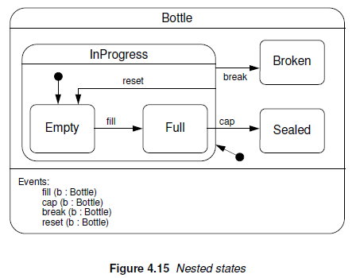
Notes:
A new state has been introduced called InProcess, which nests the Empty and Full states.
A transition leaving this state, like the one labeled break, applies to all the nested states. The reset transition is similar, except that it ends at one of the nested states.

Slide 16
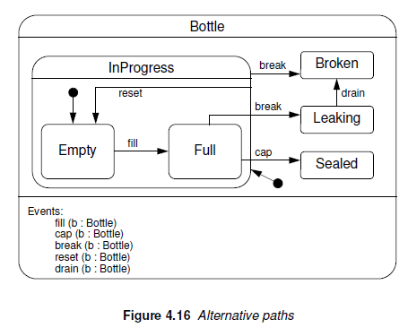
Notes:
An additional transition for the break event has been added from full to a new Leaking state.

Slide 17
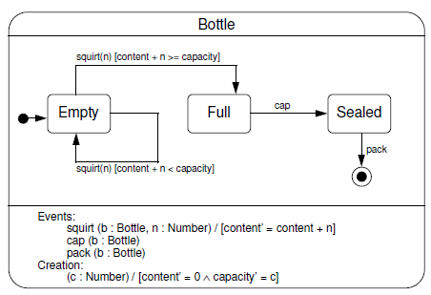
Guards:
On a more detailed level the bottle can be filled as a series of squirts of liquid into bottle.
We replaced fill with a sequence of squirt events.

Slide 18
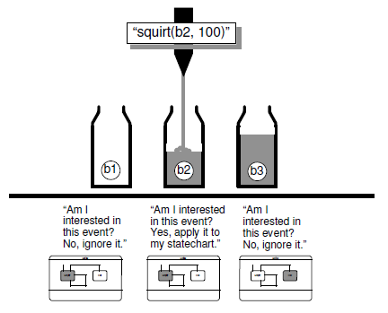

Slide 19
Mid-Term Review
Task/Vision Statements
Create a vision statement for a given problem scenario.
Scrum/Agile Methodology
Study the Scrum Implemented in 10 Steps handout
Product Backlogs
Create a product backlog from a given vision statement
Use Cases
Create detailed (fully dressed) use cases from a given product backlog
Class Diagrams
Create a class diagram from a given use case or product backlog
Interaction Diagrams
Create an interaction diagrams from a given use case document and class diagram
State Diagrams
Create a state diagram from a given use case document

Slide 20
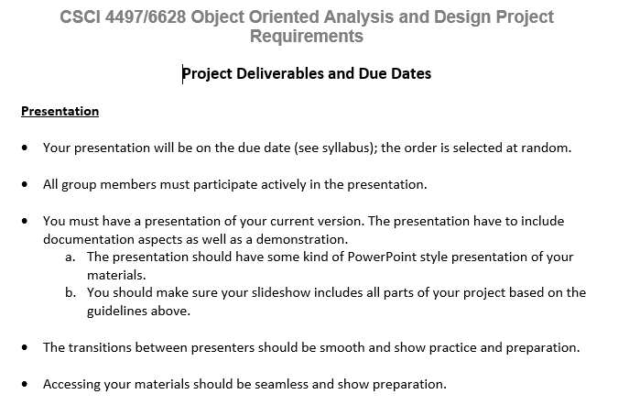

Slide 21

Sprint 1 –Project Documentation and Presentations

