Slide 1
SOA Patterns (Service Oriented Architecture)
…an architectural style for distributed systems
Request/Reply
Request/Reaction
Saga (Story) Pattern
Lecture 7 (week 8)
CSCI 6628
© 2017 The Hartford. Classification: Publicly Available; for approved external distribution. No part of this document may be reproduced, published or used without the permission of The Hartford.

Slide 2
Service Oriented Architecture
Service Oriented Architecture (SOA) is a paradigm for organizing and utilizing distributed capabilities that may be under the control of different ownership domains.
OASIS SOA reference model
The SOA approach to architecture helps with separating the concerns of what needs to get done from how it gets done, where it gets done, or who or what does it.
OMG
A service is value delivered to another through a well-defined interface and available to a community (which may be the general public). A service results in work provided to one by another.
OMG
SOA starts with a simple idea – the concept of service.
This makes it possible to introduce other ideas, such as service bus, service composition, and service virtualization, each of which can be applied to enterprise, program and project architecture in order to deliver benefits.
© 2017 The Hartford. Classification: Publicly Available; for approved external distribution. No part of this document may be reproduced, published or used without the permission of The Hartford.

Slide 3
Basic concepts
Service-Oriented Architecture (SOA) is an architectural style that supports service-orientation.
Service-orientation is a way of thinking in terms of services and service-based development and the outcomes of services.
A service:
Is a logical representation of a repeatable business activity that has a specified outcome (e.g., check customer credit, reissue policy)
Is self-contained
May be composed of other services
Is a “black box” to consumers of the service
© 2017 The Hartford. Classification: Publicly Available; for approved external distribution. No part of this document may be reproduced, published or used without the permission of The Hartford.

Slide 4
The SOA architectural style has the following distinctive features:
It is based on the design of the services – which mirror real-world business activities – comprising the enterprise (or inter-enterprise) business processes.
Service representation utilizes business descriptions to provide context (i.e., business process, goal, rule, policy, service interface, and service component) and implements services using service orchestration.
It places unique requirements on the infrastructure – it is recommended that implementations use open standards to realize interoperability and location transparency.
Implementations are environment-specific – they are constrained or enabled by context and must be described within that context.
It requires strong governance of service design, discovery and implementation.
© 2017 The Hartford. Classification: Publicly Available; for approved external distribution. No part of this document may be reproduced, published or used without the permission of The Hartford.

Slide 5
SOA Characteristics
Enterprise-wide loose coupling
Support for service-oriented business modeling
Organizational agility
Layers of abstraction
These characteristics are all addressed via conscious up-front modeling and design efforts. It is extra up-front work, but it is necessary to achieve the benefits.
© 2017 The Hartford. Classification: Publicly Available; for approved external distribution. No part of this document may be reproduced, published or used without the permission of The Hartford.

Slide 6
Messaging
Messaging is the basic mechanism through which Services interact. In other words services invoke each other through the exchange of messages. This provides significant flexibility in service configuration and maximizes reuse. Moreover, having a central mechanism by which all messages are exchanged facilitates monitoring, control, transformation, and security.
© 2017 The Hartford. Classification: Publicly Available; for approved external distribution. No part of this document may be reproduced, published or used without the permission of The Hartford.

Slide 7
Messaging Patterns
Request – Response
This pattern is initiated by a component which sends a message describing the request of information. The message is handled by another component, which processes the request message and sends a response message back
© 2017 The Hartford. Classification: Publicly Available; for approved external distribution. No part of this document may be reproduced, published or used without the permission of The Hartford.

Slide 8
The logic within the requestor can be synchronous or asynchronous.
This is a very common pattern for applications to use when the information or logic is located in other systems. Historically one may have copied the information or logic into the application, creating redundancy within the environment. Leveraging this pattern allows the application to eliminate the redundant design and maintenance by accessing the information from the provider.
This does create a dependency upon the provider for the information, so the design of the requestor needs to take this into account in case it cannot reach a provider. Similarly, the design of the provider needs to take into account availability requirements of the requestors to ensure response. All of these are achievable; they just need to be taken into account.
© 2017 The Hartford. Classification: Publicly Available; for approved external distribution. No part of this document may be reproduced, published or used without the permission of The Hartford.

Slide 9
Fire and forget
This pattern is often used when the source is pushing out information e.g. an event notification. The receiver of the message is not expected to send back a response. The sender of the message may or may not know who is receiving it.
© 2017 The Hartford. Classification: Publicly Available; for approved external distribution. No part of this document may be reproduced, published or used without the permission of The Hartford.

Slide 10
Message Correlation
It is possible that a requestor may have several requests active at a time, so the provider needs to include data within the response to identify which request it is responding to. A common way of addressing this requirement is through a correlation key within a request/response message exchange pattern.
Within the scope of an application, each transaction may contain an identifier that is a Globally Unique Identifier (GUID). This identifier would be sent in the request message, and the provider would supply it as part of the response message so the requestor would understand the response. It is not recommended to share internally defined reference ids across applications and systems because it creates tight coupling
© 2017 The Hartford. Classification: Publicly Available; for approved external distribution. No part of this document may be reproduced, published or used without the permission of The Hartford.

Slide 11
Event Processing
Publish - Subscribe
Publish/subscribe or pub/sub is a standard message exchange pattern that is utilized primarily (although not exclusively) for event notifications i.e. one application sends a message to inform another system that a change occurred within its boundaries. This pattern consists of two steps:
A consumer interested in receiving notifications subscribes to a topic associated with the notification message. This is usually implemented as a request/reply interaction with the reply being a confirmation of subscription.
The publisher pushes the notification message out to its subscribers, which in turn are listening and ready to receive it. This is implemented as a fire and forget pattern
© 2017 The Hartford. Classification: Publicly Available; for approved external distribution. No part of this document may be reproduced, published or used without the permission of The Hartford.

Slide 12
Ordered Events
Ordered Events are event messages that need to maintain their order. The pub/sub mechanism as described above although assures delivery it does not guarantee that the messages will be delivered in the same order. As a rule fire and forget type mechanisms donot assure that messages will be delivered in the same order as they were sent.
One solution for this is to utilize contiguous correlation ids as sequence numbers that can then be used by the destination application to reorder the events before they are processed. The fact that they are contiguous will also inform the destination of any possible lost or dropped messages.
© 2017 The Hartford. Classification: Publicly Available; for approved external distribution. No part of this document may be reproduced, published or used without the permission of The Hartford.

Slide 13
SOA Actor Roles –Consumer and Provider
Perhaps the most significant roles that users, actors, applications and other IT assets assume within the context of service functional interaction are that of the consumer and provider.
Any actor or asset in a Service Oriented Architecture may take on the role of either consumer or provider depending on its function within an activity that it participates. An application may be a consumer of a provider service that it calls out to in order to retrieve some useful information. That same application may expose the same functionality and thus act as provider to an external system that consumes the result of its work. The main point of the provider/consumer separation is that there is value in decoupling one from the other.
© 2017 The Hartford. Classification: Publicly Available; for approved external distribution. No part of this document may be reproduced, published or used without the permission of The Hartford.

Slide 14
The consumer/provider roles pervade the SOA and are always functionally applicable to all service interactions. However they will correspond differently to the messaging roles depending on the type. Specifically:
In the request - response message pattern the requester is always implied as the consumer and the responder as the provider. This is applicable to both synchronous and asynchronous implementations of this interaction i.e. when using a fire and forget type pattern to send a request and receive the response asynchronously by a different thread or process.
A subscriber is always the consumer.
A publisher (fire and forget) is always the provider.
© 2017 The Hartford. Classification: Publicly Available; for approved external distribution. No part of this document may be reproduced, published or used without the permission of The Hartford.

Slide 15
SOA design Principles
Service Reusability
SOA encourages reuse. This increases the chances of reuse due to the service being able to better accommodate future requirements more readily, and helps limit that amount of service restructuring or wrapping that tends to get done for hiding services that were too specific.
Types of reuse; inter-application interoperability, composition, utility services. This comes from the service itself (logical grouping of operations), the operations (encapsulations of functions/tasks), and the composition of the services and operations.
The operations need to be generic. The more generic they are, the more reusable they tend to be. If they are too specific to a particular situation and context, then it is unlikely they will be able to be reused
© 2017 The Hartford. Classification: Publicly Available; for approved external distribution. No part of this document may be reproduced, published or used without the permission of The Hartford.

Slide 16
© 2017 The Hartford. Classification: Publicly Available; for approved external distribution. No part of this document may be reproduced, published or used without the permission of The Hartford.

Slide 17
Service autonomy establishes an execution environment that facilitates reuse because the service has independence and self-governance. The less dependencies a service has, the broader the applicability of its reusable functionality.
Service statelessness supports reuse because it maximizes the availability of a service and typically promotes a generic service design that defers activity-specific processing outside of service logic boundaries.
Service abstraction fosters reuse because it establishes the black box concept, where processing details are completely hidden from requestors. This allows a service to simply express a generic public interface.
Service discoverability promotes reuse, as it allows requestors (and those that build requestors) to search for and discover reusable services.
Service loose coupling establishes an inherent independence that frees a service from immediate ties to others. This makes it a great deal easier to realize reuse.
Service composability is primarily possible because of reuse. The ability for one service to compose an activity around the utilization of a collection of services
© 2017 The Hartford. Classification: Publicly Available; for approved external distribution. No part of this document may be reproduced, published or used without the permission of The Hartford.

Slide 18
Standardized Service Contract
A service should clearly define; the service endpoint, each service operation, every input and output message supported by each operation, rules and characteristics of the service and its operations.
A good contract also specifies how a service goes about accomplishing its task.
The contracts are a dependency for both the consumer as well as the provider.
They need to be maintained in such a fashion as to not break the contract, as well as a versioning strategy that supports the changes to the service that will be required over time
© 2017 The Hartford. Classification: Publicly Available; for approved external distribution. No part of this document may be reproduced, published or used without the permission of The Hartford.

Slide 19
Service Contract – WSDL
WSDL stands for Web Services Description Language.
It is the standard format for describing a web service.
WSDL was developed jointly by Microsoft and IBM.
© 2017 The Hartford. Classification: Publicly Available; for approved external distribution. No part of this document may be reproduced, published or used without the permission of The Hartford.

Slide 20
Features of WSDL
• WSDL is an XML-based protocol for information exchange in decentralized and
distributed environments.
• WSDL definitions describe how to access a web service and what operations it will perform.
• WSDL is a language for describing how to interface with XML-based services.
• WSDL is an integral part of Universal Description, Discovery, and Integration (UDDI),
an XML-based worldwide business registry.
• WSDL is the language that UDDI uses.
• WSDL is pronounced as 'wiz-dull' and spelled out as 'W-S-D-L'
© 2017 The Hartford. Classification: Publicly Available; for approved external distribution. No part of this document may be reproduced, published or used without the permission of The Hartford.

Slide 21
WSDL Usage
WSDL is often used in combination with SOAP and XML Schema to provide web services over the Internet.
A client program connecting to a web service can read the WSDL to determine what functions are available on the server.
Any special datatypes used are embedded in the WSDL file in the form of XML Schema (XSDs).
The client can then use SOAP to actually call one of the functions listed in the WSDL.
© 2017 The Hartford. Classification: Publicly Available; for approved external distribution. No part of this document may be reproduced, published or used without the permission of The Hartford.

Slide 22
History of WSDL
WSDL 1.1 was submitted as a W3C Note by Ariba, IBM, and Microsoft for describing services for the W3C XML Activity on XML Protocols in March 2001.
WSDL 1.1 has not been endorsed by the World Wide Web Consortium (W3C), however it has released a draft for version 2.0 that will be a recommendation (an official standard), and thus endorsed by the W3C.
© 2017 The Hartford. Classification: Publicly Available; for approved external distribution. No part of this document may be reproduced, published or used without the permission of The Hartford.

Slide 23
WSDL breaks down web services into three specific, identifiable elements that can be combined
or reused once defined.
The three major elements of WSDL that can be defined separately are:
Types
Operations
Binding
A WSDL document has various elements, but they are contained within these three main elements, which can be developed as separate documents and then they can be combined or reused to form complete WSDL files.
© 2017 The Hartford. Classification: Publicly Available; for approved external distribution. No part of this document may be reproduced, published or used without the permission of The Hartford.

Slide 24
WSDL Elements
A WSDL document contains the following elements:
• Definition: It is the root element of all WSDL documents. It defines the name of the web service.
• Data types: The data types to be used in the messages are in the form of XML schemas.
• Message: It is an abstract definition of the data, in the form of a message.
• Operation: It is the abstract definition of the operation for a message.
• Port type: It is an abstract set of operations mapped to one or more end-points.
• Binding: It is the concrete protocol and data formats for the operations and messages defined for a particular port type.
• Port: It is a combination of a binding and a network address, providing the target address of the service communication.
• Service: It is a collection of related end-points encompassing the service definitions in the file.
© 2017 The Hartford. Classification: Publicly Available; for approved external distribution. No part of this document may be reproduced, published or used without the permission of The Hartford.

Slide 25
<definitions name="HelloService"
targetNamespace="http://www.examples.com/wsdl/HelloService.wsdl"
xmlns="http://schemas.xmlsoap.org/wsdl/"
xmlns:soap="http://schemas.xmlsoap.org/wsdl/soap/"
xmlns:tns="http://www.examples.com/wsdl/HelloService.wsdl"
xmlns:xsd="http://www.w3.org/2001/XMLSchema">
<message name="SayHelloRequest">
<part name="firstName" type="xsd:string"/>
</message>
<message name="SayHelloResponse">
<part name="greeting" type="xsd:string"/>
</message>
<portType name="Hello_PortType">
<operation name="sayHello">
<input message="tns:SayHelloRequest"/>
<output message="tns:SayHelloResponse"/>
</operation>
</portType>
<binding name="Hello_Binding" type="tns:Hello_PortType">
<soap:binding style="rpc"
transport="http://schemas.xmlsoap.org/soap/http"/>
<operation name="sayHello">
<soap:operation soapAction="sayHello"/>
WSDL
© 2017 The Hartford. Classification: Publicly Available; for approved external distribution. No part of this document may be reproduced, published or used without the permission of The Hartford.

Slide 26
<input>
<soap:body
encodingStyle="http://schemas.xmlsoap.org/soap/encoding/"
namespace="urn:examples:helloservice"
use="encoded"/>
</input>
<output>
<soap:body
encodingStyle="http://schemas.xmlsoap.org/soap/encoding/"
namespace="urn:examples:helloservice"
use="encoded"/>
</output>
</operation>
</binding>
<service name="Hello_Service">
<documentation>WSDL File for HelloService</documentation>
<port binding="tns:Hello_Binding" name="Hello_Port">
<soap:address location="http://www.examples.com/SayHello/">
</port>
</service>
</definitions>
WSDL
© 2017 The Hartford. Classification: Publicly Available; for approved external distribution. No part of this document may be reproduced, published or used without the permission of The Hartford.

Slide 27
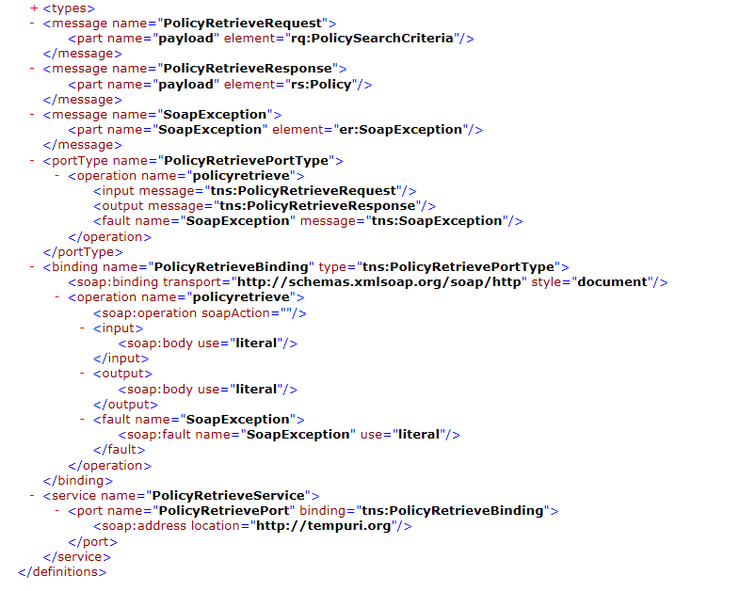
WSDL
Policy retrieve
© 2017 The Hartford. Classification: Publicly Available; for approved external distribution. No part of this document may be reproduced, published or used without the permission of The Hartford.

Slide 28
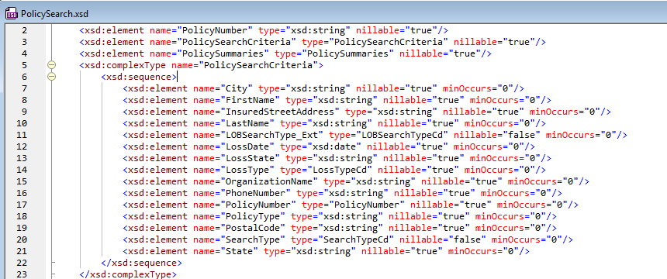
XSD Policy Retrieve
© 2017 The Hartford. Classification: Publicly Available; for approved external distribution. No part of this document may be reproduced, published or used without the permission of The Hartford.

Slide 29
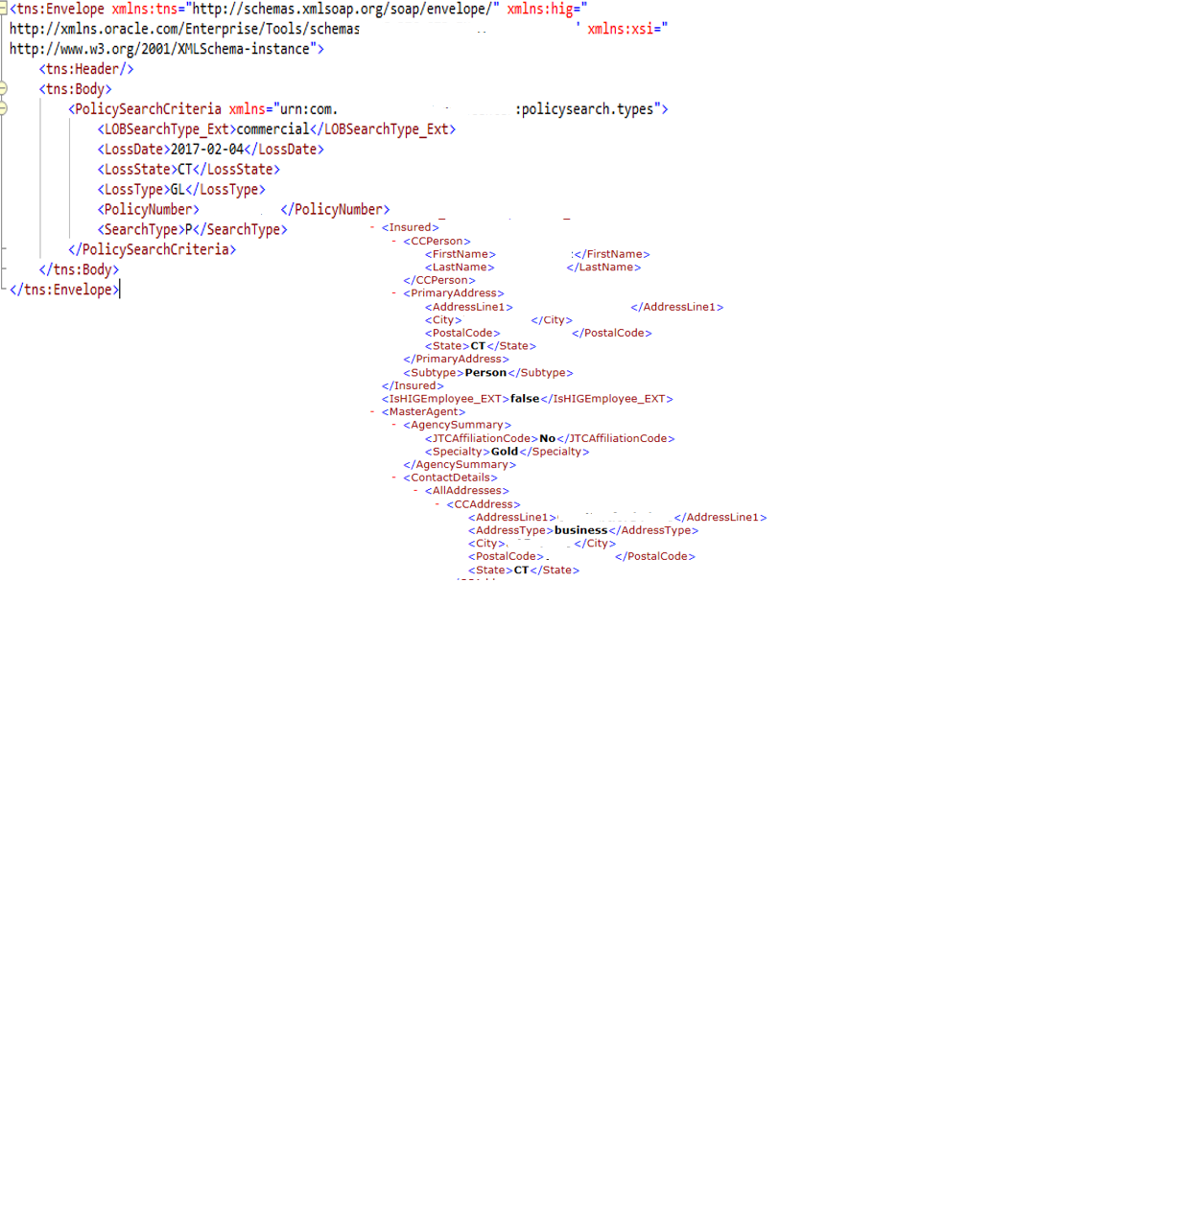
Response
Request
© 2017 The Hartford. Classification: Publicly Available; for approved external distribution. No part of this document may be reproduced, published or used without the permission of The Hartford.

Slide 30
Demo working services:
Service Virtualization or Real
© 2017 The Hartford. Classification: Publicly Available; for approved external distribution. No part of this document may be reproduced, published or used without the permission of The Hartford.

Slide 31
Service Loose Coupling
With the changes that occur over time in an IT environment due to internal or more often external drivers, services need to be loosely coupled to the environment and each other. The service contracts are the key component to enabling this level of coupling. Other services or applications then just need to know about the contract, it doesn't have to know about the implementation behind that contract. Also, over time there can be other providers of the contract that the consumers could leverage. As long as the contract is met, there is flexibility.
© 2017 The Hartford. Classification: Publicly Available; for approved external distribution. No part of this document may be reproduced, published or used without the permission of The Hartford.

Slide 32
Service reusability is supported through loose coupling because services are freed from tight dependencies on others. This increases their availability for reuse opportunities.
Service composability is fostered by the loose coupling of services, especially when services are dynamically composed.
Service statelessness is directly supported through the loosely coupled communications framework established by this principle.
Service autonomy is made possible through this principle, as it is the nature of loose coupling that minimizes cross-service dependencies.
Service contracts are what enable loose coupling between services, as the contract is the only piece of information required for services to interact.
© 2017 The Hartford. Classification: Publicly Available; for approved external distribution. No part of this document may be reproduced, published or used without the permission of The Hartford.

Slide 33
Service Contract
The service contract is a key component of enterprise application integration and arguably the most important part of SOA implementation. It is the point where the interaction with services and therefore between applications is defined and agreed upon and is the formal specification which the design should meet. The design and implementation of a service may change over time but still remain within the contract. Properly defined service contracts enable independent and speedy service implementations and decrease risk.
© 2017 The Hartford. Classification: Publicly Available; for approved external distribution. No part of this document may be reproduced, published or used without the permission of The Hartford.

Slide 34
Service Taxonomy
Service Taxonomy is the classification of the types of services within the enterprise. The purpose of a hierarchical service classification is to provide clear, concise, and non-overlapping definitions for the various types of services available within the SOA implementation.
Service classification helps facilitate communication between project groups by providing a common and accepted language and maximizes reuse
© 2017 The Hartford. Classification: Publicly Available; for approved external distribution. No part of this document may be reproduced, published or used without the permission of The Hartford.

Slide 35
Field | Description
Infrastructure tier | Gold, silver, bronze
Maximum volume | (Number of transactions)
Daily
Weekly
Monthly
Quarterly
Annually
Maximum message size | (Number of kb or mb)
Maximum concurrent invocations | (Number of concurrent sessions)
Average response time | (in seconds or milliseconds)
Service availability target | (hours/days)
Service availability schedule | day and time that service is available
Maintenance window | day and time that service is unavailable
Unplanned downtime allowed | dd/hh/mm/ss (how much time this service can be unavailable before impacting business)
Error notification list | (distribution group)
Limits on Capacity (CPU, RAM, Network, ) | (Estimation of capacity required for service to operate within SLA - CPU percentage of usage)
© 2017 The Hartford. Classification: Publicly Available; for approved external distribution. No part of this document may be reproduced, published or used without the permission of The Hartford.

Slide 36
Pattern Summary
Service Design Patterns - Summary
Pattern | Description
Atomic Service | The service mediation exposes functionality that is offered by a single provider. The provider implements functionality that is self-contained without requiring access to external components and systems.
Composite Service | The service mediation exposes functionality that requires data and information through access to multiple providers. These providers are accessed through a composite service implementation.
Composite Mediation Service | The service exposes functionality that requires access to other SOA services. The service implementation component is replaced by the provider services that are invoked.
Orchestration Service | The service provider realizes the execution of a well-defined process wherein each step involves the invocation of one or more services.
Atomic services are those whose implementation is self-contained and satisfied by a single provider.
Composite services are services whose implementation requires access to additional providers in order to fulfill their contract. They do that by either calling other services or unpublished provider endpoints. In this way they act both as a provider to their caller as well as a consumer to their aggregate services.
An orchestration service is defined within the scope of this reference architecture as a type of composite service whose function is to expose a well-defined and documented process to its consumers by coordinating the execution of other services.
*The terms composite and orchestration as applied to SOA services are used interchangeably in the industry and may be found to have slightly different assigned roles in various reference architectures than what is established here.
© 2017 The Hartford. Classification: Publicly Available; for approved external distribution. No part of this document may be reproduced, published or used without the permission of The Hartford.

Slide 37
Service Design Pattern: Atomic Service Pattern
Description
The atomic service pattern describes a design for service mediation which exposes functionality that is offered by a single provider. The service mediation implements mediator functions within the proxy as needed to ensure reliability, compatibility and compliance of the provider interface with enterprise integration standards.
Service Consumer
The atomic service implementation is self-contained within the service provider. The service, in addition to encapsulating, local to the provider, implementation logic and resources, does not require any external information or data to fulfill its contract. As such, a service implemented using this pattern has no external dependencies.
© 2017 The Hartford. Classification: Publicly Available; for approved external distribution. No part of this document may be reproduced, published or used without the permission of The Hartford.

Slide 38
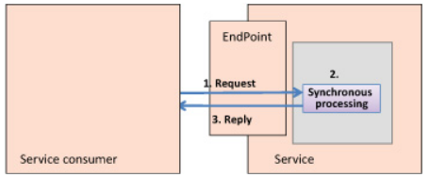
Request/Reply
Pattern
The main problem with the Request/Reply interaction style is that it’s suspiciously reminiscent of remote procedure calls (RPCs)—that DCOM/CORBA, -distributed stuff. You should be wary of modeling the services’ contracts on the RPC mindset—this can have several unfortunate effects on your SOA, ranging from poor performance to completely nullifying SOA. Instead of using the RPC approach, you should try to model your contracts on a document-centric approach.
Document-centric means that the message contains enough information to represent a complete unit of work and doesn’t instruct the service on how to handle the message. In contrast, RPC calls tend to be command-oriented and geared toward sending just the parameters needed to perform the action; they have some stateful expectations from the service side as well as implicit expectations about what’s going to happen on the consumer side.
© 2017 The Hartford. Classification: Publicly Available; for approved external distribution. No part of this document may be reproduced, published or used without the permission of The Hartford.

Slide 39
Options for providing context within a document-centric message
Context | Explanation
History | The message can contain the interactions up to this point, sort of like bread-crumbs in the Hansel and Gretel tale. In an ordering scenario, if the first step was to get customer data and the current step is to set the order (each step being performed by another service), the message would contain the customer information when it goes to the ordering service.
Future | The message can include the options the consumer can take to complete the interaction. If you think about an ordering scenario, if the previous step was to reserve the order, the return message could include the information needed to confirm the reservation.
Complete future | Another way to provide context is for the message format to contain the complete details needed for the interaction. For the ordering example, this would mean that the message would have a skeleton to support all the order and related details, and the parties involved would fill in the blanks as the interaction progresses.
© 2017 The Hartford. Classification: Publicly Available; for approved external distribution. No part of this document may be reproduced, published or used without the permission of The Hartford.

Slide 40
Request/Reaction pattern
Synchronous communication, as described in the Request/Reply pattern, is very important, but it isn’t enough.
The synchronous nature of Request/Reply means that the service consumer needs to sit and wait for the service to finish processing the request before the consumer can continue with whatever it was doing.
There are situations where the service consumer doesn’t want or can’t afford to wait but is still interested in getting a reply when it’s available.
Problem
In contemporary border-control systems, when travelers get to the immigration officer, the officer searches for the traveler’s details in the system (swipes the passport, types in the password number, and so on) and then looks at the passport and tries to match the face to the passport holder. In the last few years, countries around the world have begun the move to e-passport systems. E-passports contain several elements, including an RFID chip, machine-readable code, and a couple of biometric samples (usually a photo of the face and fingerprints).
© 2017 The Hartford. Classification: Publicly Available; for approved external distribution. No part of this document may be reproduced, published or used without the permission of The Hartford.

Slide 41
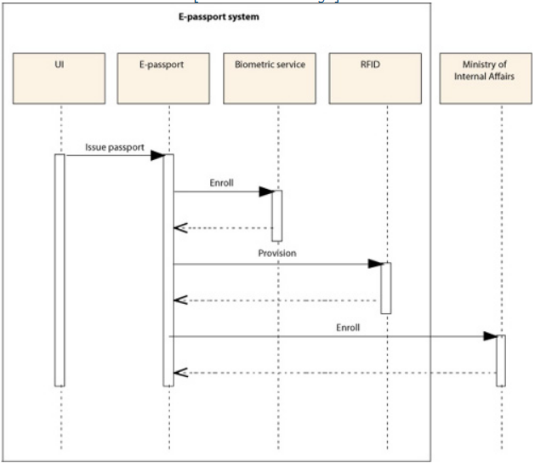
One of the steps in the flow is to enroll the person in the biometric database. While it isn’t apparent from just looking at the interaction, the enrollment task can take quite some time to complete because internally the Biometric service also checks for duplicates, which is essential in ensuring the integrity of the database and preventing mistakes as well as intentional impersonations. This step involves comparing each sample (each face, for example) against every other sample already in the database, which could contain hundreds of millions of records (the population of the country).
© 2017 The Hartford. Classification: Publicly Available; for approved external distribution. No part of this document may be reproduced, published or used without the permission of The Hartford.

Slide 42
Service Design Pattern: Composite Service Pattern
Description
The service exposes functionality that requires access to multiple providers. The mediation service implements non-stateful logic to apply mediation functions to the responses (transformation etc.) according to its interface contract. The service implementation performs any aggregation type processing needed for example consolidating search results into a single response message.
Service Consumer
© 2017 The Hartford. Classification: Publicly Available; for approved external distribution. No part of this document may be reproduced, published or used without the permission of The Hartford.

Slide 43
Service Design Pattern: Composite Mediation Service Pattern
Description
The service exposes functionality that requires access to other services, applications or components and the contract can be fully fulfilled by the service mediation components. The mediation service implements non-stateful logic to apply mediation functions to the responses (transformation etc.) according to its interface contract. The service implementation component is replaced by the provider services and end points that that are invoked
Service Consumer
Usage
This pattern may be utilized when data and information is needed from multiple external sources that are accessed through other existing services and when all necessary processing can be accomplished in the serviced mediation and does not require stateful logic through use of resources such as local database, files etc.
© 2017 The Hartford. Classification: Publicly Available; for approved external distribution. No part of this document may be reproduced, published or used without the permission of The Hartford.

Slide 44
Service Design Pattern: Orchestration Service Pattern
Description
In the orchestration service implementation pattern a service fulfills its contract by calling other published services, coordinating their execution and returning the result of the total process. The Orchestration Service maps directly to a well-defined and documented process flow which it implements. This is in contrast to the Composite Service pattern which is intended for information access from multiple sources
Service Consumer
Usage
This pattern may be used to expose a well-defined process through a single interface invocation. The Service Mediation implements the logic to coordinate the execution of each service implementation (provider)
© 2017 The Hartford. Classification: Publicly Available; for approved external distribution. No part of this document may be reproduced, published or used without the permission of The Hartford.

Slide 45
Glossary
Term | Definition
SOA | Service Oriented Architecture
Service Orientation | A way of thinking in terms of services and service-based development and the outcomes of services
ESB | An enterprise service bus (ESB) is a "software architecture" model used for designing and implementing communication between mutually interacting software applications in a service-oriented architecture (SOA).
OASIS | The Organization for the Advancement of Structured Information Standards (OASIS) is a global nonprofit consortium that works on the development, convergence, and adoption of standards for security, Internet of Things, energy, content technologies, emergency management, and other areas.
OMG | The Object Management Group (OMG) is an international, open membership, not-for-profit technology standards consortium.
EAI | Enterprise Application Integration.
WS* | “WS-“is a prefix used to indicate specifications associated with Web Services and there exist many WS* standards including WS-Addressing, WS-Discovery, WS-Federation, WS-Policy, WS-Security, and WS-Trust
WSRR | Websphere Service Registry and Repository
TOGAF | The Open Group Architecture Framework. It is a framework for enterprise architecture that provides an approach for designing, planning, implementing, and governing an enterprise information technology architecture.
MEP | Message exchange patterns
GUID | (or UUID) is an acronym for 'Globally Unique Identifier' (or 'Universally Unique Identifier'). It is a 128-bit integer number used to identify resources. The term GUID is generally used by developers working with Microsoft technologies, while UUID is used everywhere else.
TLS | Transport Layer Security (TLS) is a protocol that ensures privacy between communicating applications and their users on the Internet. When a server and client communicate, TLS ensures that no third party may eavesdrop or tamper with any message. TLS is the successor to the Secure Sockets Layer (SSL).
© 2017 The Hartford. Classification: Publicly Available; for approved external distribution. No part of this document may be reproduced, published or used without the permission of The Hartford.

Slide 46
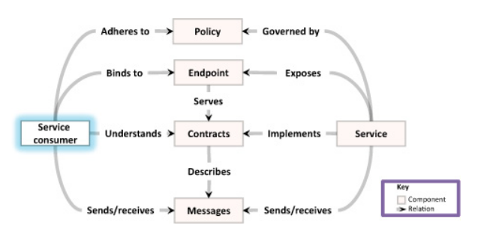
Message exchange patterns
© 2017 The Hartford. Classification: Publicly Available; for approved external distribution. No part of this document may be reproduced, published or used without the permission of The Hartford.

Slide 47
Additional Patterns
Request/Reply—Enable a service consumer to interact with a service simply
Request/Reaction—Temporally decouple the request from a service consumer and the reply from the service
Saga Interaction Pattern—Reach a distributed consensus between services without transactions
© 2017 The Hartford. Classification: Publicly Available; for approved external distribution. No part of this document may be reproduced, published or used without the permission of The Hartford.

Slide 48
Request/Reaction pattern
Synchronous communication, as described in the Request/Reply pattern, is very important, but it isn’t enough.
The synchronous nature of Request/Reply means that the service consumer needs to sit and wait for the service to finish processing the request before the consumer can continue with whatever it was doing.
There are situations where the service consumer doesn’t want or can’t afford to wait but is still interested in getting a reply when it’s available
© 2017 The Hartford. Classification: Publicly Available; for approved external distribution. No part of this document may be reproduced, published or used without the permission of The Hartford.

Slide 49
Problem
In contemporary border-control systems, when travelers get
to the immigration officer, the officer searches for the
traveler’s details in the system (swipes the passport, types
in the password number, and so on) and then looks at the
passport and tries to match the face to the passport holder.
In the last few years, countries around the world have begun
the move to e-passport systems. E-passports contain several
elements, including an RFID chip, machine-readable code,
and a couple of biometric samples (usually a photo of the
face and fingerprints).
© 2017 The Hartford. Classification: Publicly Available; for approved external distribution. No part of this document may be reproduced, published or used without the permission of The Hartford.

Slide 50
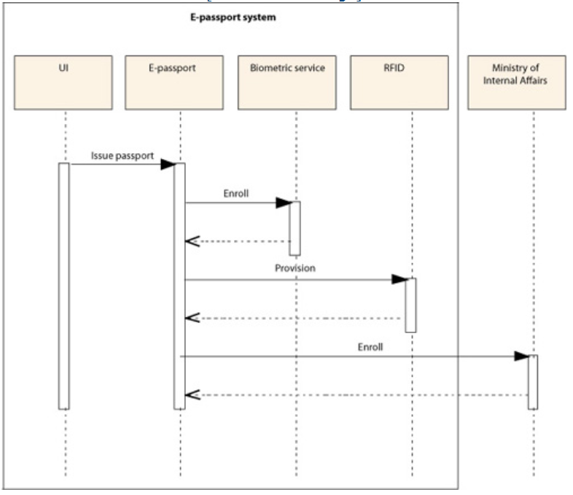
© 2017 The Hartford. Classification: Publicly Available; for approved external distribution. No part of this document may be reproduced, published or used without the permission of The Hartford.

Slide 51
One of the steps in the flow is to enroll the person in the Biometric Service. The enrollment task can take quite some time to complete because internally the Biometric service also checks for duplicates, which is essential in ensuring the integrity of the database and preventing mistakes as well as intentional impersonations. This step involves comparing each sample (each face, for example) against every other sample already in the database, which could contain hundreds of millions of records (the population of the country).
Making this type of request using the Request/Reply interaction pattern is problematic because the wait time between the request and the reply is too long. This situation isn’t unique to e-passport systems. Similar situations occur in other systems. When you buy shares in a trust fund, for example, the transaction doesn’t happen immediately, but you probably want to know when it’s been completed. Another example is requesting a travel-planning system to locate the best deal for your next vacation.
© 2017 The Hartford. Classification: Publicly Available; for approved external distribution. No part of this document may be reproduced, published or used without the permission of The Hartford.

Slide 52
How can you temporally decouple the request from a service consumer and the reply from the service?
One option is to solve the temporal coupling on the client side. To do this, you spawn a new thread before you send a request to the service; you then let that thread wait for the reply while the rest of the UI stays responsive. .NET has a component called BackgroundWorker that performs this separation and allows the UI to dispatch long-running work without blocking the UI thread.
Another option: Introduce the Request/Reaction pattern and implement asynchronous communication between service consumers and the service. Implement the message exchange as two one-way messages—a request from the consumer and a reply from the service sideIntroduce the Request/Reaction pattern and implement asynchronous communication between service consumers and the service. Implement the message exchange as two one-way messages—a request from the consumer and a reply from the service sideIntroduce the Request/Reaction pattern and implement asynchronous communication between service consumers and the service. Implement the message exchange as two one-way messages—a request from the consumer and a reply from the service sideIntroduce the Request/Reaction pattern and implement asynchronous communication between service consumers and the service. Implement the message exchange as two one-way messages—a request from the consumer and a reply from the service sideIntroduce the Request/Reaction pattern and implement asynchronous communication between service consumers and the service. Implement the message exchange as two one-way messages—a request from the consumer and a reply from the service sideIntroduce the Request/Reaction pattern and implement asynchronous communication between service consumers and the service. Implement the message exchange as two one-way messages—a request from the consumer and a reply from the service side
© 2017 The Hartford. Classification: Publicly Available; for approved external distribution. No part of this document may be reproduced, published or used without the permission of The Hartford.

Slide 53
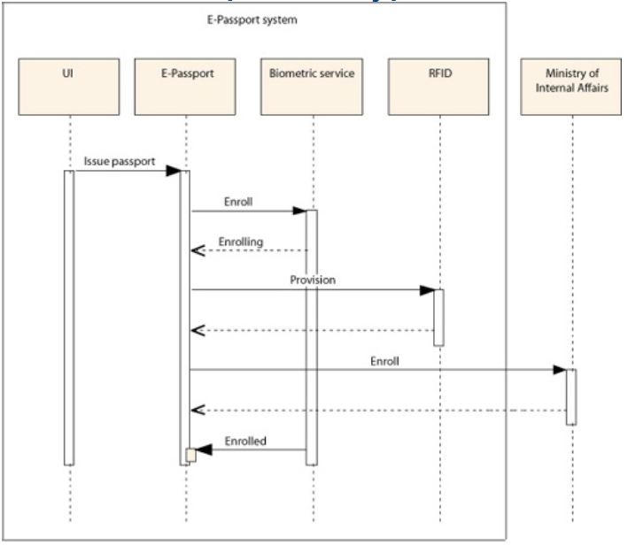
© 2017 The Hartford. Classification: Publicly Available; for approved external distribution. No part of this document may be reproduced, published or used without the permission of The Hartford.

Slide 54
Saga Interaction Pattern
Break the service interaction—the business process—into a set of smaller steps, and model that into a long-running conversation between the services.
The Saga interaction pattern is about providing the semantics and components to support the long-running conversation.
What made sense for databases makes even more sense for service interactions in SOA.
Break a long service interaction into individual actions or activities and compensations (in case there are faults or errors).
© 2017 The Hartford. Classification: Publicly Available; for approved external distribution. No part of this document may be reproduced, published or used without the permission of The Hartford.

Slide 55
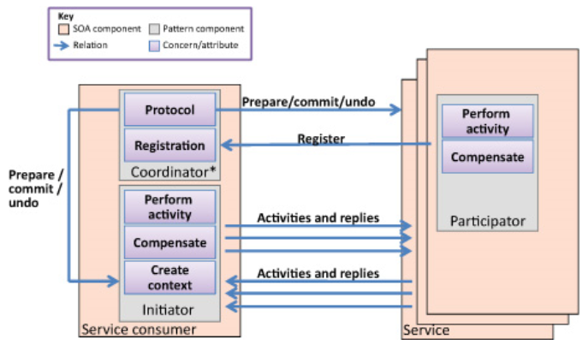
In the Saga pattern, a service consumer and one or more services hold a long-running conversation within a single context (a saga). Once the parties reach some consensus, the conversation is committed. If there are problems during the conversation, the interaction is aborted, and the involved parties perform corrective steps (compensations). (* The coordinator may be a component on its own, external to the consumer.)
© 2017 The Hartford. Classification: Publicly Available; for approved external distribution. No part of this document may be reproduced, published or used without the permission of The Hartford.

Slide 56
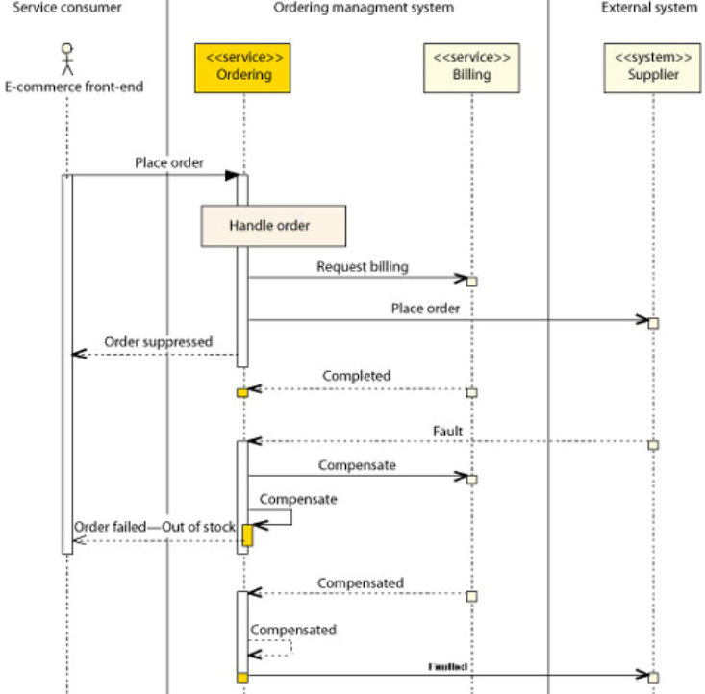
The Saga Pattern below demonstrates a scenario where the supplier is out of stock of the ordered items.
In this case, both the ordering and billing need to be canceled.
You also need to notify the front end that there was a problem and let the supplier know that you closed the interaction.
All the services involved (Ordering, Billing, and the Supplier system) send notifications about their ability to complete the saga or not
© 2017 The Hartford. Classification: Publicly Available; for approved external distribution. No part of this document may be reproduced, published or used without the permission of The Hartford.

Slide 57
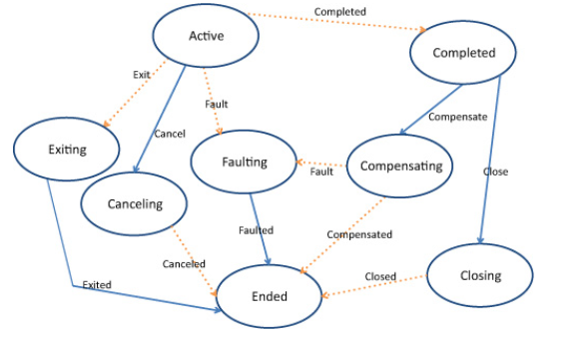
State Diagram
© 2017 The Hartford. Classification: Publicly Available; for approved external distribution. No part of this document may be reproduced, published or used without the permission of The Hartford.

