Slide 1
ACCIDENT
DETECTION SYSTEM
BY
RISHIKESH REDDY AKHIL REDDY SAITEJA PRANAY BASKAR

Slide 2
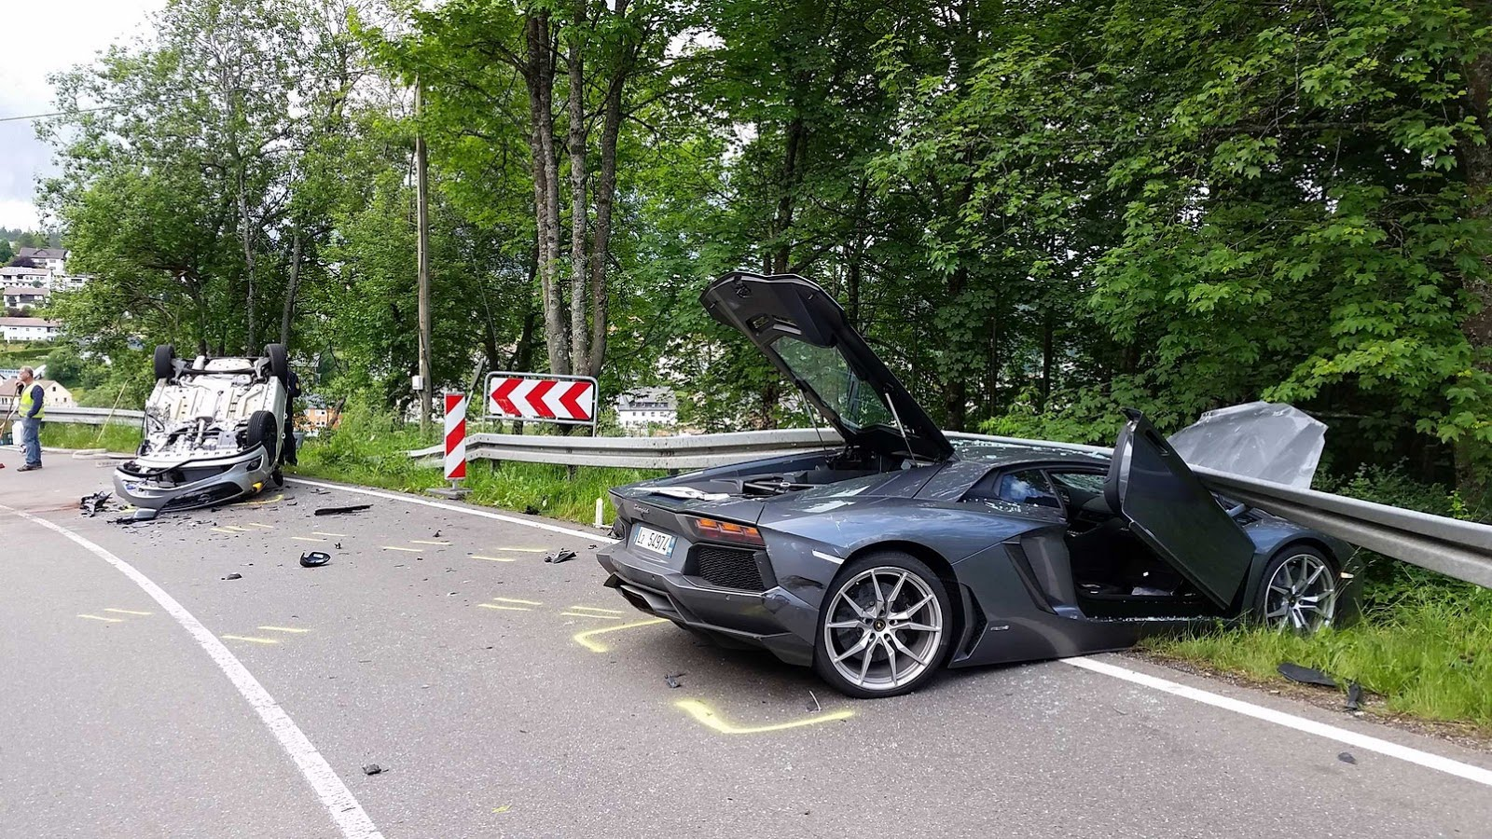
-> Now a days accidents occur on a daily bases, Even though many accident prevention system’s are available but they don’t always work .

Slide 3
Project Introduction
->Our project "ACCIDENT DETECTION SYSTEM" is used to detect vehicle accidents that occur in remote places around the world.
->It uses the latest IOT technology with cloud computing and Universal app to function accordingly.

Slide 4
Components required:
->Arduino circuit board embedded with Intel Edison processor.
->Microsoft azure cloud
->Piezo vibration sensor
->Groove led circuits
->Windows 10 OS with visual studio 2015

Slide 5
Project working :
We connect the Arduino board to the system and configure it by using PUTTY(to configure Intel Edison processor).
2.Connect the vibration detector and the led to the Arduino board.

Slide 6
3.Enter the code in Arduino code compiler to detect the vibration and to send data over to the cloud using WIFI or GSM/GPRS module.
4. Using the Visual studio 2015 create a universal mobile application to receive the data and the location of the vibration.

Slide 7
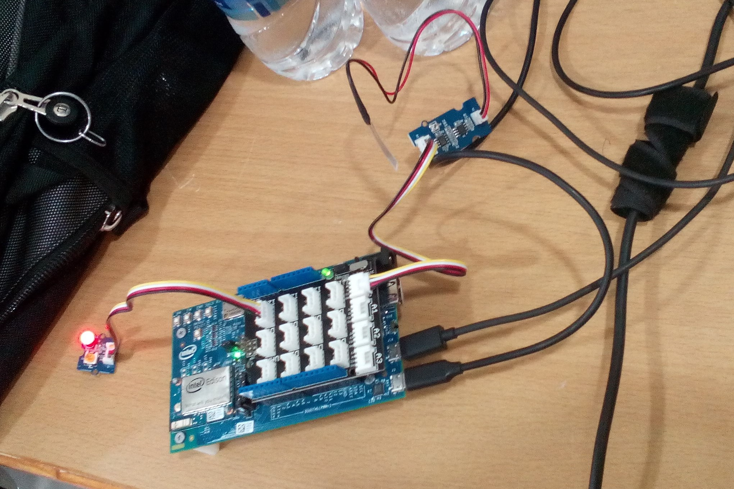

Slide 8
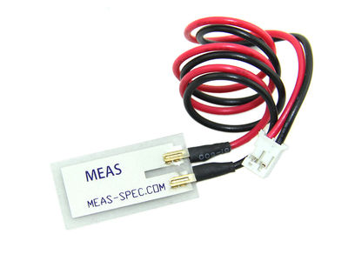
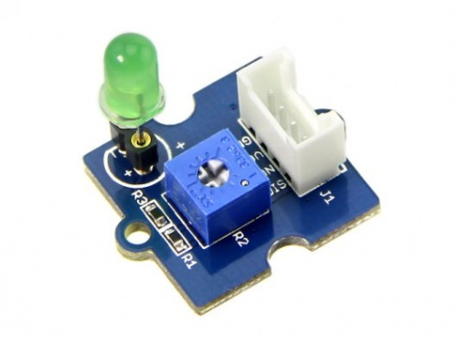
Piezo vibration sensor
Groove led circuits

Slide 9
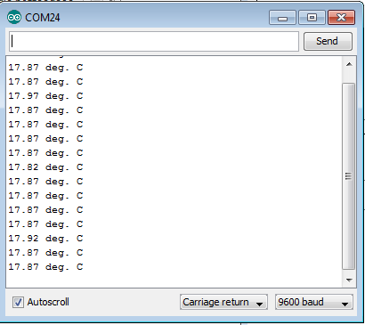
Piezo vibration sensor readings:

Slide 10
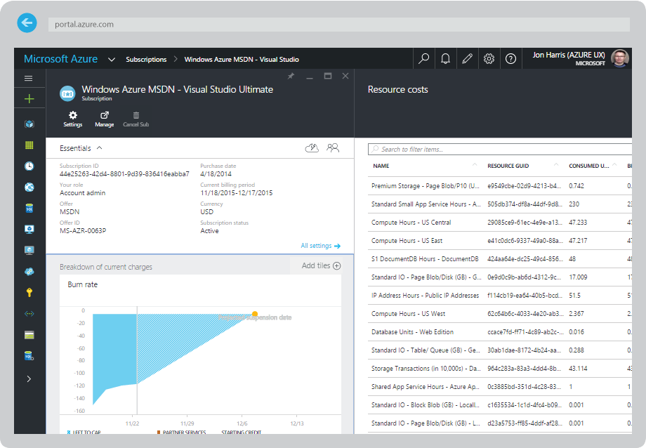
This how the info is stored in cloud :

Slide 11
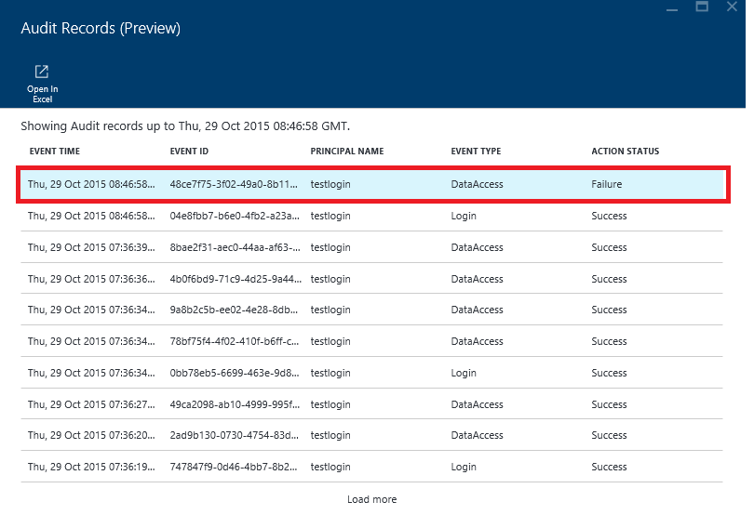

Slide 12
CONCLUSION:-
->By the help of our product we could locate when an accident occurred and that will send a notification to our mobile app/ website so that both the Police and Ambulance can rescue the people struck in the accident , the device picks up the vibration caused by the collision cause by the vehicle and send the signals to the authorities via Azure cloud and then to the mobile app as notification.

Slide 13
THANK YOU ☺

