Slide 1
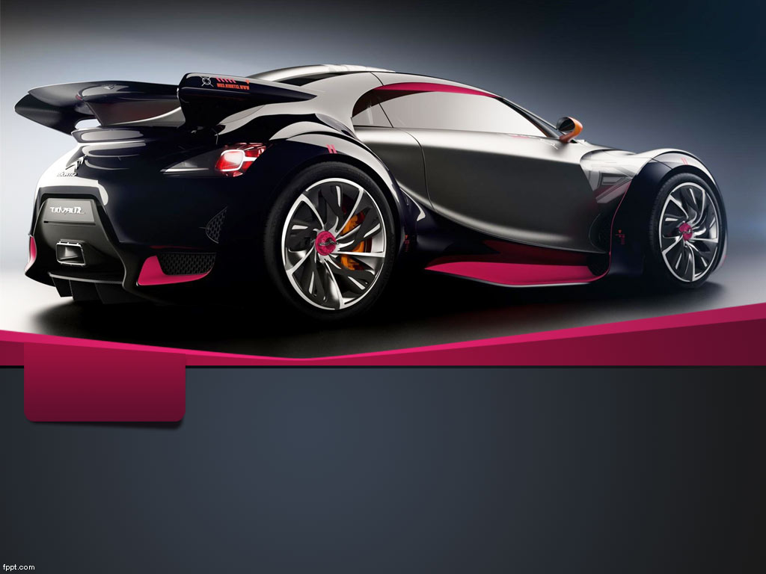
By, Hema Kothari Mounika Donepudi Maddi Rishikesh Reddy
SHOKITE VEHICLE RENTAL
Object Oriented Analysis Design
By
Prof . Thomas Shokite

Slide 2
Objective
To develop a web application for vehicle rental service.
Customers can find different vehicle services according to their requirements either for business or personal use.
Application will allow Customers to rent vehicles at reasonable offers
To provide a friendly and reliable customer service in order to gain loyal customer base.

Slide 3
Product Backlog
ID | Story | Estimation | Priority
6 | As a Database Administrator, I want to create vehicle Rental Database so that it maintains all the memberships and vehicle details | 3 | 1
7 | As an Administrator I want to upload single/bulk data for all the vehicles so that users can rent | 3 | 2
1 | As a User, I want to search all the vehicles available based on Pick-up Date – Drop-off Date and Location so that I can rent | 3 | 3
8 | As a User I want to view Make and Model, Image, Price Mileage of vehicle listed | 2 | 4

Slide 4
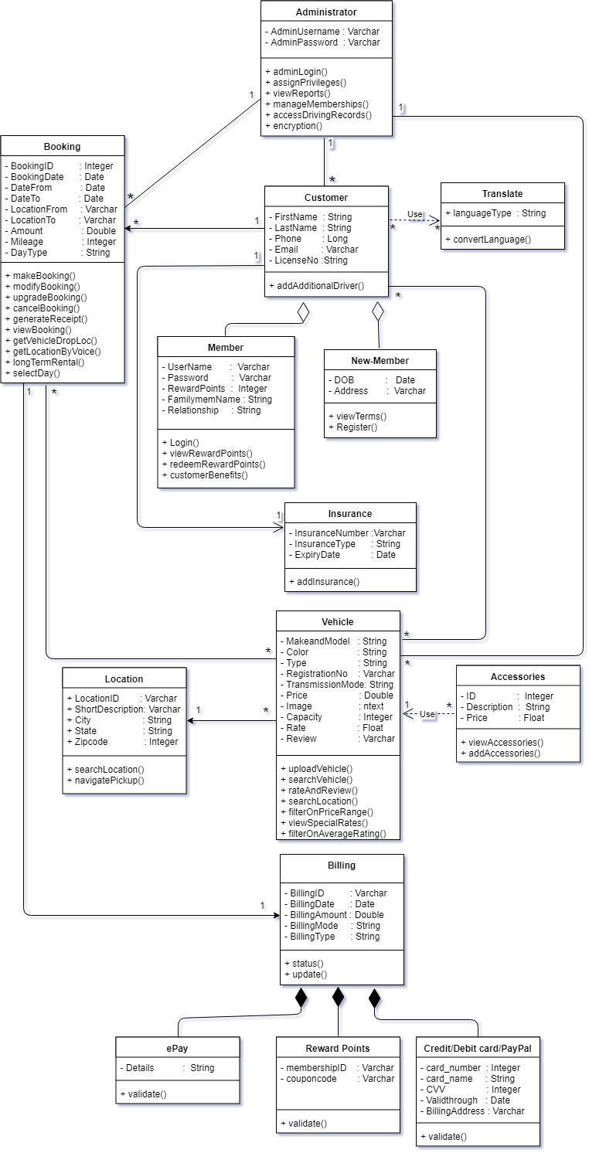
Class Diagram

Slide 5
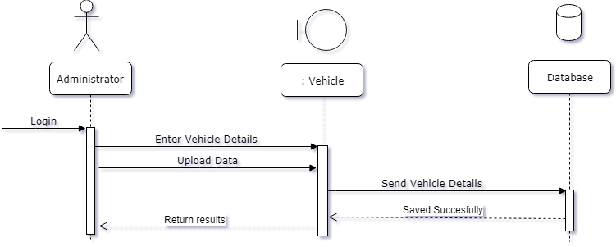
Sequence Diagram

Slide 6
Communication Diagram

Slide 7
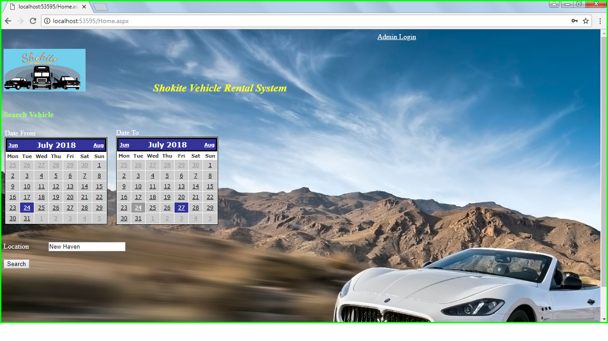
Homepage Display

Slide 8
Test Case 1 : Admin Login
Positive test case
Admin enters Username and Password.
Admin Logged in to system.
Negative test case
Admin enters Invalid Username and Password.
Message appears for Invalid Credentials.

Slide 9
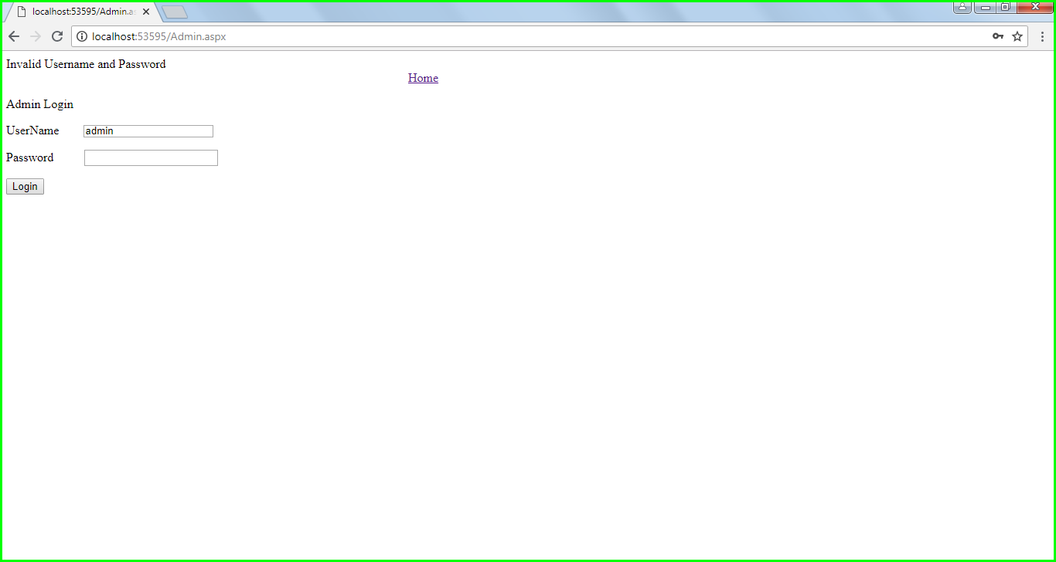
Admin Login

Slide 10
Admin Invalid Login

Slide 11
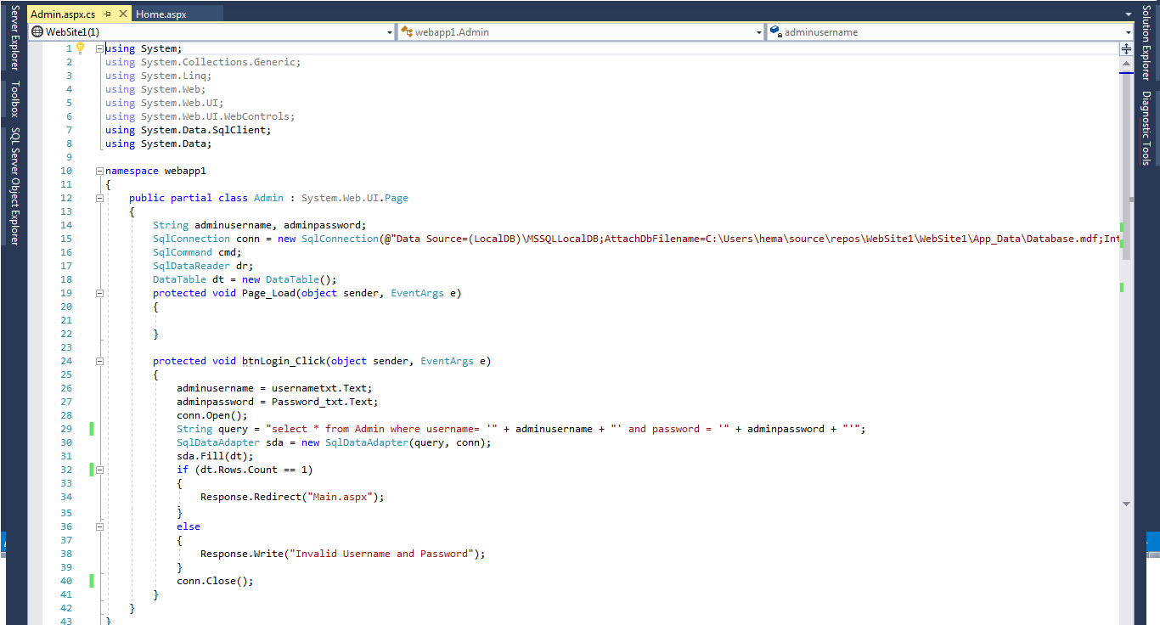
Admin Login Sourcecode

Slide 12
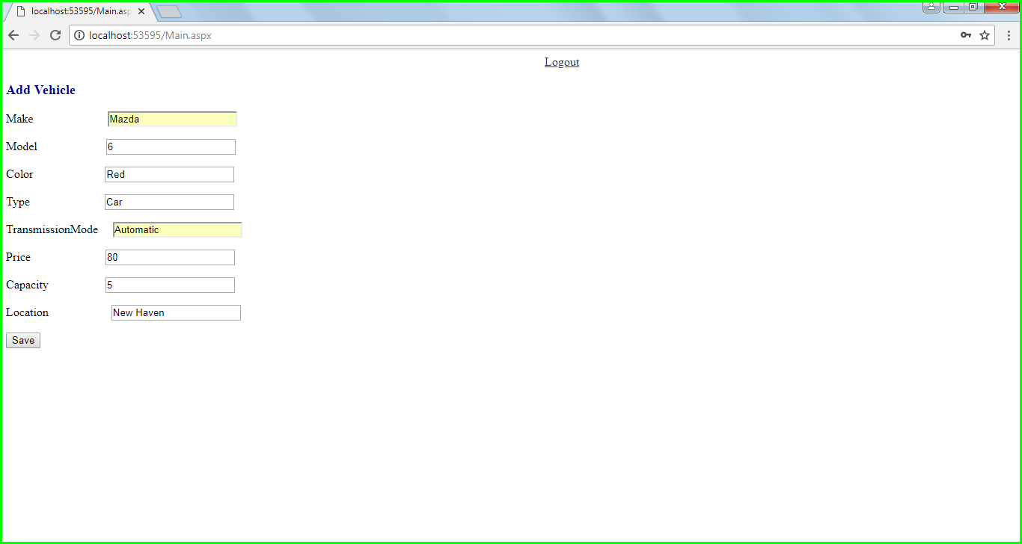
Add Vehicle Details

Slide 13
Test Case 2
Positive test case
Customer selects start date, end date and location and enters search.
Page shows list of vehicles available
Negative test case
Location not entered by Customer.
Message appears to Enter Location.

Slide 14
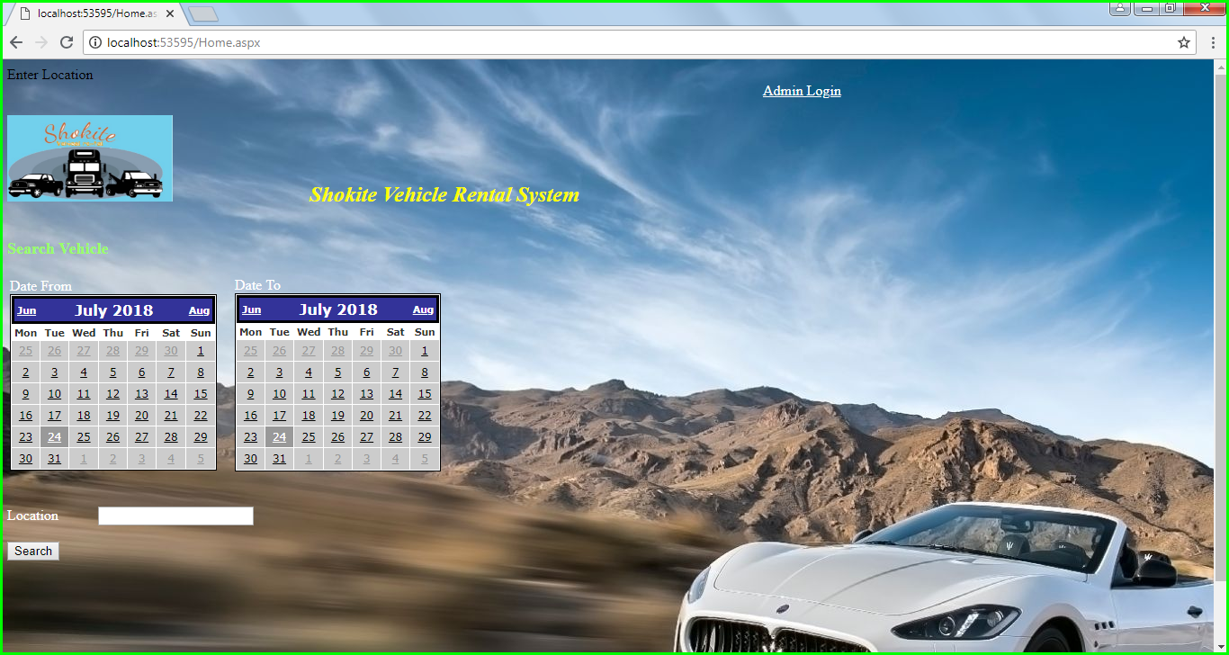
Location Not entered

Slide 15
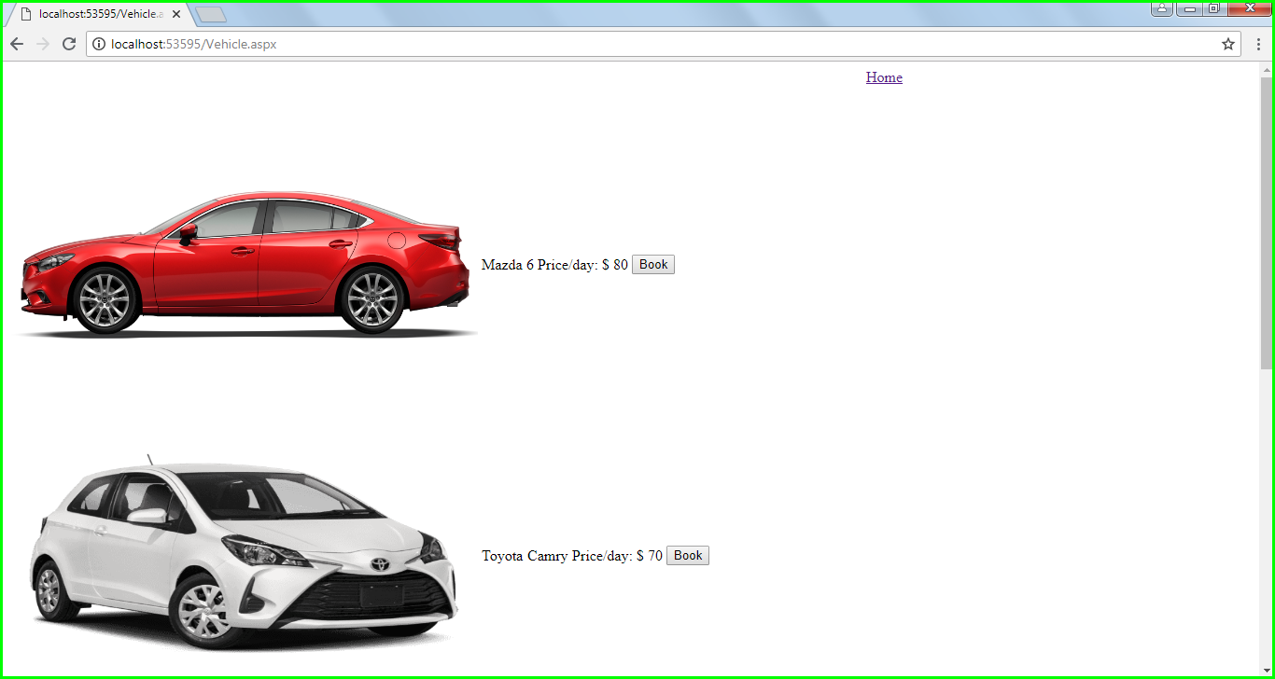
List Vehicle Page

Slide 16
Retrospective
What worked well
· Co-ordination between project members was good.
· Work was distributed well, and no one was much overloaded.
· Task allocated were worked on defined timelines.
What didn’t worked well
· Lot of time was spent in Research.
· There was rework for some of the diagrams because of some minor glitches.
Lessons Learned from this Phase.
· Spent Extended hours to cover research and rework time, so we must make sure that things are done straight at first place.
· Learned different types of diagrams and how project works in real world

Slide 17



Technology and Tools used:

Slide 18


Thank you

