Slide 1
Deadlock

Slide 2
The Deadlock Problem
Definition
  A set of blocked processes each holding a resource and waiting to acquire a resource held by another process
  None of the processes can proceed or back-off (release resources it owns)
Example
  semaphores A and B, initialized to 1
        P₀ P₁
        wait (A); wait(B)
        wait (B); wait(A)

Slide 3
Deadlock Conditions
Deadlock can arise if four conditions hold simultaneously
  Mutual exclusion: only one process at a time can use a resource instance
  Hold and wait: a process holding at least one resource is waiting to acquire additional resources held by other processes
  No preemption: a resource can be released only voluntarily by the process holding it, after that process has completed its task
  Circular wait: there exists a set {P₀, P₁, …, P_{n}} of waiting processes such that P₀ is waiting for a resource that is held by P₁, P₁ is waiting for a resource that is held by
  P₂, …, P_{n–1} is waiting for a resource that is held by
  P_{n}, and P_{n} is waiting for a resource that is held by P₀.

Slide 4
Methods for Handling Deadlocks
Ignore the problem and pretend that deadlocks would never occur.
Prevent the system from entering a deadlock state.
Allow the system to enter a deadlock state and then detect/recover.

Slide 5
The IGNORE Approach
Pretend there is no problem
  Unfortunately they can occur
  Reasonable if
    Deadlocks occur very rarely and cost of prevention is high
Do your typical OSes take this approach?
It is a trade off between
  Overhead
  Correctness

Slide 6
The PREVENT Approach
Restrain the ways requests can be made to break one of the four necessary conditions for deadlocks
Attacking the mutual exclusion condition:
  Some devices (such as printer) can be spooled
    only the printer daemon uses printer resource
    thus deadlock for printer eliminated
  Not all devices can be spooled

Slide 7
The PREVENT Approach
Attacking the Hold and Wait Condition:
  Require processes to request all resources before starting
Problems
  may not know required resources at start of run
  also ties up resources other processes could be using
Variation:
  before a process requests for a new resource, it must give up all resources and then request all resources needed

Slide 8
The PREVENT Approach
Attacking the No Preemption Condition:
  When a process holding some resources and waiting for others, its resources may be preempted to be used by others
Problems
  Many resources may not allow preemption; i.e., preemption will cause process to fail

Slide 9
The PREVENT Approach
Attacking the Circular Wait Condition:
  Impose a total order of all resource types; and require that all processes request resources in the same order

Slide 10
Deadlock Avoidance
When a process requests available resource, system must decide if immediate allocation leaves the system in a safe state
System is in safe state if there exists a sequence <P₁, P₂, …, P_{n}> of all processes, such that
  For each P_{i}, the resources that P_{i} can still request can be satisfied by currently available resources + resources held by all the P_{j}, with j < i
  That is:
    If P_{i} resource needs are not immediately available, then P_{i} can wait until all P_{j} have finished
    When P_{j} is finished, P_{i} can obtain needed resources, execute, return allocated resources, and terminate
    When P_{i} terminates, P_{i +1} can obtain its needed resources, and so on

Slide 11

Deadlock Avoidance
If a system is in safe state ⇒ no deadlocks
If a system is in unsafe state ⇒ possibility of deadlock
Avoidance ⇒ ensure that a system will never enter an unsafe state.

Slide 12
Resource-Allocation Graph
A set of vertices V and a set of edges E.
  V is partitioned into two types:
    P = {P₁, P₂, …, P_{n}}, the set consisting of all the processes in the system
    R = {R₁, R₂, …, R_{m}}, the set consisting of all resource types in the system
  E is partitioned into two types:
    request edge – directed edge P_{i} → R_{j}
    assignment edge – directed edge R_{j} → P_{i}

Slide 13
Resource-Allocation Graph
Process
Resource type with 4 instances
P_{i} requests instance of R_{j}
P_{i} is holding an instance of R_{j}
P_{i}
R_{j}
P_{i}
R_{j}

Slide 14

Resource Allocation Example 1
Is there deadlock?

Slide 15

Resource Allocation Graph Example 2
Is there a deadlock?

Slide 16

Resource Allocation Graph Example 3
Is there a deadlock?

Slide 17
Basic Facts
If graph contains no cycles ⇒ no deadlock.
If graph contains a cycle ⇒
  if only one instance per resource type, then deadlock.
  if several instances per resource type, possibility of deadlock.

Slide 18
Resource-Allocation Graph Algorithm
Suppose that process P_{i} requests a resource R_{j}
The request can be granted only if
  Converting the request edge to an assignment edge does not result in the formation of a cycle in the resource-allocation graph

Slide 19
Banker’s Algorithm
Each process must a priori claim the maximum set of resources that might be needed in its execution.
Safety check
  Repeat
    pick any process that can finish with existing available resources; finish it and release all its resources
    until no such process exists
  all finished → safe; otherwise → unsafe.

Slide 20
Data Structure for the Banker’s Algorithm
n = # of processes, m = # of resources types.
  Available: Vector of length m
    If available [j] = k, there are k instances of resource type R_{j} available
  Max: n x m matrix.
    If Max [i,j] = k, then process P_{i} may request at most k instances of resource type R_{j}
  Allocation: n x m matrix.
    If Allocation[i,j] = k then P_{i} is currently allocated k instances of R_{j}
  Need: n x m matrix.
    If Need[i,j] = k, then P_{i} may need k more instances of R_{j} to complete its task
Need [i,j] = Max[i,j] – Allocation [i,j]

Slide 21
Safety Algorithm
Step 1: Let Work and Finish be vectors of length m and n, respectively. Initialize:
  Work = Available
  Finish [i] = false for i = 0, 1, …, n- 1
Step 2: Find any i such that both (If no, Step 4)
  Finish [i] = false
  Need_{i} ≤ Work
Step 3. Work = Work + Allocation_{i}
  Finish[i] = true
  Step 2
Step 4. If Finish [i] == true for all i, then the system is in a safe state

Slide 22
Resource-Request Algorithm for Process P_{i}
Process P_{i} wants k instances of R_{j} (Request_{i} [j] = k)
  Step 1: If Request_{i} ≤ Need_{i} , go to step 2
    Otherwise, raise error condition, since process has exceeded its maximum claim
  Step 2: If Request_{i} ≤ Available, go to step 3
    Otherwise P_{i} must wait, since resources are not available
  Step 3: Pretend to allocate requested resources to P_{i} by modifying the state as follows:
      Available = Available – Request;
      Allocation_{i} = Allocation_{i} + Request_{i};
      Need_{i} = Need_{i} – Request_{i};
    If safe ⇒ the resources are allocated to Pi
    If unsafe ⇒ Pi must wait, and the old resource-allocation state is restored

Slide 23
Example of Banker’s Algorithm
5 processes P₀ through P₄;
3 resource types:
  A (10 instances), B (5 instances), and C (7 instances)
Snapshot at time T₀:
Allocation Max Available
A B C A B C A B C
P₀ 0 1 0 7 5 3 3 3 2
P₁ 2 0 0 3 2 2
P₂ 3 0 2 9 0 2
P₃ 2 1 1 2 2 2
P₄ 0 0 2 4 3 3
Question:
Is this a safe state?
Need
A B C
7 4 3
1 2 2
6 0 0
0 1 1
4 3 1
Question:
Can request for (1,0,2) by P₁ be granted?

Slide 24
Example of Banker’s Algorithm
5 processes P₀ through P₄;
3 resource types:
  A (10 instances), B (5 instances), and C (7 instances)
Snapshot at time T₀:
Allocation Max Available
A B C A B C A B C
P₀ 0 1 0 7 5 3 3 3 2
P₁ 2 0 0 3 2 2
P₂ 3 0 2 9 0 2
P₃ 2 1 1 2 2 2
P₄ 0 0 2 4 3 3
Question:
Can request for (3,3,0) by P₄ be granted?
Need
A B C
7 4 3
1 2 2
6 0 0
0 1 1
4 3 1
Question:
Can request for (0,2,0) by P₀ be granted?

Slide 25
Methods for Handling Deadlocks
Ignore the problem and pretend that deadlocks would never occur.
Prevent the system from entering a deadlock state.
Allow the system to enter a deadlock state and then detect/recover.

Slide 26
Single Instance of Each Resource Type
Maintain wait-for graph
  Nodes are processes
  P_{i} → P_{j} if P_{i} is waiting for P_{j}
Periodically invoke an algorithm that searches for a cycle in the graph. If there is a cycle, there exists a deadlock
An algorithm to detect a cycle in a graph requires an order of n² operations, where n is the number of vertices in the graph

Slide 27

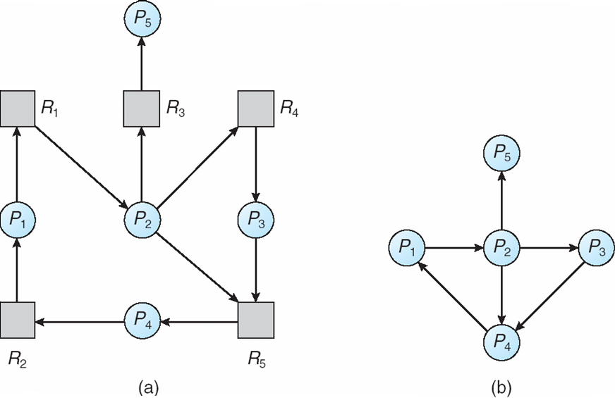
Single Instance of Each Resource Type
Resource-Allocation Graph
Corresponding wait-for graph

Slide 28
Additional Issues
When there are several instances of a resource type
  cycle detection in wait-for graph is not sufficient.
Deadlock detection is very similar to the safety check in the Banker’s algorithm

Slide 29
Recovery from Deadlock
Recovery through preemption
  take a resource from some other process
  depends on nature of the resource
Recovery through rollback
  checkpoint a process state periodically
  rollback a process to its checkpoint state if it is found deadlocked
Recovery through killing processes
  kill one+ of the processes in the deadlock cycle
  the other processes get its resources
  In which order should we choose process to kill?

