Slide 1

YUDHISHTHIRA PROJECT
RailNova
Smart Indoor Railway Navigation System
Project Team
Department
Institution
Academic Year
First Year B.E. Students
CSE [CYBER SECURITY]
RATHINAM TECHNICAL CAMPUS
2025 – 2026

Slide 2
Meet the Team
Introducing the dedicated students behind the RailNova project.
Rishi M
Sidheshwarar M
Team Lead
Team Member
Suresh Kumar S
Ramar P
Team Member
Team Member
Ragul R
Sarath S
Team Member
Team Member

Slide 3









PROBLEM STATEMENT
PROPOSED SOLUTION
The Challenge at Railway Stations
Introducing RailNova
RailNova is an AI-powered smart indoor railway navigation web portal that delivers real-time station intelligence to every passenger.
Millions of passengers face confusion, delays, and safety risks every day due to the lack of intelligent indoor navigation and real-time information at railway stations.
AI-Powered Navigation
Difficult Station Navigation
Platform Confusion
A* pathfinding algorithm calculates the safest, fastest route through the station in real time.
Frequent platform changes and last-minute announcements cause passenger panic and missed trains.
Passengers struggle to locate platforms, exits, and facilities in large, complex stations.
Real-Time Intelligence
Live platform changes, train delays, crowd alerts, and emergency notifications delivered instantly.
Crowd Management Issues
Train Info Accessibility
No unified system provides real-time train status, coach positions, and delay updates.
Overcrowding at key junctions creates safety hazards and inefficient passenger flow.
AI Assistant
Gemini AI-powered chatbot answers natural language queries about trains, platforms, and navigation.

Slide 4
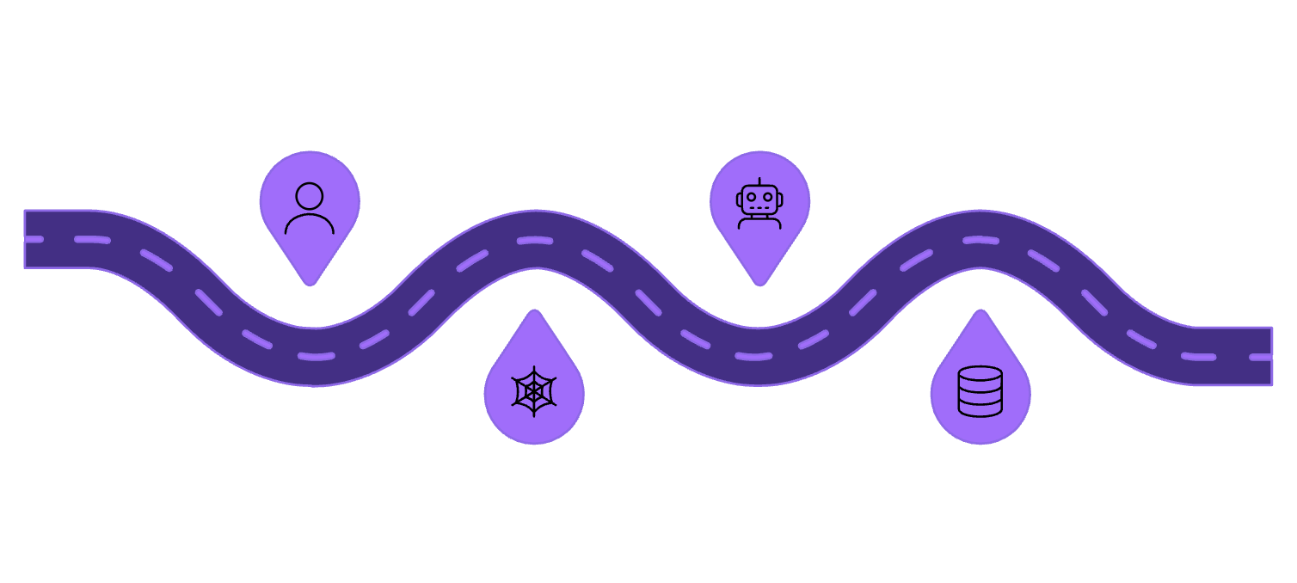
Objectives & System Architecture
Core Objectives
System Architecture
01
Passengers
AI & Navigation
Smart Navigation
Web portal entry for users
Gemini AI with A* pathfinding
Provide real-time indoor pathfinding across all station zones using the A* algorithm.
02
Passenger Assistance
Help passengers find platforms, coaches, and facilities with voice and visual guidance.
RailNova Portal
Supabase
React + TypeScript + Tailwind UI
Realtime DB, Auth, and Storage
03
RailNova's layered architecture ensures seamless data flow from passenger interaction through AI processing to secure admin governance.
Real-Time Train Updates
Deliver live delay, platform change, and coach position data to passengers instantly.
04
Safety Enhancement
Monitor crowd density and broadcast emergency notifications to improve station safety.

Slide 5
User Roles & Interactive Station Map
Role-Based Access Hierarchy
Interactive Station Map — Key Zones
1
🚉 Platforms
🚇 Subway 1 & 2
🚪 Entrance / Exit
2
Live platform status with train assignments and crowd levels
Underground passage routes with real-time congestion indicators
Main station entry with route guidance from gate to platform
3
1
Passenger
🎟️ Ticket Counter
🚲 Bike Parking
🍽️ Aiyappa Mess
Navigate station, find trains, use AI assistant, view real-time alerts
Located near entrance; navigable from any station zone
Secure parking zone with walking direction support
Food facility point of interest visible on the station map
2
Station Master (Admin)
Manage trains, platforms, crowd data, and emergency notifications
3
Head Officer
Approve/reject admin registrations and oversee all station operations

Slide 6

Navigation, Train Finder
Route Navigation Engine
Smart Train Finder
Start Location → Pathfinding Algorithm (A*) → Safe Route Calculation → Animated Route Display
Train Number Input → Platform Detection → Coach Position → Delay Status → Route Guidance
Passenger selects start and destination zone on the interactive map
A* algorithm computes the shortest, safest path avoiding congested areas
Animated step-by-step route is displayed with distance and estimated time
Enter train number to instantly retrieve platform and coach layout
Coach zone overlaid on station map for precise boarding guidance
Real-time delay status and departure time displayed

Slide 7





AI Assistant & Real-Time Features
AI ASSISTANT — POWERED BY GEMINI AI
REAL-TIME FEATURES
Natural Language Queries
⚡
Passengers ask questions in plain English — "Where is platform 3?" or "Which coach is my seat in?" — and receive instant, accurate answers.
Platform Change Alerts
Instant push notifications when a train's platform assignment changes, preventing passengers from rushing to the wrong platform.
Navigation & Train Help
AI provides platform info, train schedules, coach positions, and step-by-step navigation directions conversationally.
🚆
Train Delay Updates
Emergency Guidance
In emergencies, the AI chatbot instantly provides evacuation routes, safe zones, and emergency contact information.
Live delay status pulled from the database and displayed on the station map and passenger dashboard in real time.
👥
Crowd Monitoring
Admin-monitored crowd density data highlights congested zones and triggers route rerouting suggestions for passengers.
🚨
Emergency Notifications
Station-wide emergency alerts broadcast instantly to all active passenger sessions via Supabase Realtime subscriptions.

Slide 8



Admin Dashboard & Head Officer Approval System
ADMIN DASHBOARD
HEAD OFFICER APPROVAL WORKFLOW
Station Masters access a powerful management console to control all operational aspects of the station in real time.
🚆 Train Management
🛤️ Platform Management
Add, update, and remove trains; assign platforms; update delay status and departure times.
Admin Registration
Pending Request
Head Officer Review
Approve or Reject
Admin Access Granted
Configure platform layouts, assign trains, and broadcast platform change alerts to passengers.
This two-tier access control system ensures only verified, authorized personnel can manage critical station operations.
📊 Crowd Analytics
🚨 Emergency Controls
Monitor real-time crowd levels across station zones and trigger safety advisories.
Send station-wide emergency notifications and activate evacuation guidance instantly.

Slide 9

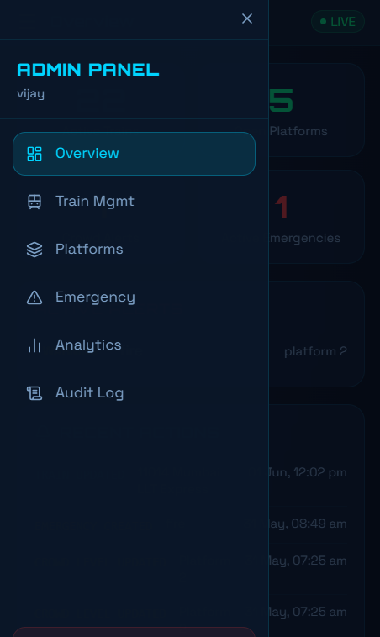
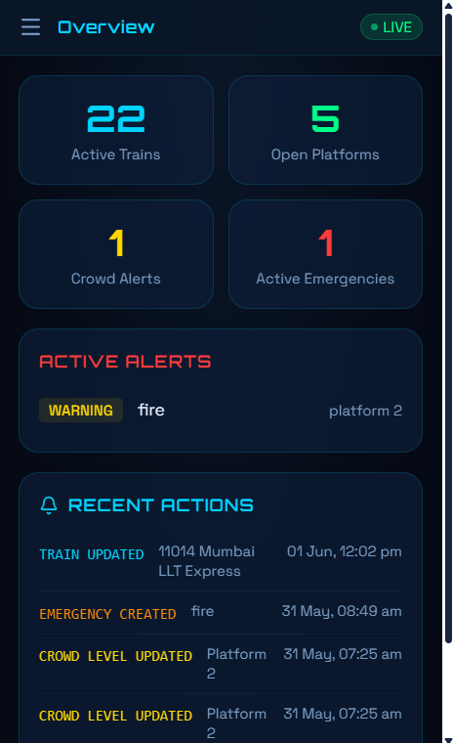

Slide 10


Technologies Used
Frontend
Backend & Database
AI & Navigation
React — Component-based UI framework
TypeScript — Type-safe development
Tailwind CSS — Utility-first responsive styling
Supabase — PostgreSQL backend-as-a-service
Supabase Auth — Role-based authentication
Supabase Realtime — Live event subscriptions
Gemini AI — Natural language AI assistant
A* Pathfinding — Optimal indoor route calculation

Slide 11






Key Innovations & Future Enhancements
KEY INNOVATIONS
FUTURE ENHANCEMENTS
Multi-Language Support
Indoor Railway Navigation
Smart Train Finder
Serve passengers in regional and national languages for inclusive accessibility.
First-of-its-kind interactive indoor map for railway stations with real-time zone status.
Instantly locate any train's platform, coach layout, and delay status from a single search.
Mobile App (iOS & Android)
Native mobile apps with offline map support and push notifications.
Real-Time Notifications
AI Assistant
Live Supabase Realtime alerts for platform changes, delays, and emergencies.
Conversational Gemini AI handles complex passenger queries in natural language.

Slide 12






RESULTS & BENEFITS
Impact of RailNova
Thank You
✅ Reduced Passenger Confusion
⚡ Faster Navigation
We are happy to take your questions.
A* pathfinding cuts walking time by guiding passengers along optimal station routes.
Clear visual routes and AI guidance eliminate platform-finding stress.
RailNova — An intelligent, AI-powered indoor railway navigation system that improves passenger experience, enhances safety, delivers real-time train information, and modernizes station management through smart digital technologies.
🛡️ Improved Safety
📊 Better Station Management
Crowd monitoring and emergency alerts enable proactive safety management.
Admins gain real-time operational control through a unified dashboard.
Project Repository
Source code & documentation available on request
🌟 Enhanced Passenger Experience
PNR assistance, AI chatbot, and voice guidance deliver a world-class travel experience.
Contact Us
Connect with the project team for queries & collaboration
RailNova transforms traditional railway stations into smart, passenger-centric digital environments — making every journey safer, faster, and stress-free.

