Slide 1

Hack-A-THON
~ Varun Pappuri, Vinay, RISHI

Slide 2

Agenda
USA ED Stats
Charlotte Health Stats (on HIV)
MIMIC Dataset
Machine Learning Techniques
Predictive Model Results
Conclusion

Slide 3
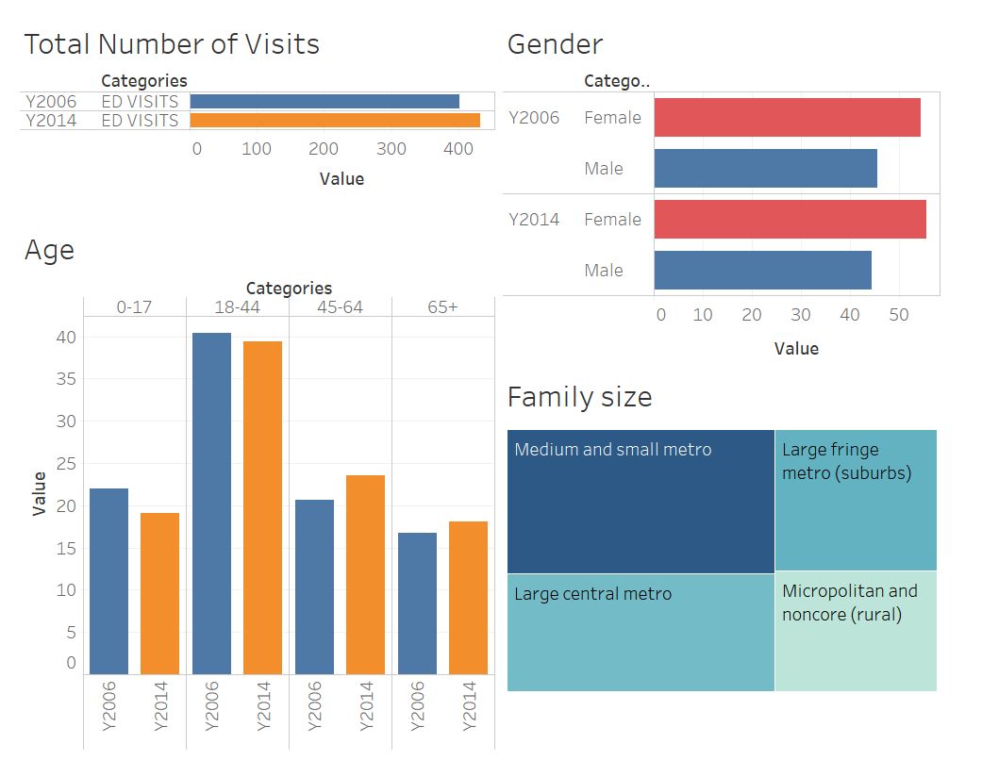
US ED DATA - ANALYSIS

Slide 4
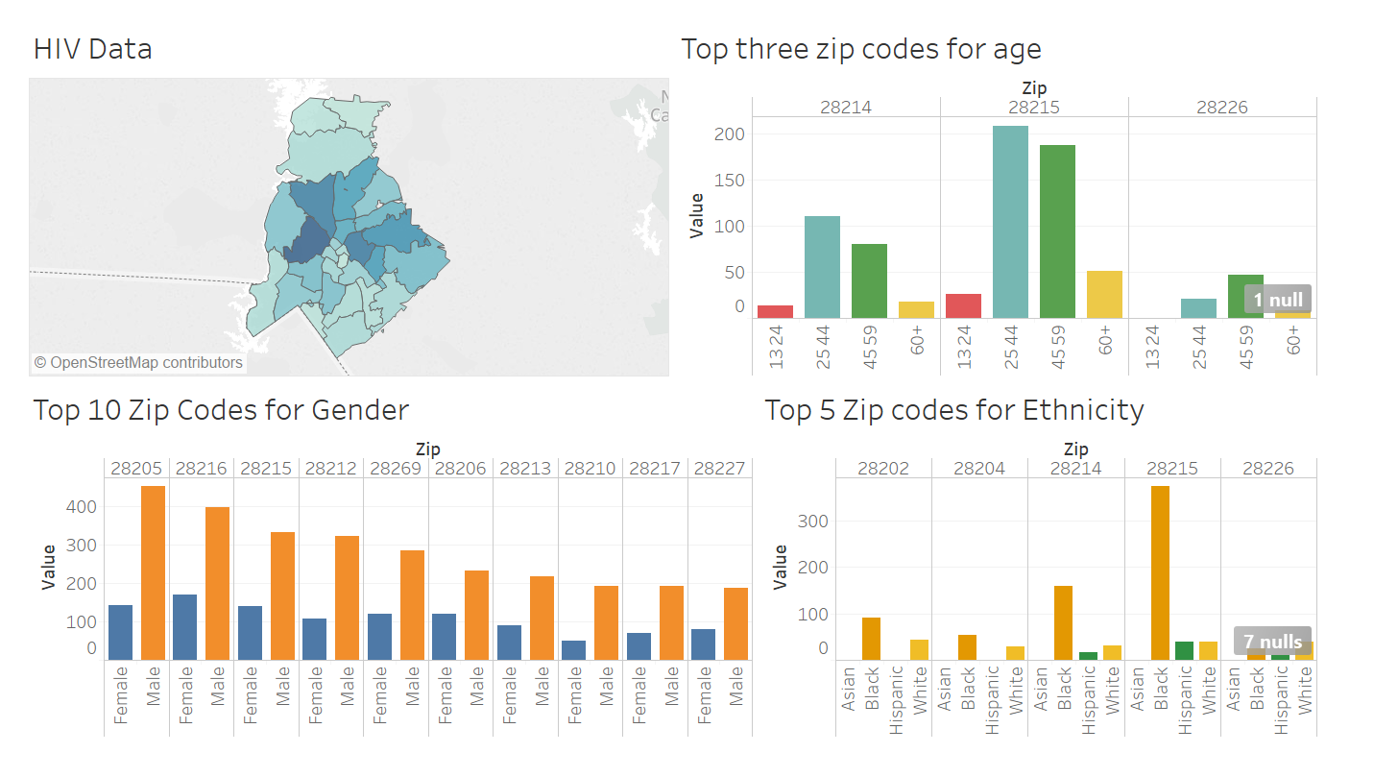
Drill Down

Slide 5

DatAset
MIMIC is an openly available dataset developed by the MIT Lab.
Used admission dataset and patient dataset.

Slide 6
Machine Learning Techniques
Logistic Regression
Decision Trees
Random Forest
Support Vector Machine
Gradient Boosting
Neural Networks

Slide 7
Random Forest
PREDICTED
Metric | Score
AUC | 0.63
Accuracy | 0.750
Specificity | 0.951
Precision | 0.751
 | YES | NO
YES | 29 | 65
NO | 10 | 196
ACTUAL

Slide 8
Support Vector Machine
PREDICTED
Metric | Score
AUC | 0.614
Accuracy | 0.710
Specificity | 0.927
Precision | 0.594
 | YES | NO
YES | 22 | 72
NO | 15 | 191
ACTUAL

Slide 9
Future Plans
Drilling down to specific diagnosis
Historical data
Monitoring the previous discharge

Slide 10

QUESTIONS?

