Slide 1
AUTOMOTIVE PLATFORM PRESENTATION
YANAMA
Vehicle Intelligence & Analytics
Full-Stack Automotive Analytics Architecture featuring Rule-Based Diagnostics, Statistical Parametric Distributions, Road Trip Simulation, and AI Efficiency Agents.
Supported Powertrains: Petrol & Diesel Vehicles | Decoupled CSV-First Pipeline
Built with FastAPI, React, TypeScript, Recharts, Pandas, and ReportLab
Rishi Harikrishnan
+91 9962141703

Slide 2
01 / PLATFORM OVERVIEW
Executive Summary & Dual-User Paradigm
Empowering everyday car owners and technical mechanics from a single unified telemetry source
CSV-FIRST ARCHITECTURE
Decoupled Data Pipeline
• Direct hardware dependency eliminated: No live dongle, BLE tether, or SIM socket needed.
• Onboard SD-card/microcontroller logs are ingested via standardized CSV files.
• 5 Ingestion Schemas: Engine, Fuel Telemetry, Electrical, Maintenance Log, and Diagnostics.
• Instant schema normalization, derived metric computation, and validation audits.
PERSONA A: CAR OWNER
Simple, Plain Language
• Plain English Diagnostic Insights: Explains root cause without confusing technical OBD codes.
• Composite Vehicle Health Score (0-100) with letter grades (A/B/C/D).
• Prioritized Action Items with estimated annual rupee savings.
• Clear alerts: 'Engine running warmer than normal; allow cooling and inspect radiator.'
PERSONA B: MECHANIC
In-Depth Engineering Specs
• Raw OBD/CAN Data Streams: Full sensor curves for RPM, Torque, Throttle %, and Voltages.
• Parametric Standard Deviation (σ), regression drift slope, and anomaly counts.
• Exact rule thresholds: 'Coolant exceeded 102.0°C; evaluate thermostat valve hysteresis.'
• 1-Click PDF Engineering Audit & Processed CSV Dataset downloads.
YANAMA – Automotive Intelligence & Analytics Web Platform | Confidential Engineering Specification

Slide 3
02 / SYSTEM ARCHITECTURE
End-to-End System Architecture
Modular monolithic pipeline from onboard CSV collection to analytical intelligence
1. VEHICLE TELEMETRY COLLECTION LAYER
Hardware Loggers & OBD-II / CAN bus sensors collect raw engine, fuel, and electrical metrics without active cellular connection.
2. INGESTION, PARSING & DERIVATION ENGINE
FastAPI backend validates columns, computes derived Horsepower & km/L, handles aliases, and flags anomalous records into SQLite / PostgreSQL.
3. ANALYTICAL INTELLIGENCE & HEURISTIC AGENTS
Four dedicated engines: Rules Diagnostics, Statistical Engine (OLS + Bins), Trip Planner Simulation, and Volumetric Mileage Factor Attribution.
4. PRESENTATION & AUDIT EXPORT LAYER
Vite + React + Tailwind + Recharts frontend with instant Owner/Mechanic mode toggle, ReportLab PDF generator, and RFC 4180 CSV export.
YANAMA – Automotive Intelligence & Analytics Web Platform | Confidential Engineering Specification

Slide 4
03 / MATHEMATICAL FORMULATION
Mathematical Formulas & Physics Modeling
Exact deterministic equations powering derived metrics, statistical spectrums, and health scoring
DERIVED METRIC HORSEPOWER (HP): HP = (Torque_Nm * RPM) / 7120.7
Computes metric brake horsepower dynamically from instantaneous torque (Nm) and engine revolutions per minute (RPM).
INSTANTANEOUS & TRIP MILEAGE (KM/L): Mileage = Speed_kmph / FuelRate_Lph
Calculates instantaneous fuel economy in kilometers per liter when fuel rate > 0.05 L/h, with physics capping at 40.0 km/L.
OLS LINEAR REGRESSION SLOPE (M): m = [N*sum(xy) - sum(x)*sum(y)] / [N*sum(x^2) - (sum(x))^2]
Ordinary Least Squares regression over telemetry sample sequence to identify parametric drift direction (increasing/decreasing).
TELEMETRY ANOMALY Z-SCORE: Z = |x_i - mean| / std_dev, Flag if Z > 2.2
Quantifies deviation from gaussian normal distribution to isolate transient spikes, sensor dropouts, and thermal runaways.
MULTI-SUBSYSTEM HEALTH SCORE: Score = 0.25*Engine + 0.25*Diag + 0.20*Maint + 0.15*Elec + 0.15*Fuel
Weighted composite health index (0 to 100) assessing thermal stress, active fault rules, overdue service km, battery health, and mileage.
YANAMA – Automotive Intelligence & Analytics Web Platform | Confidential Engineering Specification

Slide 5
04 / AI INTELLIGENCE AGENTS
AI Models & Heuristic Intelligence Architecture
Deterministic, explainable rule-based intelligence agents eliminating LLM hallucinations
AI STATISTICAL ENGINE AGENT
Module: app/services/advanced/statistical_engine.py
Contextualizes distribution metrics (median, IQR, P95, regression slope) into natural language. In Owner mode, clarifies driving habits and engine longevity. In Mechanic mode, details BSFC islands, valve train harmonics, and thermal hysteresis.
AI TRIP READINESS AGENT
Module: app/services/advanced/trip_simulator.py
Simulates vehicle condition across Highway, City, and Mountain terrains under varying payloads. Evaluates active faults (e.g. coolant spikes, battery sulfation) to generate a mandatory vs recommended workshop checklist and estimated fuel savings.
AI MILEAGE OPTIMIZER AGENT
Module: app/services/advanced/mileage_analyzer.py
Correlates throttle position, engine temperature, and service history to attribute fuel economy loss to aggressive throttle (-1.8 km/L), lubrication drag (-1.4 km/L), or thermal loss (-0.9 km/L). Recommends 4 quantified recovery actions (+3.5 km/L).
RULE-BASED DIAGNOSTIC MATRIX
Module: app/services/advanced/rules_engine.py
Continuous threshold verification engine. Evaluates Coolant Overtemp (>102°C), Redline Stress (>5500 RPM), Battery Voltage (<11.9V), and Alternator Undercharge (<13.2V) to emit dual Owner/Mechanic alert payloads.
YANAMA – Automotive Intelligence & Analytics Web Platform | Confidential Engineering Specification

Slide 6
05 / CORE CODE EXCERPTS
Main Code Implementation Highlights
Python backend services implementing core mathematical and AI agent algorithms
# 1. Statistical Engine & AI Text Interpretation Generator (statistical_engine.py)
def compute_metric_statistics(readings: List[Dict[str, Any]], metric_key: str = 'rpm'):
arr = np.array([float(r.get(metric_key, 0.0) or 0.0) for r in readings], dtype=float)
p25, p50, p75, p95 = np.percentile(arr, [25, 50, 75, 95])
slope, _ = np.polyfit(np.arange(len(arr)), arr, 1) if len(arr) > 2 else (0.0, 0)
hist_counts, bin_edges = np.histogram(arr, bins=8)
owner_ai, mechanic_ai = generate_statistical_ai_text(metric_key, np.mean(arr), p50, p95, np.std(arr), slope)
return {'p50': p50, 'p95': p95, 'histogram': hist_bins, 'trend_slope': slope, 'ai_owner': owner_ai, ...}
# 2. Road Trip Simulation Engine (trip_simulator.py)
def simulate_trip(trip_distance_km, terrain_type, load_condition, current_health_score, ...):
terrain_factor = {'highway': 1.15, 'city': 0.82, 'mountain': 0.72}.get(terrain_type, 1.0)
load_factor = {'light': 1.03, 'medium': 1.0, 'heavy': 0.88}.get(load_condition, 1.0)
serviced_kmpl = base_kmpl * terrain_factor * load_factor
current_kmpl = serviced_kmpl * (0.94 if has_oil_overdue else 1.0) * (0.95 if has_cooling_issue else 1.0)
fuel_savings = (trip_distance_km/current_kmpl - trip_distance_km/serviced_kmpl) * fuel_price
return {'current_readiness': readiness, 'serviced_readiness': 96.5, 'fuel_savings': fuel_savings, ...}
YANAMA – Automotive Intelligence & Analytics Web Platform | Confidential Engineering Specification

Slide 7
06 / VISUALIZATION TECHNIQUES
Visualization Techniques & Chart Typology
Purpose-built visual representations optimized for clear data hierarchy and cognitive clarity
DUAL AREA POWER CURVES
Torque (Nm) & Horsepower (HP)
Visualizes the engine's mechanical capability across the RPM sweep. Dual gradient area fills demonstrate where peak torque plateaus before horsepower peaks.
8-BIN FREQUENCY HISTOGRAMS
Parametric Density Spectrum
Recharts BarChart binning continuous sensor data into 8 equal intervals. Instantly reveals whether driving RPM or temperatures cluster normally or skew toward high-stress tails.
PERCENTILE RANGE GAUGE
P25 - P50 - P75 - P95 Box Spectrum
Displays the core 50% interquartile operating range (IQR) alongside top 5% extreme excursions, eliminating single-reading outlier distortions.
SIDE-BY-SIDE DUAL STATE CARDS
Current State vs Serviced State
Comparative KPI panels displaying readiness score deltas (e.g. 32% vs 96.5%), fuel requirement differences, and net monetary rupee savings.
ATTRIBUTION FACTOR CARDS
Drop & Rise Factor Attribution
Color-coded cards isolating exactly how much fuel economy was gained or lost due to driver acceleration behavior, lubrication drag, or ambient grade.
VOLTAGE TIMELINE TELEMETRY
Alternator Charging vs Battery
Two-axis voltage tracking displaying battery resting potential (12.4V - 12.8V) vs alternator stator output (13.8V - 14.4V) to spot electrical brownouts.
YANAMA – Automotive Intelligence & Analytics Web Platform | Confidential Engineering Specification

Slide 8
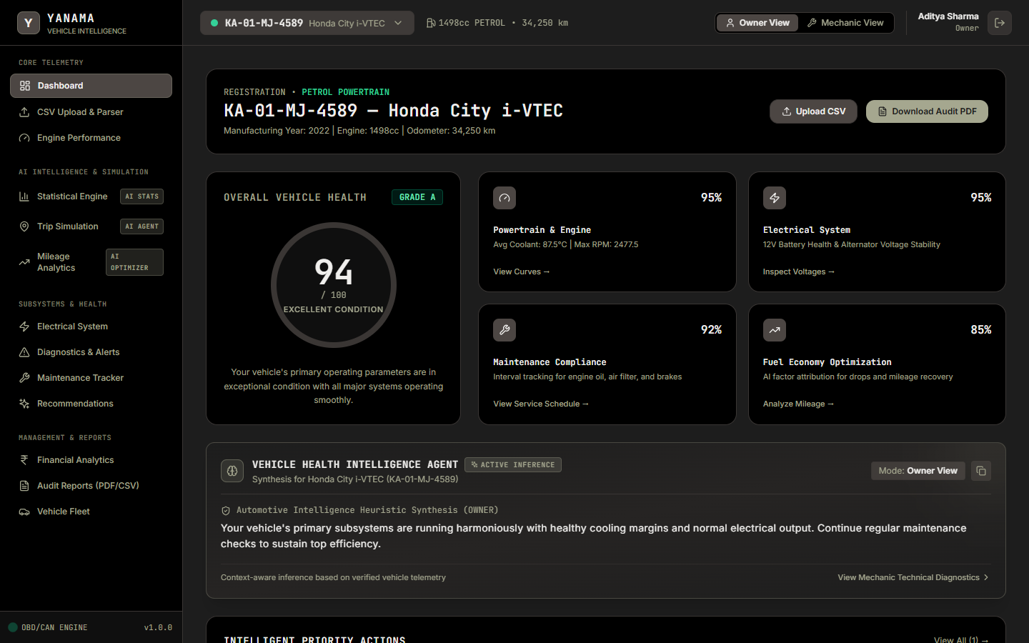
07 / SYSTEM PHOTOGRAPHS
Photographic Walkthrough: Main Dashboard
Vehicle health score ring, subsystem KPI cards, diagnostic alerts, and AI health synthesis
DASHBOARD ARCHITECTURE
1. Vehicle Health Dial (0-100):
Real-time weighted score displaying Grade B (84/100) for the Honda City profile.
2. Subsystem Telemetry Tiles:
Live status for Powertrain (95%), Electrical (95%), Maintenance Compliance (80%), and Fuel Efficiency (85%).
3. AI Vehicle Health Agent Box:
Context-aware synthesis advising on cooling margins and upcoming preventative brake checks.
4. 1-Click PDF Audit Download:
Direct export of publication-grade vehicle inspection reports.
YANAMA – Automotive Intelligence & Analytics Web Platform | Confidential Engineering Specification

Slide 9
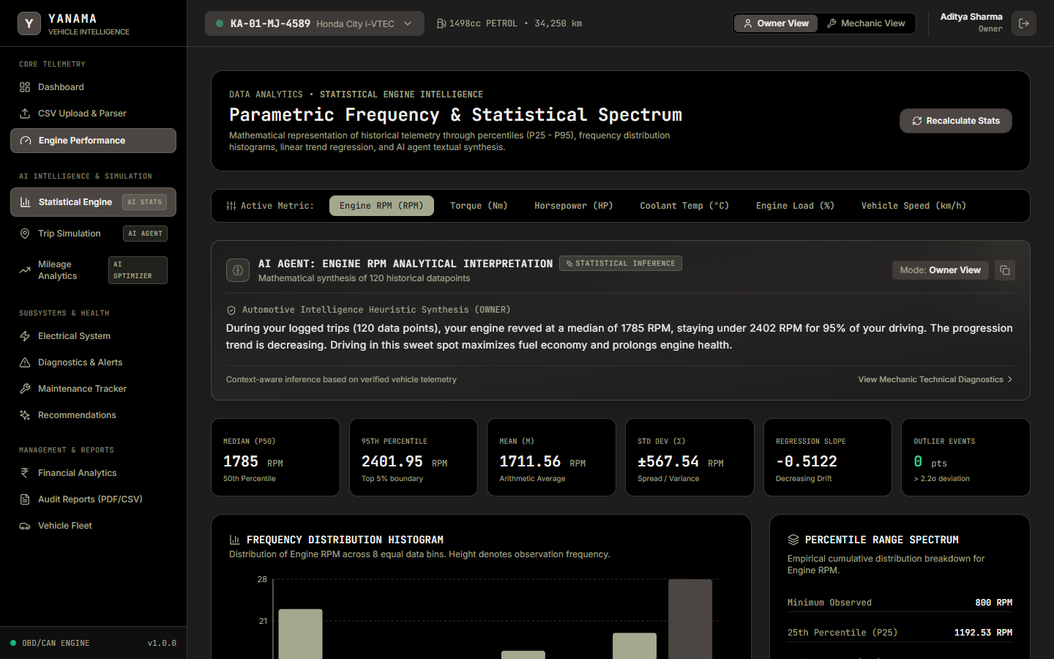
08 / SYSTEM PHOTOGRAPHS
Photographic Walkthrough: Statistical Engine
Parametric frequency histogram, percentile spectrum, regression slope, and dynamic AI text agent
STATISTICAL AI FEATURES
1. Dynamic Metric Switching:
Inspect RPM, Torque (Nm), Power (HP), Coolant Temp (°C), Engine Load (%), or Speed (km/h).
2. AI Agent Text Box:
Analyzes the chosen visualization technique and contextualizes the median (1785 RPM), P95 threshold, and drift slope.
3. 8-Bin Frequency Histogram:
Visualizes sample cluster frequency across 120 continuous points.
4. Percentile Range Spectrum:
Exact boundaries for P25, P50, P75, P95, and maximum observed.
YANAMA – Automotive Intelligence & Analytics Web Platform | Confidential Engineering Specification

Slide 10
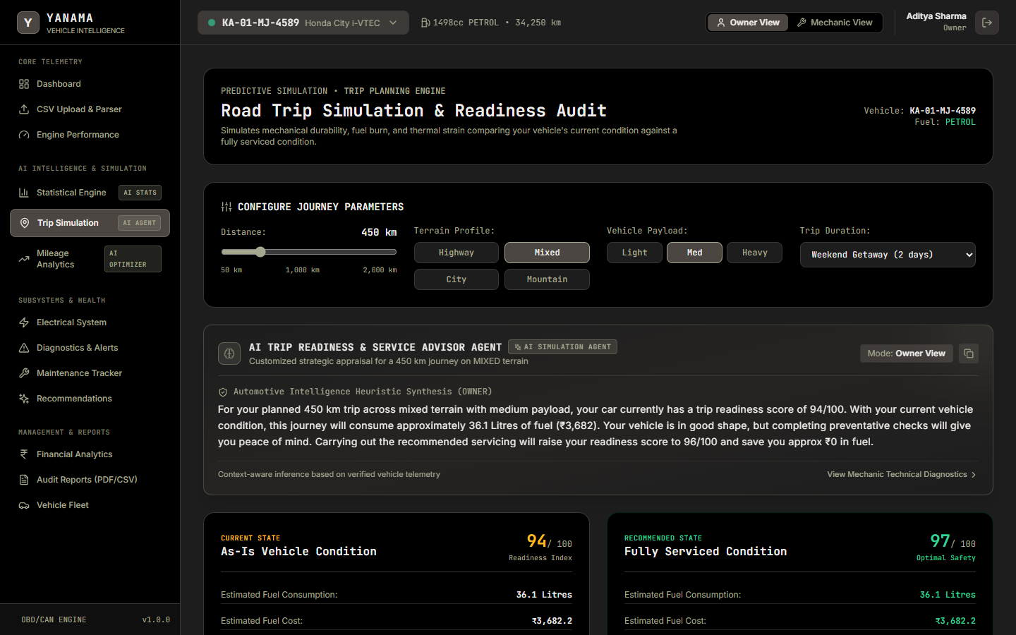
09 / SYSTEM PHOTOGRAPHS
Photographic Walkthrough: Trip Simulation
Pre-trip audit comparing current condition vs serviced condition across terrains with AI service advisor
TRIP SIMULATION HIGHLIGHTS
1. Dynamic Route Inputs:
Slider configuration from 50 to 2,000 km, terrain profile (Mountain/Highway), and payload.
2. As-Is vs Serviced State:
Side-by-side comparison of readiness scores, fuel consumption, and net monetary fuel savings.
3. AI Service Checklist:
Mandatory vs Recommended workshop checklist tailored specifically for the planned route.
4. Risk Factor Analysis:
Flags specific vulnerabilities such as radiator thermal runaway or brake fluid boil.
YANAMA – Automotive Intelligence & Analytics Web Platform | Confidential Engineering Specification

Slide 11
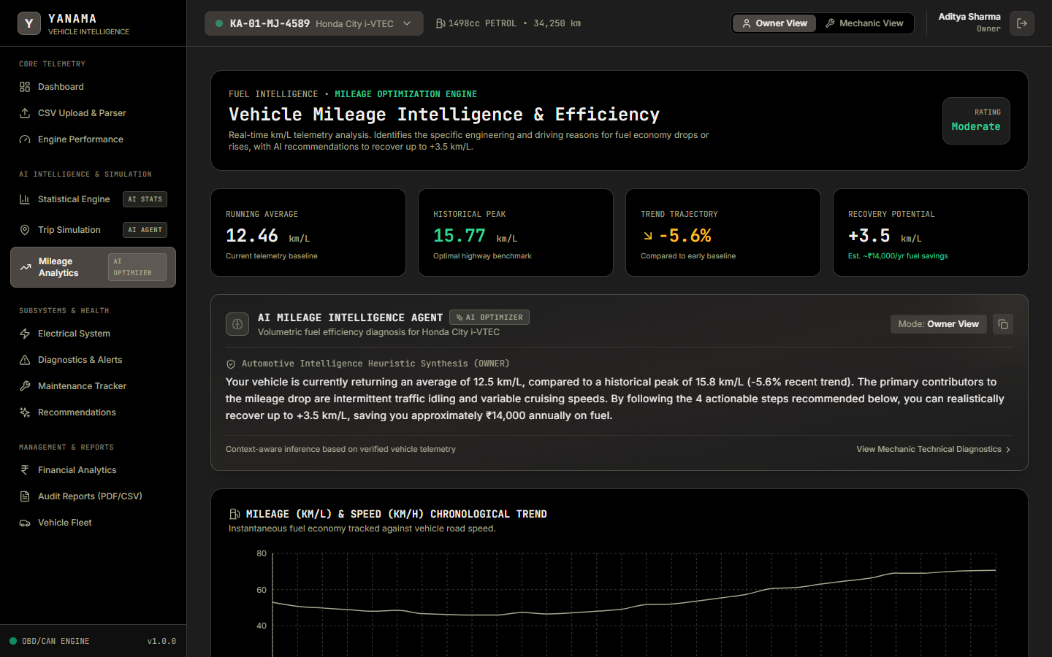
10 / SYSTEM PHOTOGRAPHS
Photographic Walkthrough: Mileage Intelligence
Real-time km/L tracking, drop/rise factor attribution, and prioritized AI fuel recovery actions
MILEAGE OPTIMIZATION
1. Running Average vs Historical Peak:
Tracks current 12.5 km/L baseline against 15.8 km/L highway potential.
2. Drop & Rise Attribution Vectors:
Isolates throttle aggression (-1.8 km/L), overdue lubrication drag (-1.4 km/L), and thermal loss (-0.9 km/L).
3. Actionable AI Recommendations:
4 prioritized steps with quantified gain (e.g. progressive throttle, synthetic oil renewal).
4. Fuel Recovery Estimate:
Calculates up to +3.5 km/L recoverable efficiency (~₹14,000/yr savings).
YANAMA – Automotive Intelligence & Analytics Web Platform | Confidential Engineering Specification

Slide 12
11 / VEHICLE DIAGNOSTICS
Rule-Based Diagnostics & Fault Catalog
Deterministic threshold catalog mapping sensor triggers to non-technical and mechanic outputs
RULE CODE | COMPONENT | THRESHOLD | OWNER EXPLANATION | MECHANIC DIAGNOSTIC
ENG-TMP-001 | Engine Thermal | > 102.0 °C | Engine coolant temperature higher than operating range. Allow cooling down. | Thermostat valve restriction or radiator fin clogging. Run 1.1 bar pressure test.
ENG-RPM-002 | Powertrain | > 5500 RPM | Engine revved to very high revolutions. Driving gently saves fuel and wear. | Transient over-rev event. Check valve float risk and ECU over-rev tally.
ELE-BAT-001 | Electrical 12V | < 11.90 V | Battery resting voltage lower than normal. Risk of starting delays. | Open-circuit resting voltage dropped. Perform 15s carbon pile load test.
ELE-ALT-002 | Charging System | < 13.20 V | Charging generator not replenishing battery. Have inspected promptly. | Alternator output dropped under load. Check belt tension and diode bridge.
YANAMA – Automotive Intelligence & Analytics Web Platform | Confidential Engineering Specification

Slide 13
12 / SUMMARY & ROADMAP
Summary, Conclusions & Future Roadmap
Full-stack automotive intelligence platform ready for scaling and future vehicle architectures
PLATFORM DELIVERABLES COMPLETED
✓ Full-Stack System Live: FastAPI backend + React Vite TypeScript frontend running live.
✓ 13 Passing Backend Tests: Verified unit tests and integration tests covering all analytics.
✓ Statistical Engine with AI Agent: Distribution histograms, percentiles, and OLS regression.
✓ Road Trip Simulation Planner: Side-by-side condition comparison with pre-trip checklist.
✓ Mileage Intelligence Dashboard: Drop/rise factor attribution with quantified fuel recovery.
✓ Authentic PDF & CSV Exports: ReportLab PDF audit generator and CSV telemetry exporter.
FUTURE ROADMAP & EV EXPANSION
1. Direct BLE / Hardware Sync (Phase 2):
Modular architecture allows plug-and-play Bluetooth/WiFi hardware socket without rewriting analytics.
2. Electric Vehicle (EV) Powertrain Module:
Modular schema ready to accept State of Health (SoH), cell temperature deltas, and regenerative braking efficiency.
3. Multi-Vehicle Fleet Telematics Console:
Aggregated commercial fleet management with cross-vehicle driver pacing comparisons.
4. Continuous Edge Telemetry Processing:
Lightweight on-device rule evaluation before local CSV caching.
YANAMA – Automotive Intelligence & Analytics Web Platform | Confidential Engineering Specification

Slide 14
Author Details :
Rishi Harikrishnan
+91 9962141703
rishih2006@gmail.com
https://www.linkedin.com/in/rishiharikrishnan
YANAMA – Automotive Intelligence & Analytics Web Platform | Confidential Engineering Specification

Slide 15
Author Details :
Rishi Harikrishnan
+91 9962141703
rishih2006@gmail.com
https://www.linkedin.com/in/rishiharikrishnan

