Slide 1
FACE RECOGNITION ATTENDANCE
GUIDED BY:
Prof.G.S.Karthik., M.Sc., NET., DST Fellow.,(Ph.D)., Assistant Professor
Department of Software Systems
DONE BY
Rishikeshan NS
19MSS033
Department of Software Systems

Slide 2
ABSTRACT
There are lots of problems faced with the current technique used in the attendance system all over the world. It is a time-consuming process and there are more chances for a possible mishap during the manual attendance taking system.
All the disadvantages of the manual method of attendance system can be totally eliminated with the help of an automated facial recognition attendance system.
Facial Recognition Attendance is an attendance system that can be used to take attendance anywhere. This Facial Recognition Attendance uses technologies like Python, OpenCV. The system detects the face in the camera and then check it with the data saved about the particular person in the database, compares and marks attendance.

Slide 3
EXISTING SYSTEM
At present attendance marking involves manual attendance on paper sheet by professors and teachers.
The problem with this approach in which manually taking and maintains the attendance records is that it is very inconvenient and time consuming event.
Moreover, it is very difficult to verify one by one student in a large classroom environment and manual computation can also produce error after all, we all are Humans.
Also, this method is dead easy for someone to impersonate for proxy attendance and the sheet could be stolen or lost leading to many problems.

Slide 4
PROPOSED SYSTEM
The Face Recognition Attendance technique eliminates classical student attendance marking technique problems such as calling student names, proxy, and checking respective.
Face recognition student attendance system is proposed in order to replace the manual signing of the presence of students which are burdensome and causes students get distracted in order to sign for their attendance.

Slide 5
ADVANTAGES OF PROPOSED SYSTEM
Removes the risk of manual errors
Fast, Hygiene, and Secure
Proxy Attendance eliminated
Easy to maintain the records
Best for Virtual Classrooms

Slide 6
HARDWARE SPECIFICATIONS
S.NO | CONTENTS | REQUIREMENTS
1. | PROCESSOR | Intel i3 or i5
2. | RAM | 4GB or Higher
3. | GPU | Nvidia GeForce GTX 800/900 Series or Nvidia GeForce MX Series or Intel HD Integrated Graphics
4. | HARD DISK CAPACITY | 300GB or Above
5. | CAMERA | 720p HD Webcam

Slide 7
SOFTWARE SPECIFICATIONS
S.NO | CONTENTS | REQUIREMENTS
1. | OPERATING SYSTEM | Ubuntu 18.04 LTS or Windows 10 2004
2. | FRONT-END | PyCharm 2020.2.1 and Python 3.6
3. | BACK –END | OpenCV and Microsoft Excel
4. | OpenCV | VERSION 4.1.0 or Higher

Slide 8
MODULES
Check Camera:
To check if camera is connected to the system and if it is working.
Capture Faces:
Detect the faces in the camera feed using Haar Cascades Algorithm and capture the images for the dataset.
Train Images:
Train the model by using the captured images in Capture Faces module as the dataset.
Recognize and Mark Attendance:
The final module uses Haar Cascades to detect the images, then uses LBPH algorithm to recognize the student in the camera feed and then marks the attendance for the student.

Slide 9
SYSTEM FLOW DIAGRAM

Slide 10
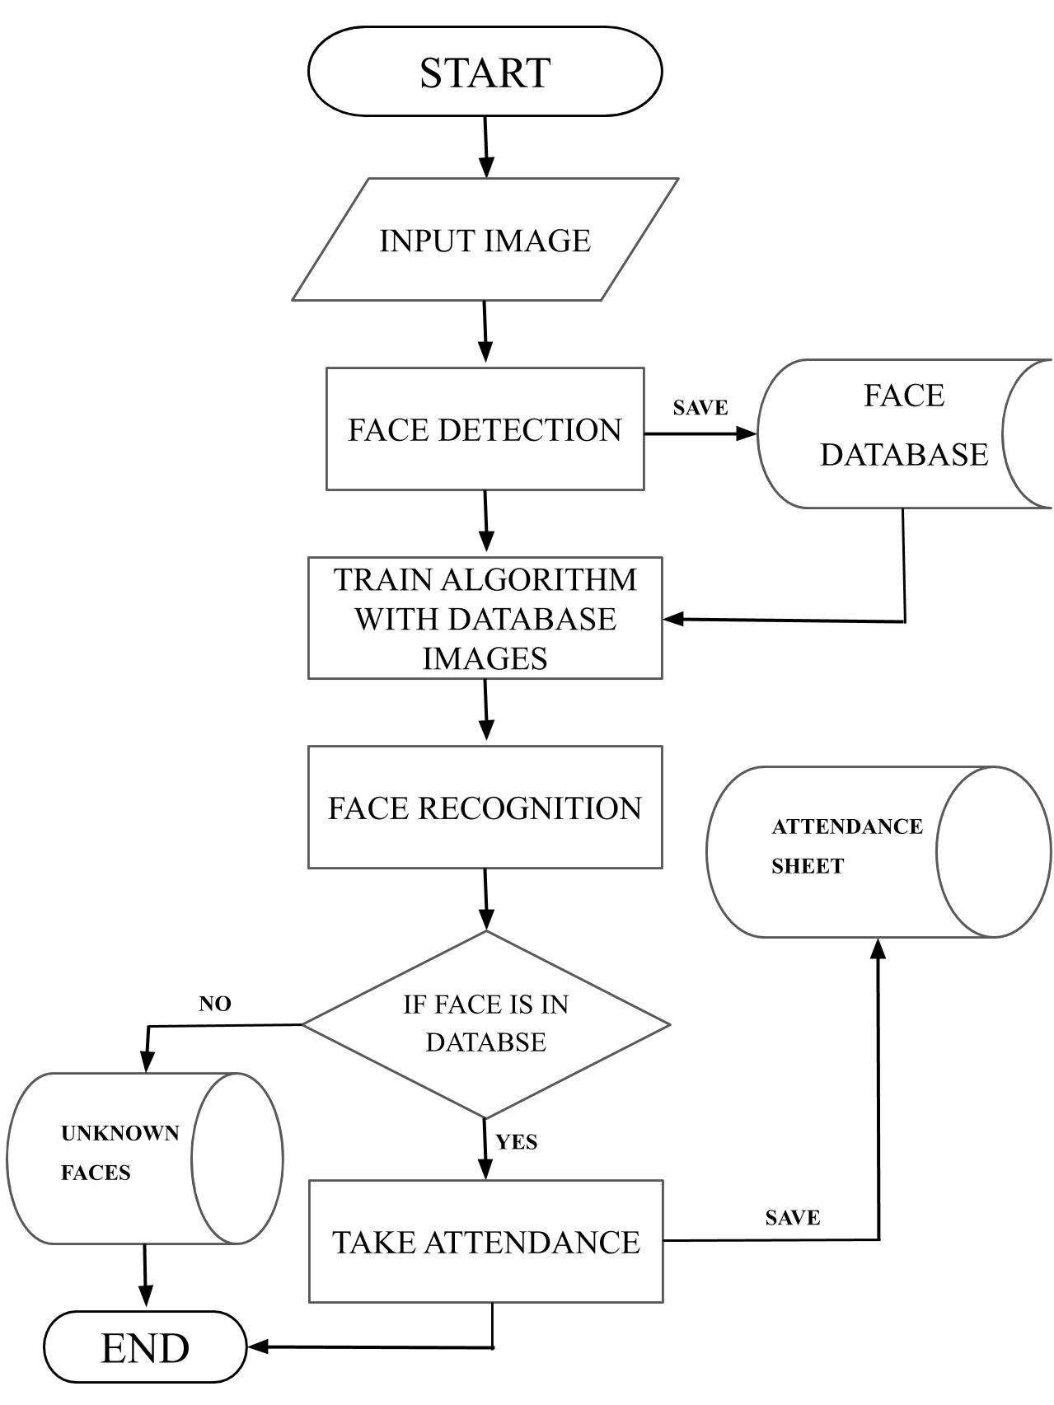

Slide 11
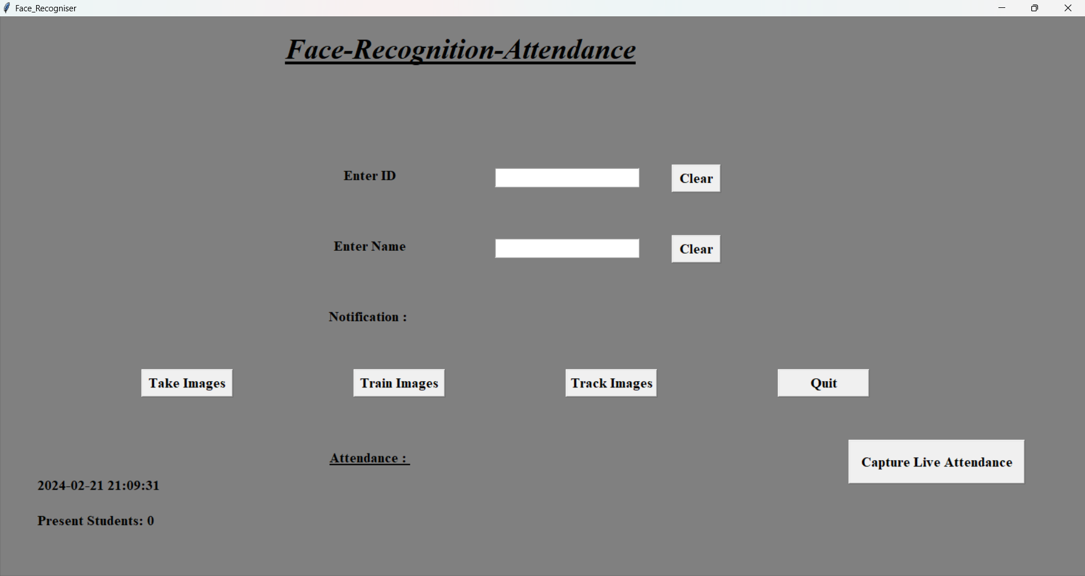
UI DESIGN

Slide 12
FUTURE SCOPE
Can be implemented using Raspberry Pi in University, Schools, and Offices.
Use of Deep Learning and Neural Networks to detect faces as it will give great accuracy than Haar Cascade Algorithm.
But it requires lot of computing power and data to train along with a powerful device to run like Nvidia Jetson Nano.
Nvidia provides custom Deep Learning libraries like Transfer Learning Toolkit to train and deploy in Jetson Nano.
The training and deployment process in Nvidia’s TLT is very complex and time consuming.

Slide 13
THANK YOU!

