Slide 1




Artificial Intelligence with Machine Learning: Internship Overview
1
Presented by:- Bibek Sah Kanu
2
Internship: April 10-25, 2025
3
BCA Final Semester Viva

Slide 2

Introduction to the Internship
Duration
Intensive 14-day hands-on internship
Skills
Focus on foundational AI and ML technologies
Topics
Supervised, unsupervised learning, neural networks
Tools
Python, Scikit-learn, TensorFlow, real datasets

Slide 3
Learning Objectives
AI and ML Fundamentals
Core Algorithms
Practical Skills
Regression, classification, clustering
Data preprocessing, model building
Basic concepts and principles
Deep Learning
Problem Solving
Neural networks basics
Real-world AI applications

Slide 4
Key Concepts Covered
Programming & Tools
Learning Methods
Advanced Topics
Python, NumPy, Pandas, Matplotlib
Supervised: Linear & Logistic Regression, KNN, SVM
Neural Networks, TensorFlow, Keras
Jupyter Notebook environment
Unsupervised: K-Means, PCA
MNIST handwritten digit dataset

Slide 5
Tools and Technologies
Programming Platforms
Libraries
Datasets
Python scripting
NumPy, Pandas, Matplotlib, Seaborn
OpenML, Kaggle (Titanic, MNIST)
Jupyter Notebook, Google Colab
Scikit-learn, TensorFlow, Keras
Real-world, diverse data

Slide 6
Practical Applications and Projects
Regression Models
Classification Tasks
Clustering
Housing price prediction
Titanic survival, cancer diagnosis
Customer segmentation analysis
Neural Networks
Evaluation Metrics
MNIST digit recognition
RMSE, F1 score, confusion matrix

Slide 7
Challenges and Industry Relevance
Challenges
Industry Applications
AI Ethics
Understanding gradient descent
Healthcare: Disease prediction
Bias mitigation
Transparency and fairness
Avoiding overfitting
Finance: Fraud detection
E-commerce: Recommendations

Slide 8
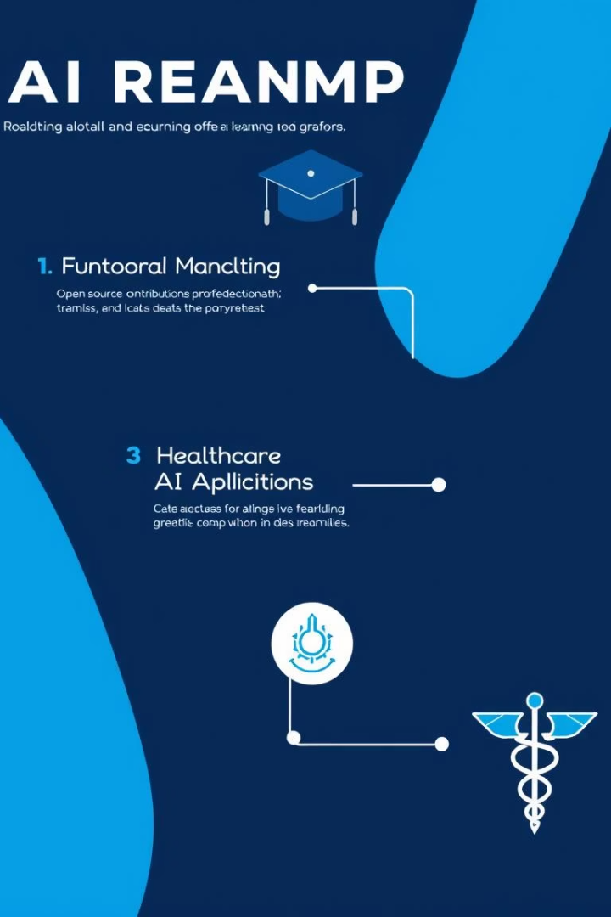




Conclusion and Future Goals
Skills Acquired
Model building and evaluation
Future Learning
Deep learning, NLP, reinforcement learning
Certifications
TensorFlow Developer & more
Career Focus
Healthcare AI, automation projects

