Slide 1

+
By Rishi Ahuja

Slide 2
What do you have to spend to make the most money?
Goal
+

Slide 3
We used data provided by IMDB and The Numbers database to compare Production Budgets to World-Wide Gross
Data
+

Slide 4
Are movies more profitable with a budget:
over $200 million?
between $100 and $200 million
between $50 and $100 million
Methods
+

Slide 5
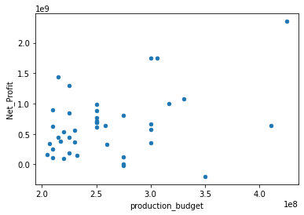
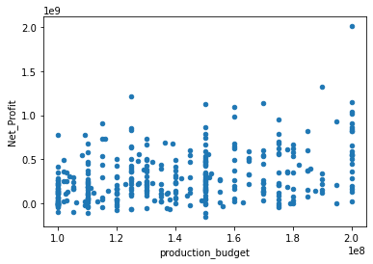
Budget >= $100 Million & <= 200 Million
Budget > $200 Million
Net Profit ($)
Net Profit ($)
Production Budget ($)
Production Budget ($)

Slide 6
Budget > $200 million ~ Net Profit Increase of 234%
Budget between $100 million and $200 Million ~ Net Profit increase of 204%
Budget between $50 million and $100 Million ~ Net Profit increase of 154%
More likely for a movie with a budget between $50 and $100 million to not make it to theaters at all
Conclusions
+

Slide 7
Recommendation
Create Movies with only a budget over $200 Million
+

Slide 8
Sort movies with a budget of over $200 million by director, genre, and runtime
Analyze by studio to see which employees we need to poach
Next Steps
+

Slide 9
Thanks
For additional info, contact Rishi Ahuja at rishiahuja515@gmail.com
+

