Slide 1

JCS1832 PROJECT WORK PHASE - II PERCEIVING AND PREVENTING ATTACKS IN CLOUD ENVIRONMENT VIVA VOCE Date: 24-02-2025 BATCH NO: 06
JERUSALEM COLLEGE OF ENGINEERING, CHENNAI-100
DEPARTMENT OF COMPUTER SCIENCE AND ENGINEERING
PRESENTED BY
PRIYA DHARSHINI A(130721104061)
RAJESHWARI B(130721104067)
SADHANA N(130721104072)
SUPERVISED BY
Mrs. P. MAHALAKSHMI
ASSISTANT PROFESSOR(CSE)
Feb 23, 2025
Department of CSE Jerusalem College of Engineering
<number>

Slide 2
OBJECTIVE
The objective of this project is to develop a Python-based malware detection system that identifies SQL injection and brute-force attack scripts in text-based files.
It will use regex-based scanning to detect attack patterns and ensure only relevant file types are analyzed. Also it will include metadata analysis, ZIP file scanning.
Feb 23, 2025
Department of CSE
Jerusalem College of Engineering
<number>

Slide 3
PROJECT DOMAIN
Cybersecurity:
Detects and mitigates SQL injection and brute-force attack scripts.
Scans files and folders to identify malicious content.
Digital Forensics & Threat Intelligence:
Extracts metadata from files for forensic analysis.
Logs detected threats for security auditing and investigation.
Low Power Cloud Computing:
Optimized for lightweight scanning on cloud servers and edge devices.
Ensures efficient performance with minimal resource consumption.
Feb 23, 2025
Department of CSE
Jerusalem College of Engineering
<number>

Slide 4
EXISTING SYSTEM
Traditional antivirus software primarily focuses on detecting known malware signatures but lacks specialized detection for SQL injection and brute-force attack scripts in text-based files.
Most existing file scanning tools do not perform regex-based detection to identify hidden attack patterns within documents and scripts.
Manual inspection of files for malicious SQL queries and brute-force scripts is time-consuming and error-prone.
Limited support for metadata analysis and deep file inspection in conventional security solutions.
Feb 23, 2025
Department of CSE
Jerusalem College of Engineering
<number>

Slide 5
LITERATURE SURVEY
Sl . No. | REFERENCE PAPER TITLE | WORK DONE IN REFERENCE PAPER | INFERENCE
1. | "Detecting SQL Injection Attacks in Cloud SaaS using Machine Learning“, D. Tripathy, R. Gohil, T. Halabi,(IEEE),2020 | Developed a machine learning-based detection system for SQL injection attacks targeting Software as a Service (SaaS) applications in the cloud. | The machine learning approach enhances the detection accuracy of SQL injection attacks, providing a robust security measure.
2. | Shail Saharan, Vishal Gupta, "Prevention of SQL Injection attacks: a comprehensive review and future directions", (ISCON)2022. | This comprehensive review discusses various SQL Injection attack prevention techniques, exploring both current practices and future directions for research in the field. | Continuous research and innovation are necessary to stay ahead of evolving sql injection threats.
3. | Aditya Kumar Shukla, Ashish Sharma, "Classification and Mitigation of Brute force Attacks Based on Self-Organizing Map and Support Vector Machine",(IEEE),2021 | This research mitigation of Brute force attacks, showcasing the effectiveness of machine learning in enhancing cloud security | Combining SOM and SVM offers a promising approach to classify and mitigate brute force attacks effectively
Feb 23, 2025
Department of CSE
Jerusalem College of Engineering
<number>

Slide 6
LITERATURE SURVEY
Sl.No. | REFERENCE PAPER TITLE | WORK DONE IN REFERENCE PAPER | INFERENCE
4. | Adarsh M G., Bhargavi K., "Double Reinforcement Learning Based Interactive GAN for Detection of Volumetric Attacks in Cloud Computing", (IEEE)2023. | The authors introduce an interactive combined with double reinforcement learning to improve the detection accuracy of volumetric DDoS. | Machine learning techniques can enhance the detection capabilities of DDoS attacks.
5. | R.A. Karthika, P. Sriramya , A. Rohini , "Detection and Classification of BRUT FORCE Attacks in Cloud Data Using Hybrid LSTM and RNN for Feature Selection", (IEEE) ,2023. | The paper presents a Recurrent Neural Networks (RNN) for the detection and classification of Brute force attacks. | Hybrid deep learning models can significantly improve the accuracy and efficiency of Brute force attack detection in cloud.
6. | "Intercept the Cloud Network from Brute Force and DDoS Attacks via Machine Learning Techniques”,M. A. Ferrag, L. Maglaras, H. Janicke,2019. | Utilized various machine learning algorithms to analyze network traffic and detect malicious activities. | The proposed system demonstrates the potential for real-time intrusion detection, contributing to improved cloud security.
Feb 23, 2025
Department of CSE
Jerusalem College of Engineering
<number>

Slide 7
LILITERATURE SURVEYLITERATURE LITERATURE SURVEYSURVEYTERATURE SURVEY
LITERATURE SURVEY
Sl.No. | REFERENCE PAPER TITLE | WORK DONE IN REFERENCE PAPER | INFERENCE
7. | John Doe et al., “A Novel Approach for Detecting SQL Injection Attacks Using Machine Learning" , (IEEE),2023. | This paper presents a machine learning-based approach for detecting SQL Injection attacks using a k-means clustering algorithm. It preprocesses data from SQL logs and uses clustering to classify and predict suspicious queries. | The method showed promising results in identifying SQL injection attacks with high accuracy and low false positives, making it a suitable solution for real-time detection in web applications.
8. | L. Sharma, P. Raj“Multiple Attack Detection Using Ensemble Learning” ,(IEEE),2022. | This paper presents an ensemble learning model for detecting multiple types of attacks, combining several classifiers to enhance detection accuracy. The study explores different ensemble techniques like boosting, bagging, and stacking. | Ensemble methods improve detection accuracy by reducing bias and variance, which is especially useful when detecting complex attack scenarios involving multiple threats.

Slide 8
PROPOSED SYSTEM
Our proposed system enhances malware detection by integrating regex-based scanning, heuristic analysis, and metadata extraction. It efficiently scans files for embedded scripts, suspicious metadata, and known attack patterns without heavy computational requirements.
Unlike AI/ML models that demand high processing power and large datasets, our system operates with minimal resources, making it ideal for low-power environments.
By combining signature-based detection with heuristics, it provides fast, accurate threat identification while reducing dependency on cloud-based solutions, ensuring lightweight and effective cybersecurity.
Feb 23, 2025
Department of CSE
Jerusalem College of Engineering
<number>

Slide 9
SCOPE
Our system is designed for efficient malware detection in low-power environments, making it suitable for digital forensics, threat intelligence, and cybersecurity applications.
It can be deployed on client devices or servers, enabling real-time scanning of files and folders without requiring AI/ML models.
With modular integration, it supports metadata analysis, heuristic detection, and pattern-based scanning, ensuring lightweight yet effective protection.
Feb 23, 2025
Department of CSE
Jerusalem College of Engineering
<number>

Slide 10
HARDWARE AND SOFTWARE REQUIREMENTS
HARDWARE REQUIREMENTS:
Processor: ARM/X86
RAM: Minimum 8GB
Networking equipments: 4G modules/ Wi-Fi/LAN
Storage: Minimum 20GB free space
SOFTWARE REQUIREMENTS:
Operating System: Linux/web based OS
Python Version: 3.8+
Database: SQLite (default) or MySQL for larger deployments
Libraries: Flask, sqlite3, python-docx, python-pptx, openpyxl, numpy
Feb 23, 2025
Department of CSE
Jerusalem College of Engineering
<number>

Slide 11
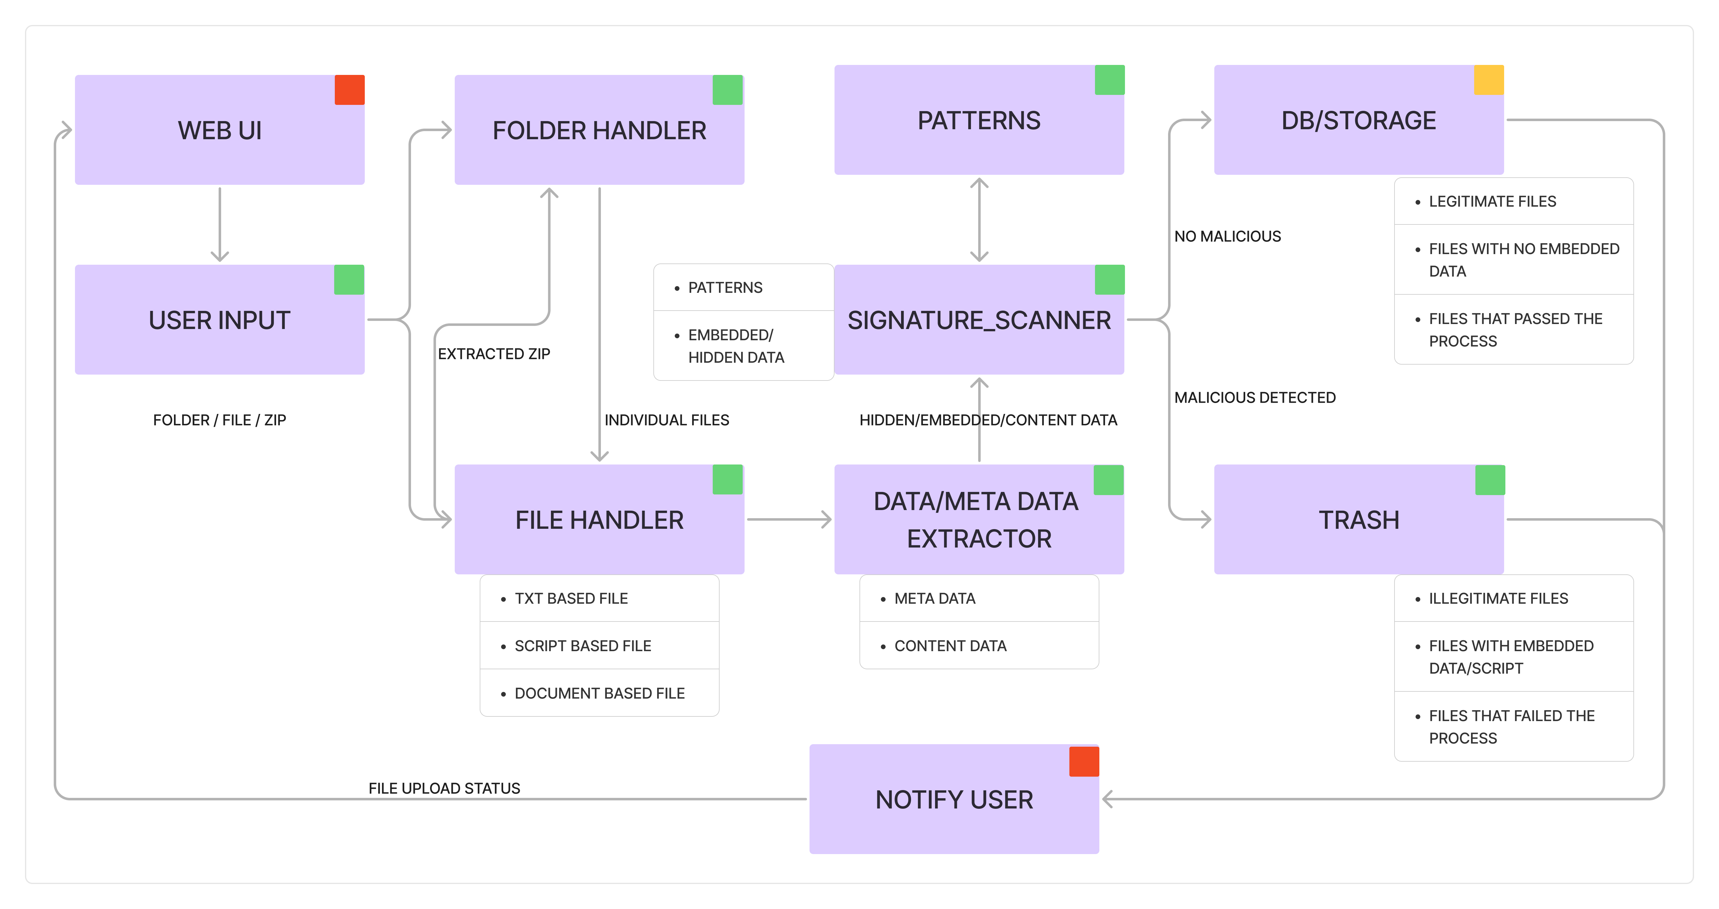
SYSTEM ARCHITECTURE
Feb 23, 2025
Department of CSE
Jerusalem College of Engineering
<number>

Slide 12
MODULES
Phase 1:(Text-Based File Scanning and Analysis)
Recursive Folder Scanning Module
File Type Filtering Module
Regex-Based Malware Detection Module
Threat Reporting and Logging Module
Phase 2: (Advanced File Analysis and ZIP Scanning)
Metadata Extraction Module
Hidden Script Detection Module
ZIP File Scanning Module
Feb 23, 2025
Department of CSE
Jerusalem College of Engineering
<number>

Slide 13
PHASE 1- MODULES
Recursive Folder Scanning Module:
The system scans directories and subdirectories to locate files for analysis, ensuring comprehensive detection of potential threats in all accessible locations.
File Type Filtering Module:
Only text-based files such as .txt, .yaml, .xml, .docx, .pptx, and .xlsx are analyzed, preventing false positives from binary files(exec,images)
Regex-Based Malware Detection Module:
The system detects SQL injection and brute-force attack scripts using predefined regex patterns, ensuring accurate identification of malicious content within text-based files.
4)Threat Reporting and Logging Module:
Suspicious files are flagged, and logs are generated to provide insights into detected threats, helping in forensic analysis and future threat mitigation.

Slide 14
PHASE II- MODULES
5)Metadata Extraction Module
Metadata from .docx, .pptx, and .xlsx files is analyzed to detect hidden threats, such as embedded scripts or suspicious document properties.
6)Hidden Script Detection Module:
XML and YAML files are scanned for malicious embedded scripts, ensuring that attackers do not exploit configuration files or structured data for executing harmful code.
7)ZIP File Scanning Module:
The system extracts and scans the contents of ZIP files to identify and flag attack scripts hidden within compressed archives, preventing malware distribution.

Slide 15
PHASE II WORK
Advanced File Analysis and ZIP Scanning detects hidden threats in document metadata, embedded scripts, and compressed files.
Metadata Extraction analyzes .docx, .pptx, and .xlsx metadata to uncover hidden scripts or suspicious modifications.
Hidden Script Detection scans XML and YAML files for embedded malicious code, preventing hidden attacks.
ZIP File Scanning extracts and analyzes ZIP files to detect hidden attack scripts and malware.

Slide 16
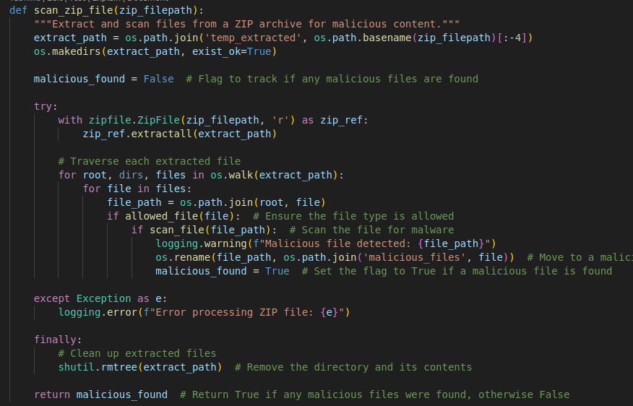
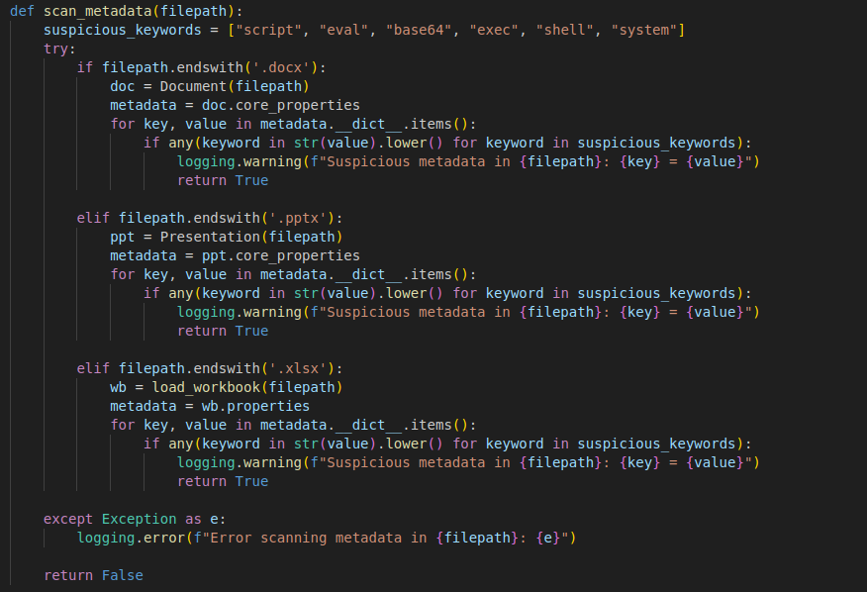
PHASE II IMPLEMENTATION

Slide 17
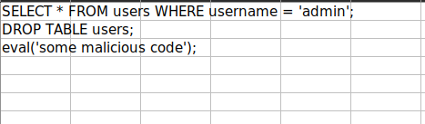
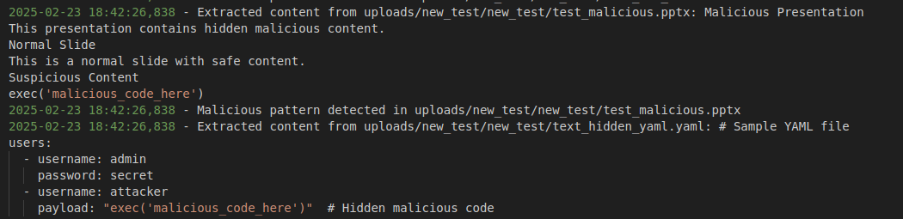
PHASE II IMPLEMENTATION

Slide 18
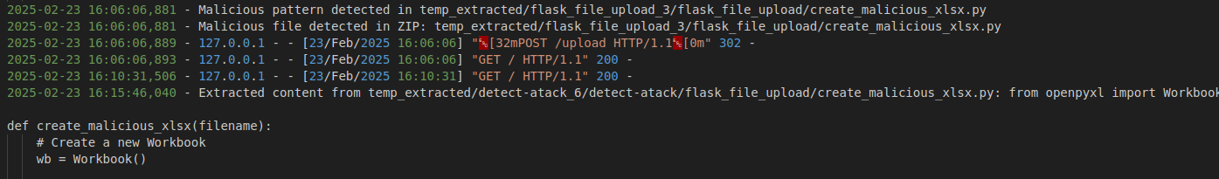
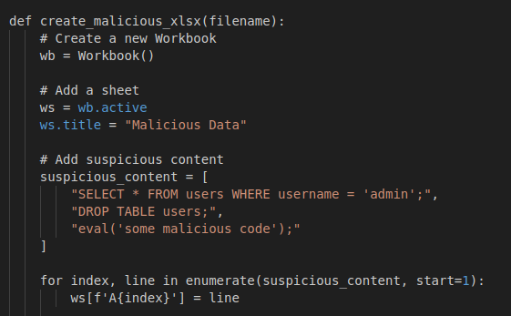
PHASE II IMPLEMENTATION

Slide 19
REFERENCES
[1] Qingyang Zhang, Chang Xu, Hong Zhong, Chengjie Gu, Jie Cui, "Revocable and Efficient Blockchain-Based Fine-Grained Access Control Against EDoS Attacks in Cloud Storage", IEEE Transactions on Computers, vol.73, no.8, pp.2012-2024,
[2]Ammar Odeh, Abobakr Aboshgifa, Nabil Belhaj, "Mitigating DDoS Attacks in Cloud Computing Environments: Challenges and Strategies",(2021) 2023.
[3]Adarsh M G., Bhargavi K., "Double Reinforcement Learning Based Interactive GAN for Detection of Volumetric Attacks in Cloud Computing", 2023 IEEE
[4] R.A. Karthika, P. Sriramya, A. Rohini, "Detection and Classification of DDoS Attacks in Cloud Data Using Hybrid LSTM and RNN for Feature Selection", 2023 International Conference on Circuit Power and Computing Technologies (ICCPCT)
Feb 23, 2025
Department of CSE Jerusalem College of Engineering
<number>

Slide 20
REFERENCES
[5] Muhammad Tehaam, Salman Ahmad, Hassan Shahid, Muhammad Suleman Saboor, Ayesha Aziz, Kashif Munir, "A Review of DDoS Attack Detection and Prevention Mechanisms in Clouds", ,(IEEE) 2023.
[6] Monika Mangla, Amaan Sayyad, Sachi Nandan Mohanty, "An AI and Computer Vision-based Face Mask Recognition & Detection System”,(IEEE) 2020.
[7] Chilla Sathvika, Vuyyuru Satwika, Yarrapothu Sruthi, Maddali Geethika, Suneetha Bulla, Swathi K, "DDoS Attack Detection on Cloud Computing Services using Algorithms of Machine Learning: Survey,(IEEE) 2020.
[8] Aditya Kumar Shukla, Ashish Sharma, "Classification and Mitigation of DDOS attacks Based on Self-Organizing Map and Support Vector Machine",(IEEE) 2021.
Feb 23, 2025
Department of CSE Jerusalem College of Engineering
<number>

Slide 21
THANK YOU

