Slide 1
Lending Club Case Study
Rishi Shah
Mohinesh Tayade
11/10/2023

Slide 2
Executive Summary
Goal is to determine driving factors behind potential default by customers
5 factors have been determined by Team
Customer Debt and Revolving Credit
Negative Public Records
Loan Parameters
Loan Grade
Purpose, Annual Income & Residence State
Team has analysed 46 columns with relevant data
Data columns were analysed individually
Bivariate analysis of data columns with Loan Status
Certain metrics were derived but less insights derived
Several columns has no data or data with just one value

Slide 3
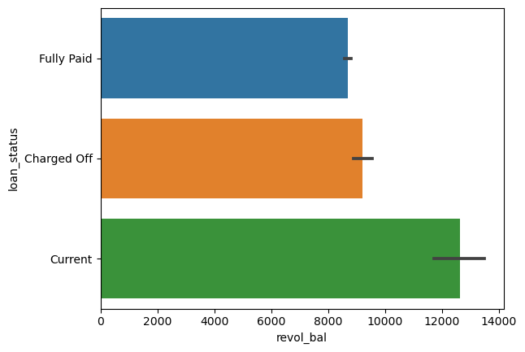
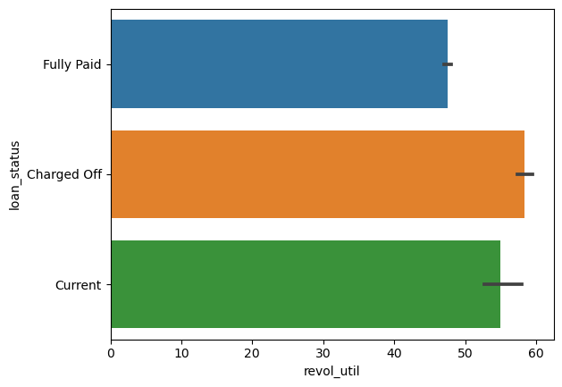
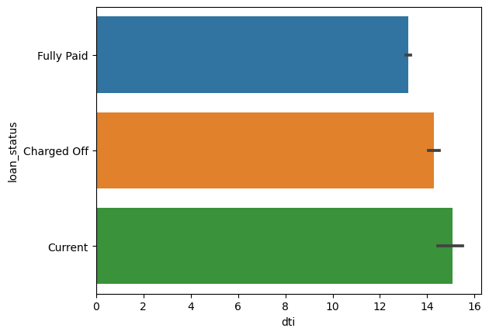
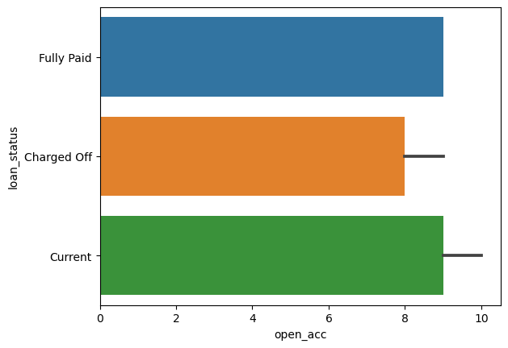
Driver 1 – Customer Debt & Revolving Credit
Customer is likely to default if they have more debt or utilizing their credit line
Determining Factors
Revolving Balance
Revolving Line Utilization
DTI
Open Credit Line Accounts

Slide 4
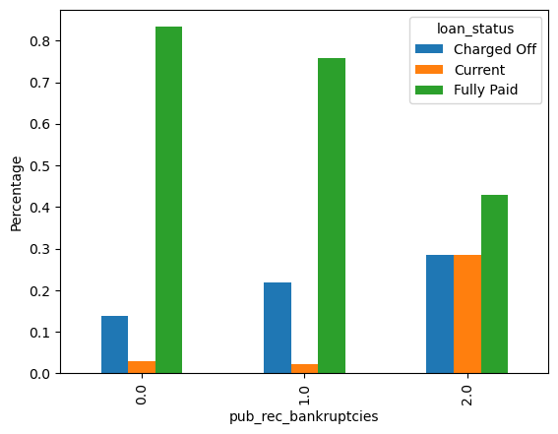
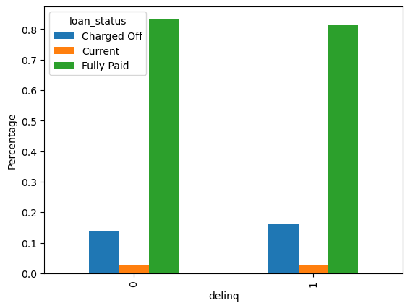
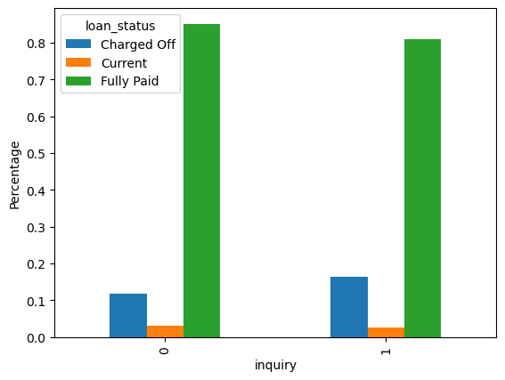
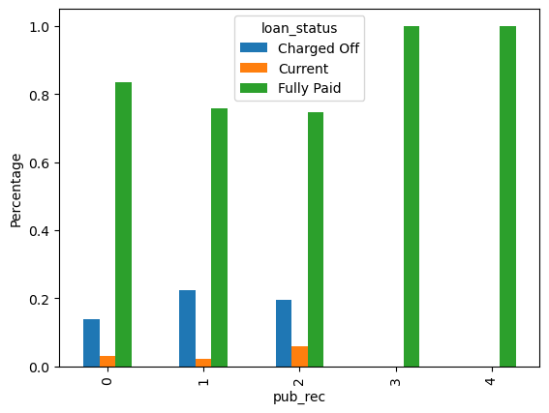
Driver 2 – Negative Public Records
Customer is more likely to default if they have negative public records
Determining Factors
Bankruptcies
Delinquencies in Past 2 Years
Credit Inquiries
Derogatory Public Records

Slide 5
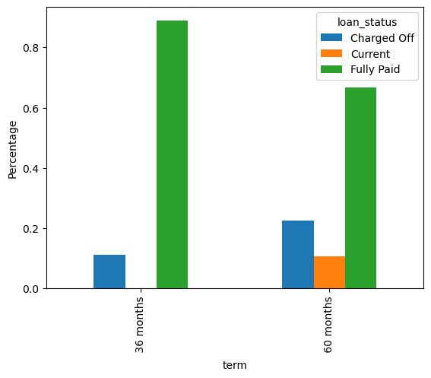
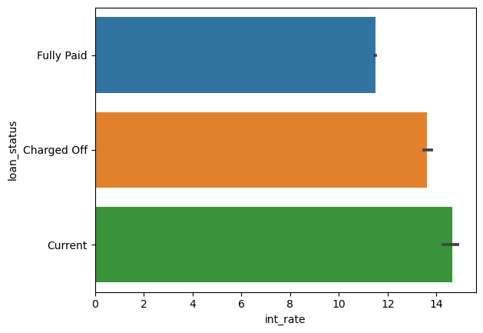
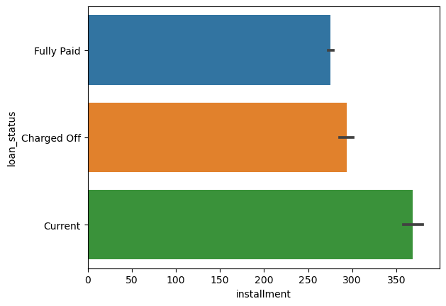
Driver 3 – Loan Parameters
Longer or higher loan parameters could lead to more defaults
Determining Factors
Longer Term
Higher Interest Rate
Bigger Instalments
Loan amounts were not of significance since quite consistent and below $35k

Slide 6
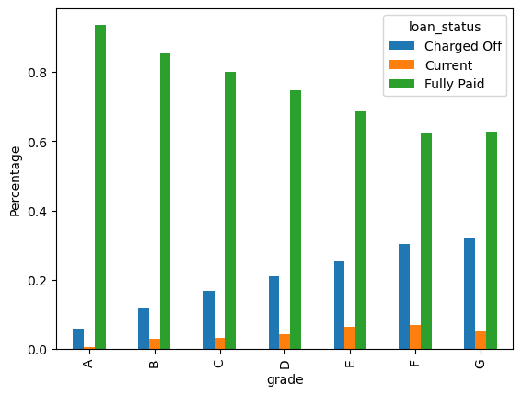
Driver 4 – Loan Grade
Loan Status | Charge_Off
G5 | 33.33%
G4 | 23.21%
G3 | 39.58%
G2 | 35.90%
G1 | 29.81%
F5 | 45.76%
F4 | 31.55%
F3 | 27.57%
F2 | 28.11%
F1 | 27.66%
E5 | 26.20%
E4 | 27.75%
E3 | 21.52%
E2 | 24.85%
E1 | 25.95%
D5 | 23.91%
D4 | 21.92%
D3 | 21.82%
D2 | 20.10%
D1 | 17.94%
C5 | 17.54%
C4 | 17.15%
C3 | 17.66%
C2 | 15.96%
C1 | 15.73%
B5 | 13.17%
B4 | 13.10%
B3 | 11.69%
B2 | 11.08%
B1 | 9.34%
A5 | 7.91%
A4 | 6.17%
A3 | 5.69%
A2 | 4.91%
A1 | 2.63%
Loans that are rated lower by loaning agencies have high default rate
Results are consistent for sub-grades

Slide 7
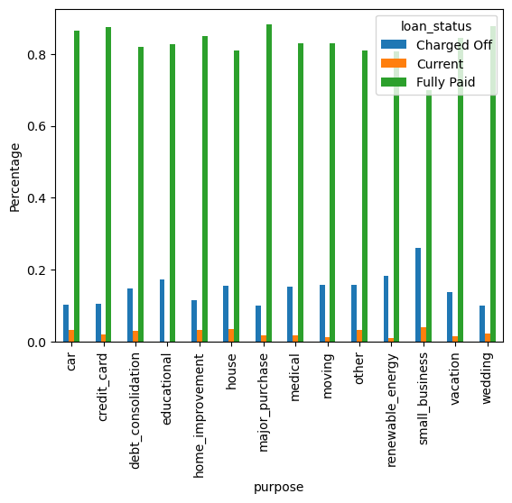
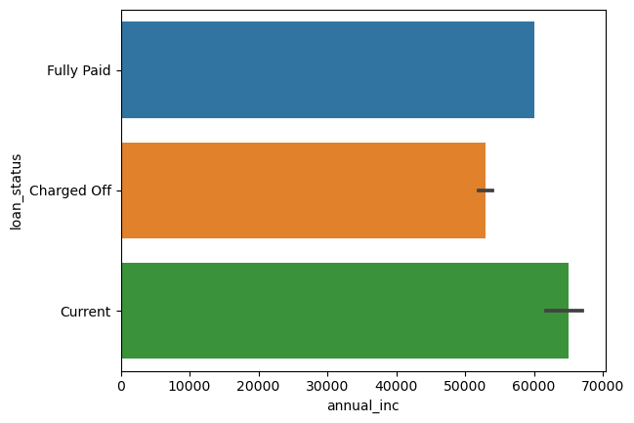
Driver 5 – Purpose, Annual Income & Residence State
Purpose and Annual Income are important factors to determine defaulters
Determining Factors
Purpose – Small business, energy and education loans are riskier
Annual Income – Less annual income indicates higher default
State – Customer from certain states are more likely to default
Nevada
Arkansas
South Dakota
Florida
Montana

