Slide 1


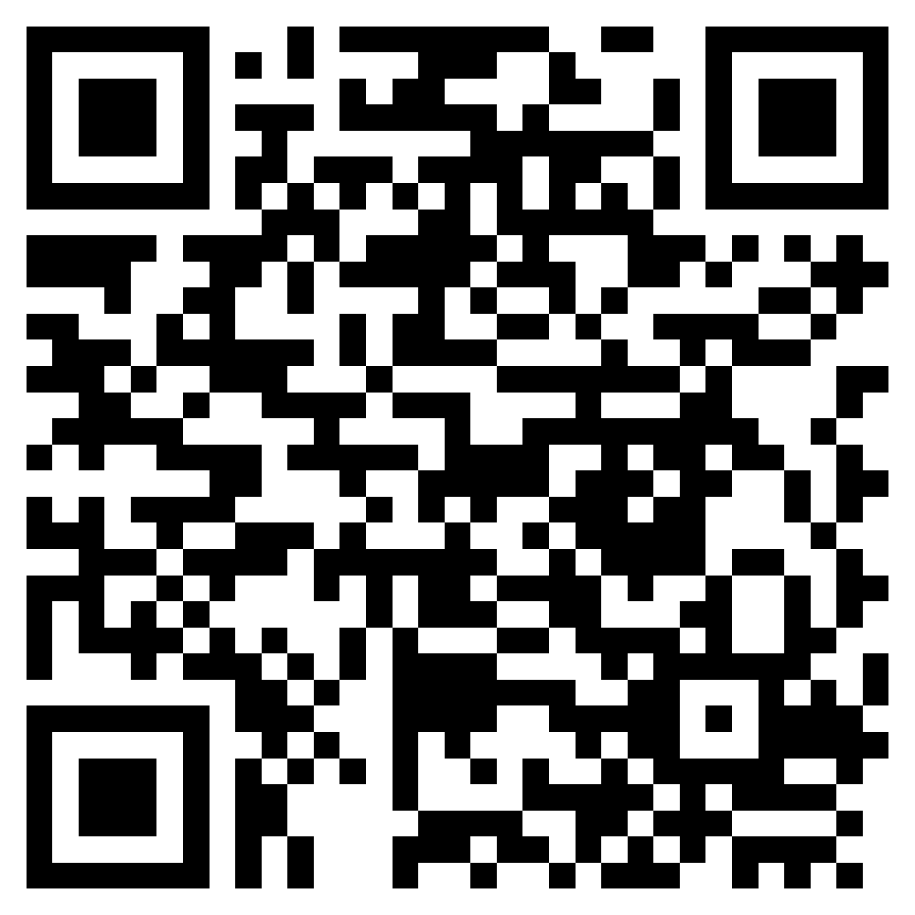

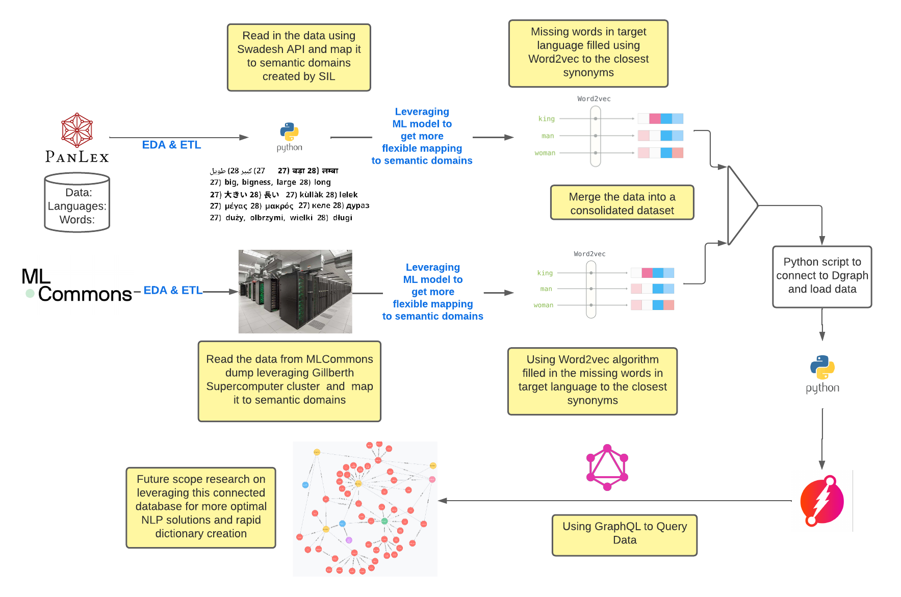
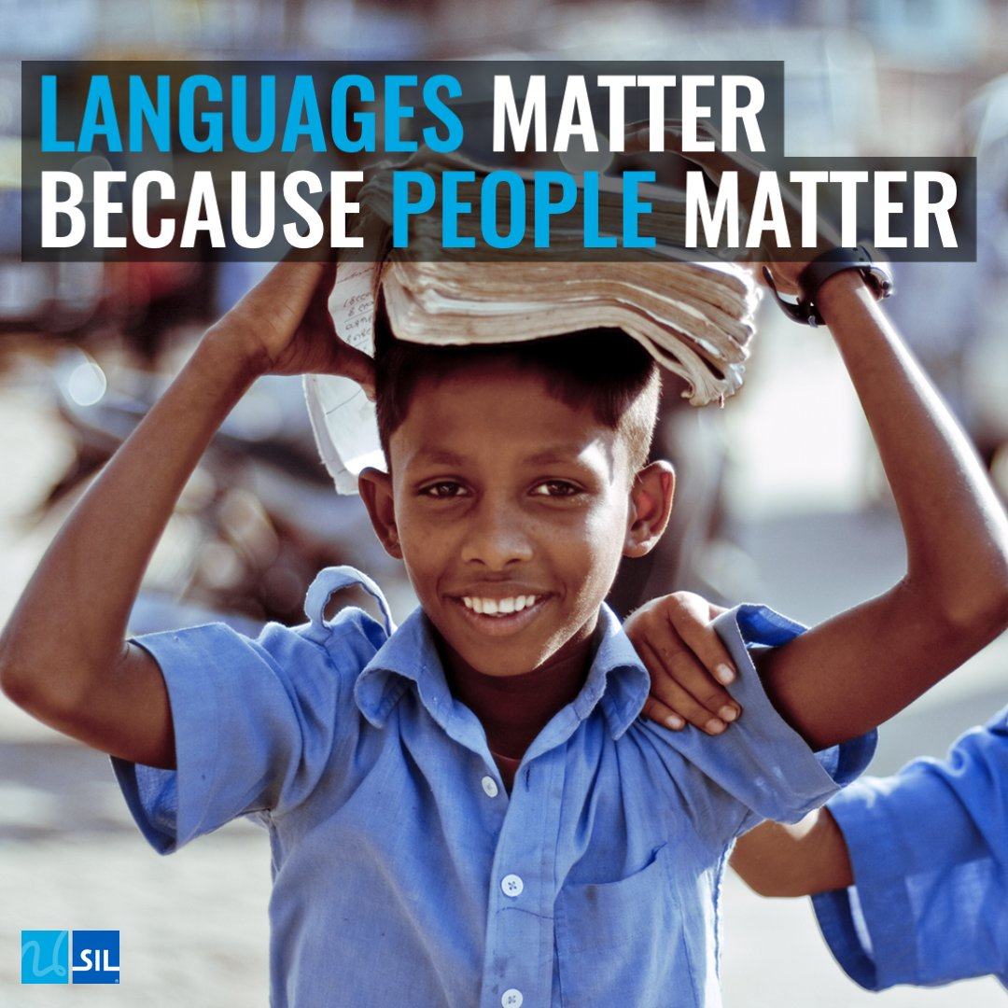
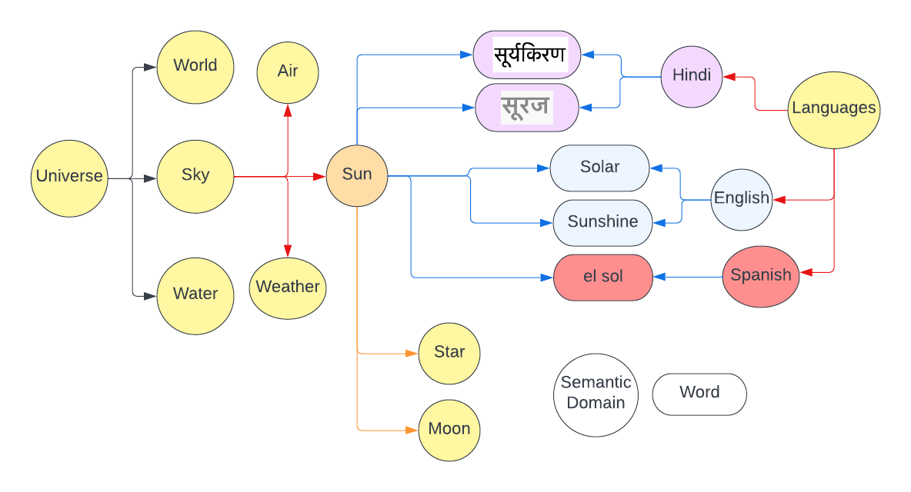
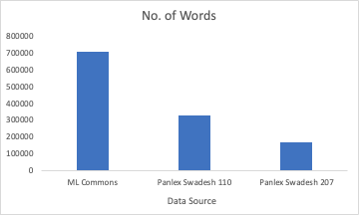
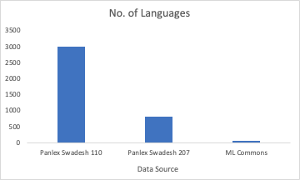
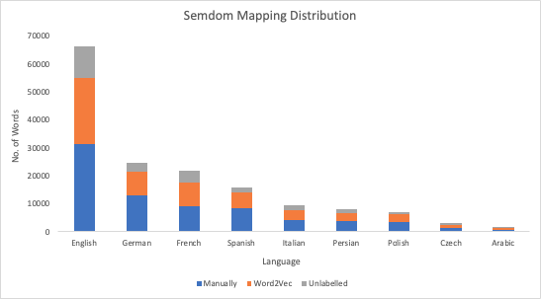
Massive Multilingual Knowledge Graph of Semantic Domains
Rajarshi Biswas, Arpan Datta, Nikhil Katiki, Rajib Kumar Mahato, Nitesh Wagh, Matthew A. Lanham
Purdue University, Krannert School of Management
biswas36@purdue.edu; datta41@purdue.edu; rmahato@purdue.edu; katiki@purdue.edu; nwagh@purdue.edu; lanhamm@purdue.edu
ABSTRACT
METHODOLOGY
Expected Business Impact
Languages are essential to human life. There are currently around 7151 languages being spoken. According to UNESCO Atlas of the World’s Languages in Danger, between 1950 and 2010, 230 languages went extinct and as of 2018, a third of the world’s languages have fewer than 1,000 speakers left.
Create a massively multilingual repository of words arranged in semantic domains for use in dictionary creation tasks and other downstream NLP tasks (for e.g., Dialogue Systems)
Develop a foundational database for NLP practitioners to innovate using advance ML and DL techniques
Enabling prediction of key terms in low resource, minority languages using words that are related (linguistically) in the graph
We are creating a multilingual database comprising of 500+ languages and mapping them to semantic domains. A graph database of words in different languages is mapped to their respective semantic domains creating a diverse list of words and phrases that will enable simpler literature translation. This will enable-
Rapid development of linguistic resource (like dictionaries) in local languages.
Development of new translation and NLP techniques that rely on word lists and topic modeling techniques.
Business Case: Understanding the variations of word Sun.
INTRODUCTION
English words are mapped to their corresponding semantic domains and subsequently map words from other languages with the same/similar meaning to the respective semantic domain. This gives us a cluster of word lists and groups of words which is useful in creating rapid dictionaries and variety of downstream NLP tasks. To achieve such related mapped structure of words and their languages, regions, and semantic domains. DGraph database is being used. It extensively maps and segregates relations between each data point.
Fig 2. Methodology
STATISTICAL RESULTS
800K
3K
9K
4K
Fig 4. Representation of Graph Database
Words
Languages
Word2Vec
SemDom
CONCLUSIONS
We are creating a database consisting 800K words mapped to 4K semantic domains
The languages covered are 3000
We labelled 25% of the unlabeled knowledge base of words using ML techniques
We have successfully created a consolidated multilingual dictionary mapped to semantic domains leveraging machine learning techniques and existing knowledge base of words in different languages
We built a process to load the consolidated data mapped to semantic domains to DGraph which has the scope of adding more words and languages in the future as per future requirements
We were able to query the similar words in different languages from same semantic domains in the DGraph, this will enable to detect/predict the semantic domains of unmapped words
Fig 1. Data Composition
RESEARCH QUESTIONS
ACKNOWLEDGEMENTS
Can existing multilingual dictionaries be combined with semantic domains to create a massively multilingual dictionary arranged in semantic domains?
Can the massively multilingual dictionary transformed into a DGraph database?
Can the data in the graph database be used to detect/predict the semantic domains for unmapped words/phrases?
We would like to thank our professors Prof. Matthew Lanham and Yang Wang. We also would like to appreciate the guidance and mentorship from our industry specialist Daniel Whitenack for this project providing us with key suggestions and insights.
Fig 3. Top 9 Languages Direct translation vs Word2vec

