Slide 1



ROUND 1 : Online Screening
First round will be online screening round of your idea
Team is requested to make PPT on it
All the guidelines are given in this document
Team should strictly follow it and submit it for evaluation on 26th January before midnight

Slide 2
AI Multi-Disease Diagnostic Assistant for Rural Healthcare (Gujarati Voice Based System)
Team Name: CodeCure
Team Introduction:
Makwana Ayush (Leader)
Charadva Rishi (Member)
Savaliya Abhi (Member)

Slide 3
Slide 2: Problem Statement
  Rural people in Gujarat face difficulty in early disease diagnosis due to lack of doctors, language barriers, and low digital literacy
  This project fulfills the Healthcare, Artificial Intelligence, and Social Impact tracks by providing an AI-based diagnostic system for underserved rural communities using regional language voice support.”.
  It is important solve this now because rural areas lack of doctors, people mainly speak Gujarati, not English, AI can help in early screening and awareness.

Slide 4
Slide 3: Proposed Solution (Core Idea)
How It Solves the Problem:
  Supports Gujarati language
  Works with voice input for illiterate users
  Gives instant disease prediction
  Provides explanation and medical report using AI
Key Features:
  Symptom-based disease prediction
  Gujarati & English AI explanation
  Voice-to-symptom system
  AI medical report generation
  Image-based diagnosis support

Slide 5
Slide 4: Technology Stack
We used python as our programming language.
Frameworks & Libraries:
  Streamlit (Web UI)
  Scikit-learn (Disease prediction model)
  SpeechRecognition (Voice input)
  Whisper / Google Speech API (Voice processing)
  OpenAI API (AI explanation & report generation)
  Pillow (Image processing)
Tools & Platforms:
  Visual Studio Code
  Anaconda Environment
  Local Laptop (Windows 11)
APIs / Cloud:
  OpenAI API (for AI assistant & image diagnosis)

Slide 6
Slide 5: Innovation & Unique Value Proposition
What Makes Our Solution Different:
  Gujarati Voice Based Diagnosis
  Designed specially for rural population
  Multi-mode input (Symptoms + Voice + Image) Auto-prediction after voice input
  Simple UI for low-literacy users
Innovation:
  Regional language voice healthcare assistant
  Rural-focused AI screening system
  Combination of AI + Voice + Image diagnosis
Competitive Advantage:
  Existing apps mostly in English
  Very few support Gujarati voice
  No rural-specific diagnostic assistant available

Slide 7
Slide 6: Feasibility & Implementation Plan
Development Phases:
  Phase 1 – UI & Symptom Input System
  Phase 2 – Disease Prediction Model
  Phase 3 – Voice Input (Gujarati + English)
  Phase 4 – AI Explanation & Medical Report
  Phase 5 – Image Diagnosis Integration
Milestones:
  Working web app prototype
  Voice system implemented
  AI assistant integrated
Feasibility:
  Runs on local laptop
  Uses free / low-cost APIs
  Simple deployment using Streamlit

Slide 8
Slide 7: Future Scope & Scalability
Future Enhancements:
  Add more Indian languages (Hindi, Marathi, Tamil)
  Offline voice model using Whisper
  Add hospital & doctor recommendation system
  Add emergency alert feature
Scalability:
  Can be deployed in rural clinics
  Can run on tablets & low-cost systems
  Can connect with government health programs

Slide 9
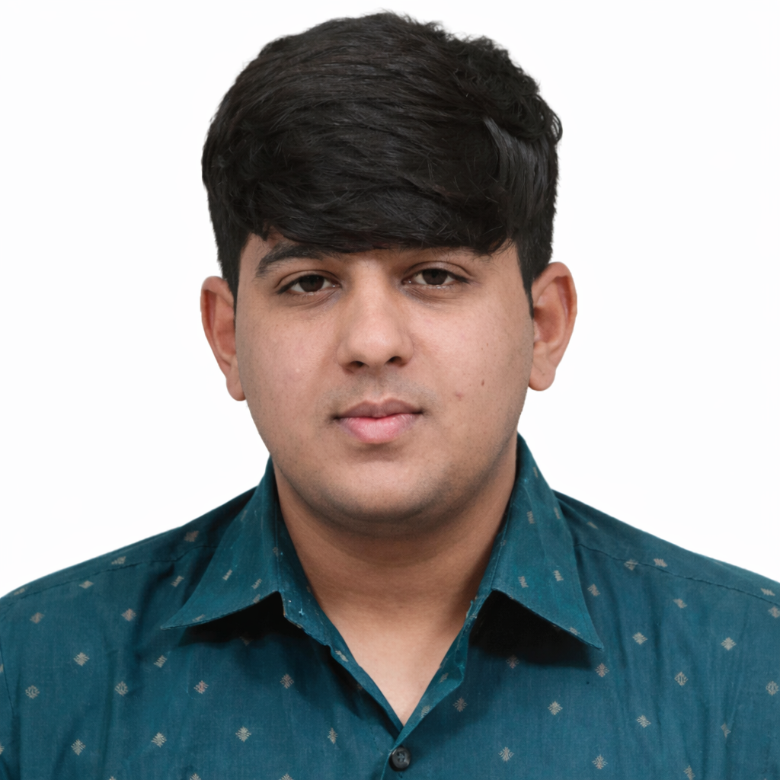
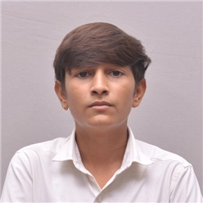
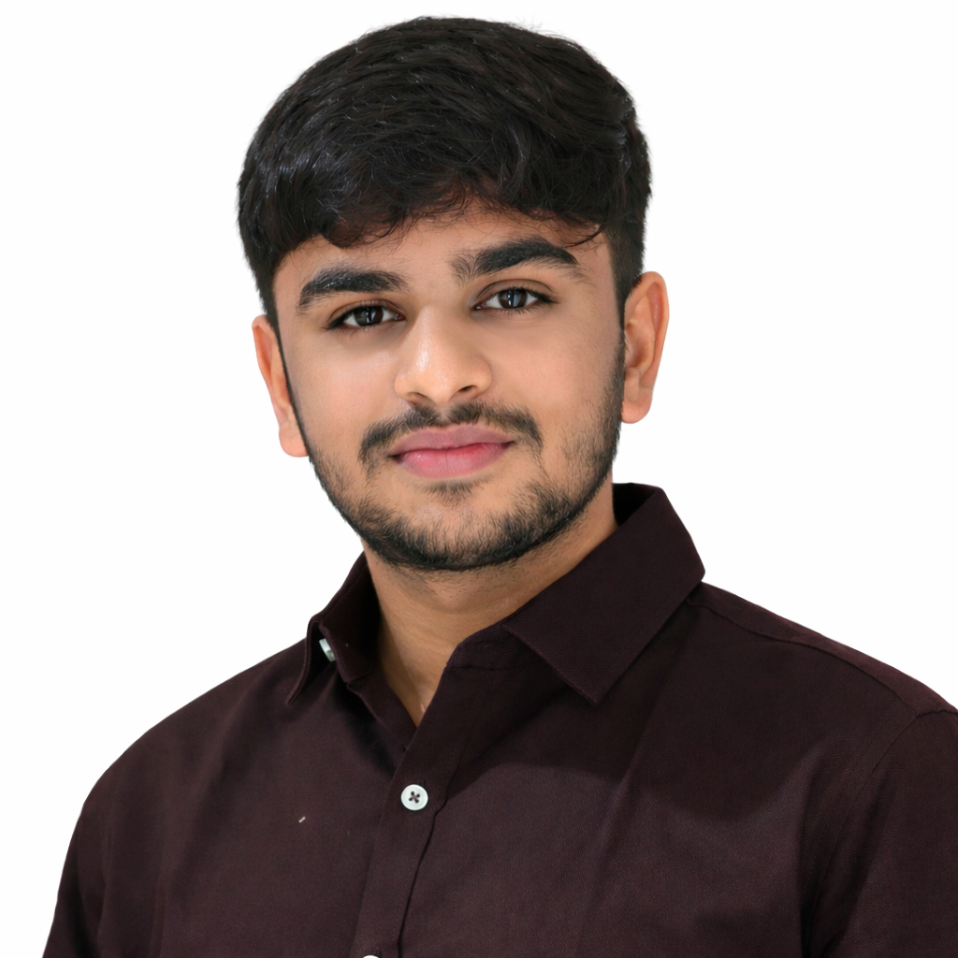
Slide 8: Team Details & Roles
Makwana Ayush
(Leader)
(ML Engineer)
Charadva Rishi
(AI Specialist)))
Savaliya Abhi
(UI/UX Designer)

Slide 10
Important Submission Guidelines
Language: Clear, simple, professional
Use visuals over text wherever possible
No unnecessary animations
This PPT is only for screening round
The result of the finalized teams will be declared on 27th January
Only selected teams will compete offline on 28th January
Submission link : https://forms.gle/s5rMwoG4XRQ1G5Mu6

Slide 11
Thank you
ATMIYA AI SUMMIT 2026
ATMIYA UNIVERSITY

