Slide 1
AI211 — Machine Learning
Client Selection in
Federated Learning
I. Nikhil RM Varma
Kush Mistry
Rishi Datt Gupta
2024AIB1350
2024AIB1368
2024AIB1377
Mentor: Shradha Sharma

Slide 2
Problem Statement
What is Federated Learning?
Why Client Selection?
Federated Learning (FL) is a Machine Learning paradigm introduced for collaborative model training
The data owned by each client is
private, and not shared with other clients or the server. Each client participates in FL by sharing only the model updates, not the raw data.
Why use FL:
Privacy protection and data security — especially important in healthcare, finance, and mobile settings.
How FL differs from distributed optimization:
Data across clients is non-IID — a single client's local dataset may not represent the overall population.
Data is unbalanced — the amount of private data varies significantly across clients.
Full client participation leads to:
Increased communication overhead
Longer training time due to stragglers
Clients with poor-quality or highly biased local data negatively impact convergence and final performance of the global model
By carefully selecting a
subset of suitable clients each round, it is possible to:
Reduce communication costs
Improve training efficiency
Enhance model performance while preserving data privacy
Setup:
MNIST dataset, 50 clients (each with 2 out of 10 digit classes), 10 clients selected per round.
Client Selection in Federated Learning | AI211
2 / 8

Slide 3
Motivation
01
Limitation of DivFL
02
Limitation of S-FedAvg
03
What We Need
Greedy diversity maximization works well in stable environments, but anomalous or poisoned clients produce the most divergent gradients — making them appear as valuable diversity.
Under concept drift, DivFL actively selects harmful clients, treating poisoned updates as useful diversity. This is a fundamental algorithmic vulnerability.
Shapley-based rewards correctly penalise bad clients via a clean validation set. However, the fixed EMA memory (α = 0.75) decays old scores slowly.
After 10 rounds, the old positive score still retains (0.75)¹⁰ ≈ 6% influence — taking 10–15 rounds to fully suppress a newly poisoned client.
An algorithm that:
(1) Uses Shapley values as principled rewards
(2) Adapts its forgetting speed in real-time when drift is detected — not a fixed memory
(3) Temporarily isolates harmful clients without permanently banning them, since they may represent a valid new data concept.
→ FedCADS-UCB: Federated CUSUM-Adaptive Discounted Shapley UCB — bridging drift detection and client selection
Client Selection in Federated Learning | AI211
3 / 8

Slide 4
Related Work
McMahan et al., AISTATS 2017
Balakrishnan et al., ICLR 2022
FedAvg
DivFL — Diverse Client Selection
Foundational FL aggregation. Global model trained by averaging client weight deltas after local SGD. Establishes the communication round framework used throughout our work.
Selects clients by greedily maximizing gradient diversity via a facility location submodular objective. Greedy solution provides (1−1/e) ≈ 63% optimality guarantee.
Nagalapatti & Narayanam, AAAI 2021
Jothimurugesan et al., AISTATS 2023
S-FedAvg — Game of Gradients
FL under Distributed Concept Drift
Uses Monte Carlo Shapley values to measure each client's marginal contribution to validation accuracy. EMA relevance scores and softmax sampling filter irrelevant or harmful clients.
Multiple global models with time-varying client-cluster assignments. Introduces cross-validation distance for HAC over drifted client models — inspires our dual-model design.
Fouad et al., UAI 2020
Non-Stationary Combinatorial Bandits (CUCB)
Combinatorial semi-bandit with discounted (CUCB) and sliding-window (CUCB-SW) variants for non-stationary reward environments. Theoretical regret O(T²/³). Basis for our UCB formulation.
Client Selection in Federated Learning | AI211
4 / 8

Slide 5
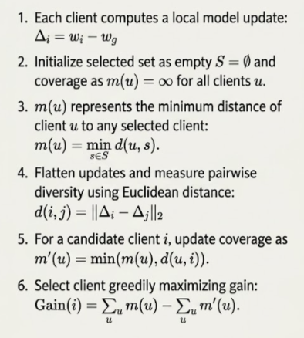
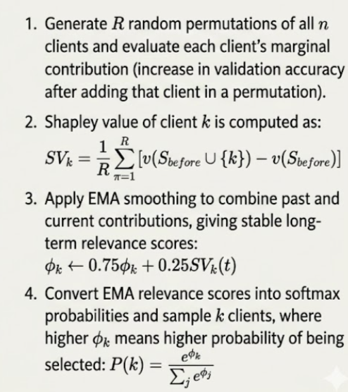
Methodology — Task 1: Baseline Client Selection Strategies
DivFL (Diversity-Aware Federated Learning)
S-FedAvg (Shapley Value-Based Method)
DivFL — Key Insight
S-FedAvg — Key Insight
Objective: G(S) = Σₖ min_{i∈S} ‖∇Fₖ − ∇Fᵢ‖ (Facility Location — submodular)
Greedy (1−1/e) ≈ 63% optimal. Early convergence advantage: covers all digit classes from round 1.
SV > 0: helpful | SV < 0: harmful | SV ≈ 0: irrelevant
EMA (α=0.75) smooths scores over time. Softmax sampling ensures higher-score clients get higher selection probability.
Client Selection in Federated Learning | AI211
5 / 8

Slide 6
Methodology — Task 3: FedCADS-UCB (Proposed Algorithm)
1
Memory Statistics & UCB Scoring
2
CUSUM Drift Detection → Adaptive γ
R̃ₖ(t+1) = γ·R̃ₖ(t) + SVₖ(t)·1[k∈Sₜ] Ñₖ(t+1) = γ·Ñₖ(t) + 1[k∈Sₜ]
UCBₖ = μ̂ₖ + √(ln(t+1)/Ñₖ) Exploitation + Exploration bonus
γ controls forgetting speed. High γ (0.95) = long memory; low γ (0.30) = rapid forgetting.
gₜ = acc_{t-2} − acc_{t-1} Cₜ = max(0, C_{t-1} + gₜ − 0.01)
Alarm fires when Cₜ > 0.05
Adaptive discount: γ(t) = 0.95 − 0.65 × min(Cₜ/0.05, 1)
Stable → γ=0.95 | Full drift → γ=0.30 (rapid forgetting)
3
Fairness Debt & Final Score
4
Quarantine + Two Global Models
Dₖ(t) = max(0, Dₖ(t−1) + cₖ − bₖ(t−1)) cₖ = 0.01
Final score: Scoreₖ(t) = 0.9 × UCBₖ(t) + 0.1 × Dₖ(t)
Ensures every client is selected with minimum frequency — model does not forget entire digit classes.
Client quarantined if SVₖ < −0.01 for two consecutive rounds.
Timeout: Qₖ = 10 × 2^min(nₖ−1, 3) → 10, 20, 40, 80 rounds
Gradual suspicion decay (not hard reset) prevents evasion via alternating SV signs.
h_global trains on clean updates; h_drift trains on quarantined updates.
Why FedCADS-UCB beats the competition: S-FedAvg has fixed memory (α=0.75) | CUCB-SW uses fixed window | CUCB-BoB guesses window size | FedCADS-UCB directly links CUSUM drift measurement to real-time memory adaptation
Client Selection in Federated Learning | AI211
6 / 8

Slide 7
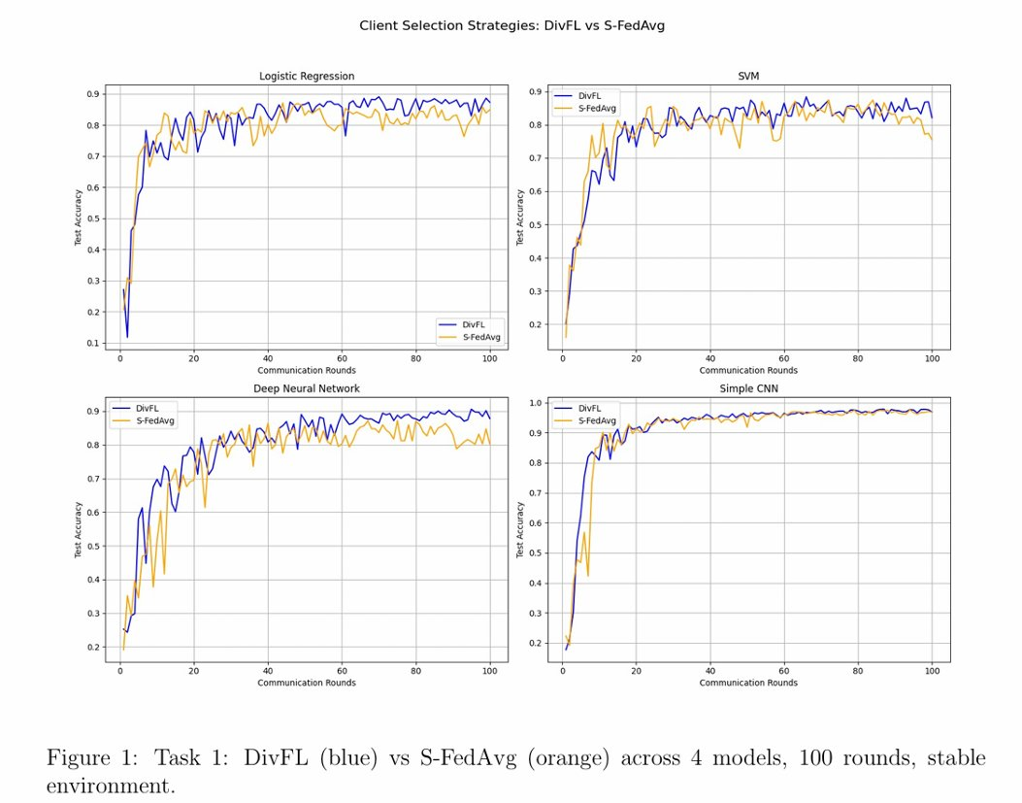
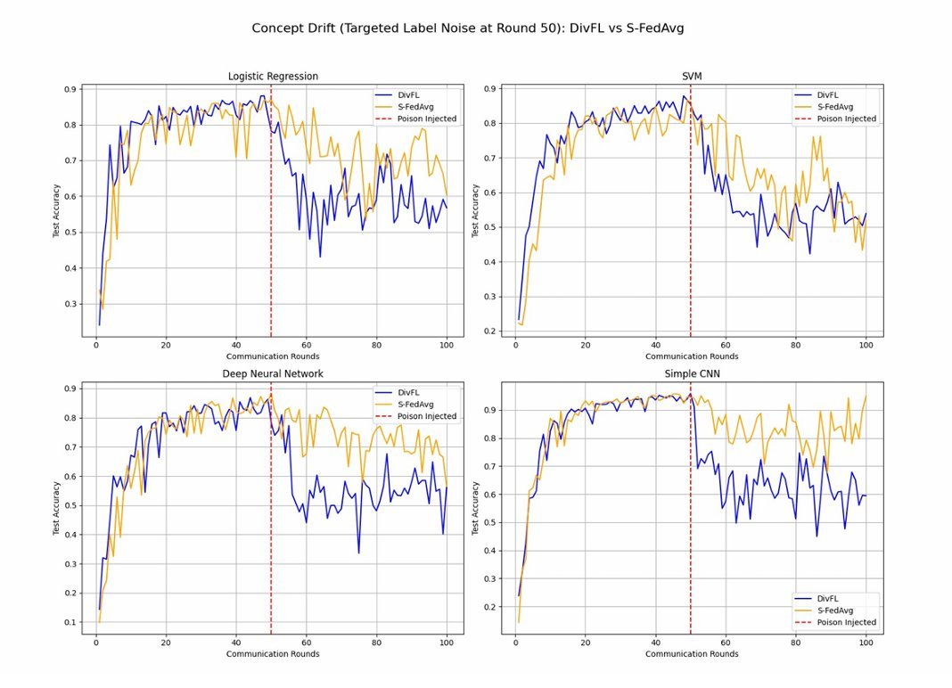
Experimental Results — Task 1 & Task 2
Task 1: DivFL vs S-FedAvg (Stable)
Task 2: Concept Drift at Round 50
Task 1 takeaway: DivFL converges faster in early rounds (diversity from round 1). Both converge to ~96.8% CNN accuracy by round 100. Task 2 takeaway: DivFL collapses (CNN: 95.87% → 57.46% by round 60, never recovers). S-FedAvg partially recovers via Shapley penalisation but is slow due to fixed EMA α=0.75.
Client Selection in Federated Learning | AI211
7 / 8

Slide 8
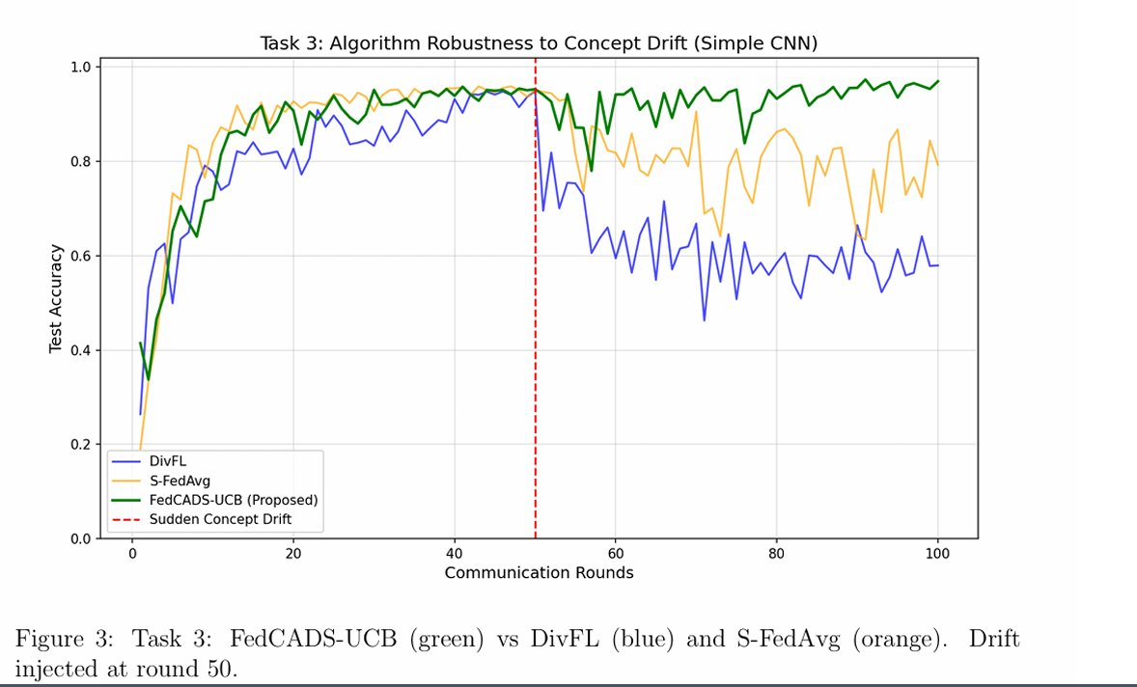
Results & Future Directions
Algorithm | R50 | R60 | R100
DivFL | 95.87% | 57.46% | 58.43%
S-FedAvg | 95.20% | 78.31% | ~80%
FedCADS-UCB | 94.60% | ~90% | 96.95%
+38.52% over DivFL | +16.95% over S-FedAvg
Future Directions
Extend to multiple simultaneous drift events via full hierarchical client clustering (HAC)
Evaluate on realistic datasets: FEMNIST, CIFAR-10
Communication-aware reward design (latency + gradient quality)
Formal convergence proof with tighter two-regime constants
FedCADS-UCB achieves 96.95% accuracy at round 100 under concept drift — vs 58.43% for DivFL and ~80% for S-FedAvg.
The CUSUM→γ linkage is a principled, parameter-free mechanism for automatic memory adaptation in non-stationary federated environments.
Client Selection in Federated Learning | AI211
8 / 8

