Slide 1
Perl XS
Rishi Nag
Ensembl Genebuild Team

Slide 2
Outline
Choose a reporter!
Perl XS
Introduction (10 mins)
Practical (30 mins)
Bringing XS Into Ensembl (5 mins)
http://www.ebi.ac.uk/~rishi

Slide 3
Part 1: Perl XS Introduction
Perl Interpreter
converts script into optimised bytecode
runs the bytecode
Perl has
perlguts: C variable representation, manipulation
perlapi: Perl C API
Perl XS allows C code with Perl
Script thinks it’s calling Perl
Custom C code or call a C Library

Slide 4
Perl Guts
Three main data types represented as C structures
SV Scalar Value
AV Array Value
HV Hash Value
Subroutines
Memory Allocation
Moving/Copying/Zeroing/Setting values
Dump functions….
More subroutines in the Perl API
http://perldoc.perl.org/perlguts.html
http://perldoc.perl.org/perlapi.html
Notes:
Outside of the scope of the basic workshop

Slide 5
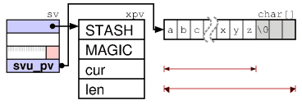
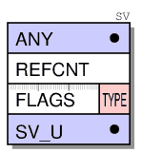
Scalar Value Representation
SV Fields
pointer
reference counter
flags/type
data block
String SV Representation (SvPV)
Stash: namespace
Magic: extending functionality
http://prrbl.org/Perl/illguts/ http://perldoc.perl.org/perlguts.html
Notes:
The first word contains the ANY pointer to the optional body. All types are implemented by attaching additional data to the ANY pointer, just the RV not.
The second word is an 32 bit unsigned integer reference counter (REFCNT) which should tell us how many pointers reference this object. When Perl data types are created this value is initialized to 1. The field must be incremented when a new pointer is made to point to it and decremented when the pointer is destroyed or assigned a different value. When the reference count reaches zero the object is freed.
The third word contains a FLAGS field and a TYPE field as 32 bit unsigned integer.
Since 5.10 the fourth and last HEAD word contains the sv_u union, which contains a pointer to another SV (a RV), the IV value, the PV string, the AV svu_array, a HE hash or a GP struct. The TYPE field contains a small number (0-127, mask 0xff) that represents one of the SVt_ types shown in the type hierarchy figure above. The FLAGS field has room for 24 flag bits (0x00000100-0x80000000), which encode how various fields of the object should be interpreted, and other state information. Some flags are just used as optimizations in order to avoid having to dereference several levels of pointers just to find that the information is not there.

Slide 6
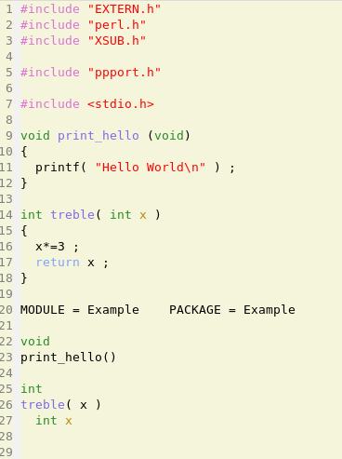
Workshop Start: Perl XS
Generate Framework
XS file contains
#includes
C code
XS Interface code
Make
Generates PM
Run Perl script
C Code
XS Code
Notes:
XS can do the bit of translating variable representation in Perl to variable representation in C. Examples here show functions called automatically by name. Point perl config file to Perl module

Slide 7
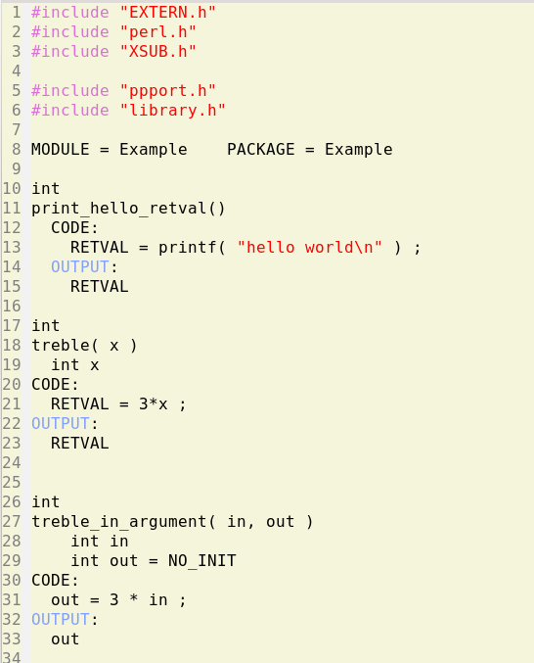
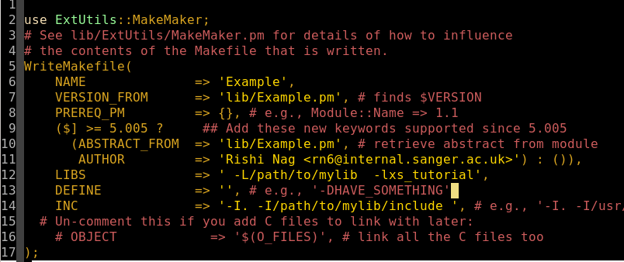
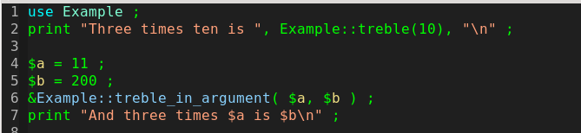
Workshop End: Calling A C Library
XS Code
Makefile.PL
Perl code
Notes:
The C code can be removed if values are in a library, and the XS code can have CODE, OUTPUT sections added to make the call and return the value.

Slide 8
Part 2: Workshop
http://www.ebi.ac.uk/~rishi/2015_ensembl_retreat/
Pre-requisites
Perl, C build tools
Steps
Make An XS Framework
Passing Scalar Parameters
Returning Scalar Values
Using a C Library
Not necessarily to be completed in this session

Slide 9
Part 3: Bringing XS into Ensembl
Existing C Libraries
added functionality (HTSlib for CRAM/BCF file reading)
correct functionality (bgzip)
speed gains
Custom C Possibilities
used frequently
uses pack/unpack a lot?
Remember: e! DB routines already optimised

Slide 10
Case Studies
HTSlib (nee Samtools)
Allows Bio::DB::Sam to read BAM/SAM/CRAM
http://search.cpan.org/~lds/Bio-SamTools/lib/Bio/DB/Sam.pm
https://github.com/GMOD/GBrowse-Adaptors
ensembl-xs
rearrange() function called whenever an EnsEMBL object is instantiated
benchmark suite can be 2 orders of magnitude faster than the original
https://github.com/Ensembl/ensembl-xs
Notes:
How will we release? Fork without the sort seems best method

Slide 11
Install Procedures
User Downloads
Install script
Check for build tools
Check for the C library
Install if required (easier to do a local install if not on the system)
Makefile
set links if required
Notes:
VEP, Ensembl-IO.

Slide 12






Acknowledgements
Andy Yates
Alessandro Vullo
Will McClaren
John Marshall
Kieran Raine
Funding by BBSRC grant number BB/M018458/1
Extending and Embedding Perl, by Tim Jenness and Simon Cozens (Manning Publications)
Funding
Co-funded by the European Union

Slide 13
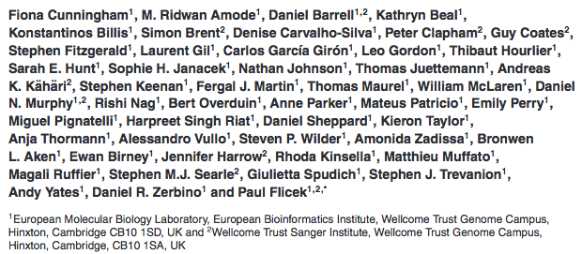
Ensembl Acknowledgements
The Entire Ensembl Team
Funding
Co-funded by the European Union

