Slide 1

PROBLEM STATEMENT
QUIZ GENERATOR
TEAM NAME
SHARP CODER
Presented by
RISHI GUPTA (MCA23191)
KESHAV KUMAR JHA (MCA23192)
RAHUL KUMAR PANDEY (MCA23169)
RAHUL RAJ(MCA23168)

Slide 2
TEAM WORK
TEAM LEADER
Rahul kumar Pandey as a backend developer.
TEAM MEMBER
Rishi Gupta as a frontend developer.
Keshav kumar Jha as a manage recourse .
Rahul raj as a content creator.

Slide 3
OBJECTIVE:
Create an interactive tech quiz generator for educational purposes.

Slide 4
Tools and Technologies:
HTML
CSS
JavaScript
Open TDB AI for fetching quiz questions.

Slide 5
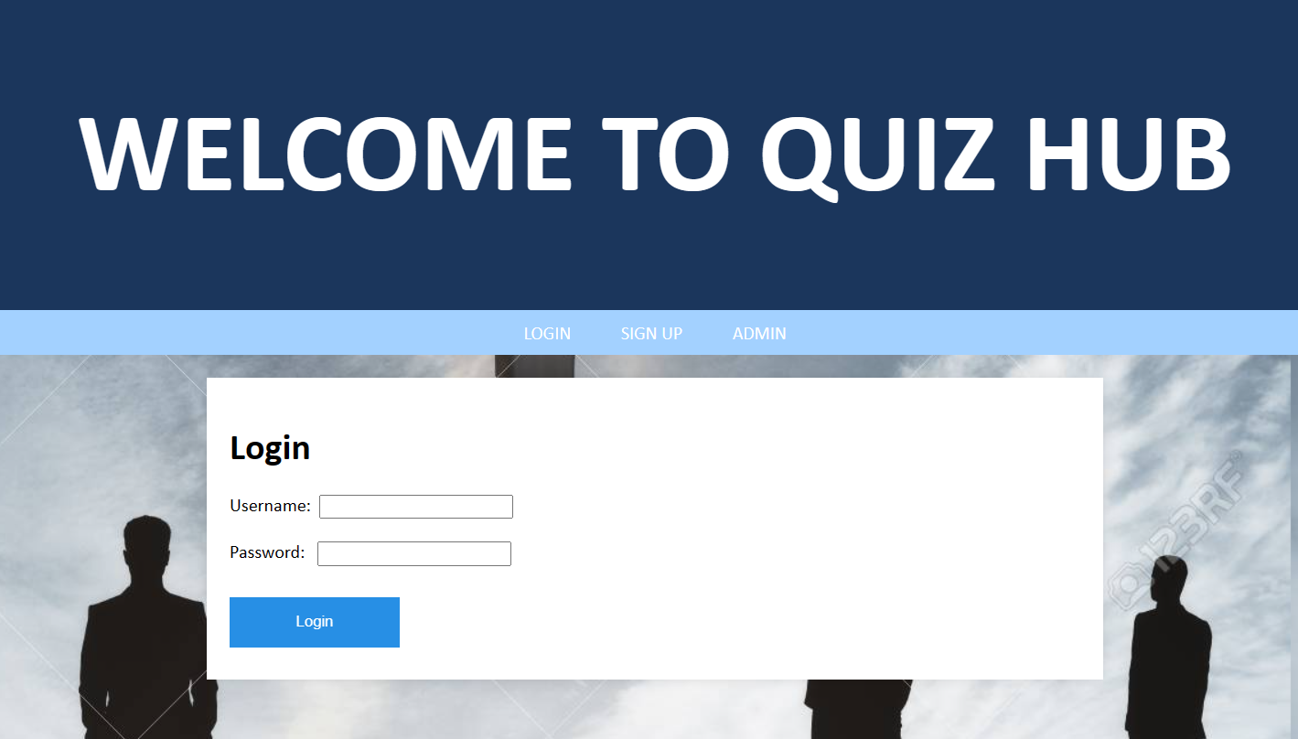
FRONTEND
This is the front page of our web page. Here we have used HTML, CSS to create the webpage. And to validate the id and password we are using java script.

Slide 6
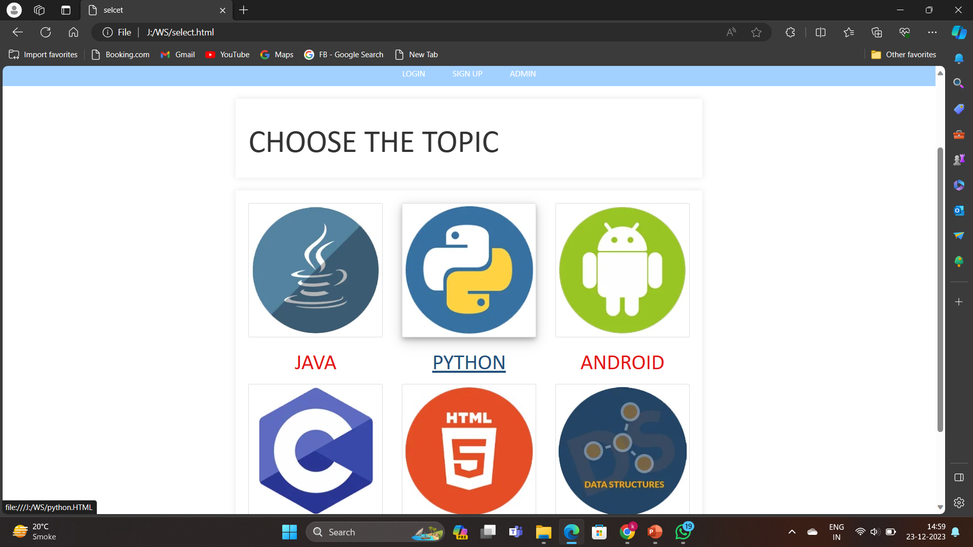
FRONTEND
After login we will have to choose the topic that we want to give the quiz of

Slide 7
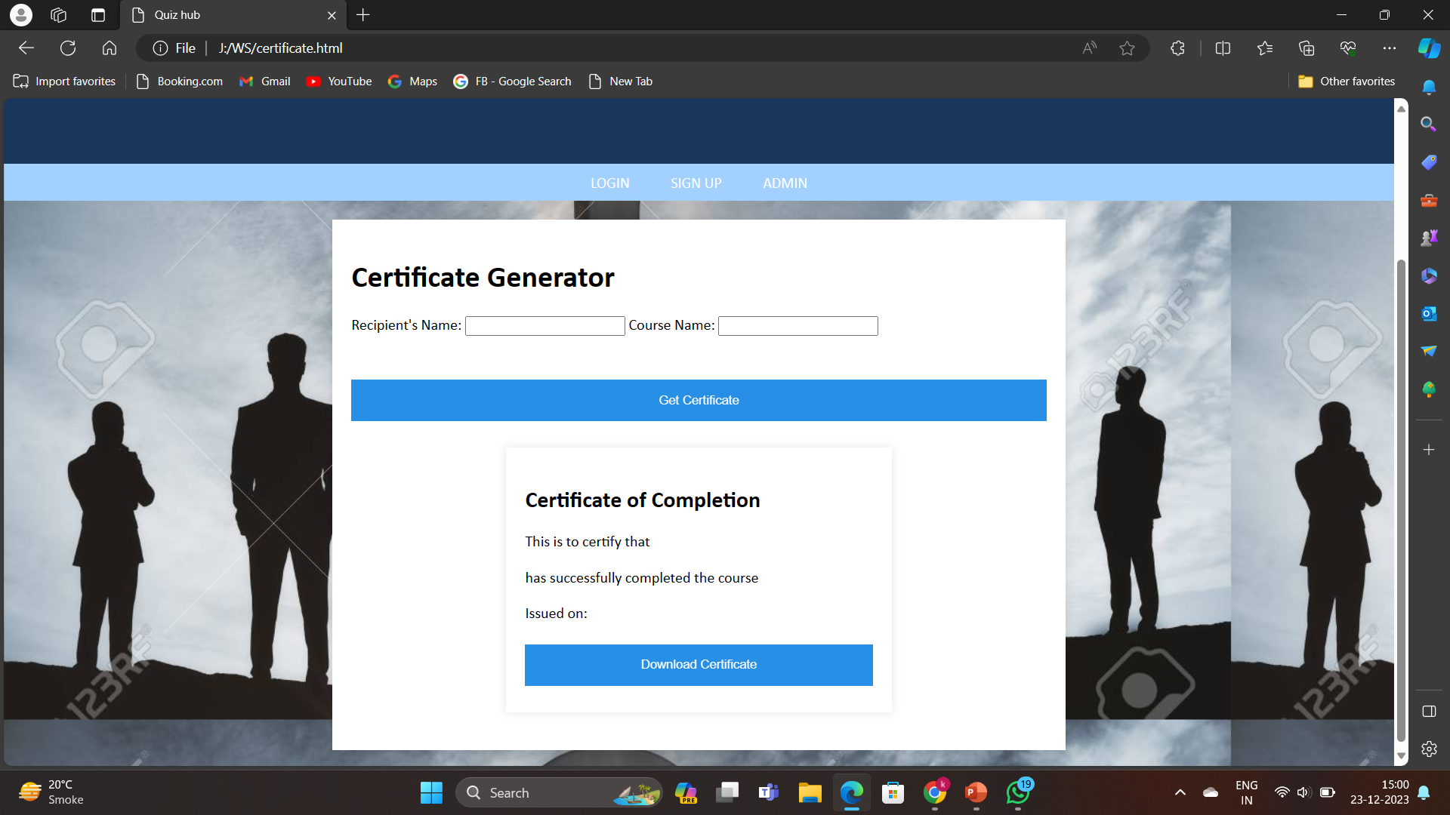
BACKEND DEVELOPER (Rahul kumar Panday)
After completing the QUIZ we can also get the certificate and download it for our futher use.

Slide 8

THANK YOU

